Slide 2
Knowledge Grid
What I know | What I would like to know | What I now know

Slide 3
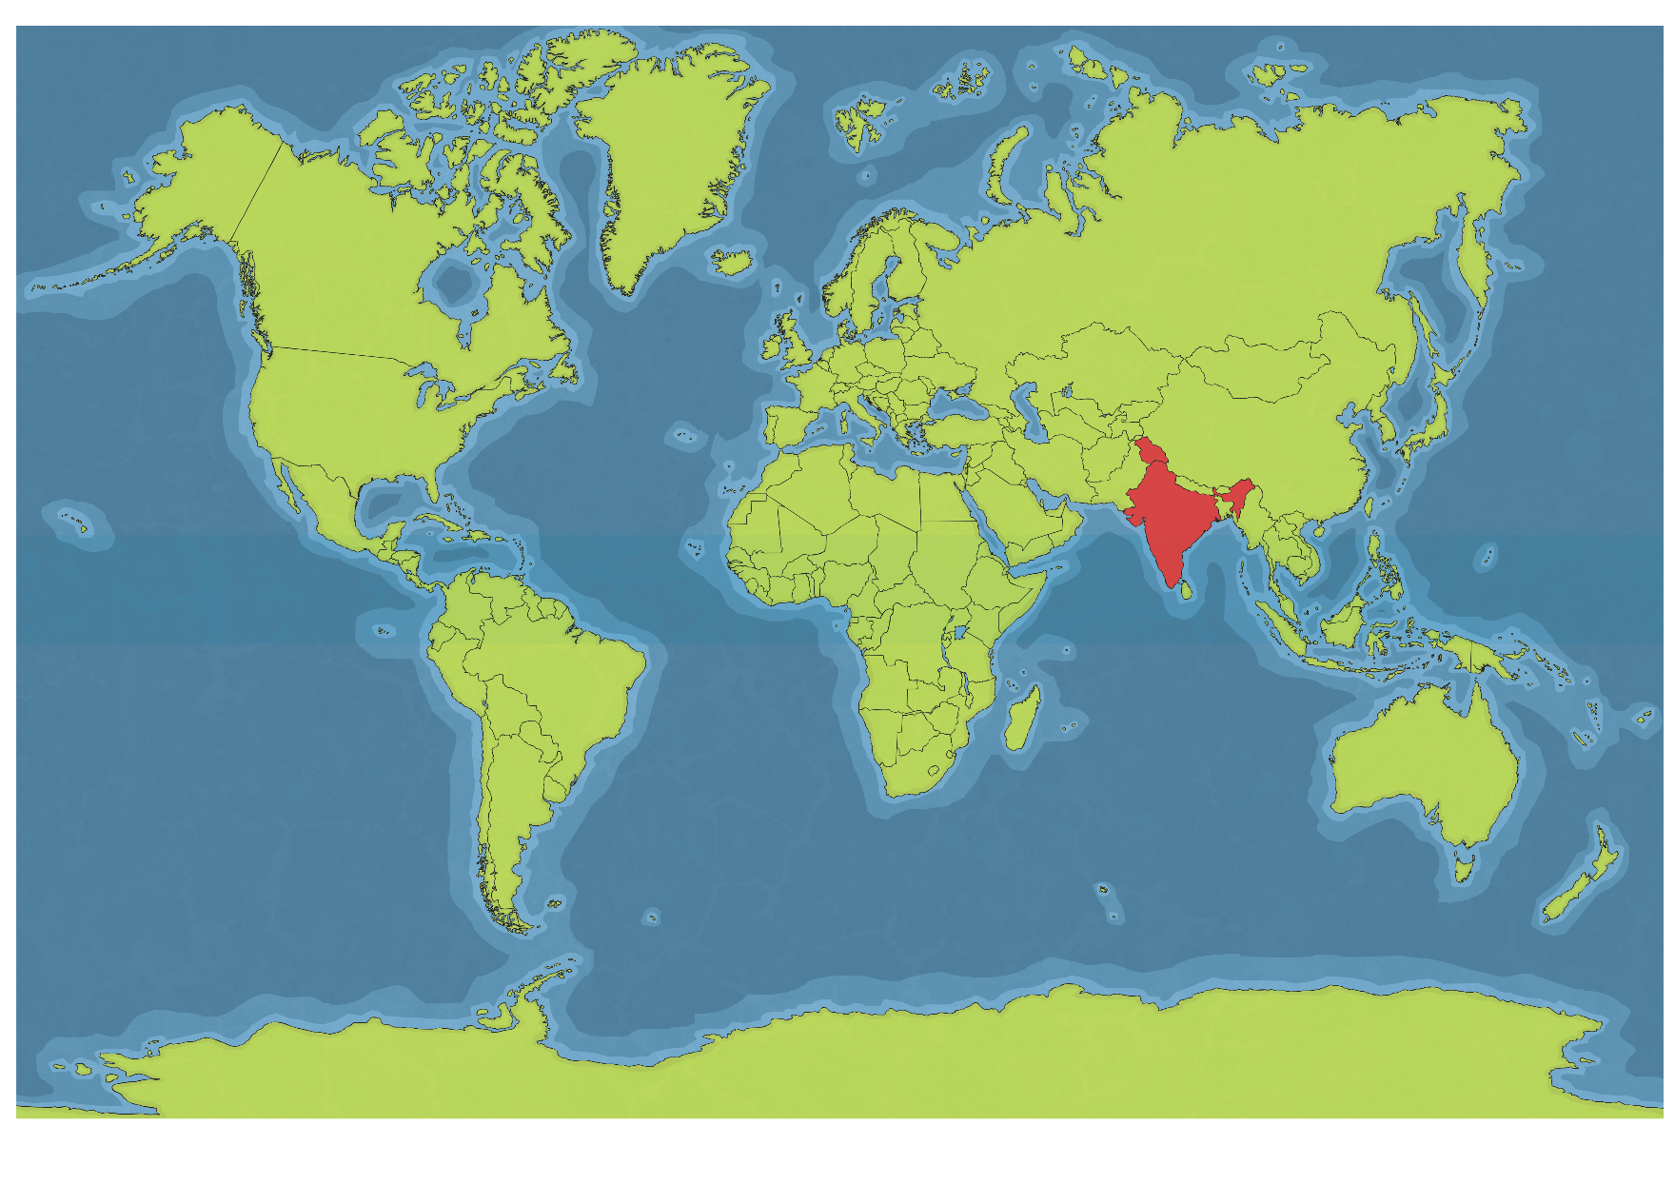
India’s Location
India is located in Asia. It is sometimes referred to as a subcontinent. Ganges, Brahmaputra, Narmada and Godavari are few main rivers.

Slide 4
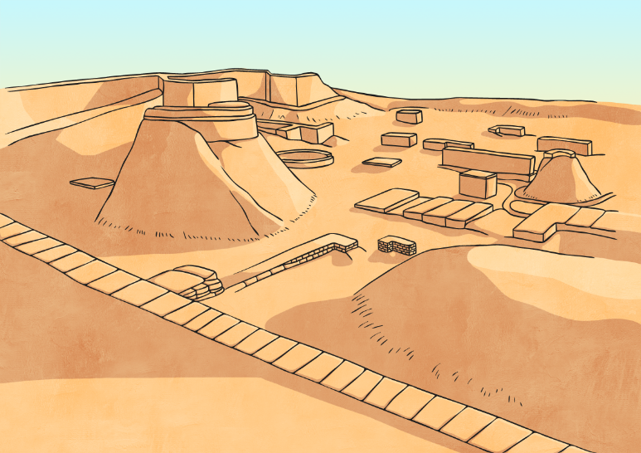
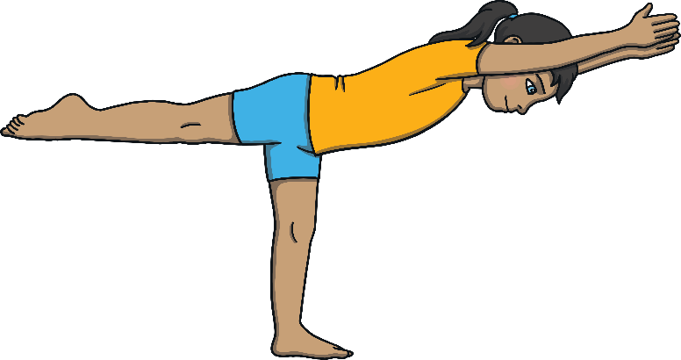
Facts About India
India’s official name is the “Republic of India."
India has the second largest population in the world.
India is the oldest civilization in the world.
India produces the most milk in the world.
India is the birthplace of Hinduism and Yoga.

Slide 5
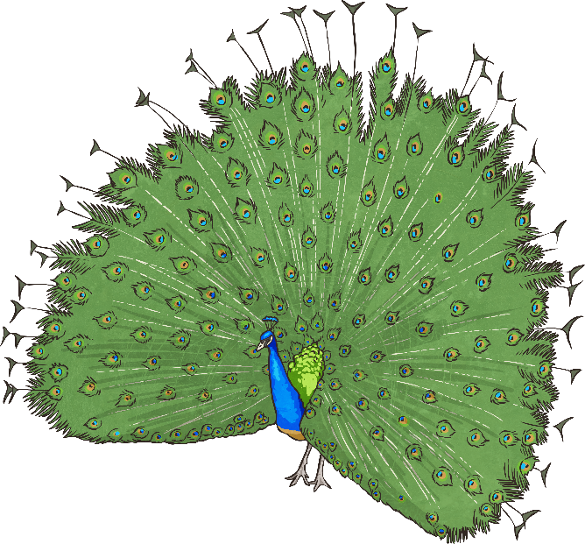
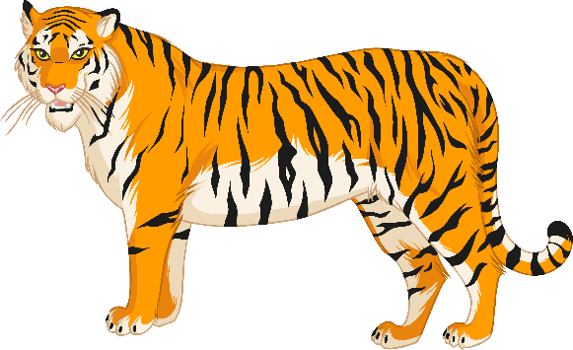
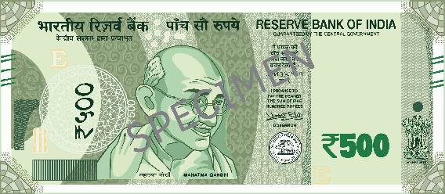
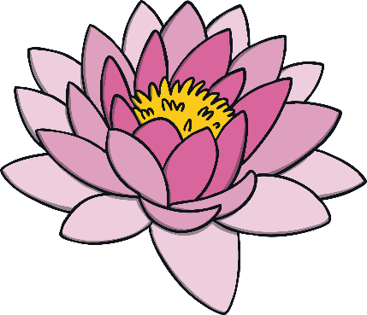
Symbols of India
India’s national flag is a horizontal tricolour with saffron (top), white (middle) and green (bottom) colours and a blue wheel in the middle.
India’s national anthem is ‘Jana, Gana, Mana’ originally composed by Rabindra Nath Tagore.
India’s national song is ‘Vande Mataram’.
India’s national: 1. Animal is: Tiger
2. Flower is: Lotus 3. Bird is: Peacock
4. Currency is: Rupee (₹)

Slide 6
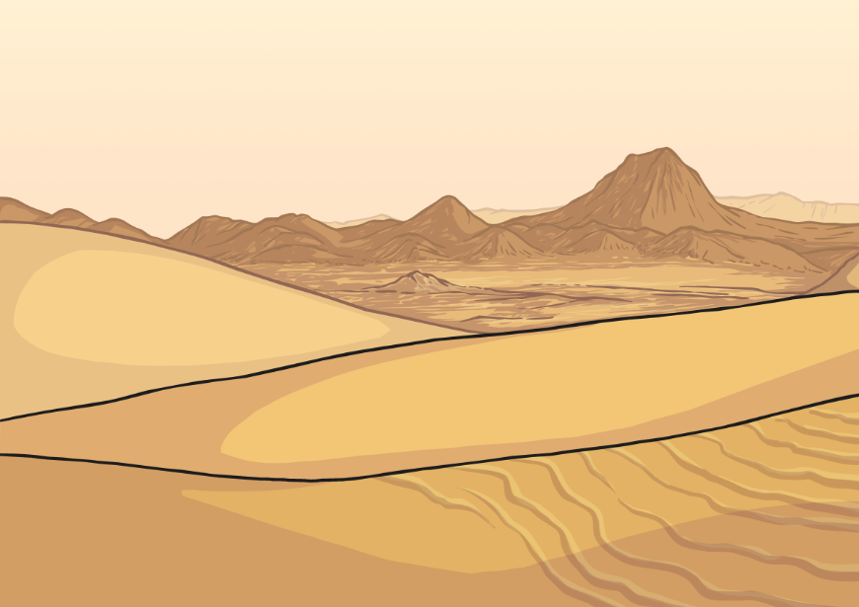
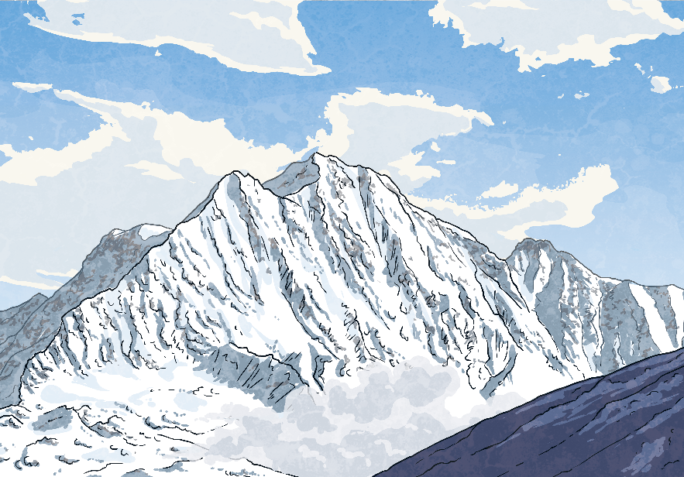
India’s Geography
India has a large desert called the Thar Desert.
India also borders the Himalayan mountain range, the highest mountain range in the world.
Like the United States, India is divided into states. India has 28 states. It also has eight union territories.

Slide 7
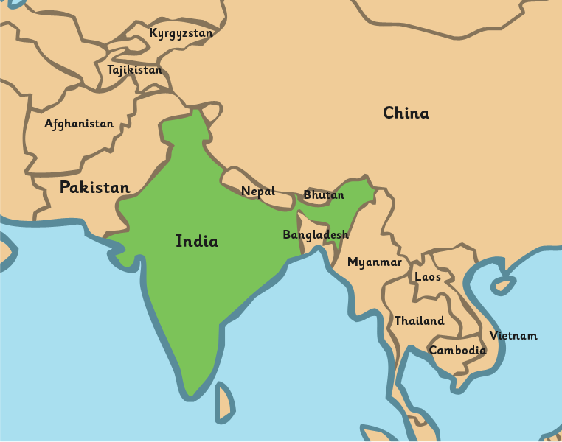
India’s Geography
India shares borders with several sovereign countries; it shares land borders with China, Bhutan, Nepal ,Pakistan in the north or north-west, and Bangladesh and Myanmar in the east. India also shares water borders with Sri Lanka, Maldives and Indonesia.
Sri Lanka

Slide 8
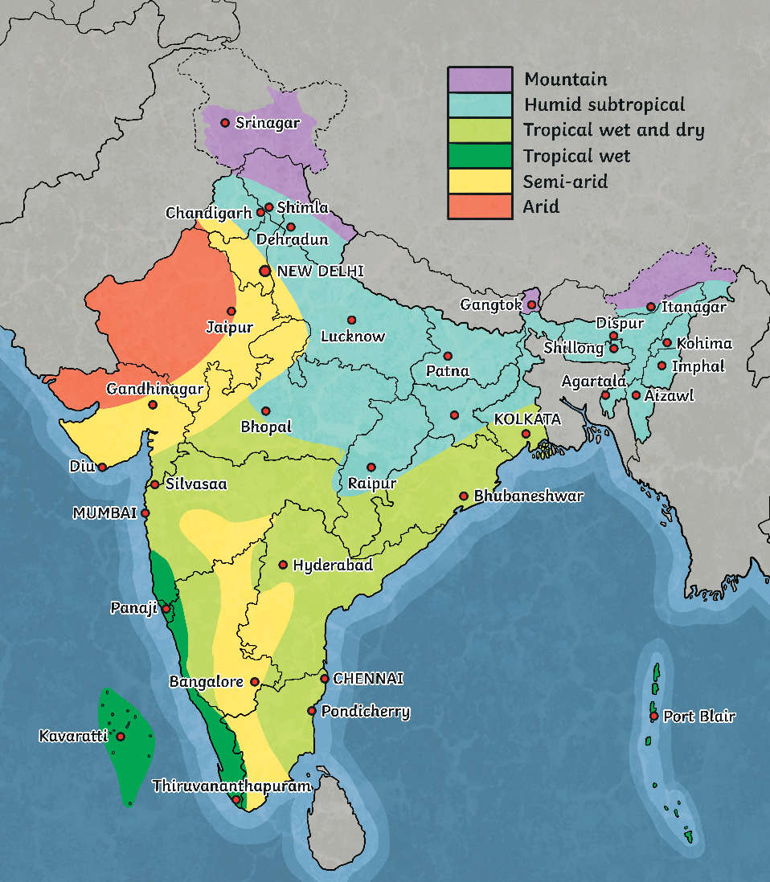
India’s Climate
Most of India is classified as tropical climate.
India has many climates because it is so large in area.
Some areas of India have an arid climate, some have a humid climate, and some even have a glacial climate.

Slide 9
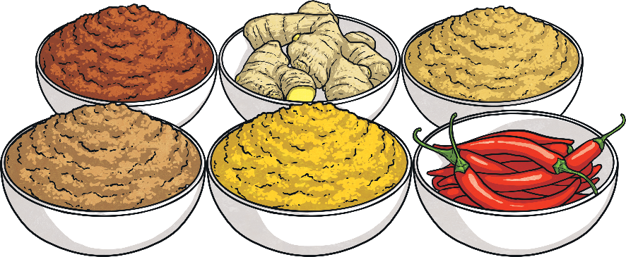
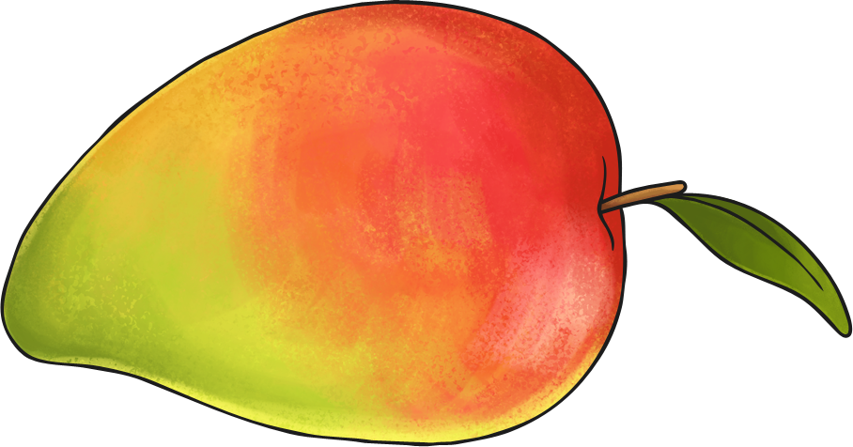
India’s Food
Since India is so diverse, its food is varied.
Rice is the staple food crop and used in many dishes.
Lentils are also very popular.
As India is famous for its spices, food in India usually contains spices.
Common spices are curry, turmeric, and cinnamon. Garam masala is a popular spice mixture.
Mango is India’s national fruit and India produce variety of other tropical fruits like guava, banana, grapes, pear, papaya and pineapple every year.

Slide 10
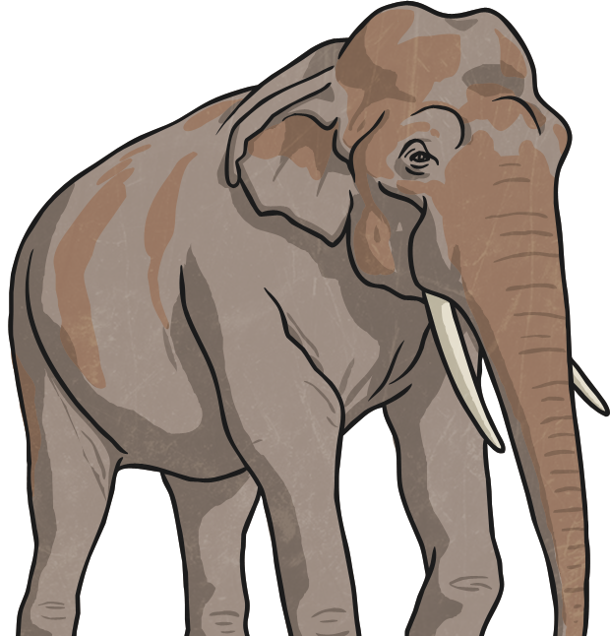
India’s Animals
India is home to many animals including:
the Bengal tiger
the Indian elephant
the Asiatic lion
the Indian rhinoceros
the Indian leopard
the sloth bear
the wild water buffalo
the red panda

Slide 11
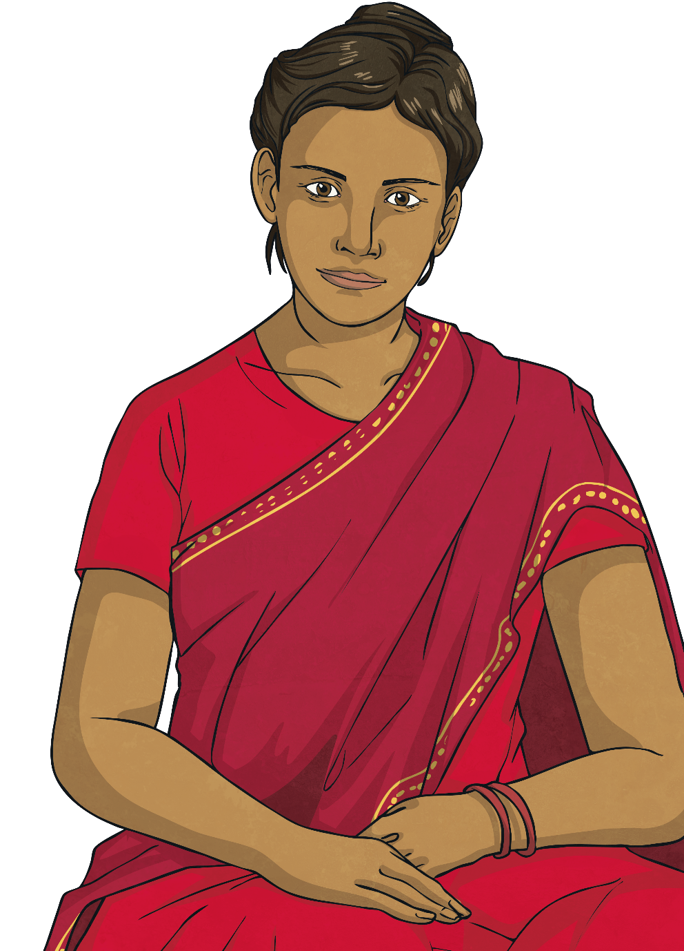
India’s Clothing
Climate impacts clothing in India.
Linen and silk are popular fabrics of many Indian clothes.
An example of traditional clothing for women is the sari. It is a draped robe-like dress.
A dhoti is a traditionally draped cloth for men.
twinkl.com

Slide 12
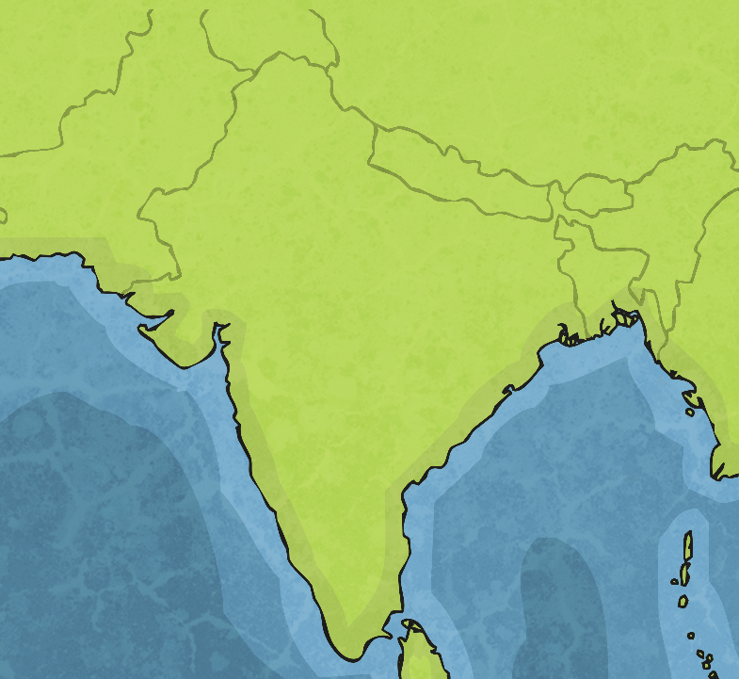
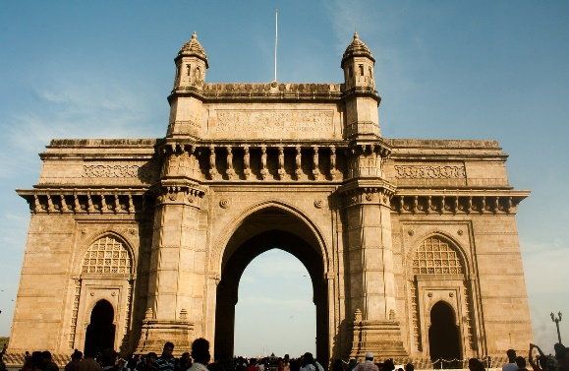
Mumbai
Mumbai is India’s largest city in terms of population.
Mumbai was formerly named Bombay.
It is named after a goddess (Mumbadevi) and had the first train in India.
Mumbai is famous for its film industry, Bollywood which produces a great deal of Indian movies.
Mumbai
Gateway of India

Slide 13
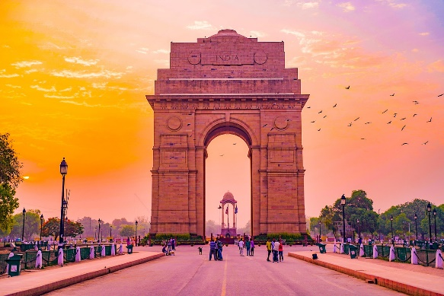
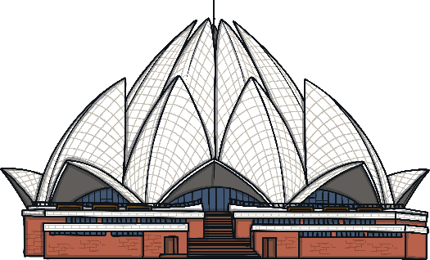
Delhi
Delhi has over 18 million people. It is the second-largest city in India in terms of population.
Delhi is the largest city of India in terms of area.
Delhi is home to the largest spice market in Asia.
New Delhi is India’s capital and political hub of India.
Delhi
India Gate
Lotus Temple

Slide 14
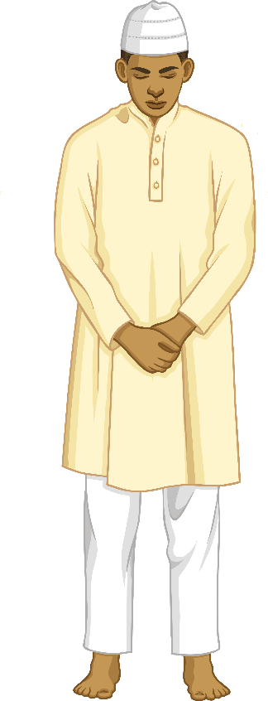
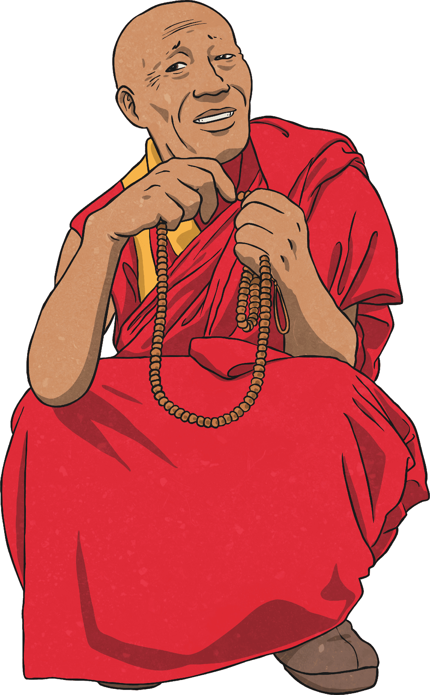
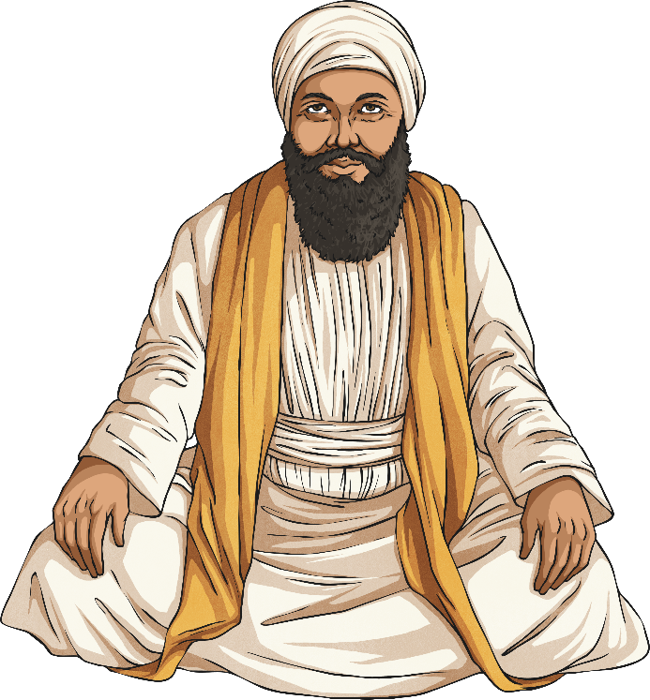
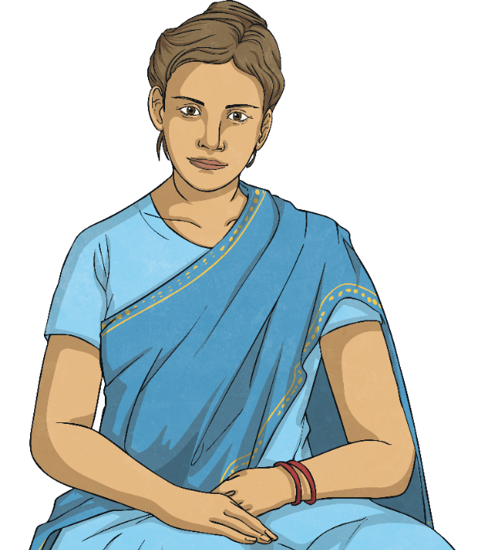
India’s Culture
India’s culture is very diverse. It includes many different people from different backgrounds.
India has many religions, including Hinduism, Buddhism, Sikhism, Islam, and Christianity.

Slide 15
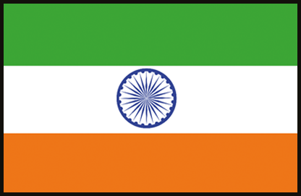
India’s Culture
The Constitution of India now recognizes 23 languages. These consist of English plus 22 Indian languages. Few major languages are: Assamese, Bengali, Gujarati, Hindi, Kannada, Maithili, Malayalam, Marathi, Oriya, Punjabi, Sanskrit, Tamil, Telugu and Urdu..

Slide 16
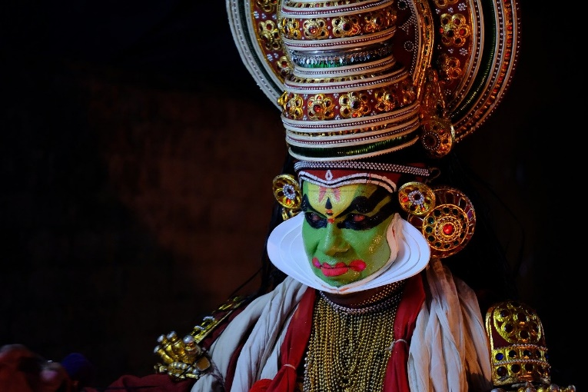
India’s Dances
Dance in India has many styles of dances, generally classified as classical or folk.
Few of them are: Bharatanatyam, from Tamil Nadu, Kathak from Uttar Pradesh, Kathakali from Kerala Kuchipudi from Andhra Pradesh Odissi from Odisha Sattriya from Assam Manipuri from Manipur Mohiniyattam from Kerala Bhangra from Punjab
Kathakali

Slide 17
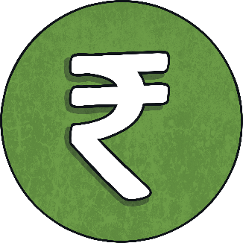
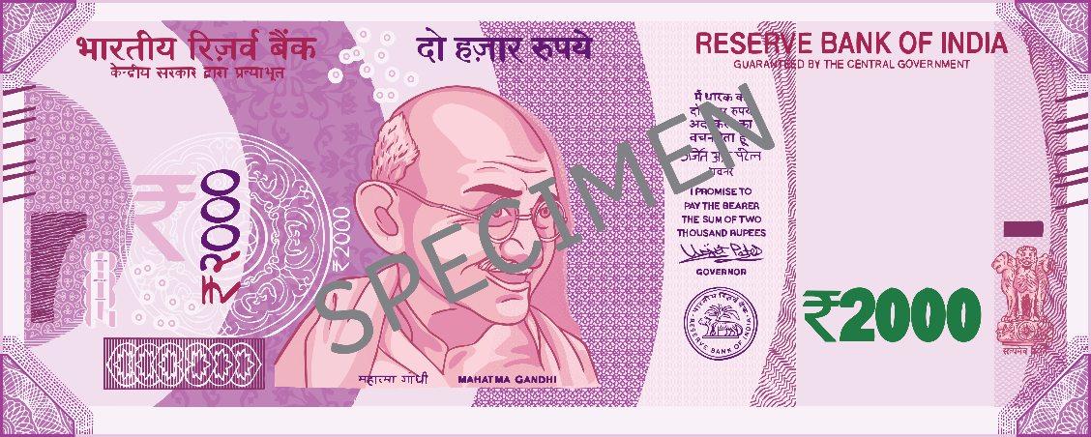
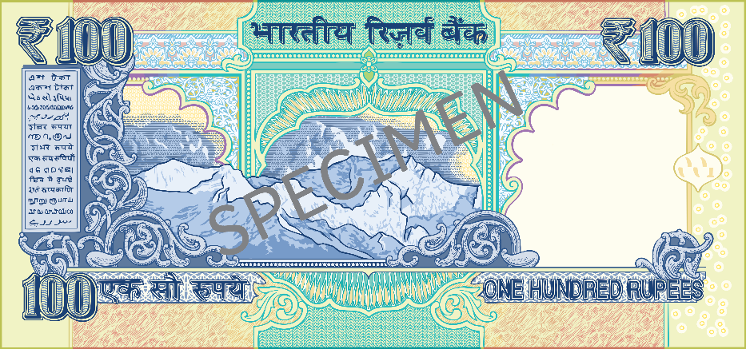
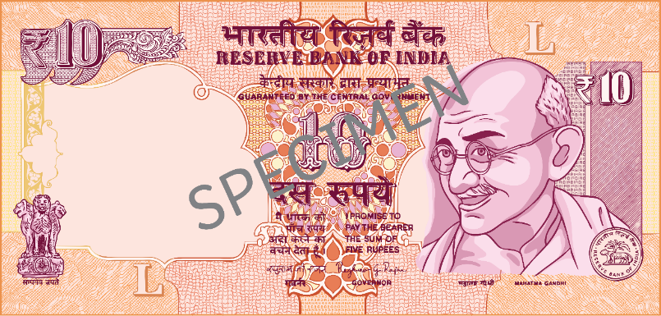
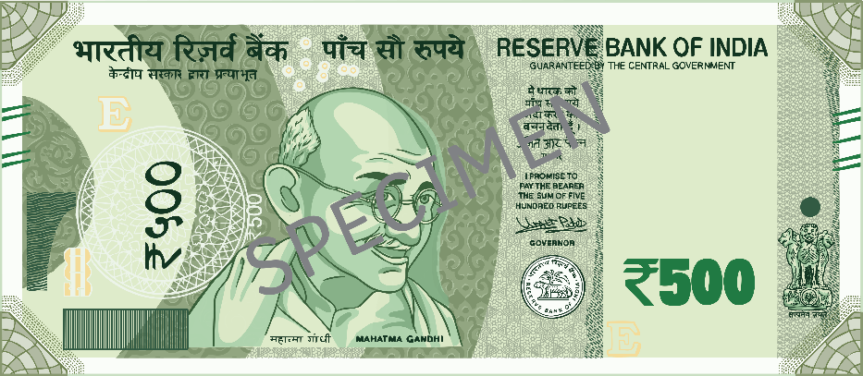
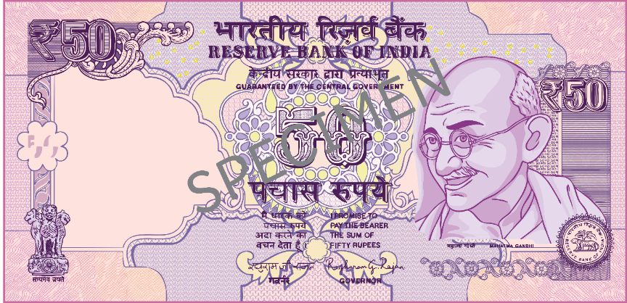
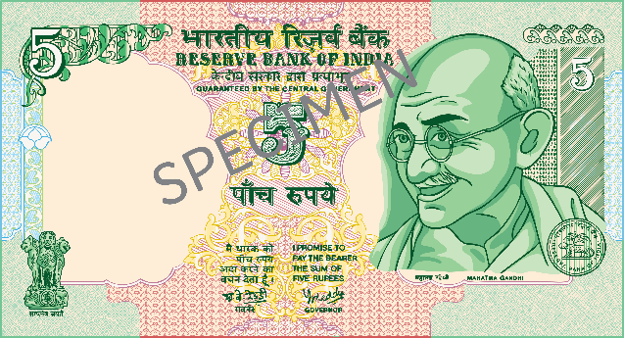
India’s Money
Rupee is the national currency of India.
The symbol is ₹.
India’s money is very colourful compared to the United Kingdom.

Slide 18
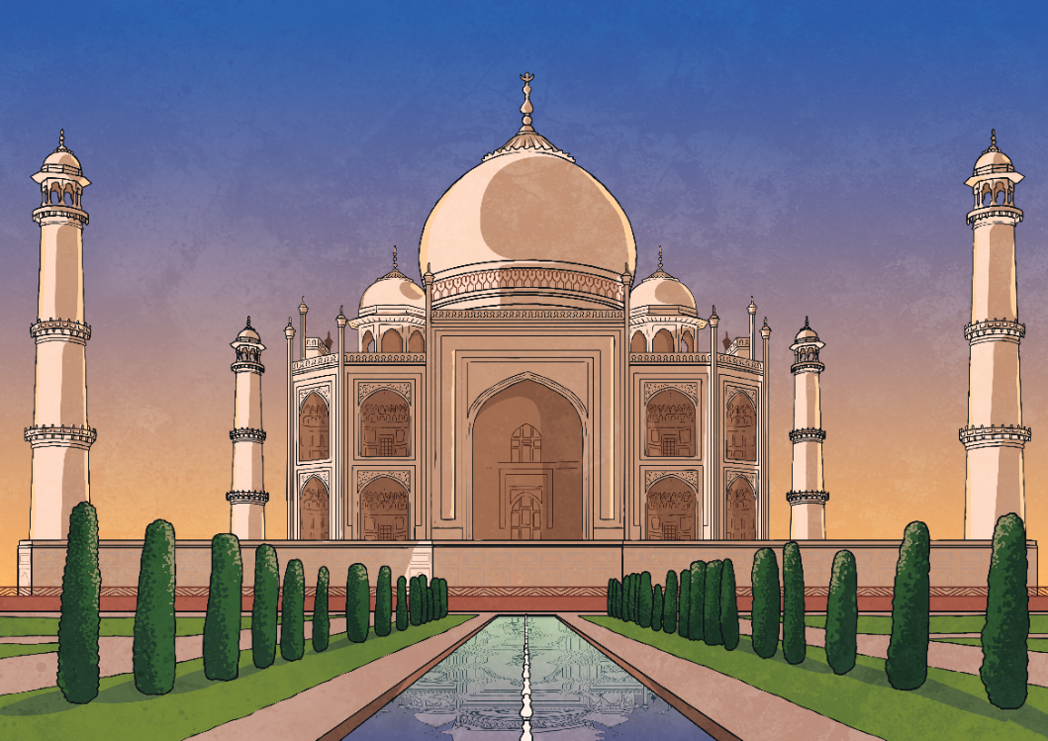
Taj Mahal
The Taj Mahal is located in Agra, which is near New Delhi. It is one of the most popular tourist sites in India.
It is a world-famous site and emperor Shahjahan built it for his wife Mumtaz after she died.
The Taj Mahal is constructed from white marble.
It is one of the new Seven Wonders of the World.

Slide 19
Knowledge Grid
What I know | What I would like to know | What I now know
Now that you have learned more about India, fill out your Knowledge grid.

