Slide 2
Note for teachers.
Depending on the level of your students, you can use this to teach just ‘have to’ in affirmative (up to slide 12) or continue to teach third person, negative, short answer and question form.
Please review this PowerPoint before teaching in order to check for any vocabulary that may be new to your students.

Slide 3
Welcome to your English class!
?
Name 3 objects in your classroom.
?
Name 3 colours you can see in your classroom.
?
Name 2 things in your bag.
?
Name 2 items of clothing in your classroom.

Slide 4
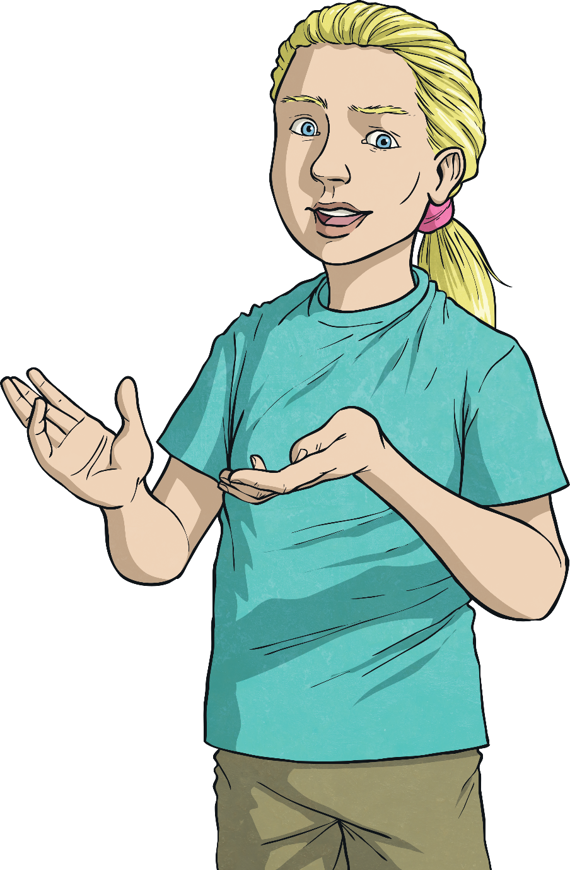
In English class, you have to
speak in English.
?
Is this necessary?
?
Is this an obligation?

Slide 5
In English class, you have to
do your homework.
?
Is this necessary?
?
Is this an obligation?

Slide 6
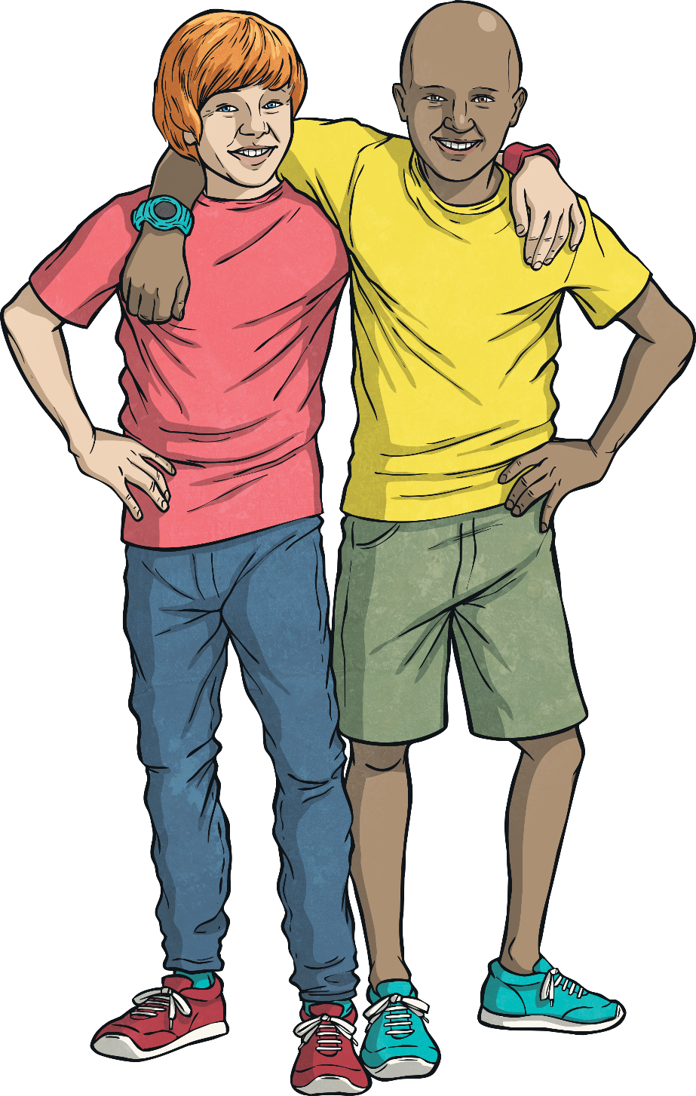
In English class, you have to
be kind to your classmates.
?
Is this necessary?
?
Is this an obligation?

Slide 7
In English class, you have to
bring your pencil or pen.
?
Is this necessary?
?
Is this an obligation?

Slide 8
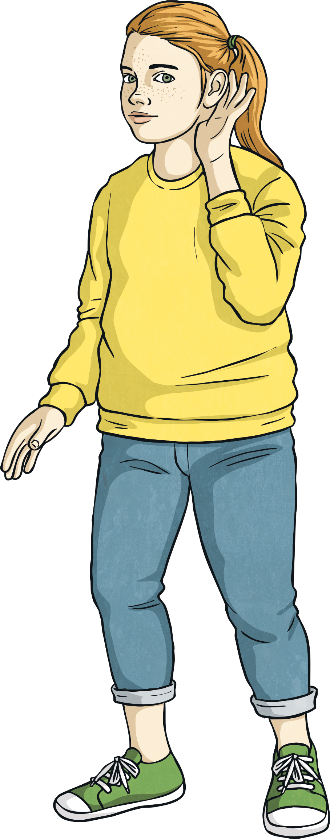
In English class, you have to
listen to the teacher.
?
Is this necessary?
?
Is this an obligation?

Slide 9
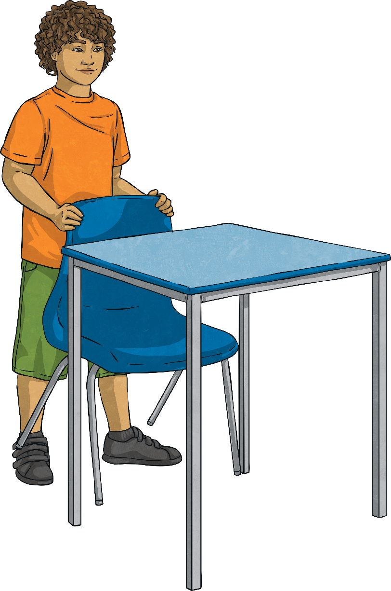
In English class, you have to
leave your desk tidy.
?
Is this necessary?
?
Is this an obligation?

Slide 10
You have to listen to the teacher.
We use ‘have to’ to show obligation.
This means it’s necessary to do something.
What form of the verb do we use?
Base (infinitive) form
The verb with ‘ing’
The past simple

Slide 11
Match the beginnings and endings of these sentences:
Answers
At the airport, you have to…
wear your seatbelt.
In the library, you have to…
shower before you swim.
In a cafe, you have to…
be quiet.
When you’re driving, you have to…
be kind to the animals
At the zoo, you have to…
wear a uniform.
At the swimming pool, you have to…
show your ticket.
On the train, you have to…
pay before you eat.
Police officers have to…
show your passport and ticket.

Slide 12
Oh no! Your class is stuck on a desert island!
You’re the president!
Make 5 rules with ‘have to’.
For example:
“You have to get water.”
Who is the best president?

Slide 13
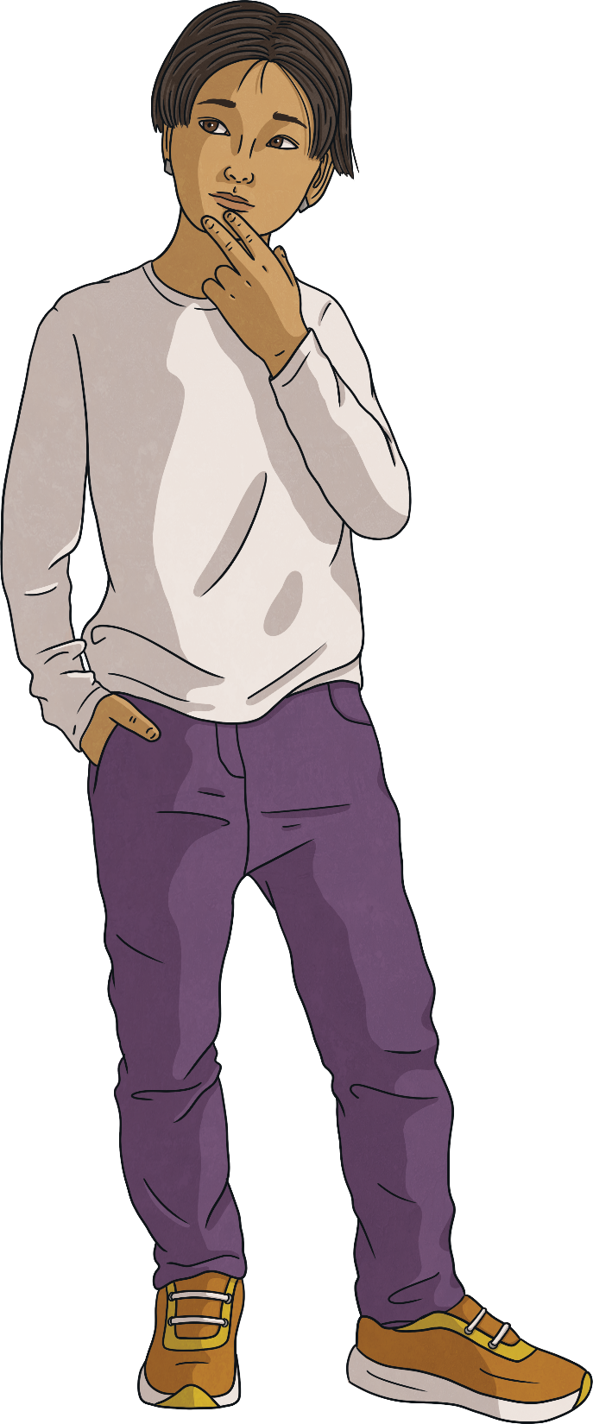
Extra: Have to or has to?
Complete these sentence with ‘have to’ and ‘has to’.
I have to get up early.
She has to help her dad do the shopping.
They have to do the washing up.
Ron has to take the bus to school.
We have to help our teacher.
My car has to have petrol, or it doesn’t work!
See answers
What’s the rule
We use ‘has to’ when the subject is he, she, or it.

Slide 14
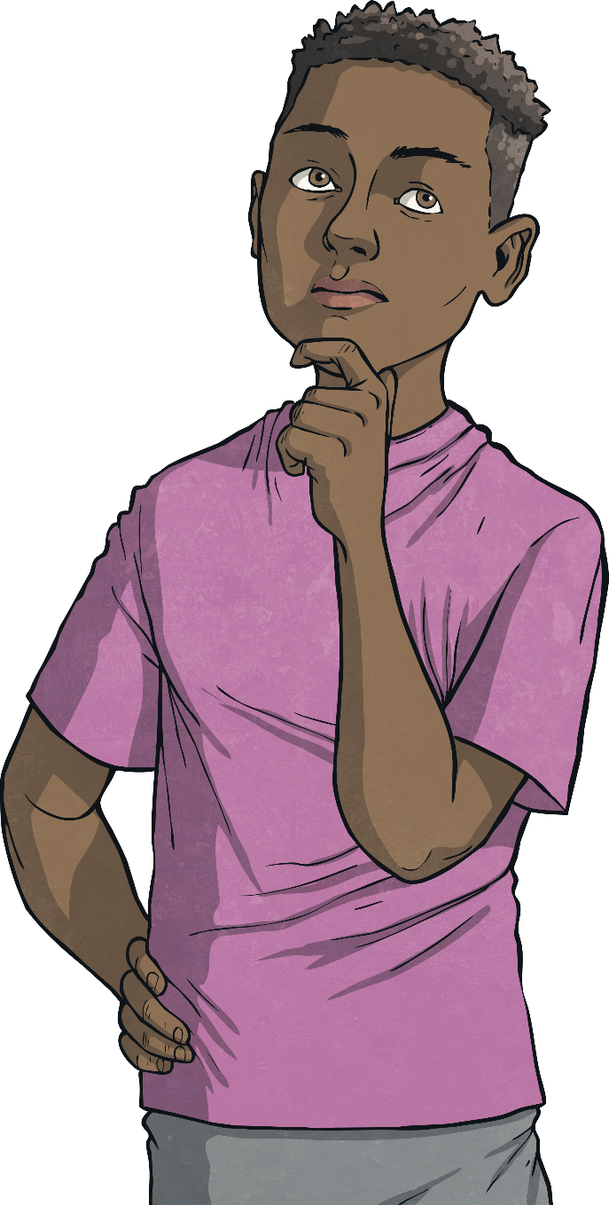
Extra: Question and short answer forms.
Complete these sentence with ‘have to’ and ‘has to’.
Do you have to clean your room?
Does she have to speak English?
Yes, she does!
Where do you have to put your bag?
Do you have to show your passport on the train?
No, you don’t.
See answers
What’s the rule
We use ‘do’ or ‘does’ to make questions and short answers with ‘have to’.

Slide 15
Extra: Negatives
Choose the right sentence:
You have to show your passport at the library.
You don’t have to show your passport at the library.
You have to pay for books at the library.
You don’t have to pay for books at the library.
You have to be quiet at the park.
You don’t have to be quiet at the park.
Does ‘don’t have to’ mean?
It’s not possible / it’s forbidden
It’s not necessary

Slide 16
Can you guess the job?
Think of a job. Keep it a secret. Make sentences with ‘have to’ and ‘don’t have to’. See if your classmates can ask you questions, and guess the job.
Hmm. Do they have to work in a hospital?
They have to help sick people.
They don’t have to drive.
Yes, they do!
Is it a doctor?
Yes, it is!

