Slide 2
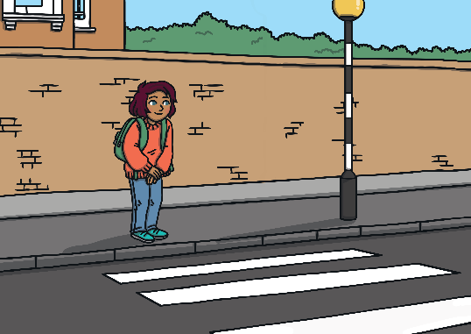
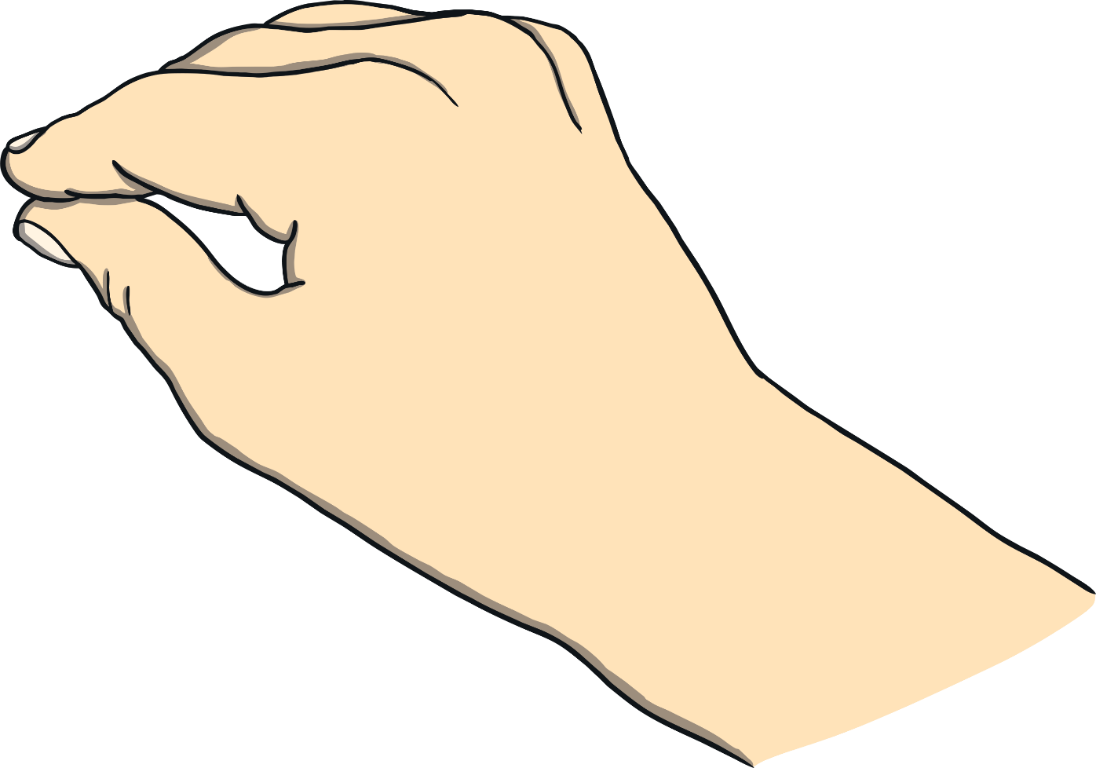
I need to cross the road.
Correct. Good job!
Try again!
Who can help me?
or
Next
crossing guard
nurse

Slide 3
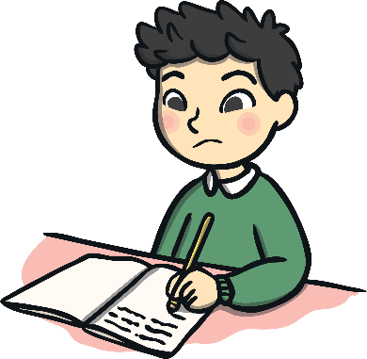
I need help with my work.
Correct. Good job!
Try again!
Who can help me?
or
Next
police
teacher

Slide 4
I am lost.
Correct. Good job!
Try again!
Who can help me?
or
Next
police
nurse

Slide 5
My dog is sick.
Correct. Good job!
Try again!
Who can help me?
or
Next
vet
crossing guard

Slide 6
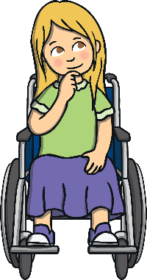
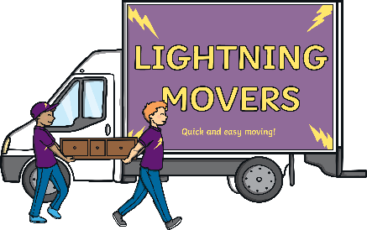
I am moving to a new house.
Correct. Good job!
Try again!
Who can help me?
or
Next
doctor
professional mover

Slide 7
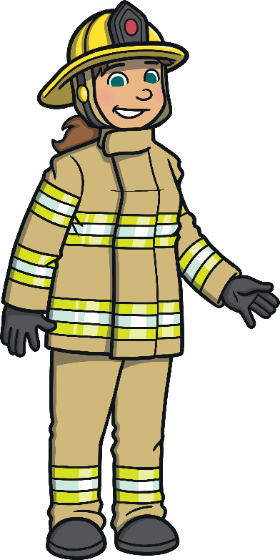
There is a fire.
Correct. Good job!
Try again!
Who can help me?
or
Next
crossing guard
firefighter

Slide 8
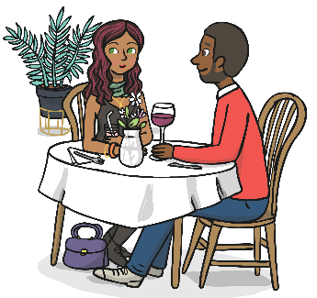
I would like to order some food.
Correct. Good job!
Try again!
Who can help me?
or
Next
waiter
police

Slide 9
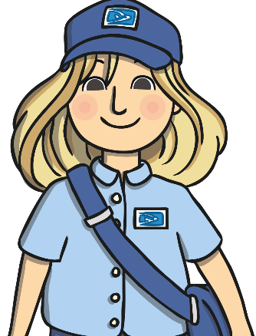
I need a cake for the party.
Correct. Good job!
Try again!
Who can help me?
or
Next
baker
postal worker

Slide 10
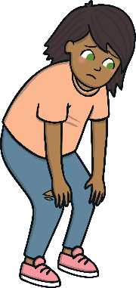
I have hurt my knee.
Correct. Good job!
Try again!
Who can help me?
or
Next
postal worker
nurse

Slide 11
My teeth hurt.
Correct. Good job!
Try again!
Who can help me?
or
Next
dentist
referee

Slide 12
I want to change my hairstyle.
Correct. Good job!
Try again!
Who can help me?
or
Next
server
hair stylist

Slide 13
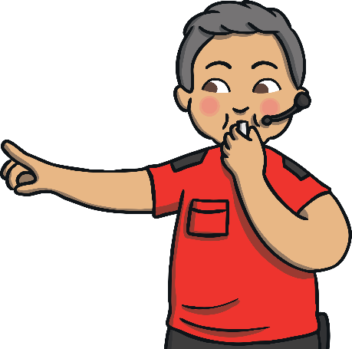
I just got fouled during soccer.
Correct. Good job!
Try again!
Who can help me?
or
Next
baker
referee

Slide 14
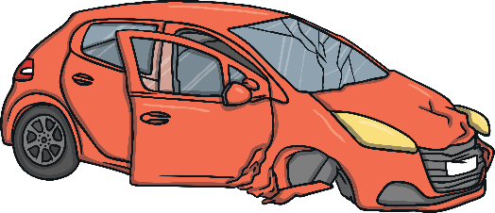
I need a new car.
Correct. Good job!
Try again!
Who can help me?
or
Next
car salesperson
teacher

Slide 15
My trash can is full.
Correct. Good job!
Try again!
Who can help me?
or
Next
trash collector
vet

