Slide 3
Happy, Healthy and Safe
All children should feel happy, healthy and safe.
All children have basic needs and these needs should be met to ensure children and young people are nurtured.
Can you sort these things into needs and wants for a happy, healthy and safe life?
A new pair of trainers
Clean water
Health care
A television
Being able to express your opinion
A holiday
A safe place to live
An education
A games console

Slide 4
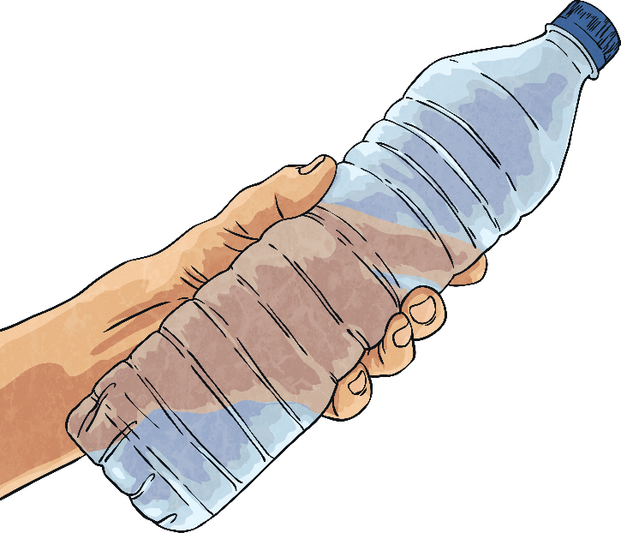
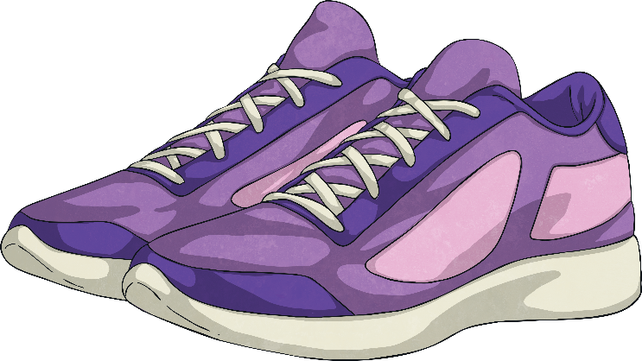
Needs and Wants
Needs | Wants
Clean water | A new pair of trainers
A safe place to live | A holiday
An education | A television
Being able to express your opinion | A games console
Health care

Slide 5
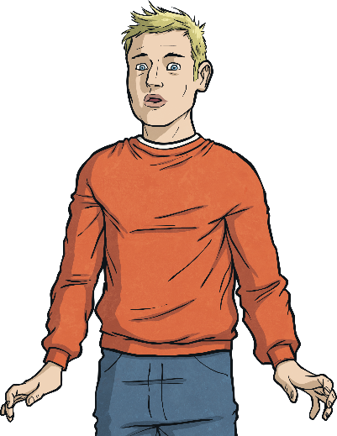
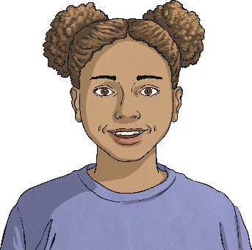
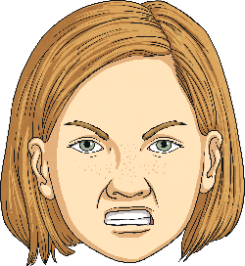
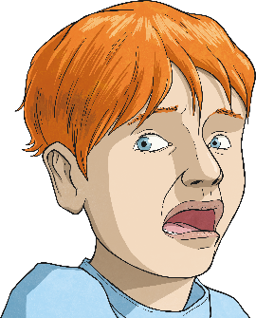
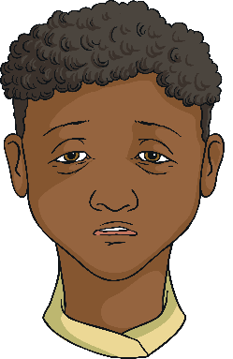
Feelings
How are these people feeling?

Slide 6
Hidden Feelings
Our feelings can sometimes show on the outside, like crying when we feel sad, but there can be times when the inside of our body will signal that we are feeling a certain way.
This could be:
butterflies in our stomach;
feeling sick;
Would you like to share a time when you have felt any of these body sensations?
feeling tension in our muscles;
losing our appetite;
feeling fidgety and agitated.
Everyone reacts different in different situations. Our bodies all respond differently to different situations and this is OK!

Slide 7
Feeling Safe
Being safe means you are protected from abuse, neglect or harm and all children under the age of 18 have the right to be safe under the
United Nations Convention on the Rights of the Child.
Article 19 (protection from violence, abuse and neglect)
Where do you feel safe?
Governments must do all they can to ensure that children are protected from all forms of violence, abuse, neglect and bad treatment by their parents or anyone else who looks after them.
Who helps you to feel safe?
What helps to make you feel safe?
Notes:
Teacher note: Click on the underlined text to reveal “Article 19” text.

Slide 8
Safe or Not Safe?
Would you feel safe in these situations?
Walking home by yourself when it is dark outside.
Your friend’s parent offers to drive you home from school on a rainy day.
Watching a
scary movie.
You get separated from your parents at the shops, but there is a police officer nearby.
Someone hits you in the school playground.
When some older youths you don’t know ask to join your friendship group at the park.
A stranger offers you a lift home on a rainy day.
When a grown up tries to show you a video that makes you feel uncomfortable.
When someone tries to touch your private parts when you don’t want them to.
When an online friend offers to meet up in person.
Going on a rollercoaster.
Going out to play with your friends at the park.

Slide 9
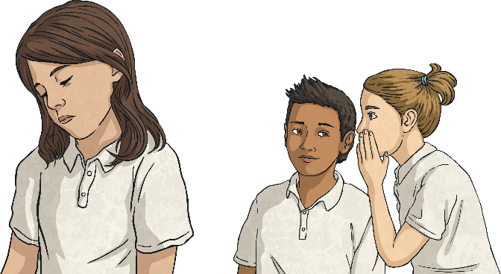
Bullying
What is bullying?
Bullying can be:
saying unkind things;
Bullying is repeatedly hurting someone on purpose. Bullying is a form of abuse and all types of abuse are wrong and can make people feel unsafe.
saying unkind things to others about someone;
physically hurting someone;
Bullying is not when you hurt someone once. This is also unkind and not OK, but bullying behaviour is a repeated act.
purposefully leaving someone out;
destroying someone’s property.
Bullying affects many people. It can make us feel hopeless and sad. But we don’t have to suffer in silence. If we can reach out to each other to talk about what’s happening, we can help to stop bullying.

Slide 10
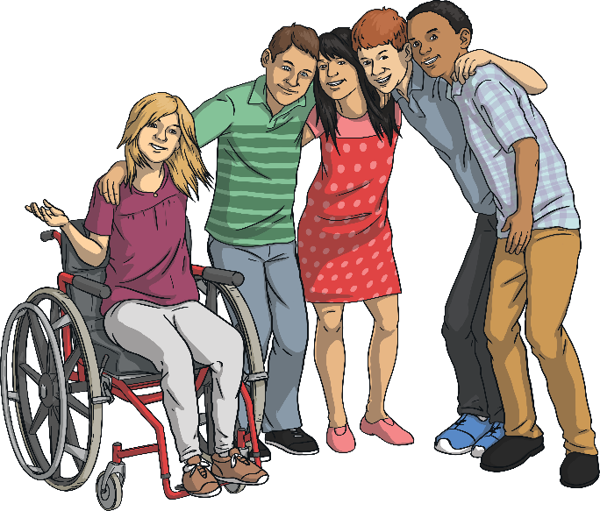
Human Dignity
Every person is equally unique, important and special in their own right. This is human dignity.
Embracing the differences of others, showing kindness and not making others feel bad about themselves are all important in respecting the human dignity of others.
No one has the right to put you down and take away your
human dignity.
Bullying takes away a person’s human dignity and this is not OK!
If you know someone is being bullied, stand up for their human dignity by speaking to an adult you trust!

Slide 11
Kindness, Trust and Empathy
What is kindness?
Kindness and empathy are important in respecting human dignity and standing up to bullying behaviour. Kindness and empathy make people feel that they are not alone and help to reduce bullying.
Kindness is being friendly, generous and compassionate to others. Showing kindness towards someone might include helping them, showing concern or doing something nice for another person.
Trust is important in helping people speak out about bullying. People need to feel that there is someone there to listen that they can rely on for support.
What is trust?
Trust is when you can rely on someone to act in your best interests, be there to support you, listen to you and know they will not let you down.
Kindness, trust and empathy make the world a happier, safer place.
What is empathy?
Empathy is when you can consider how another person might feel in a particular situation and put yourself in their shoes.

Slide 12
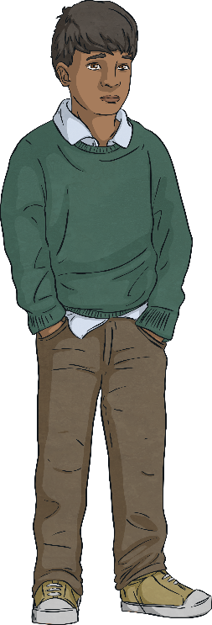
Neglect
All children should be happy, healthy and safe.
United Nations Convention on the Rights of the Child
Article 24
Every child has the right to the best possible health. Governments must provide good quality health care, clean water, nutritious food, and a clean environment and education on health and well-being so that children can stay healthy. Richer countries must help poorer countries achieve this.
Article 27
Every child has the right to a standard of living that is good enough to meet their physical and social needs and support their development. Governments must help families who cannot afford to provide this.
Sometimes the basic needs of children are not being met. They might not have adequate clothing, access to nutritious food or a warm, safe place to sleep. This is called neglect.
You might find this information upsetting. You can ask to leave if it is challenging or speak to an adult you trust about any worries you have.
There can be many reasons why children aren’t being cared for properly and are neglected, but neglect is not OK!
Neglect is never the fault of the child.

Slide 13
Physical Abuse
Physical abuse can be:
hitting or smacking with hands or objects;
kicking;
You might find this information upsetting. You can ask to leave if it is challenging or speak to an adult you trust about any worries you have.
A child may not be happy, healthy or safe because someone is hurting them. This might be with their hands, feet or an object. This is called physical abuse. Physical abuse of any kind is wrong, no matter who it is hurting a child.
pinching or scratching;
All types of physical abuse are wrong and not the fault of the child. In Scotland it is illegal for an adult to use physical punishment of any kind.
burning a child;
pulling hair;
spitting;
throwing objects;
giving a child harmful substances or medicine they do not need.

Slide 14
Private Parts
Remember:
The parts of your body that are covered by your underwear are private and your body belongs to YOU. You have the right to say no to any forms of touch and no means no! If you ever feel uncomfortable or worried you should always talk to someone you can trust.
You might find this information upsetting. You can ask to leave if it is challenging or speak to an adult you trust about any worries you have.
All children have the right to be happy, healthy and safe from all types of abuse.
This includes sexual abuse.

Slide 15
Sexual Abuse
Sexual abuse is when someone touches a child’s private body parts, shows their private body parts, shows sexual pictures or videos or asks a child to take a photograph of the private parts of their body.
Sexual abuse can happen to boys and girls and a child can be abused by a stranger or someone they know.
You might find this information upsetting. You can ask to leave if it is challenging or speak to an adult you trust about any worries you have.
An abuser might ask a child to keep what they are doing in secret and make them believe what they are doing is OK. IT IS NOT OK!
Sexual abuse is illegal and wrong. It is NEVER the fault of the child.
If anything ever makes you feel uncomfortable or worried speak to an adult you trust.
Speak out and ask for help!

Slide 16
Support
It is always best to speak up and ask for advice or help, sooner rather than later. Knowing when to ask for help is an important skill.
No young person has to keep their concerns and worries to themselves.
If something happens that makes someone feel uncomfortable, it is not their fault. A trusted adult will be able to help.
Sometimes people may need to seek support for themselves but sometimes it is for someone else. If a friend tells you something that has happened that has made them feel worried or uncomfortable, the most helpful thing to do is to talk to a trusted adult about what's been shared, to make sure your friend gets the help they need.

Slide 17
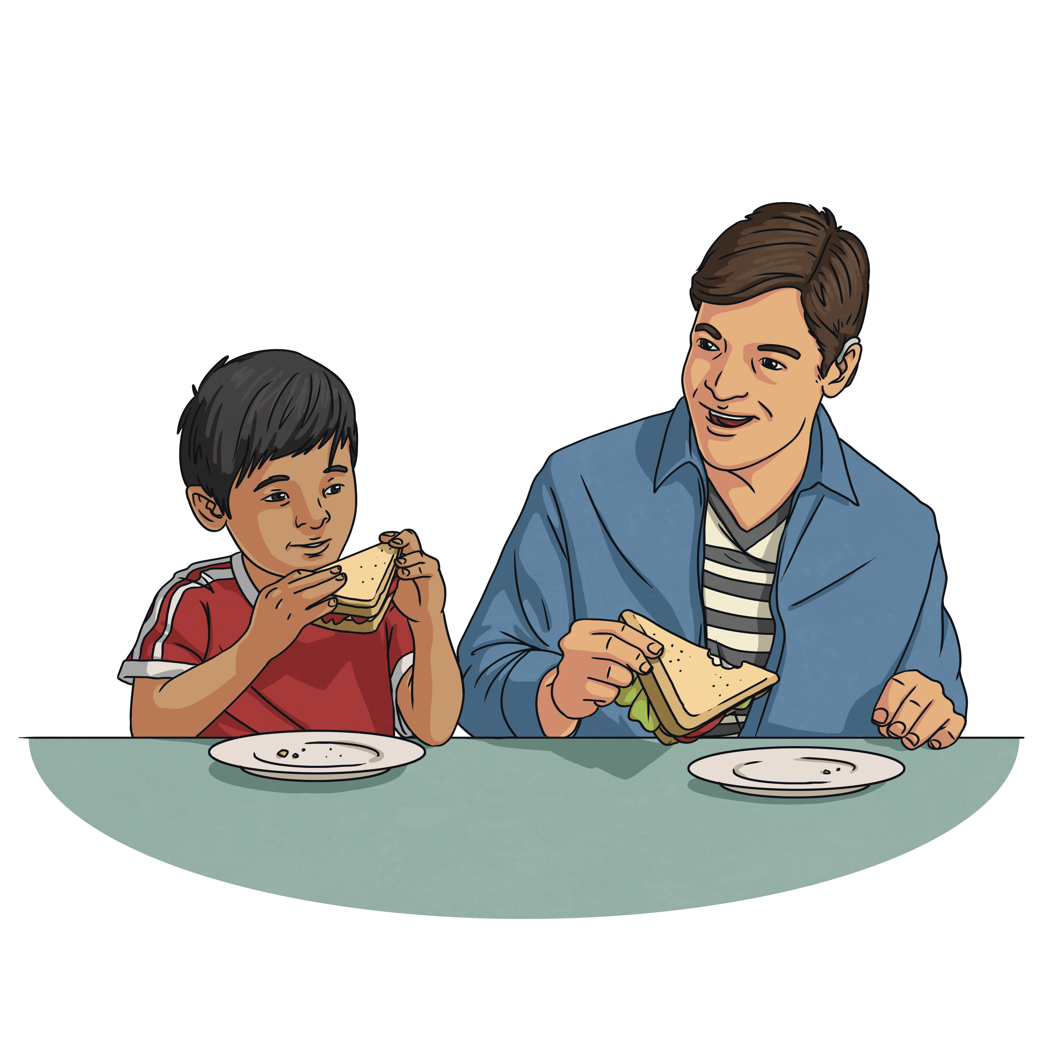
Who Can You Trust?
Who are your trusted adults?
A trusted adult could be:
a parent or carer;
another family member, such as a grandparent;
a friend’s parent or carer;
a teacher or another adult in school;
a doctor, nurse or police officer.
A trusted adult is someone who should help you to feel safe. It is also helpful to think of a few trusted adults in your life in case the first person you talk to is not able to help you.

Slide 18
Help and Support
Sometimes, young people might feel that they have no one to talk to. Maybe they are worried or frightened to speak to someone they know. Perhaps they are embarrassed or think that they will not be believed.
This is why Childline exists.
Childline is a charity that provides help for children. Children can speak to a grown-up who will listen to their worry, concern or problem and give them advice about what they can do.
The number to call is 0800 11 11.

Slide 19
Speak Out
Any kind of abuse is never the fault of the child.
No child should feel unsafe or frightened.
If you ever do, SPEAK OUT!
Talk to an adult you trust and get the support you need.
You have the right to be happy, healthy and safe.

