Slide 1
Disclaimer/s
We hope you find the information on our website and resources useful.
Animations
This resource has been designed with animations to make it as fun and engaging as possible. To view the content in the correct formatting, please view the PowerPoint in ‘slide show mode’. This takes you from desktop to presentation mode. If you view the slides out of ‘slide show mode’, you may find that some of the text and images overlap each other and/or are difficult to read.
To enter slide show mode, go to the slide show menu tab and select either from beginning or from current slide.
Links to External Websites
This resource contains links to external websites. Please be aware that the inclusion of any link in this resource should not be taken as an endorsement of any kind by Twinkl of the linked website or any association with its operators. You should also be aware that we have no control over the availability of the linked pages. If the link is not working, please let us know by contacting TwinklCares and we will try to fix it although we can assume no responsibility if this is the case. We are not responsible for the content of external sites.
You may wish to delete this slide before beginning the presentation.

Slide 3
Aim
To learn about dairy farming.
Success Criteria
Having explored the variety of foods produced in Australia, I can discuss the importance of different types of agriculture in the production of these foods.

Slide 4
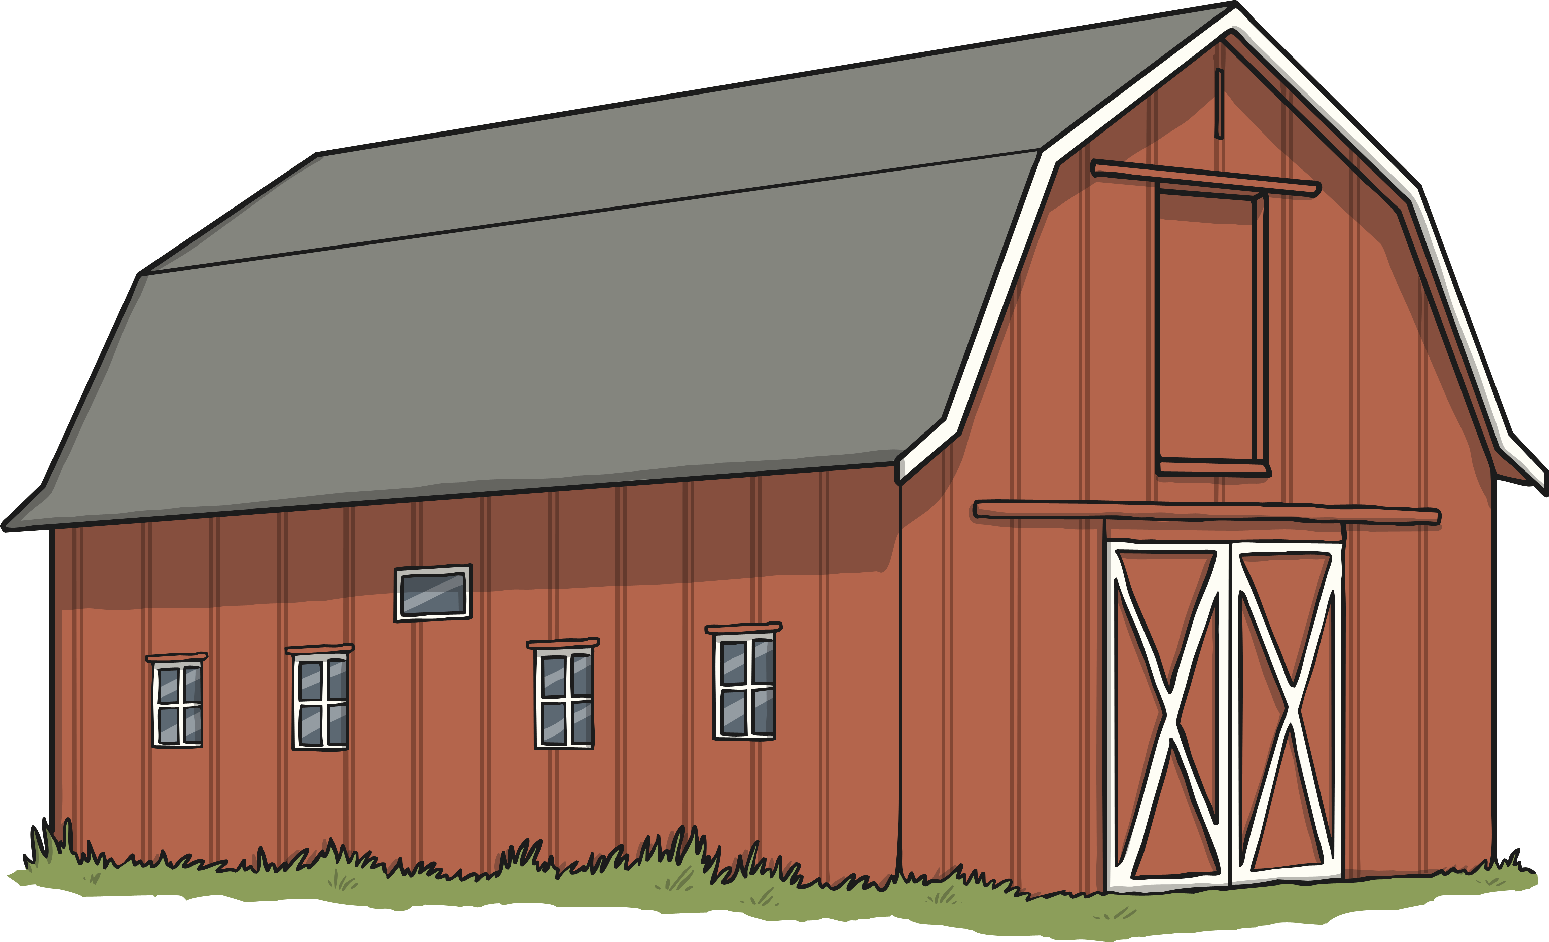
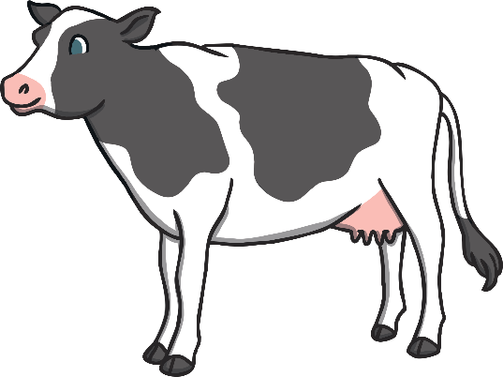
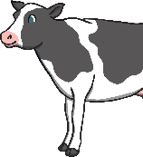
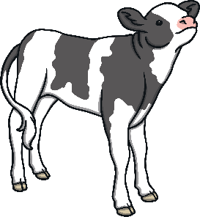
Dairy Farms in Australia
Around 5,789 farms of different sizes, in Australia, have dairy cows.
In 2017, there were 1.5 million dairy cows in Australia.
The state of Victoria has the most dairy cows. New South Wales and Tasmania are the next biggest producers of milk.

Slide 5
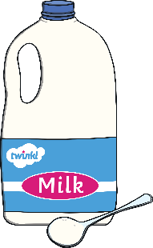
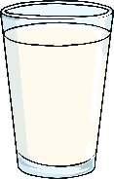
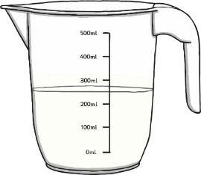
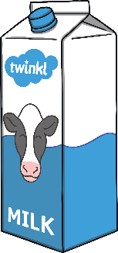
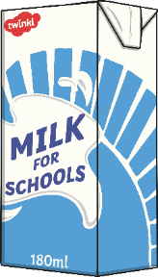
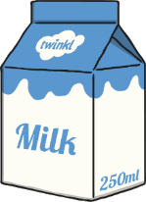
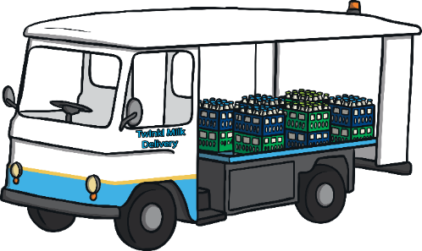
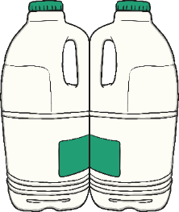
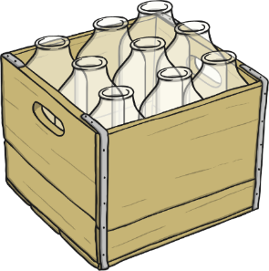
Dairy farms produce…
milk!

Slide 6
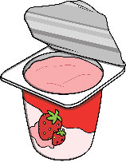
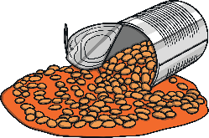
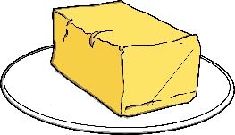
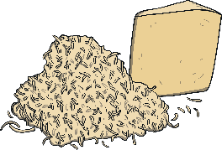
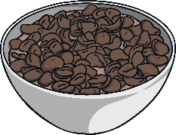
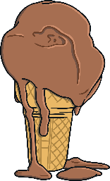
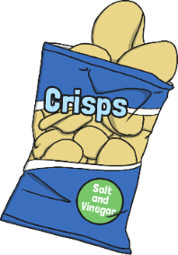
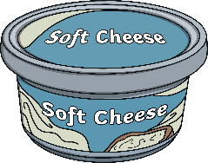
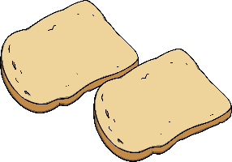
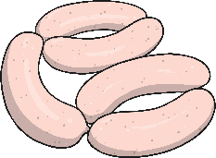
Which of These Products Have Milk in Them?

Slide 7
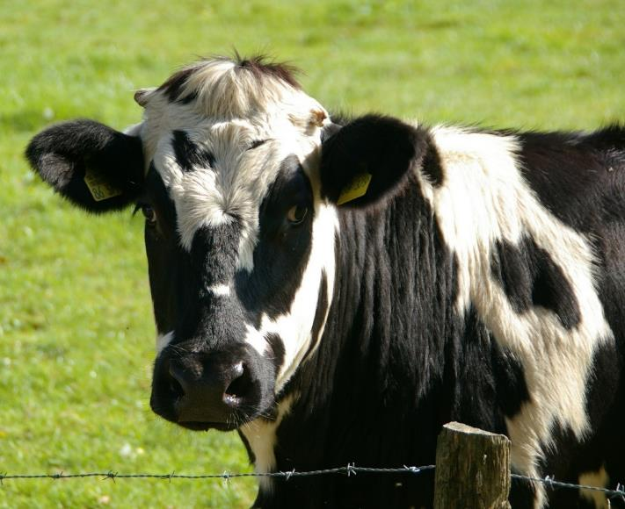
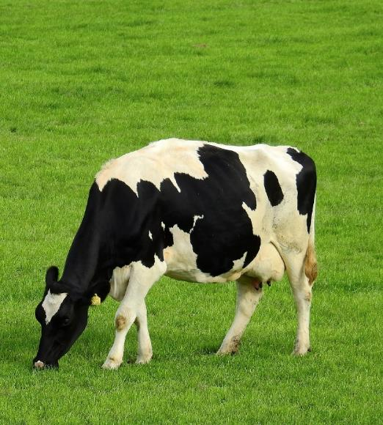
Types of Cow
There are lots of different types of cows used in dairy farming but the Holstein cow is the most common in Australia. They are black and white.

Slide 8
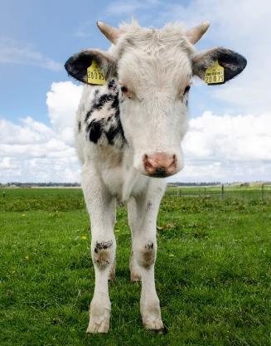
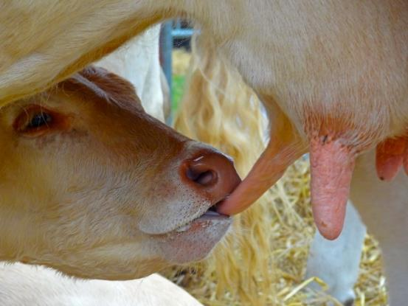
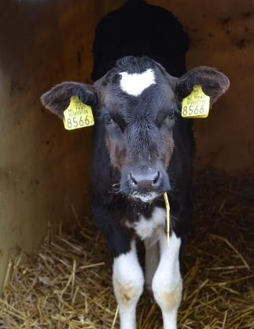
Did You Know…?
It is only female cows who produce milk.
They only produce milk after they have had a calf, so on a dairy farm there are always lots of calves being born!

Slide 9
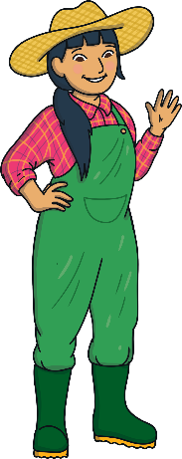
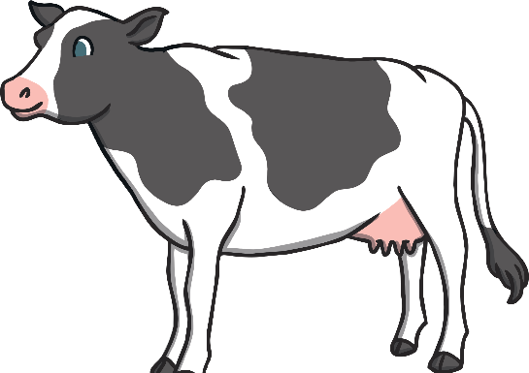
How Often Are Cows Milked?
Most farmers milk their cows 2 – 3 times a day.
First milk can be as early as 4 a.m.
Second milk is usually around 12.30 p.m.
Last milk is usually around 8 p.m.

Slide 10
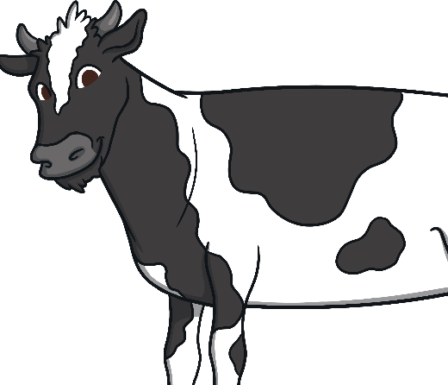
How Often Are Cows Milked?
At some farms, the cows get to choose when they are milked because they are milked by machines.
Some cows choose to get milked 4-5 times a day!
Cows have to be milked 365 days of the year - even on Christmas Day!

Slide 11
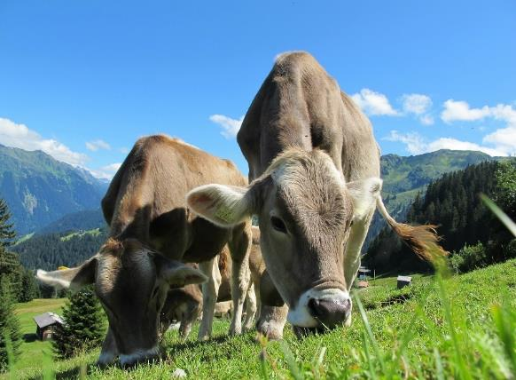
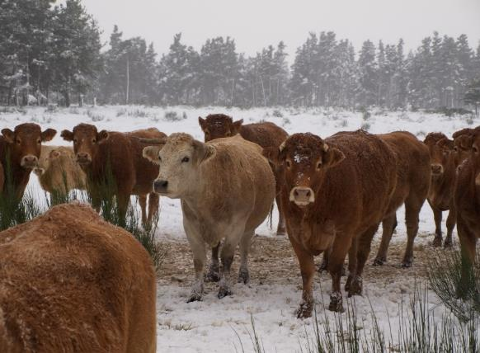
What Do the Dairy Cows Eat?
summer – grass
winter – silage (stored grass or corn)
They also get dried feeds like cereal.
They eat between 25-50kg of feed per day!

Slide 12
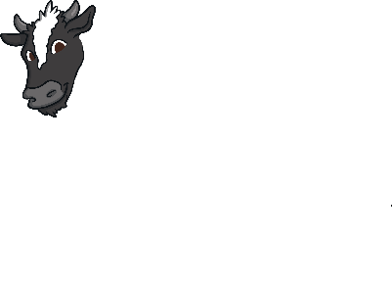
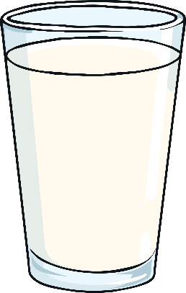
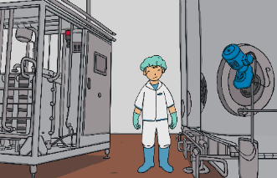
Process of Milk Production
The bottles are sold to the public.
Milk is collected from the cow.
The milk is chilled.
The milk is put into bottles.
This whole process takes only two days.
The milk is collected in a milk tanker.
Some milk has the fat removed, e.g. semi-skimmed milk.
Raw milk is treated at a plant to get rid of any harmful bacteria (pasteurisation).
Some milk goes to make cheese, yoghurt, cream or other milk based products.

Slide 13
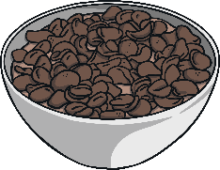
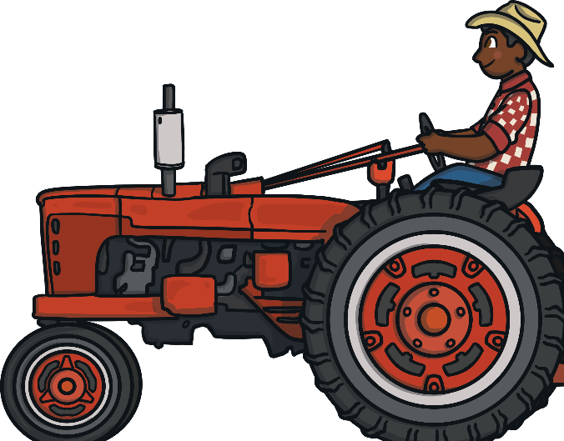
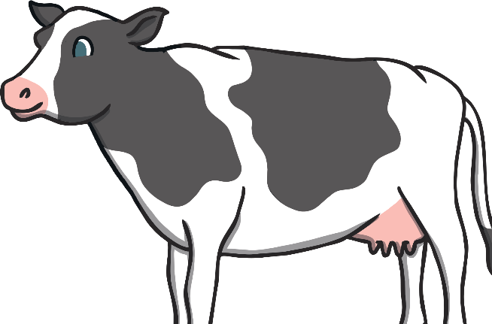
A Lot to Think About…
So next time you are tucking into a glass of milk or a bowl of cereal with milk, just think about those hard-working dairy farmers and their hard-working cows!

Slide 14
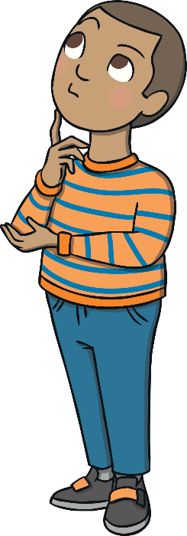
A Lot to Think About…
What do you think are the good and bad parts
of dairy farming?
environmental impacts: pollution, deforestation, manure
dairy as part of your diet: fat, calcium, intolerances
animal welfare: calves, old dairy cows, shelters
jobs and money: farmers, equipment, supermarkets

