Slide 2
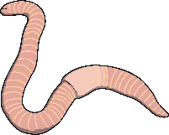
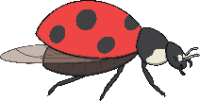
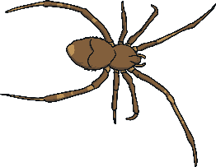
Minibeasts
Many different minibeasts live in many different micro habitats.
They are suited to live in that micro habitat because they can find the food, water and shelter they need.
Minibeasts help to keep the micro habitat healthy.

Slide 3
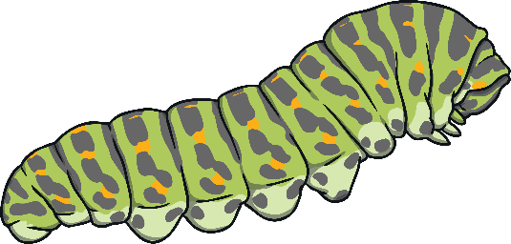
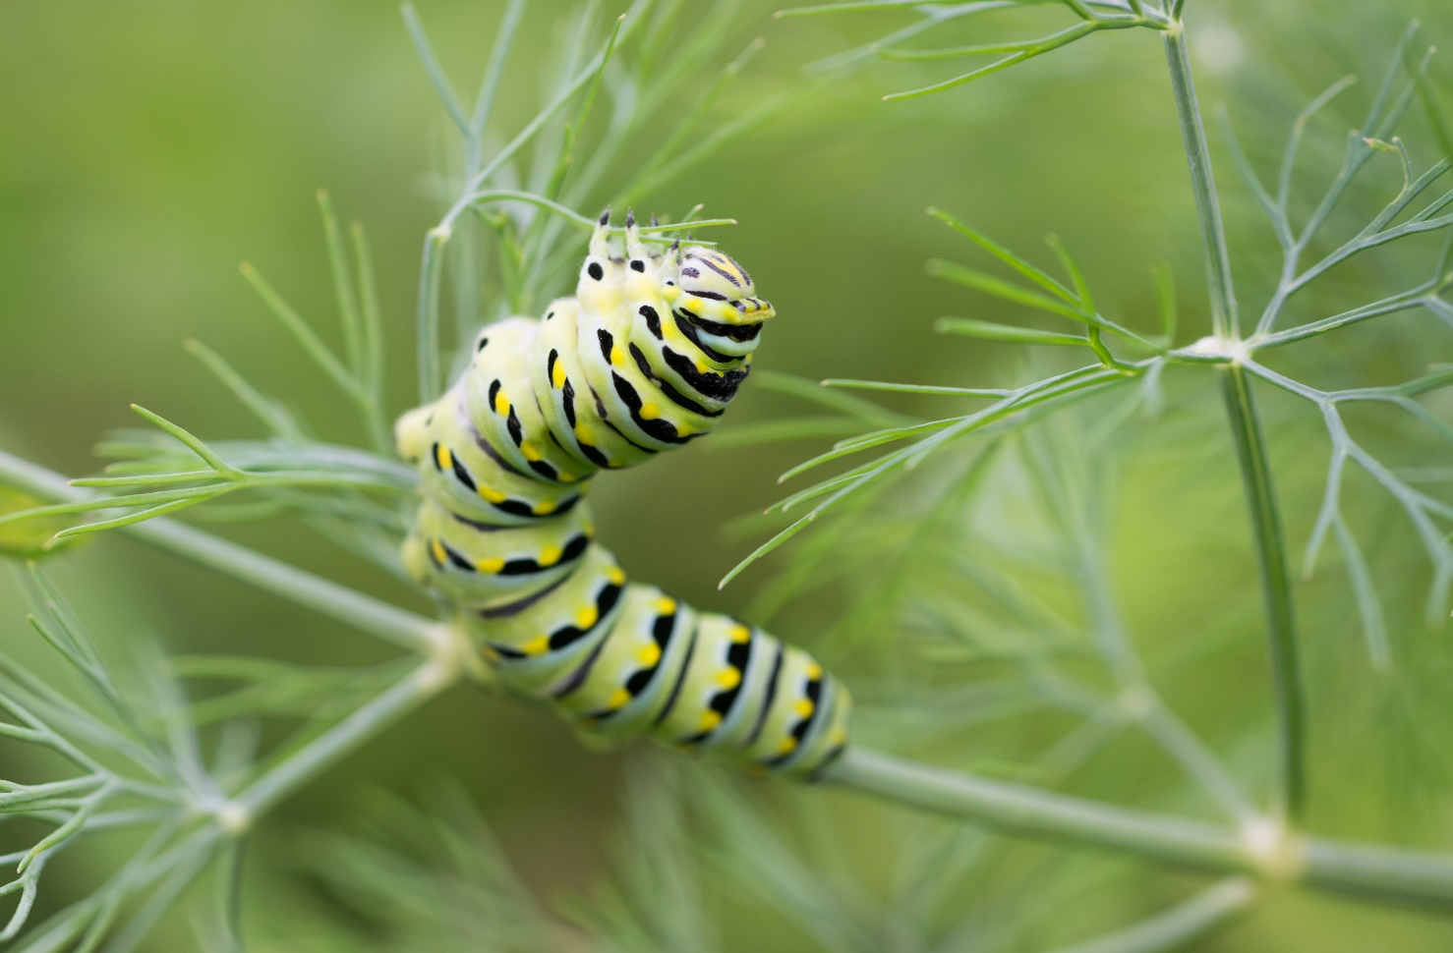
Caterpillar
Caterpillars like to live on top and underneath leaves.
This is so they can use their camouflage and blend into the leaf.
This helps protect them so they can not be seen by predators.
The caterpillars can then eat the leaves.

Slide 4
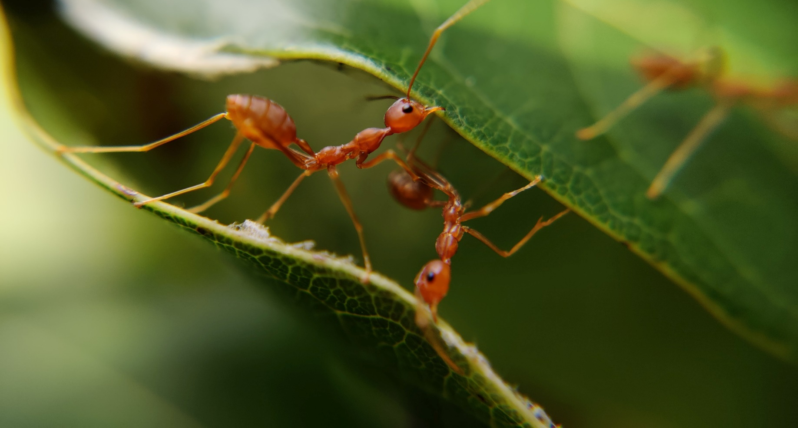
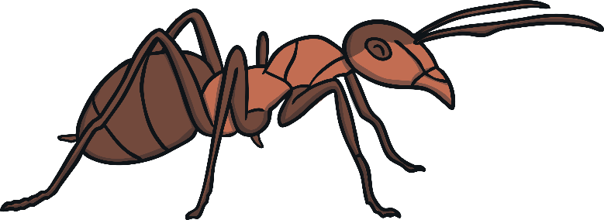
Ants
Ants mostly live underground.
They live in big families.
There are lots of insects to eat underground.
Ants don’t have ears. Ants "hear" by feeling vibrations in the ground through their feet.

Slide 5
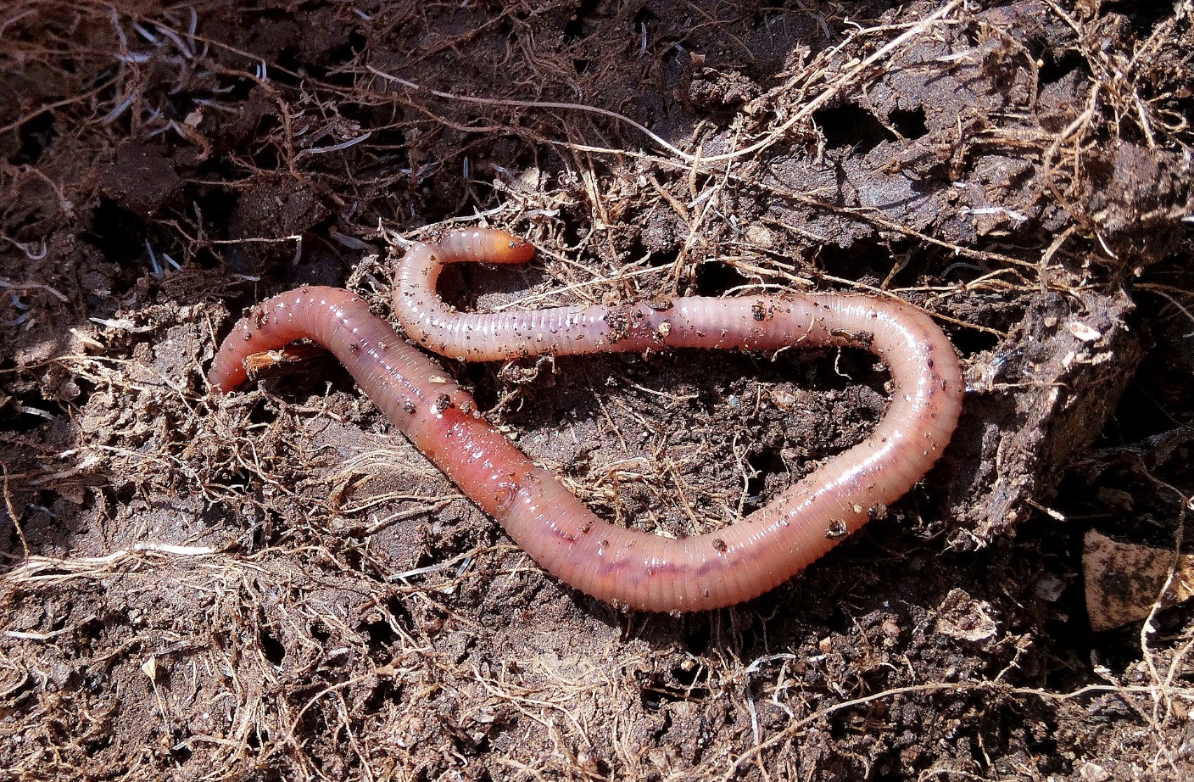
Worms
Worms like to live anywhere there is soil.
They like to eat dead leaf matter and need the soil to be moist.
Worms help keep soil healthy as they dig tunnels that let air and water into soil to the roots of plants.

Slide 6
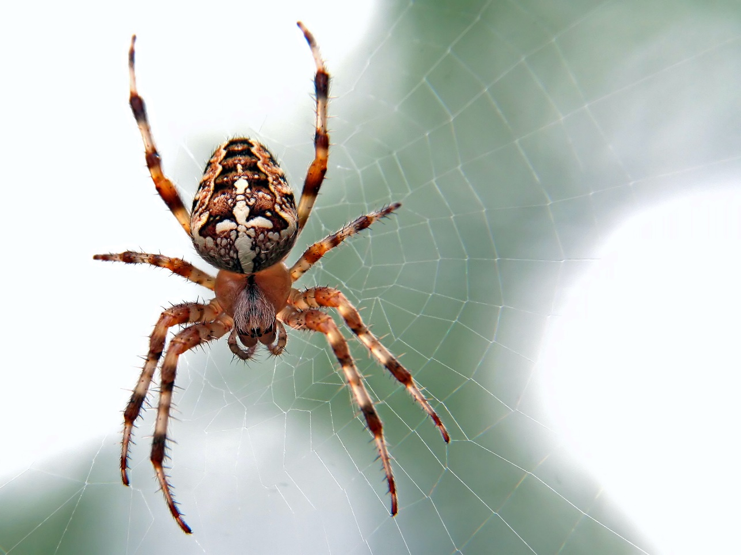
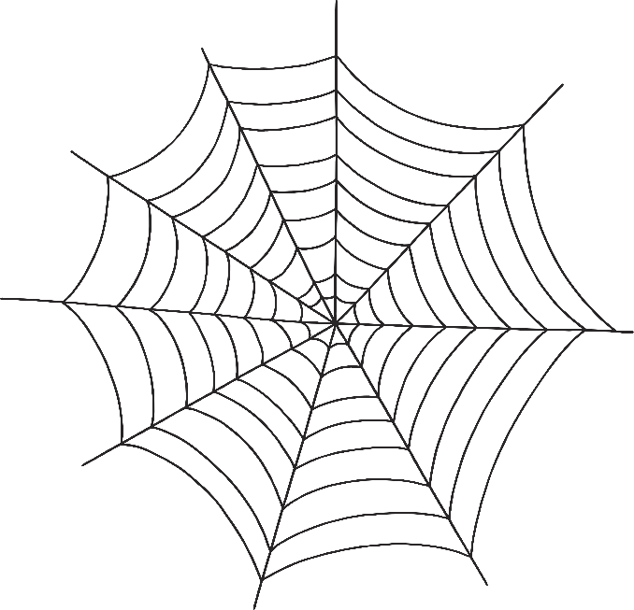
Spider
Spiders are able to live just about anywhere.
They do well in all types of habitats but they do have to find shelter when the weather gets colder.
Their body colours help them blend in well to their surroundings.
Spiders build webs to catch small insects to eat.

Slide 7
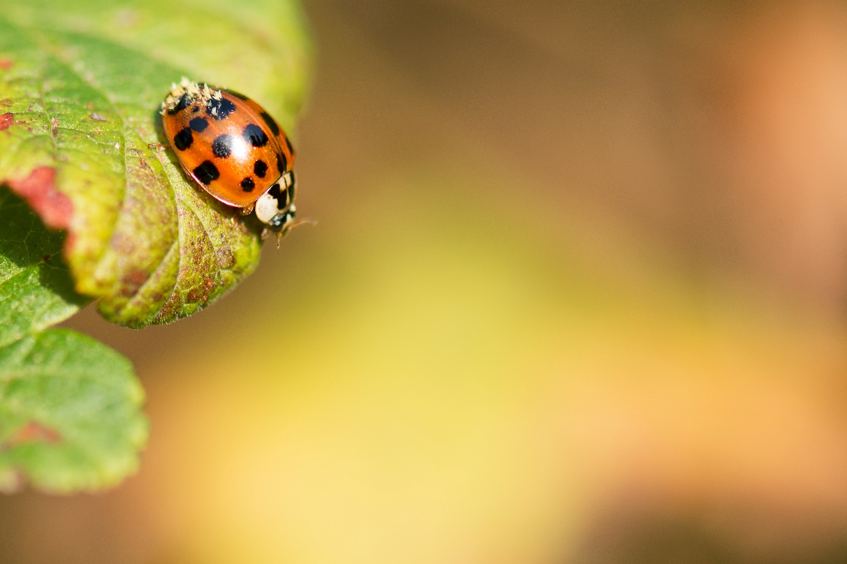
Ladybird
During the summer, ladybirds live in shrubs, branches, and flowers.
When the weather gets colder they find protective hiding places, such as tree stumps or cracks in wood. This then becomes a place to hibernate–at the base of a tree, under a fallen tree, or even under a rock. They crawl under leaves to protect themselves from the winter cold.
When hibernating ladybirds huddle together in order to keep warm.

