Slide 2
China

Slide 3
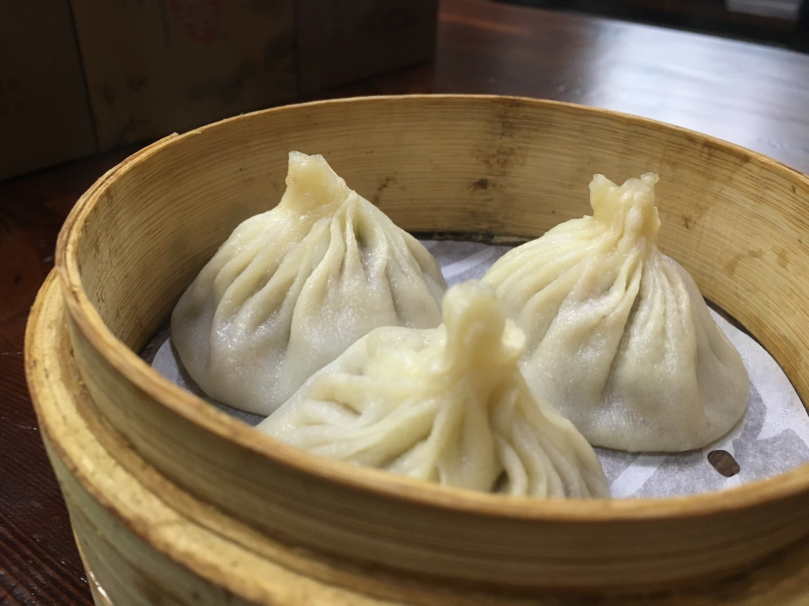
Dumplings

Slide 4
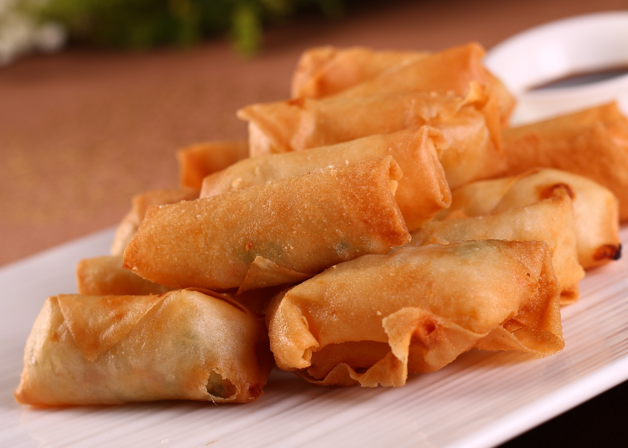
Spring Rolls

Slide 5
Wontons

Slide 6
Ethiopia

Slide 7
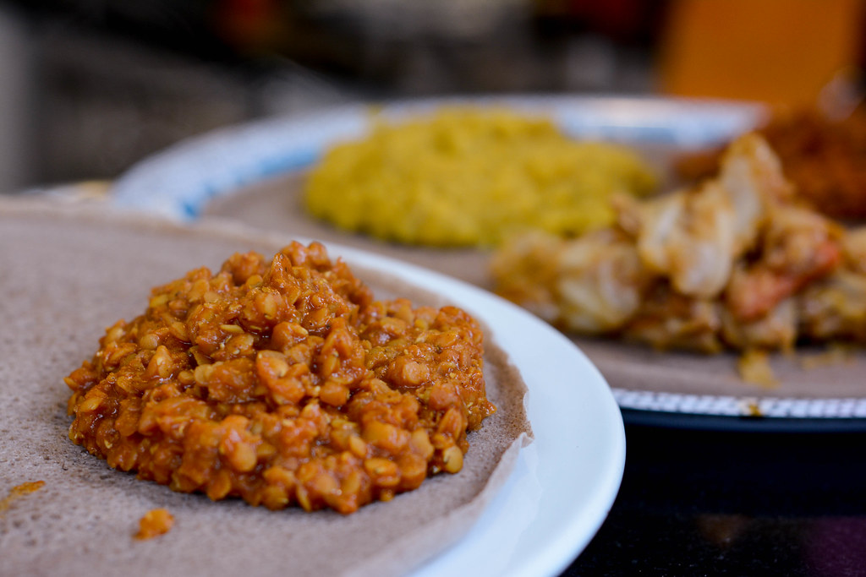
Wat
“Mesir Wat” by [Lauren PM] is licensed under CC BY 2.0

Slide 8
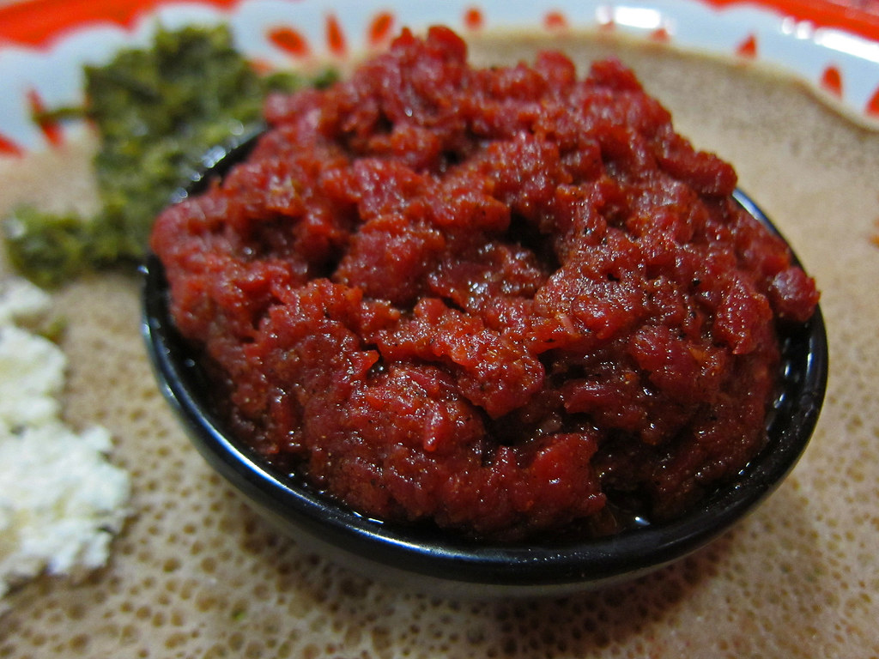
Kitfo
“Kitfo - Awash” by [mmmyoso] is licensed under CC BY 2.0

Slide 9
France

Slide 10
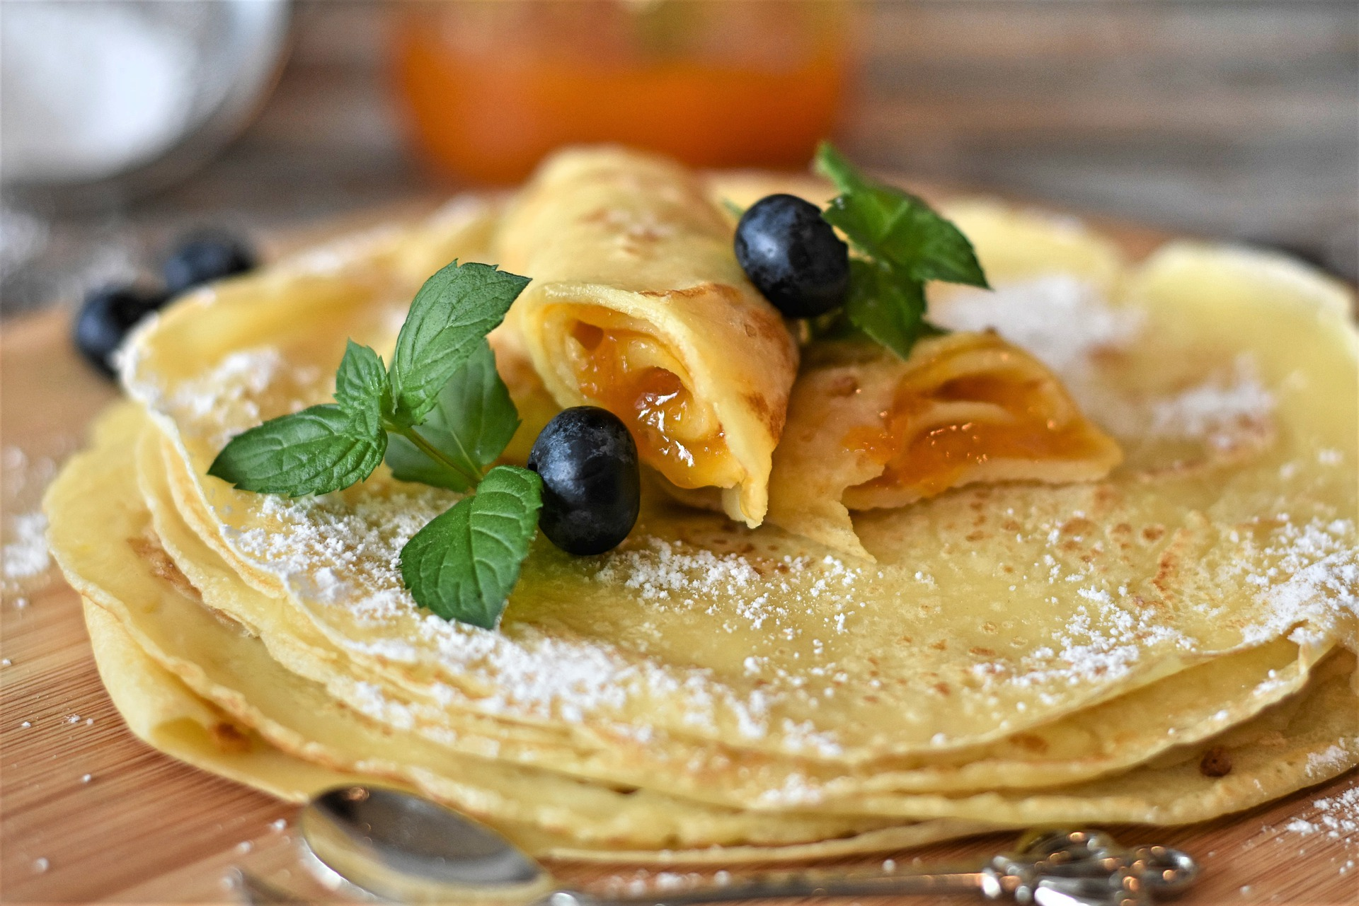
Crepes

Slide 11
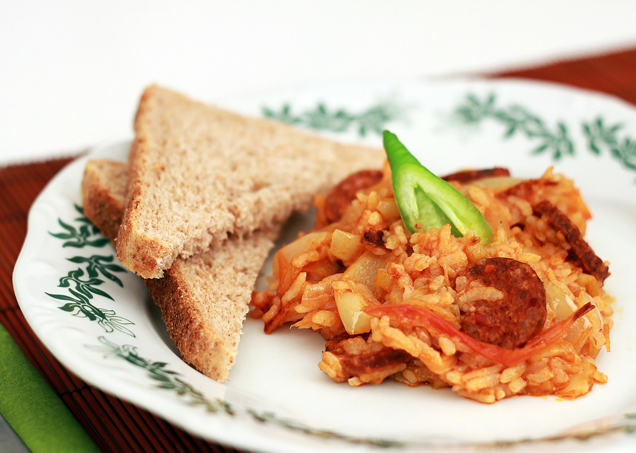
Ratatouille

Slide 12
Germany

Slide 13
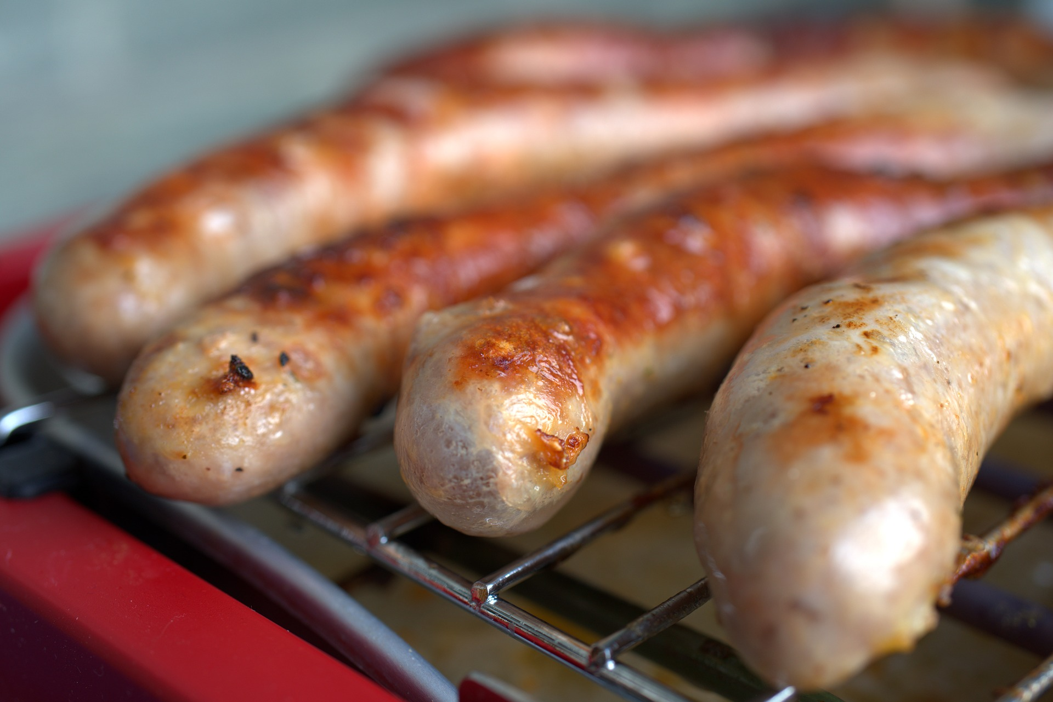
Bratwurst

Slide 14
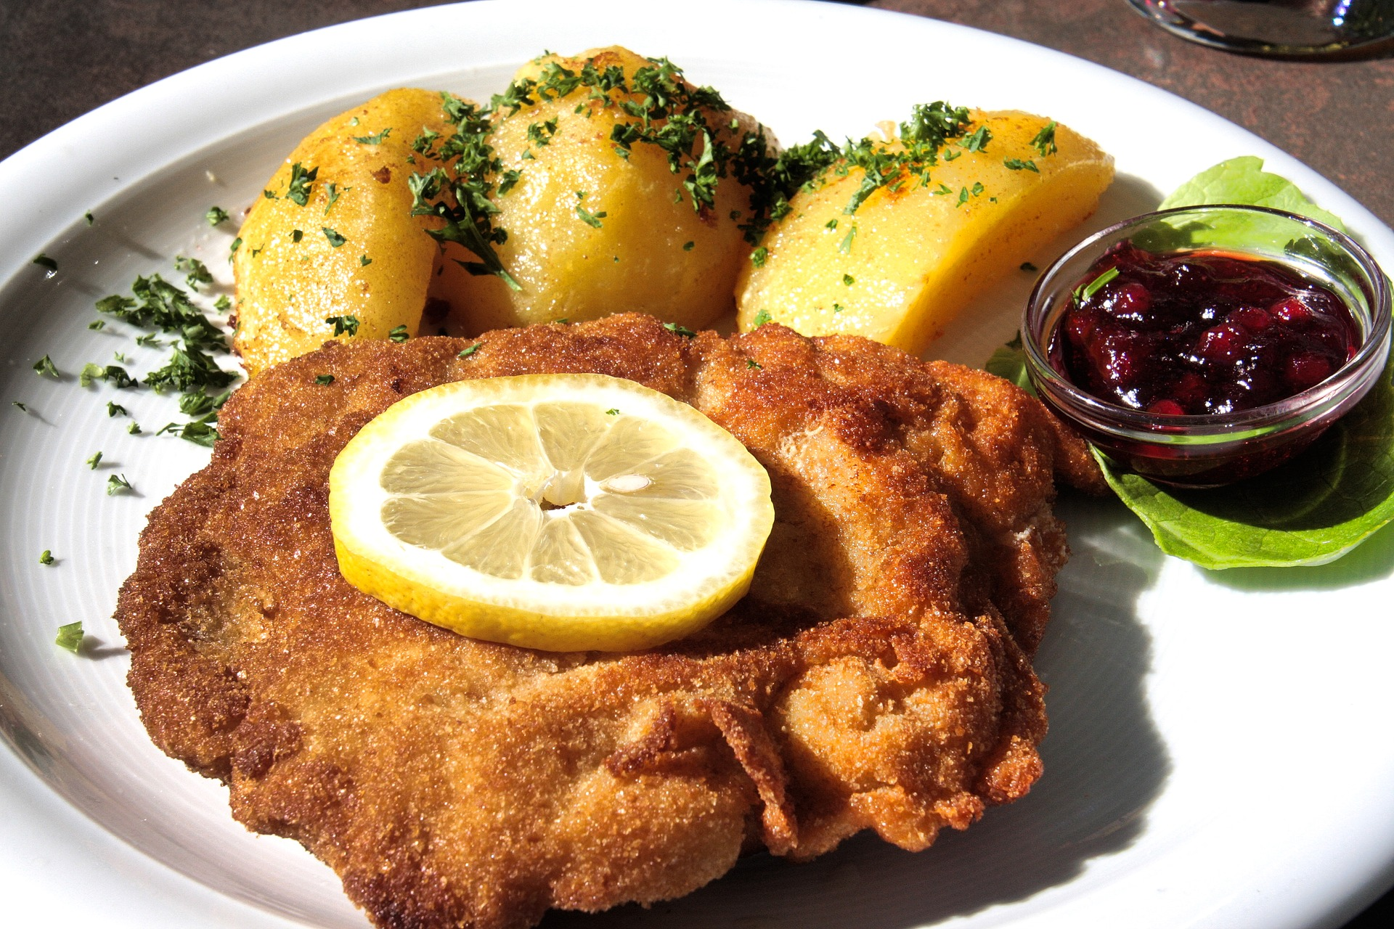
Schnitzel

Slide 15
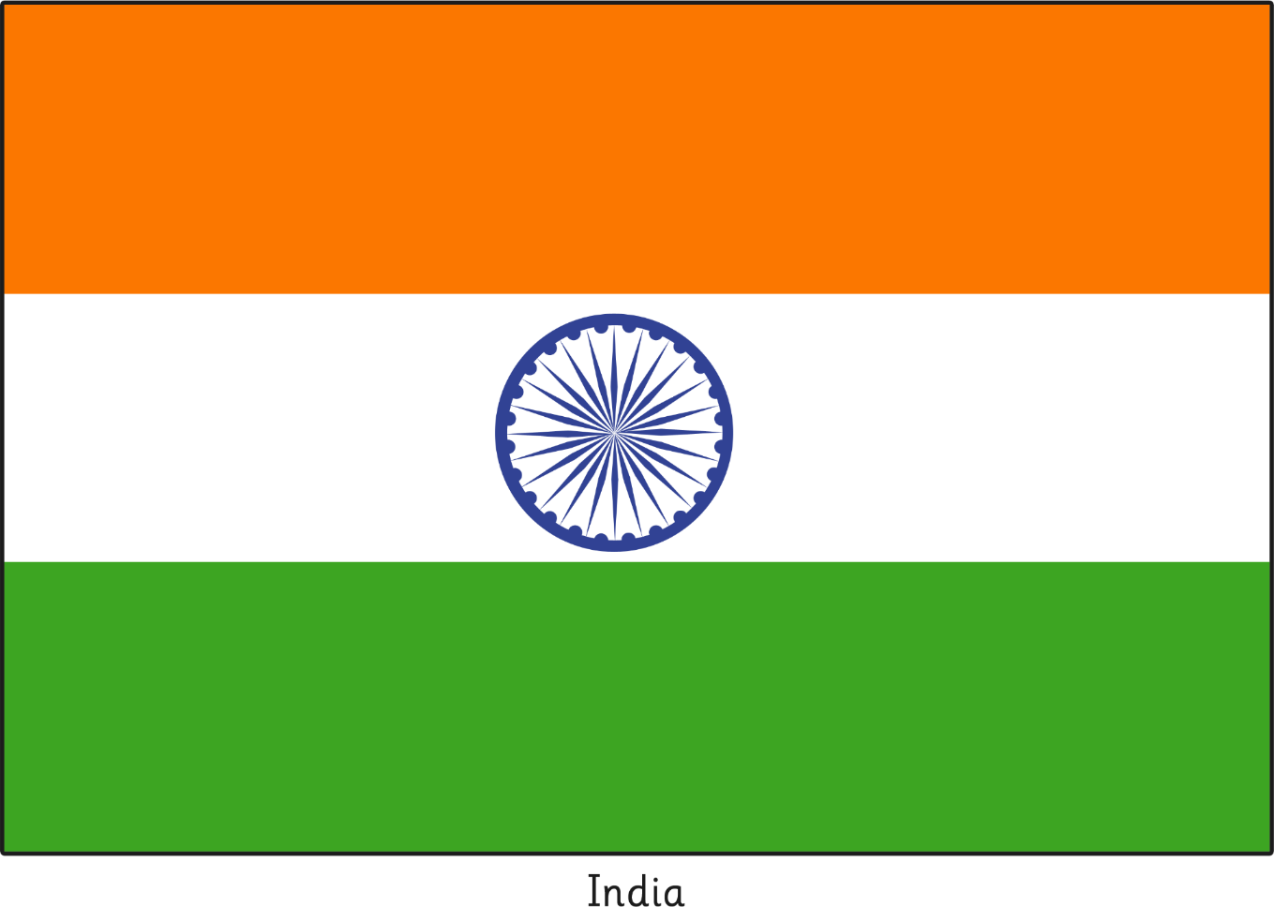
India

Slide 16
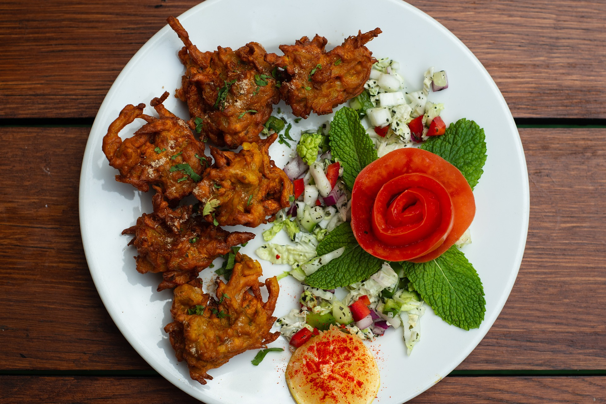
Pakora

Slide 17
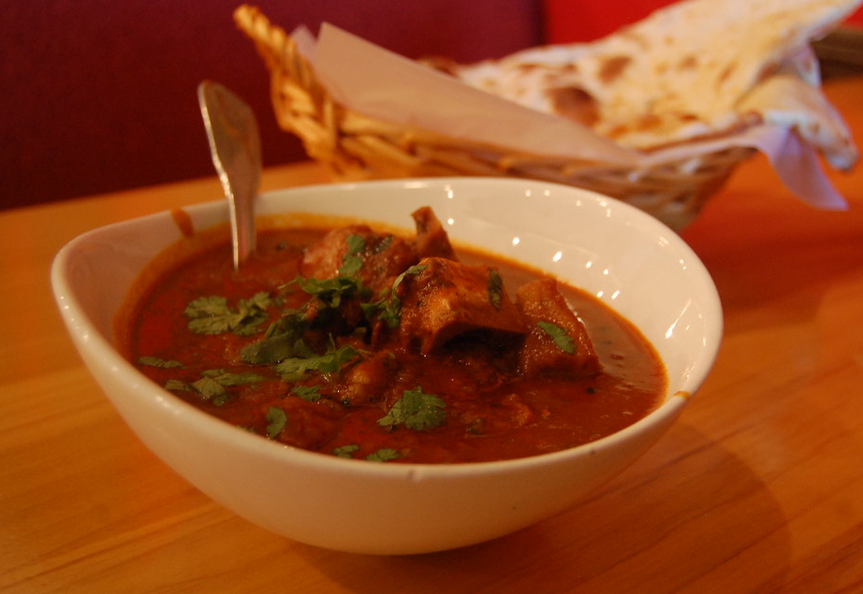
Rogan Josh
“rogan josh” by [stu_spivack] is licensed under CC BY 2.0

Slide 18
Iran

Slide 19
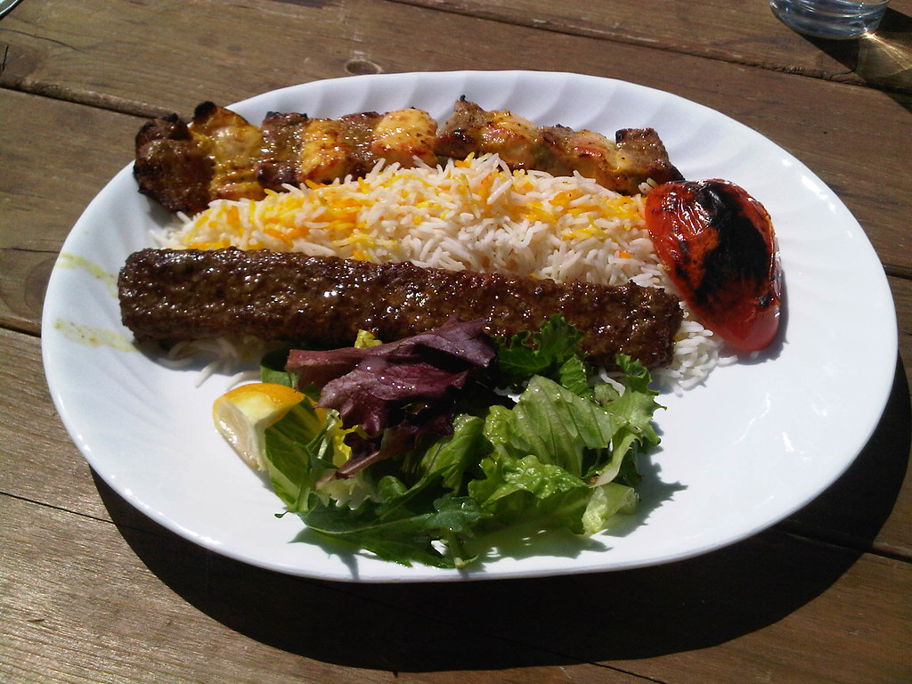
Chelow Kabab
“Kabab Bakhtiari” by [Taylor and Kevin] is licensed under CC BY 2.0

Slide 20
Iraq

Slide 21
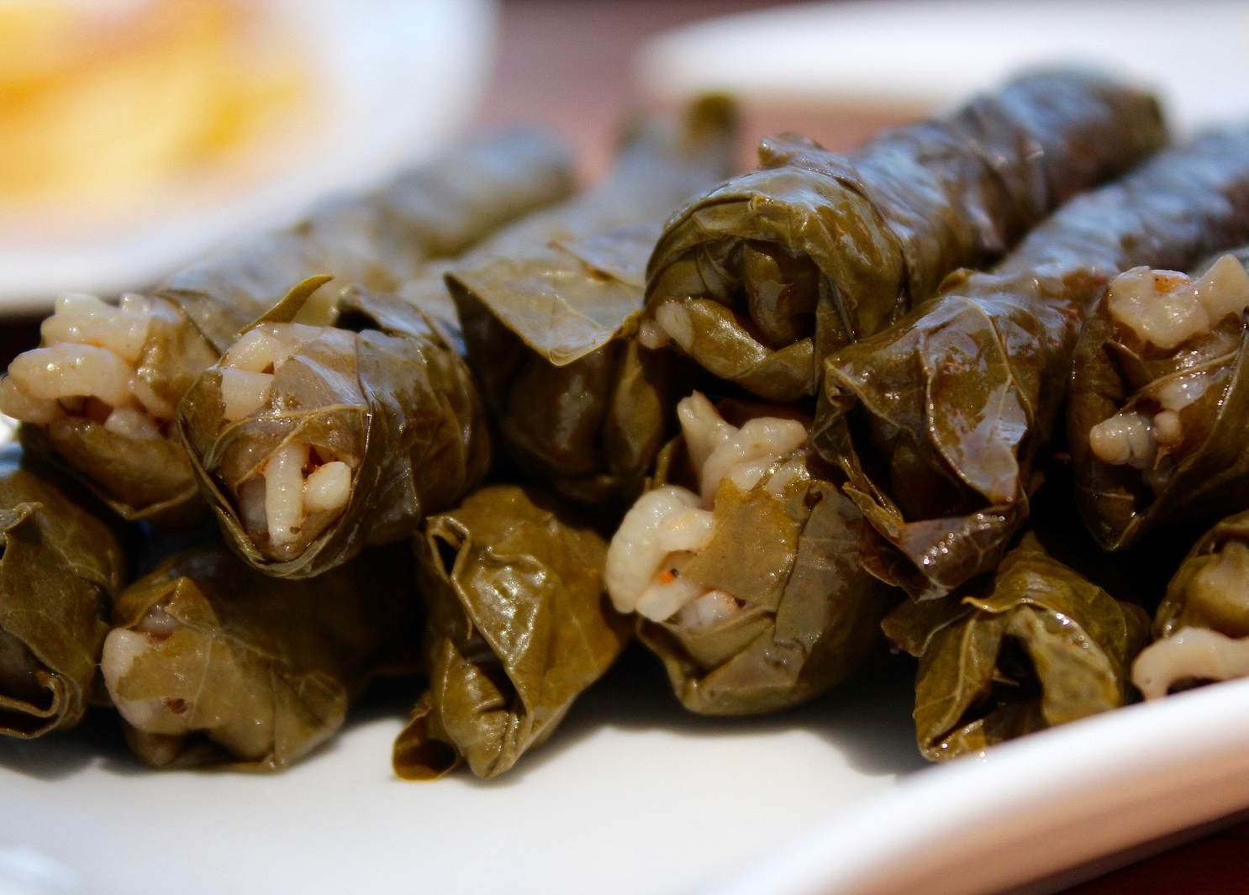
Dolma

Slide 22
Italy

Slide 23
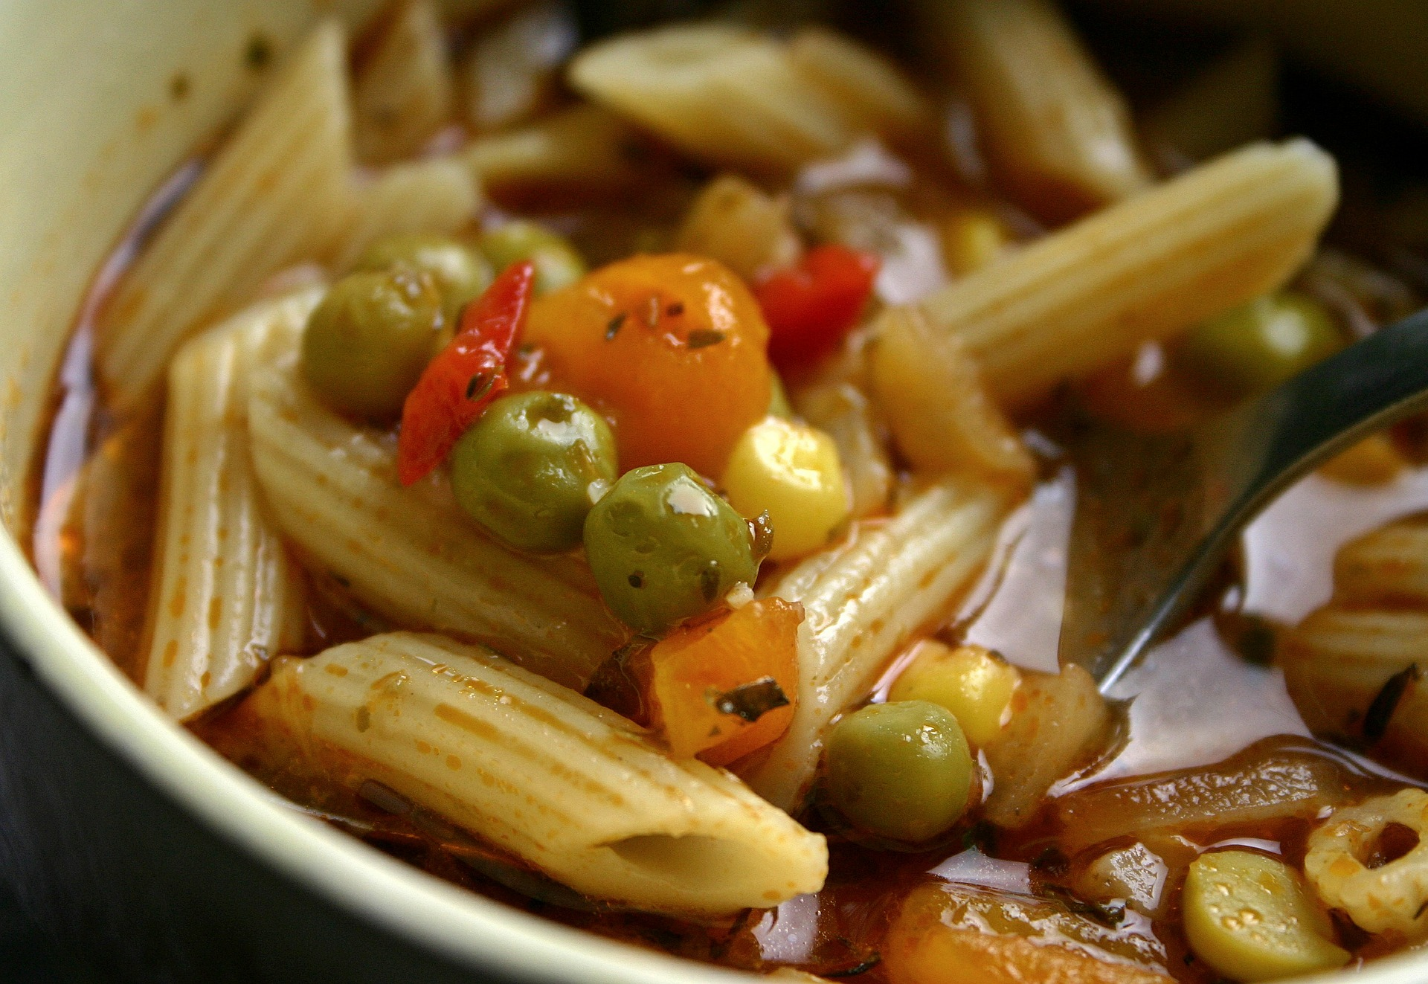
Minestrone

Slide 24
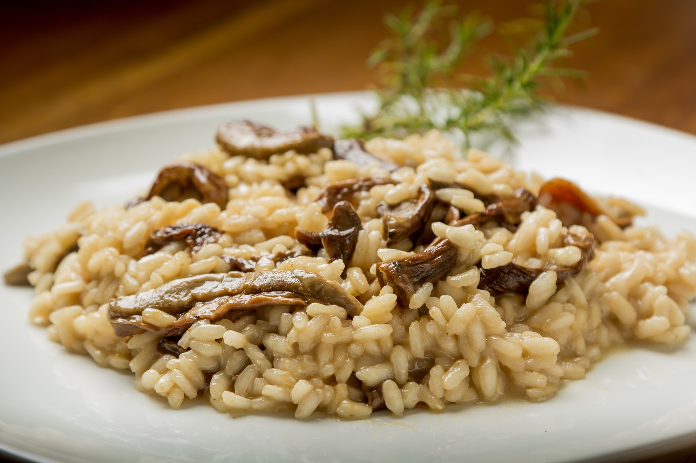
Risotto

Slide 25
Japan

Slide 26
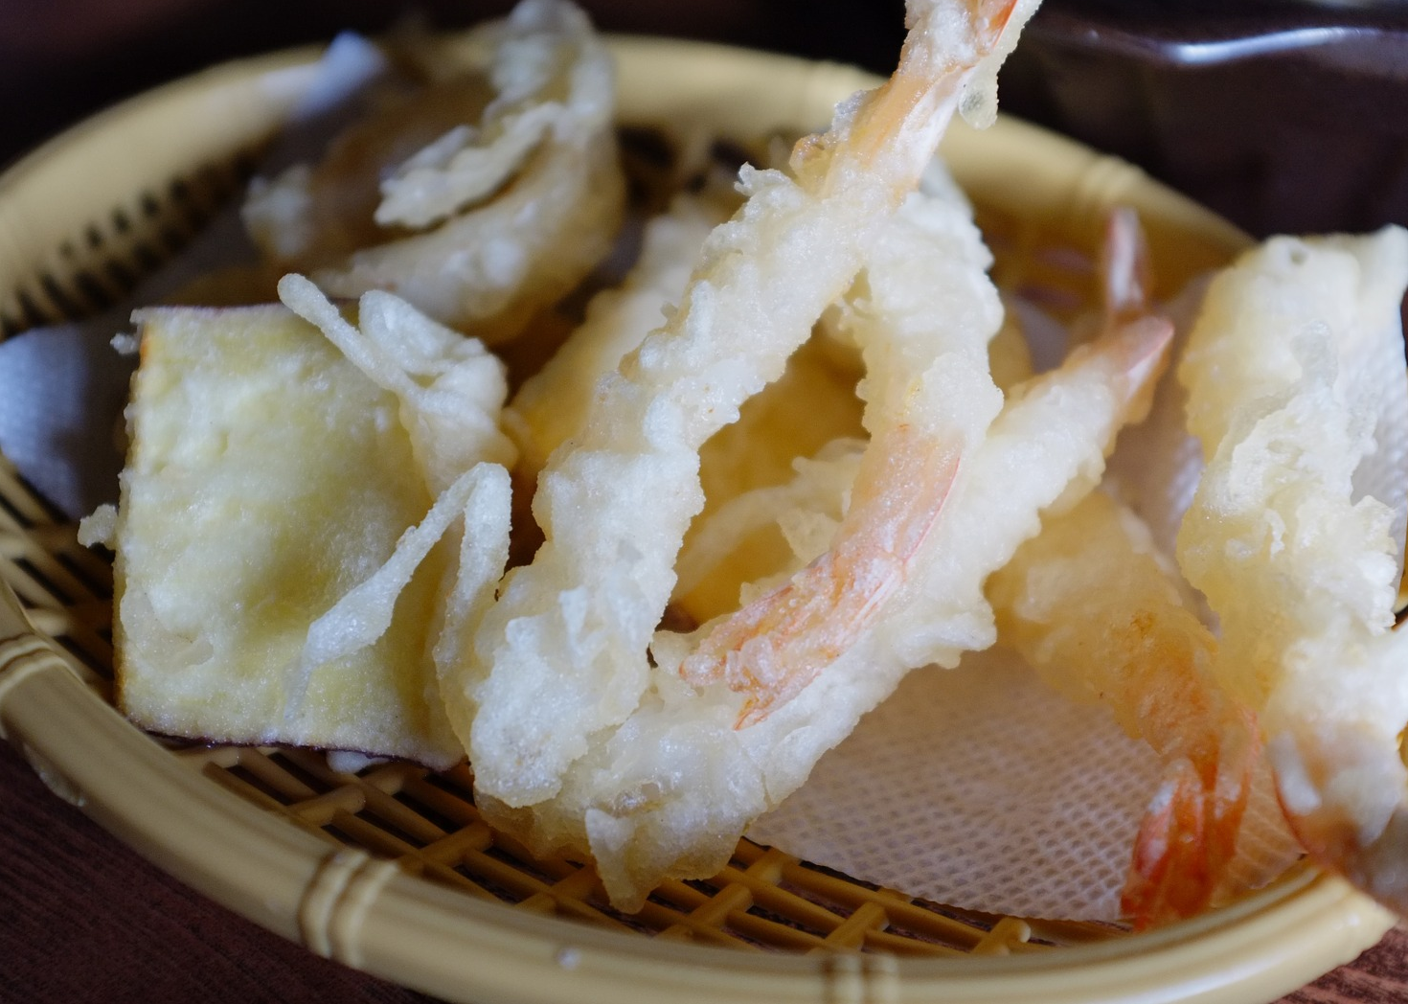
Tempura

Slide 27
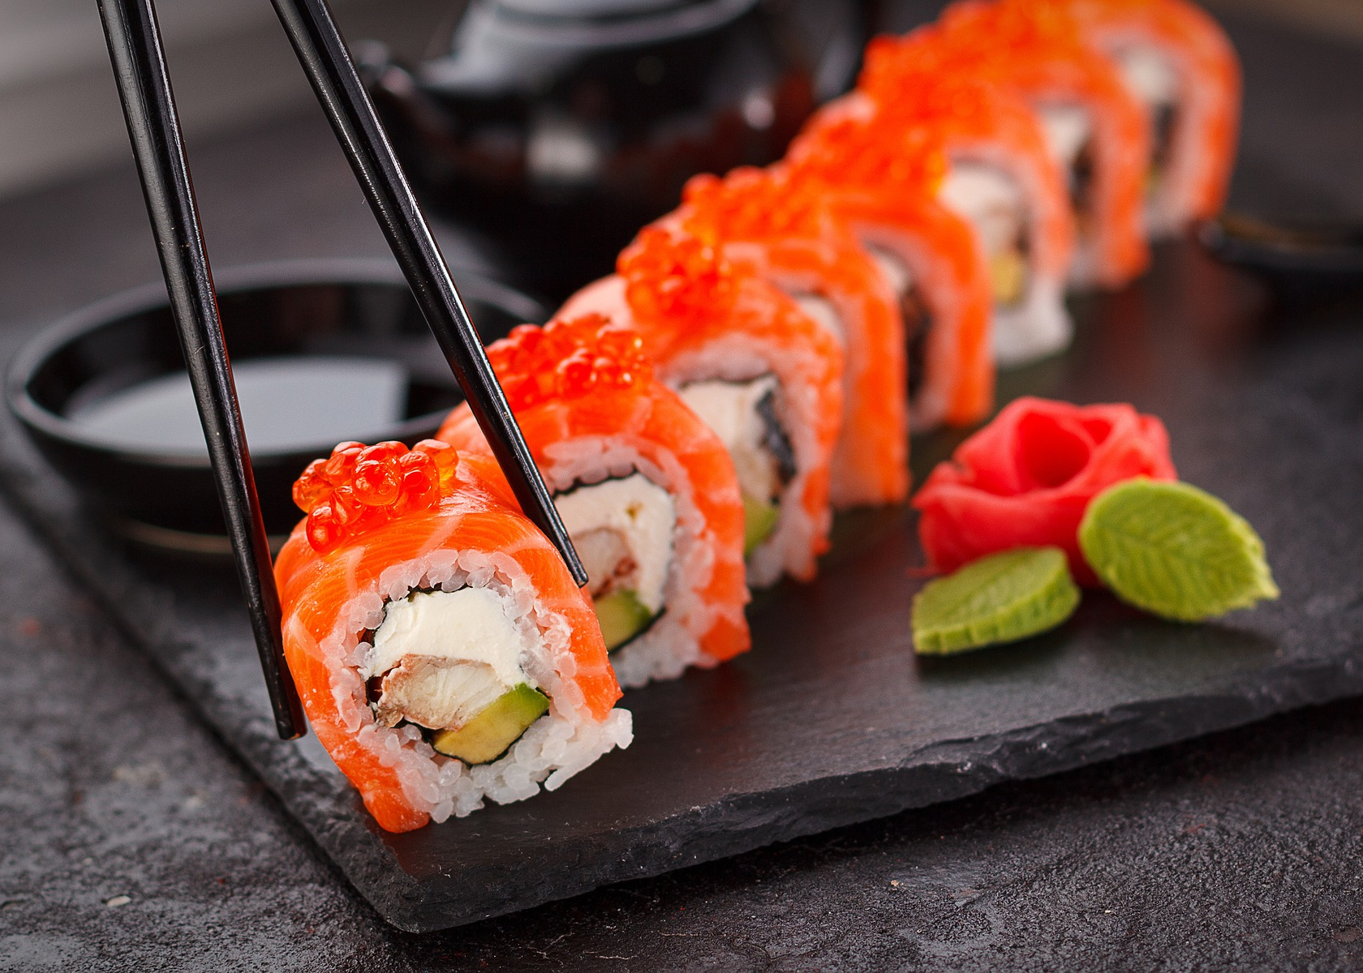
Sushi

Slide 28
Mexico

Slide 29
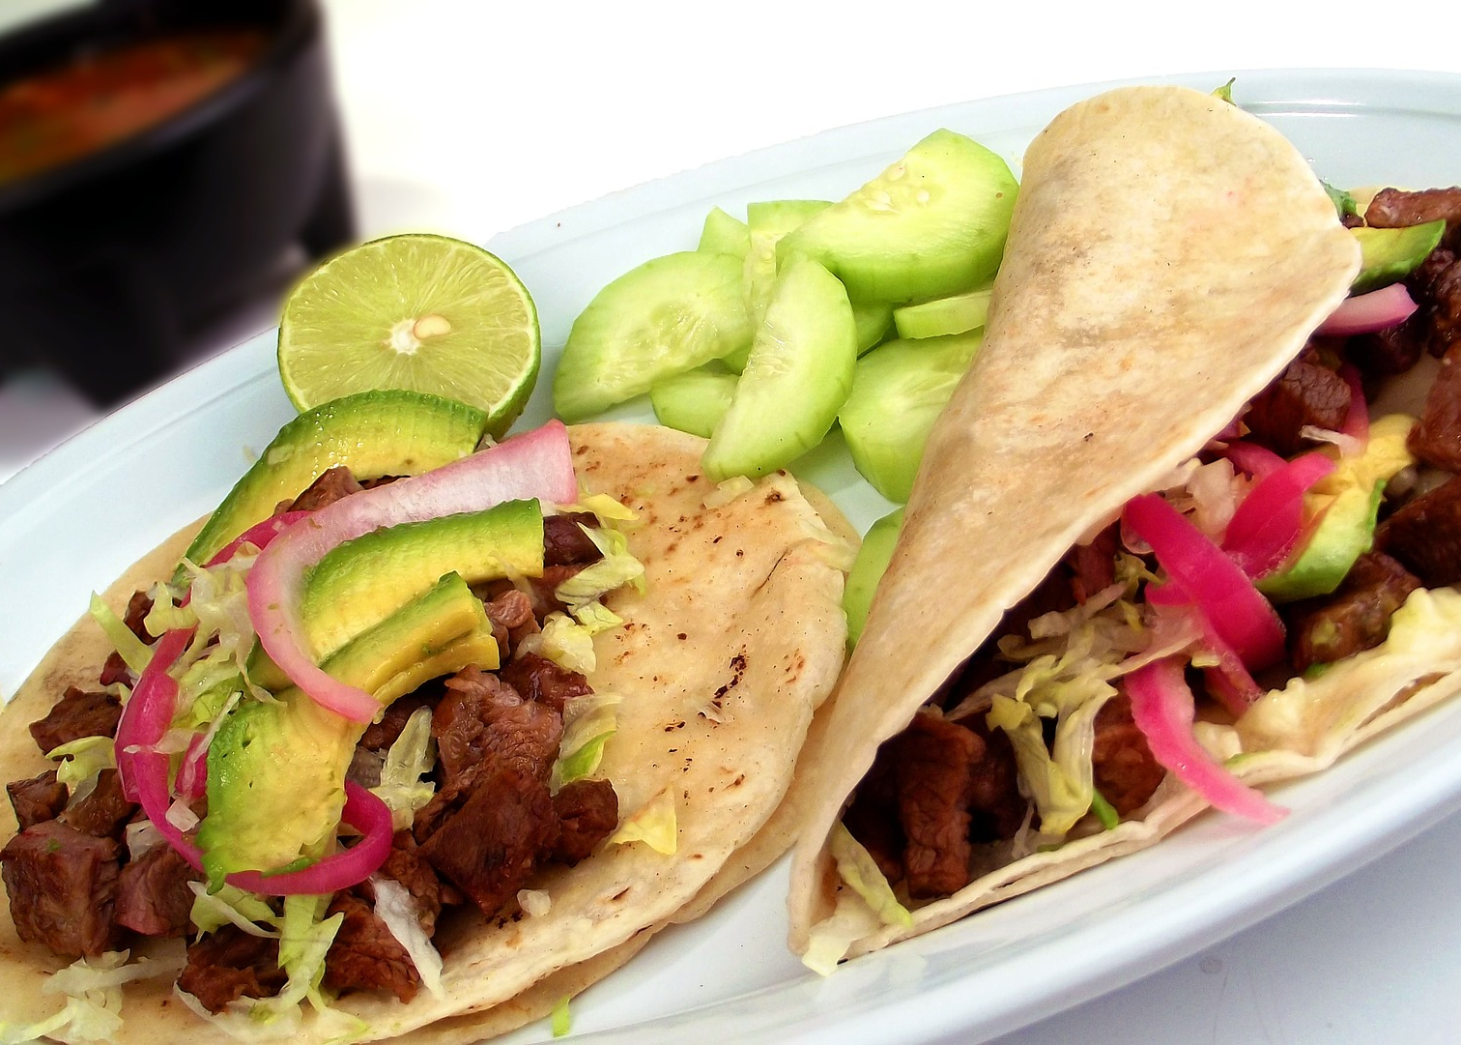
Taco

Slide 30
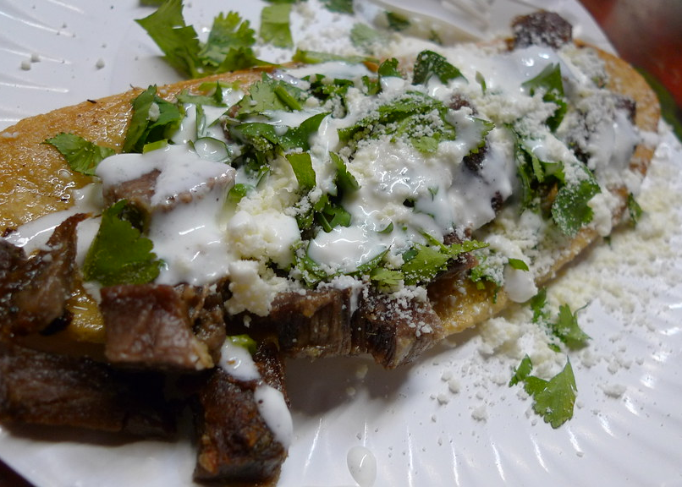
Huarache
“Huarache de Suadero” by [Ron Dollete] is licensed under CC BY 2.0

Slide 31
Morocco

Slide 32
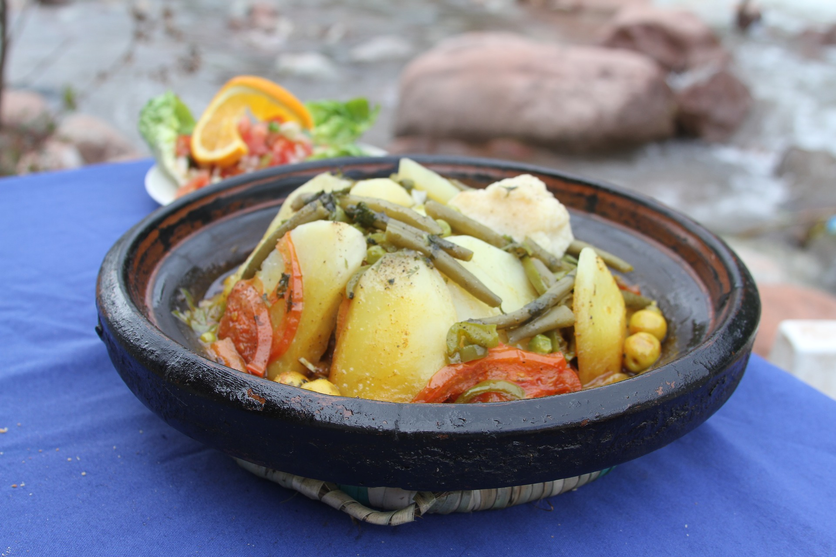
Tagine

Slide 33
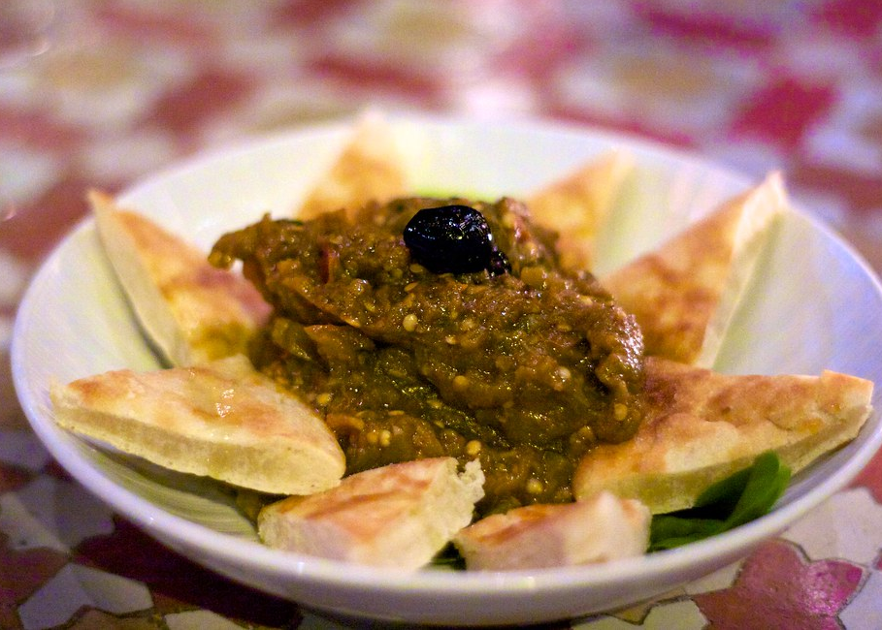
Zaalouk
“Nomad” by [missmeng] is licensed under CC BY 2.0

Slide 34
Norway

Slide 35
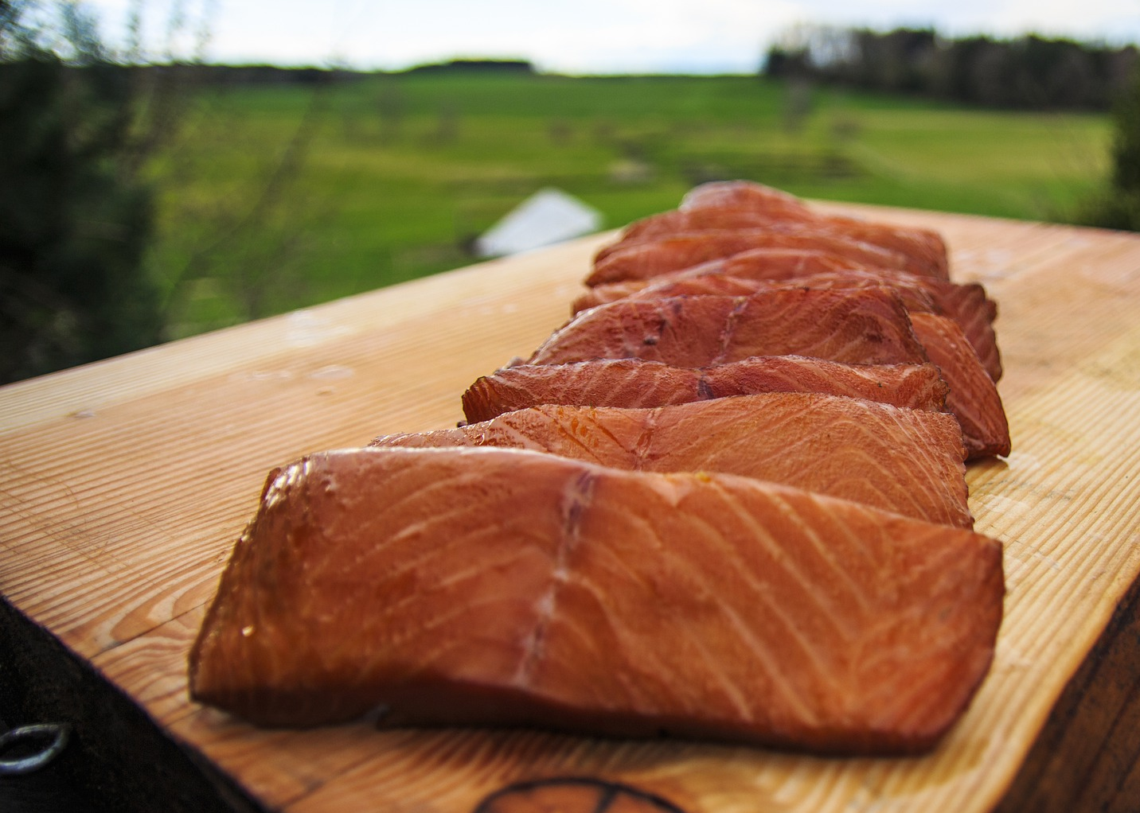
Smoked Salmon

Slide 36
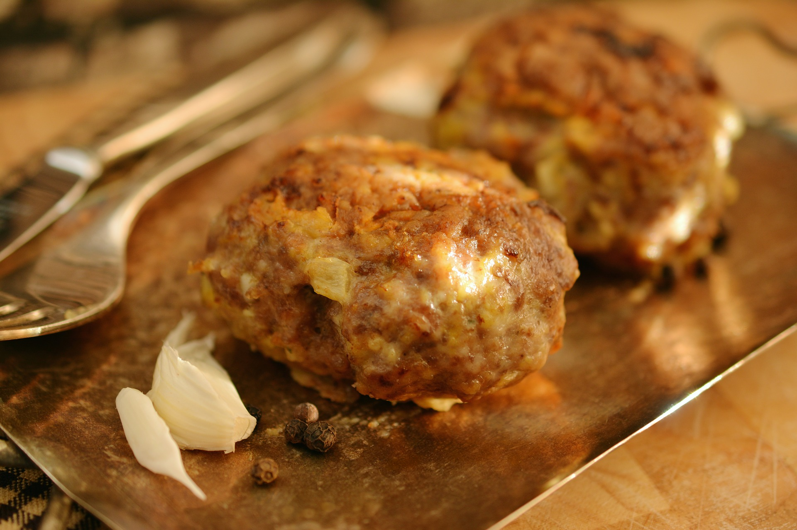
Meatballs

Slide 37
Poland

Slide 38
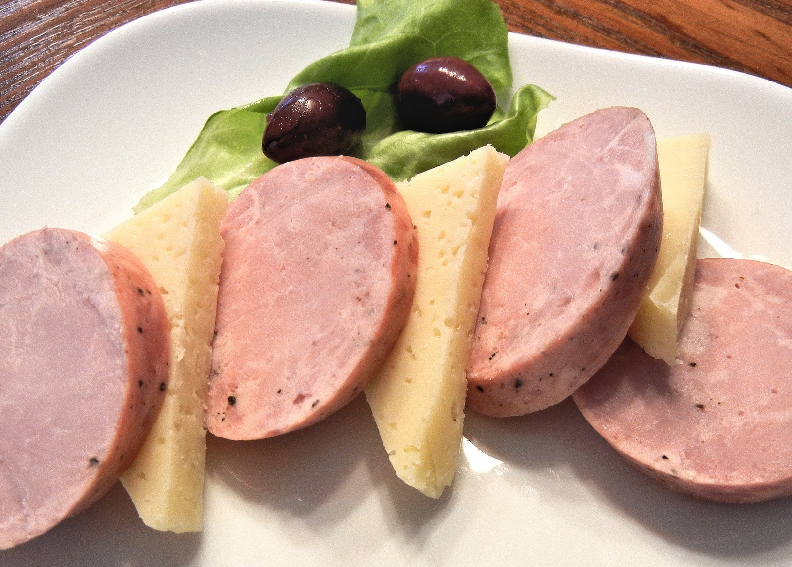
Kielbasa

Slide 39
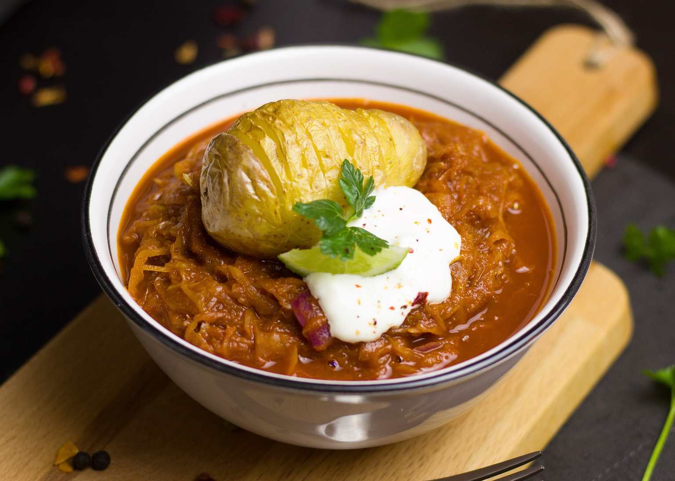
Sauerkraut

Slide 40
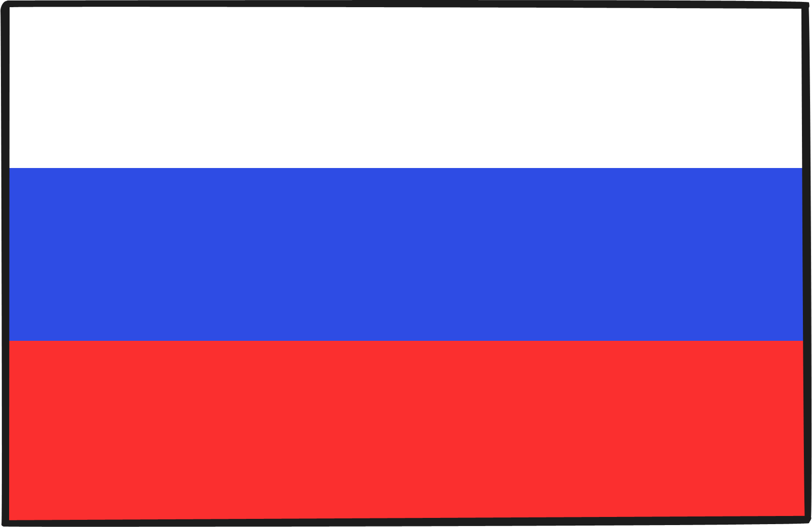
Russia

Slide 41
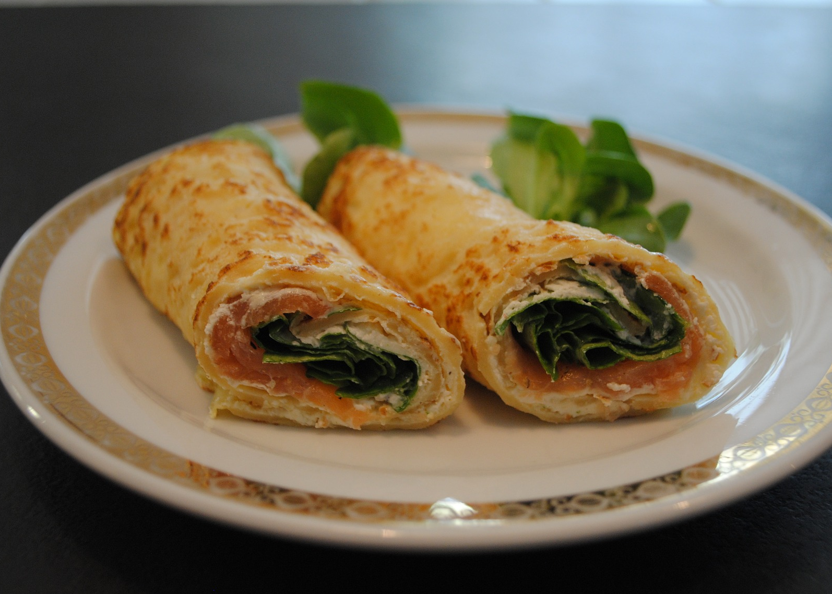
Blini

Slide 42
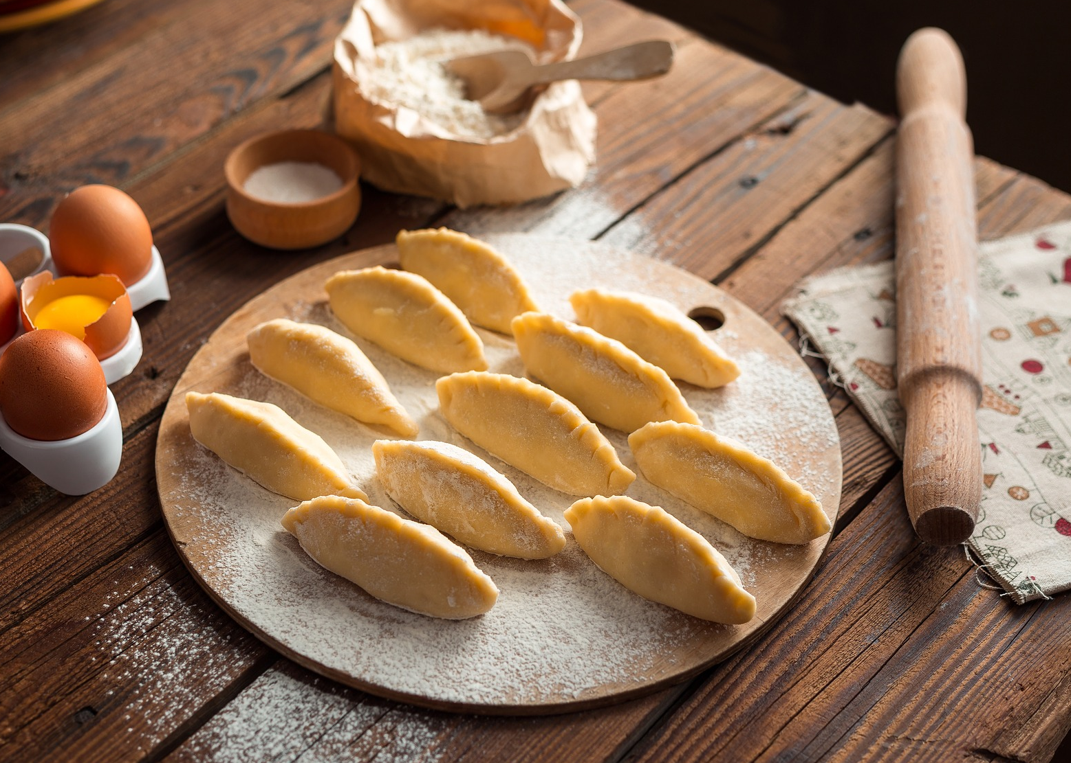
Pelmeni

Slide 43
Thailand

Slide 44
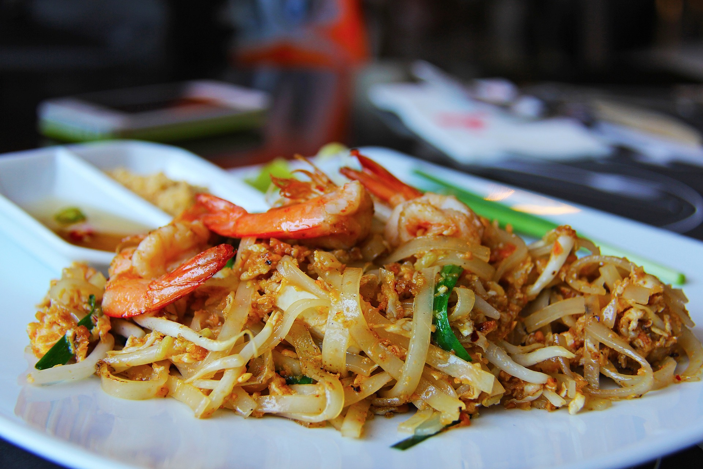
Pad Thai

Slide 45
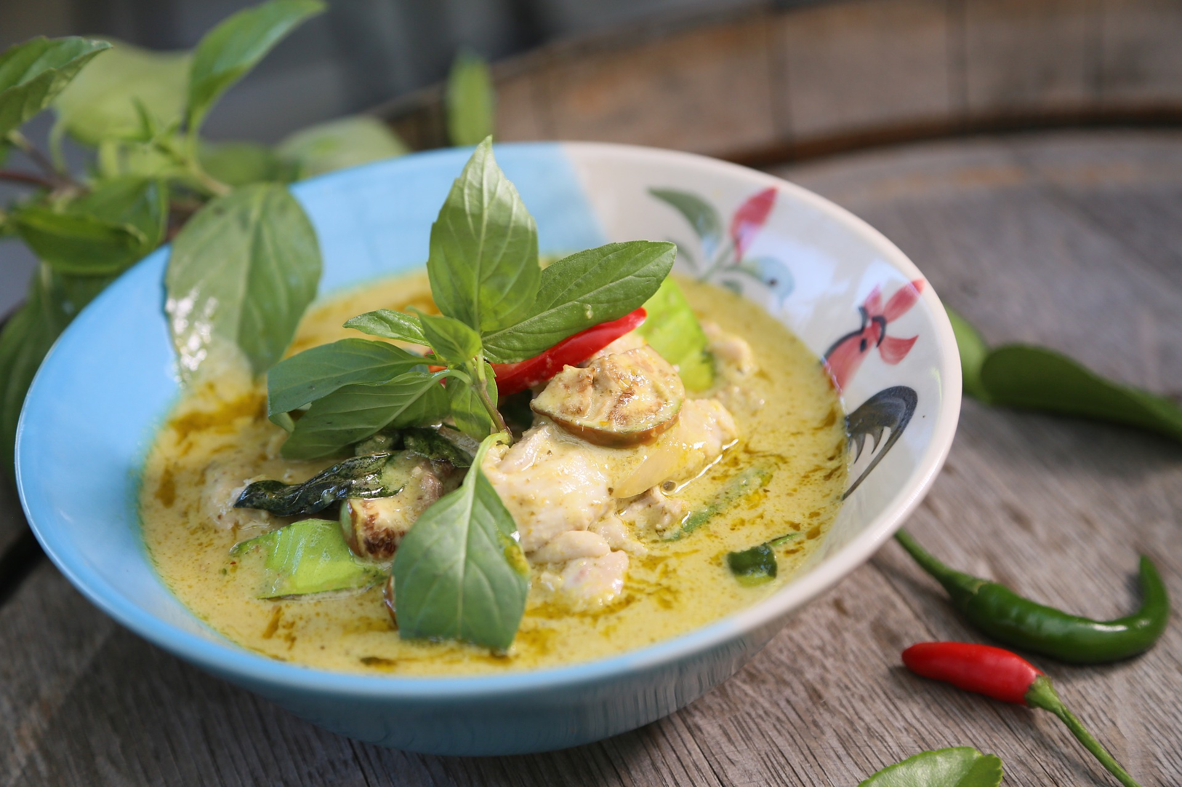
Thai Green Curry

Slide 46
Trinidad

Slide 47
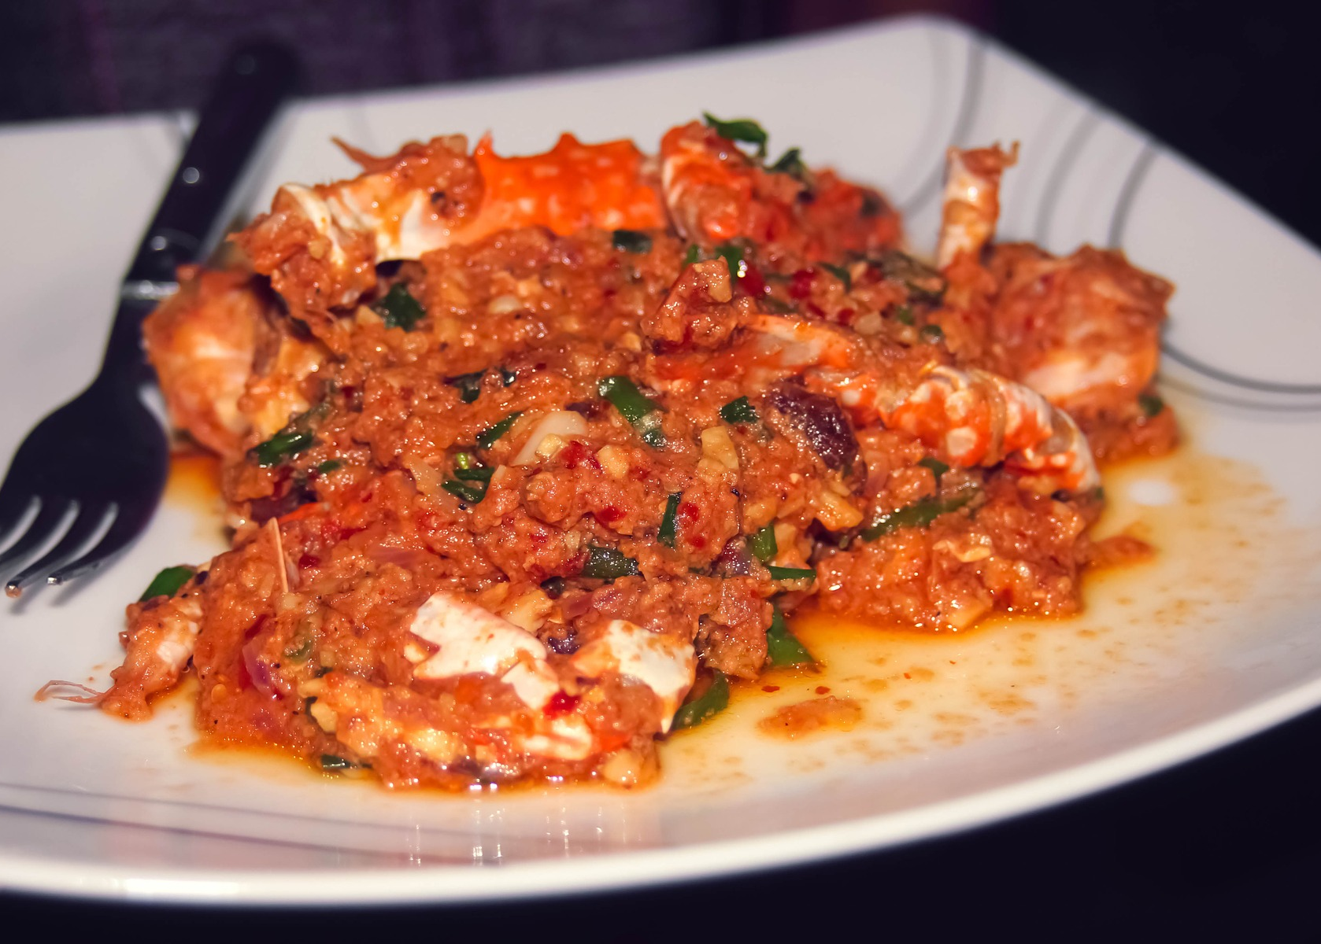
Curried Crab

Slide 48
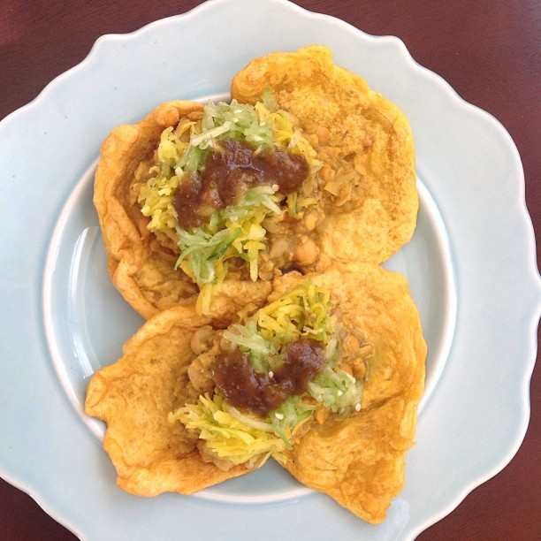
Doubles
“Doubles” by [steve loya] is licensed under CC BY 2.0

Slide 49
United Kingdom

Slide 50
Victoria Sponge Cake

Slide 51
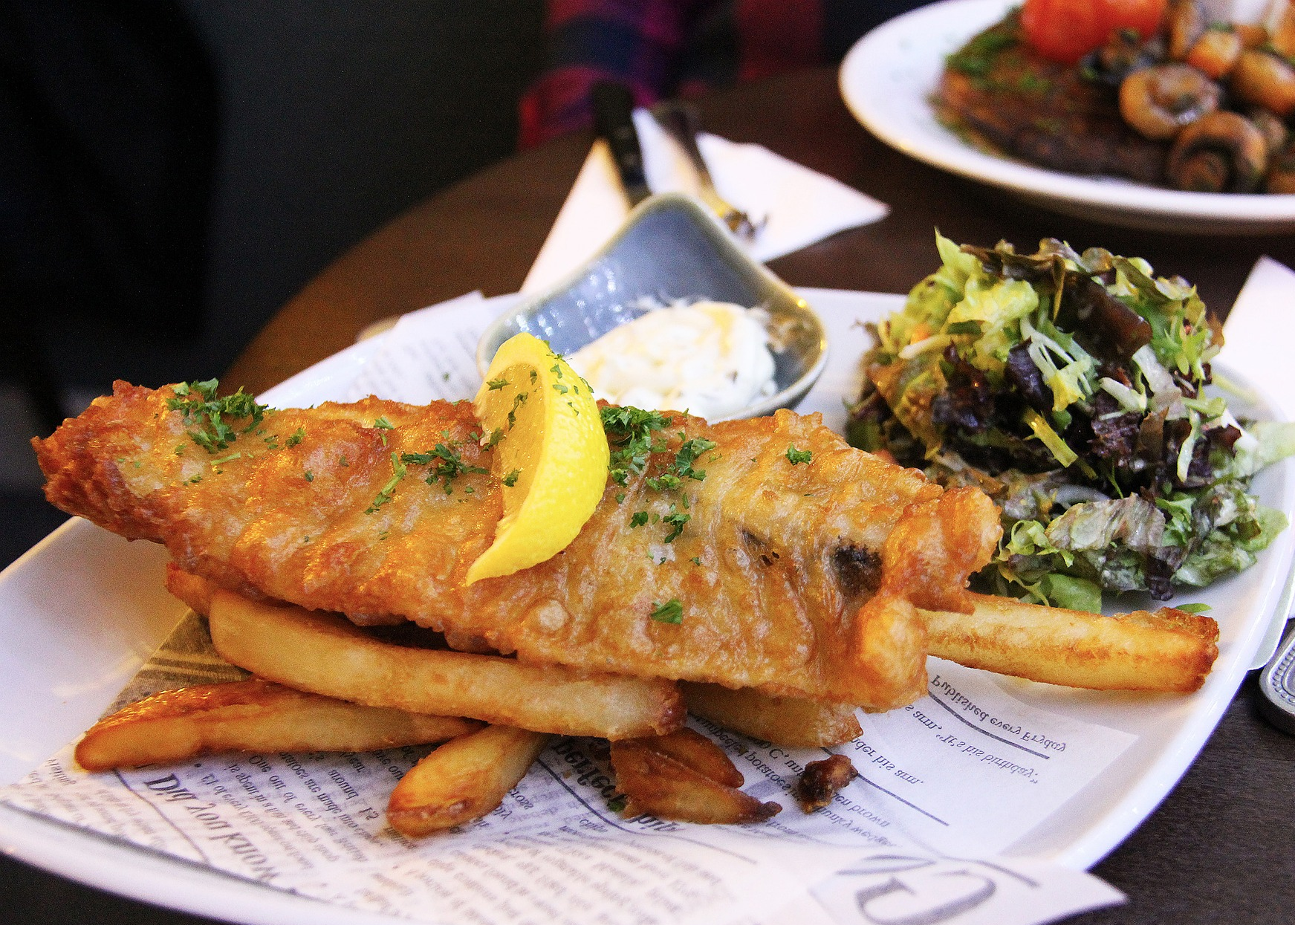
Fish and Chips

Slide 52
United States

Slide 53
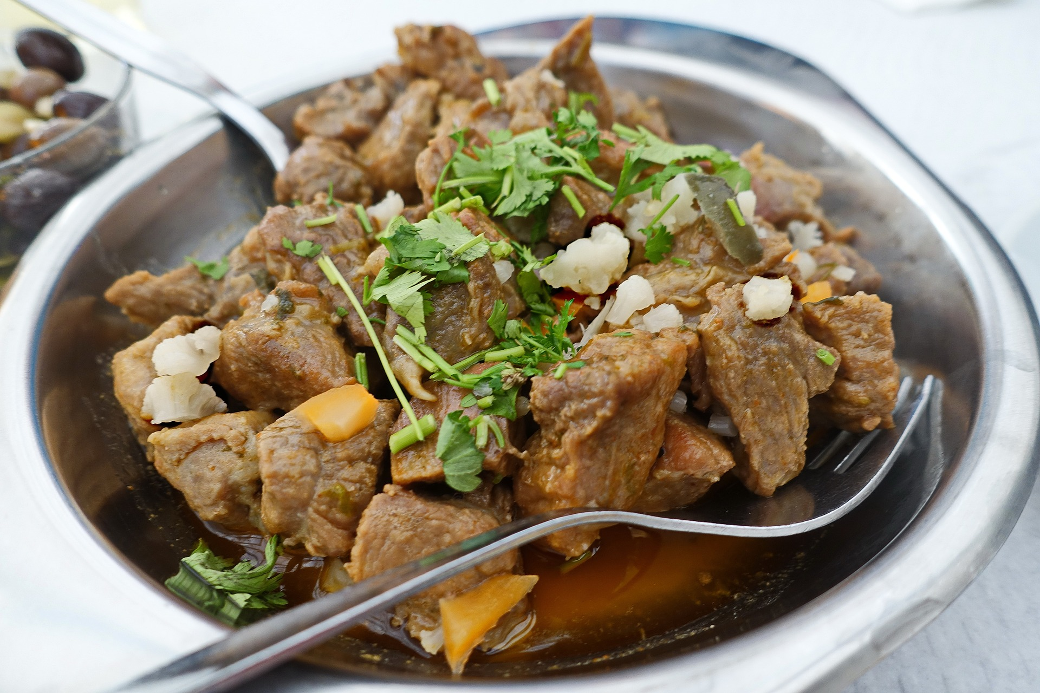
Pot Roast

Slide 54
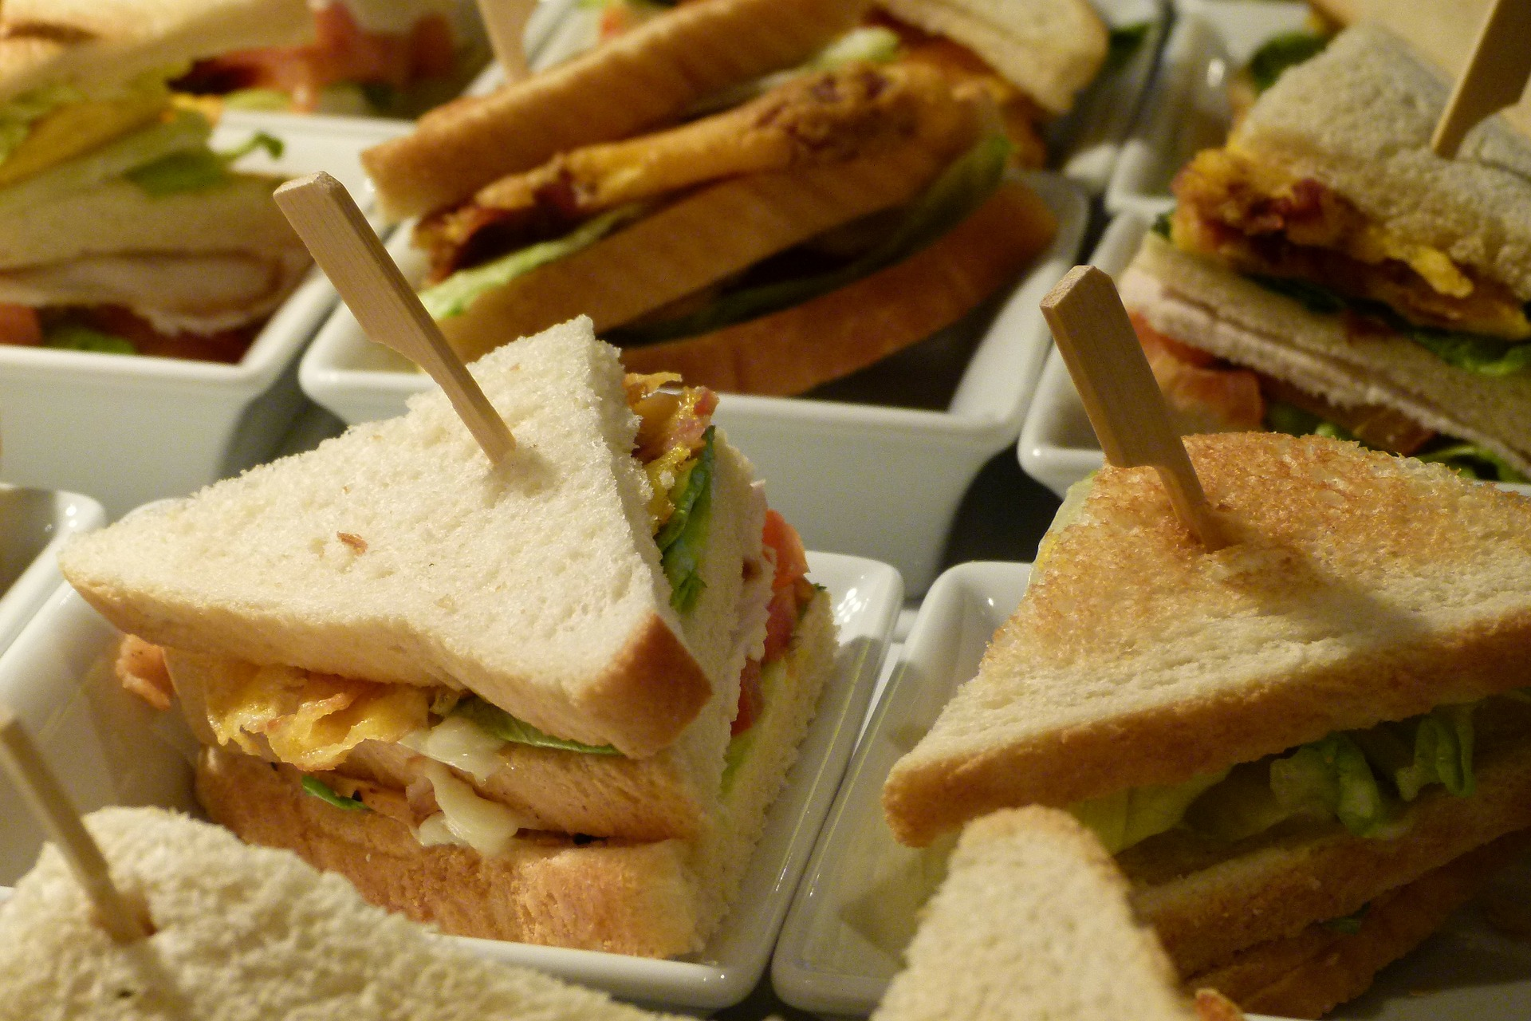
Club Sandwich

Slide 55
Australia

Slide 56
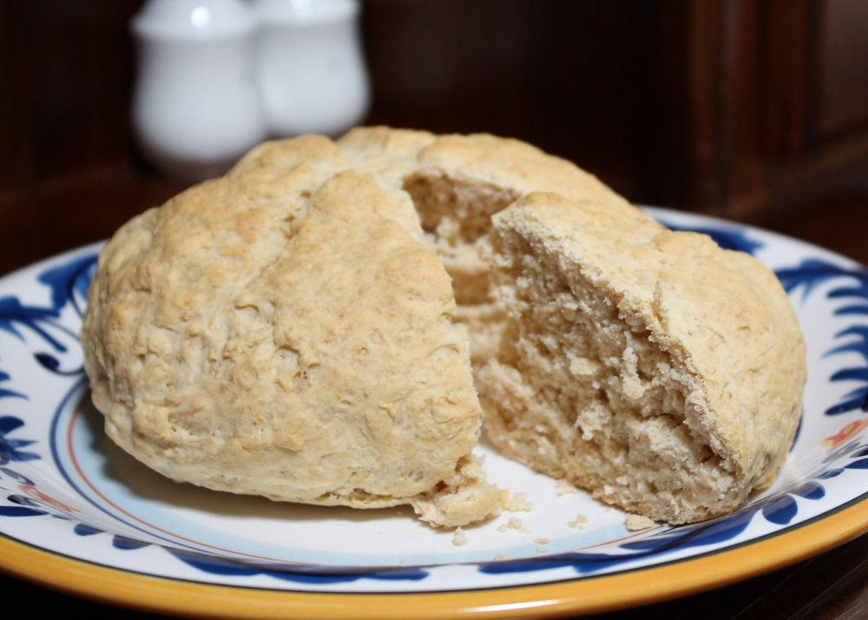
Damper
“Damper” by [HeatherW] is licensed under CC BY 2.0

Slide 57
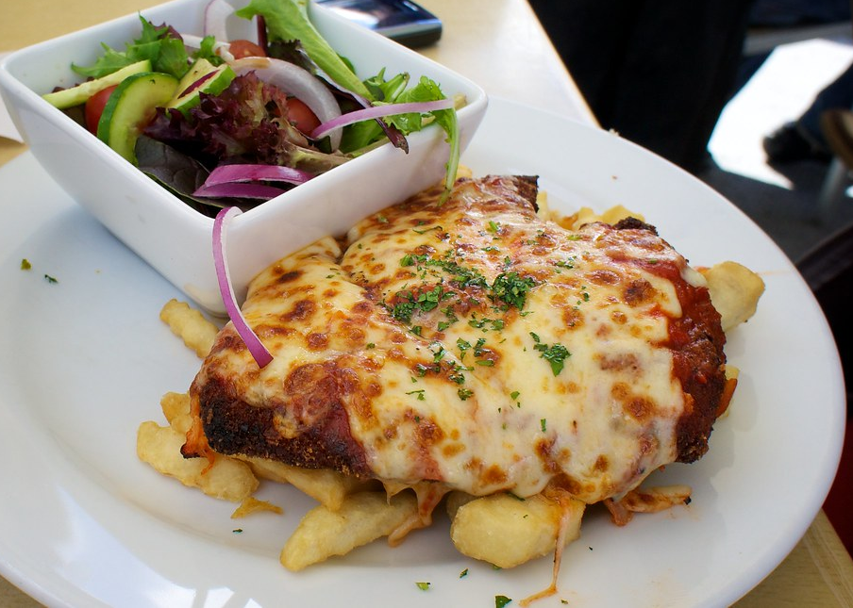
Chicken Parmigiana
“Chicken Parmigiana” by [thepatrick] is licensed under CC BY 2.0

Slide 58
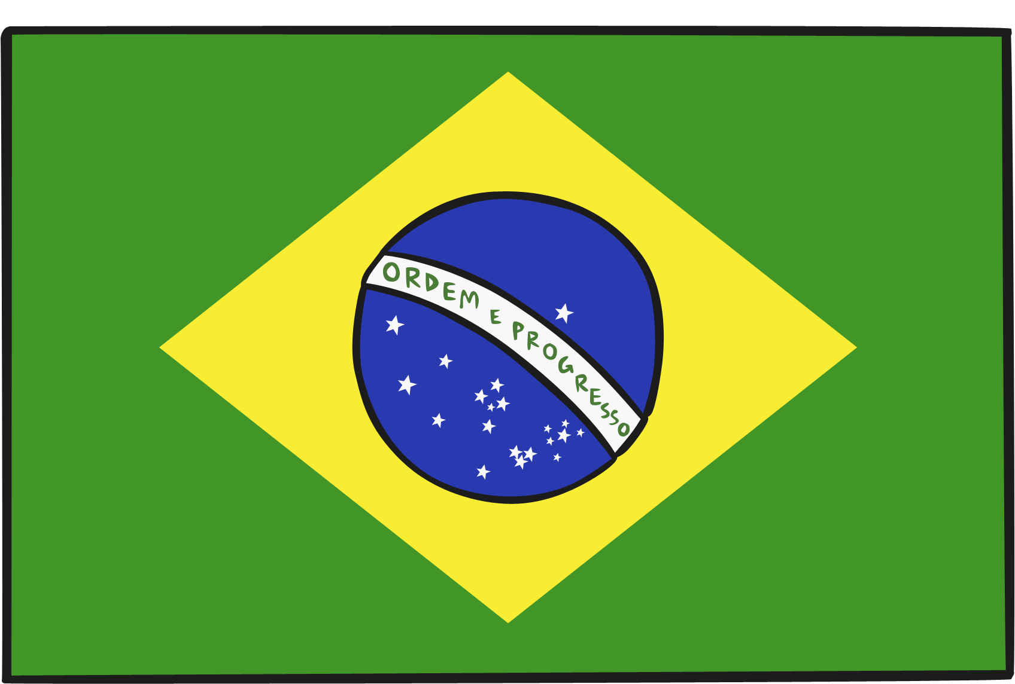
Brazil

Slide 59
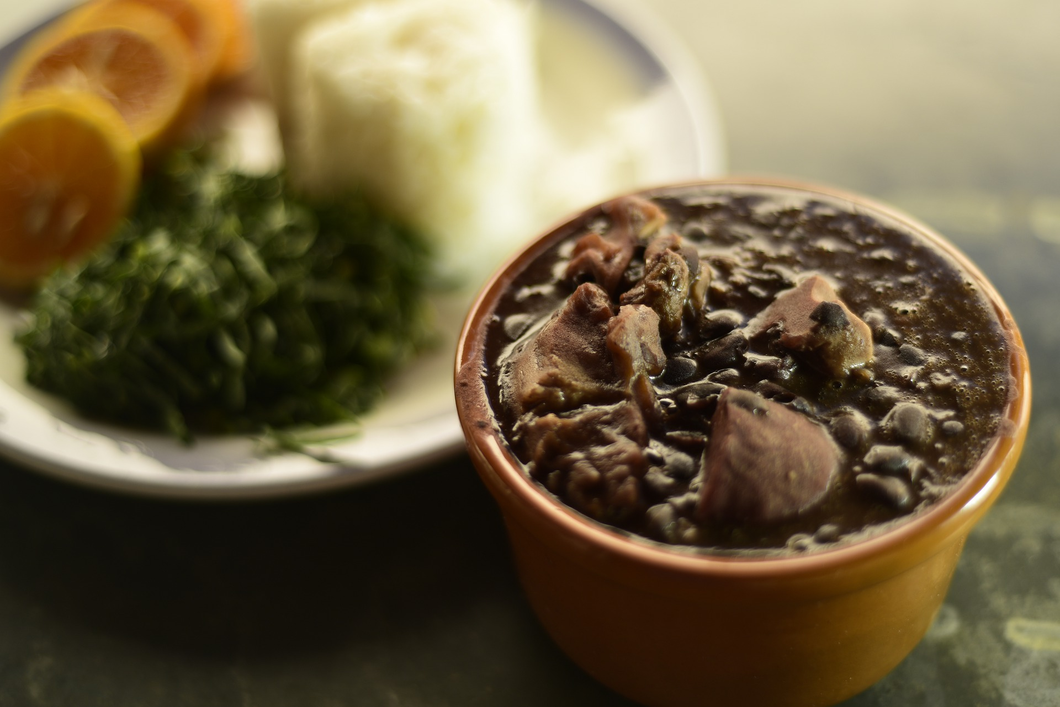
Feijoada

Slide 60
Brigadeiro

Slide 61
Chile

Slide 62
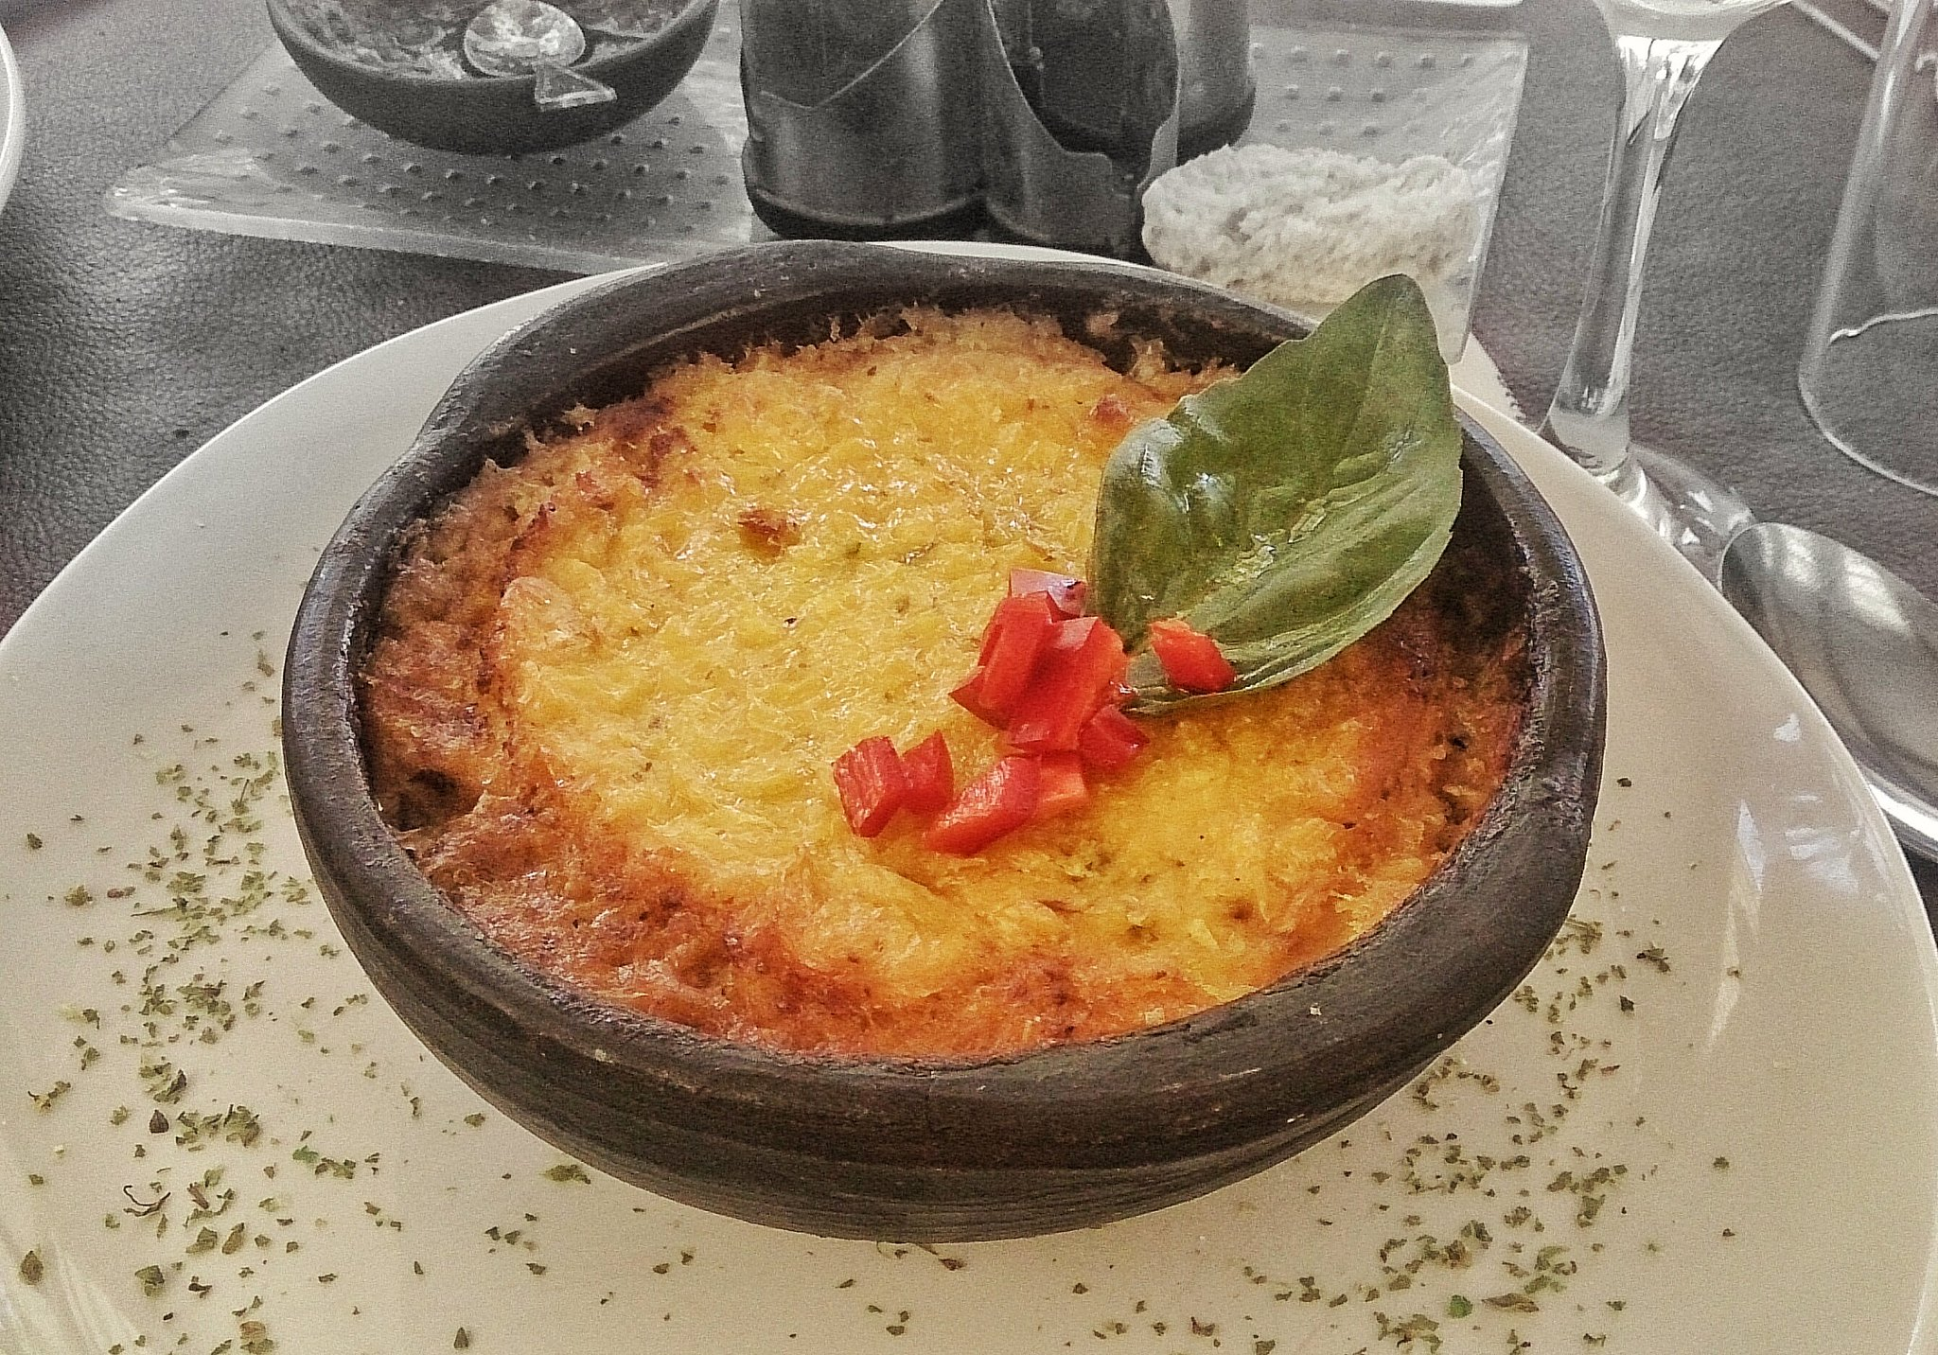
Pastel De Choclo
“Pastel De Choclo” by [mariela morales] is licensed under CC BY 2.0

Slide 63
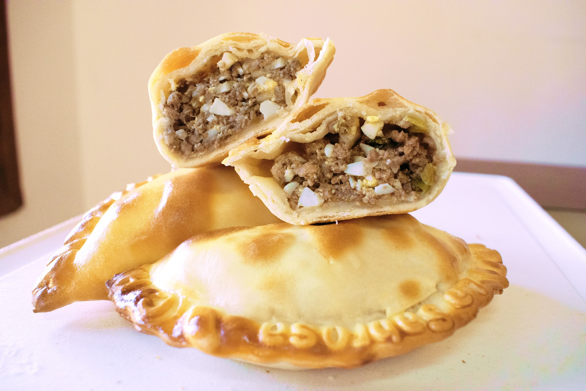
Empanadas

Slide 64
Peru

Slide 65
Ceviche

Slide 66
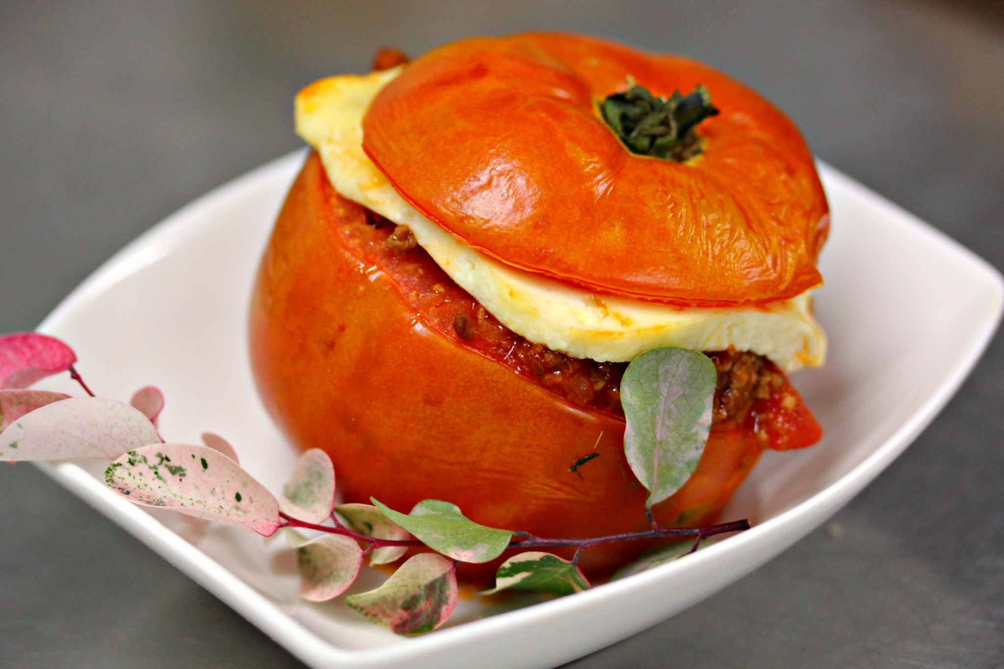
Rocoto Relleno
“Rocoto Rolleno” by [franzconde] is licensed under CC BY 2.0

