Slide 2
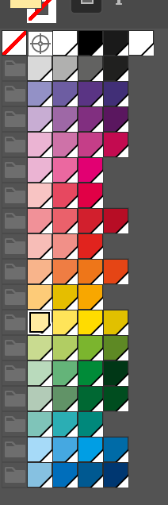
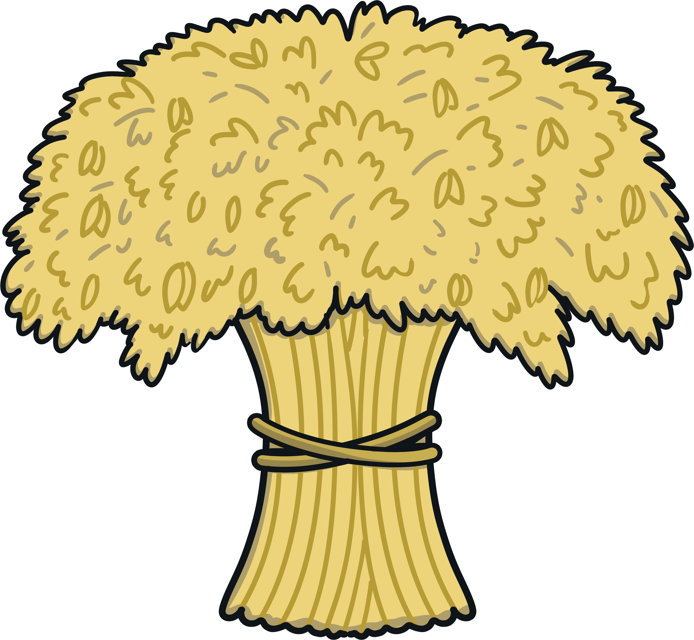
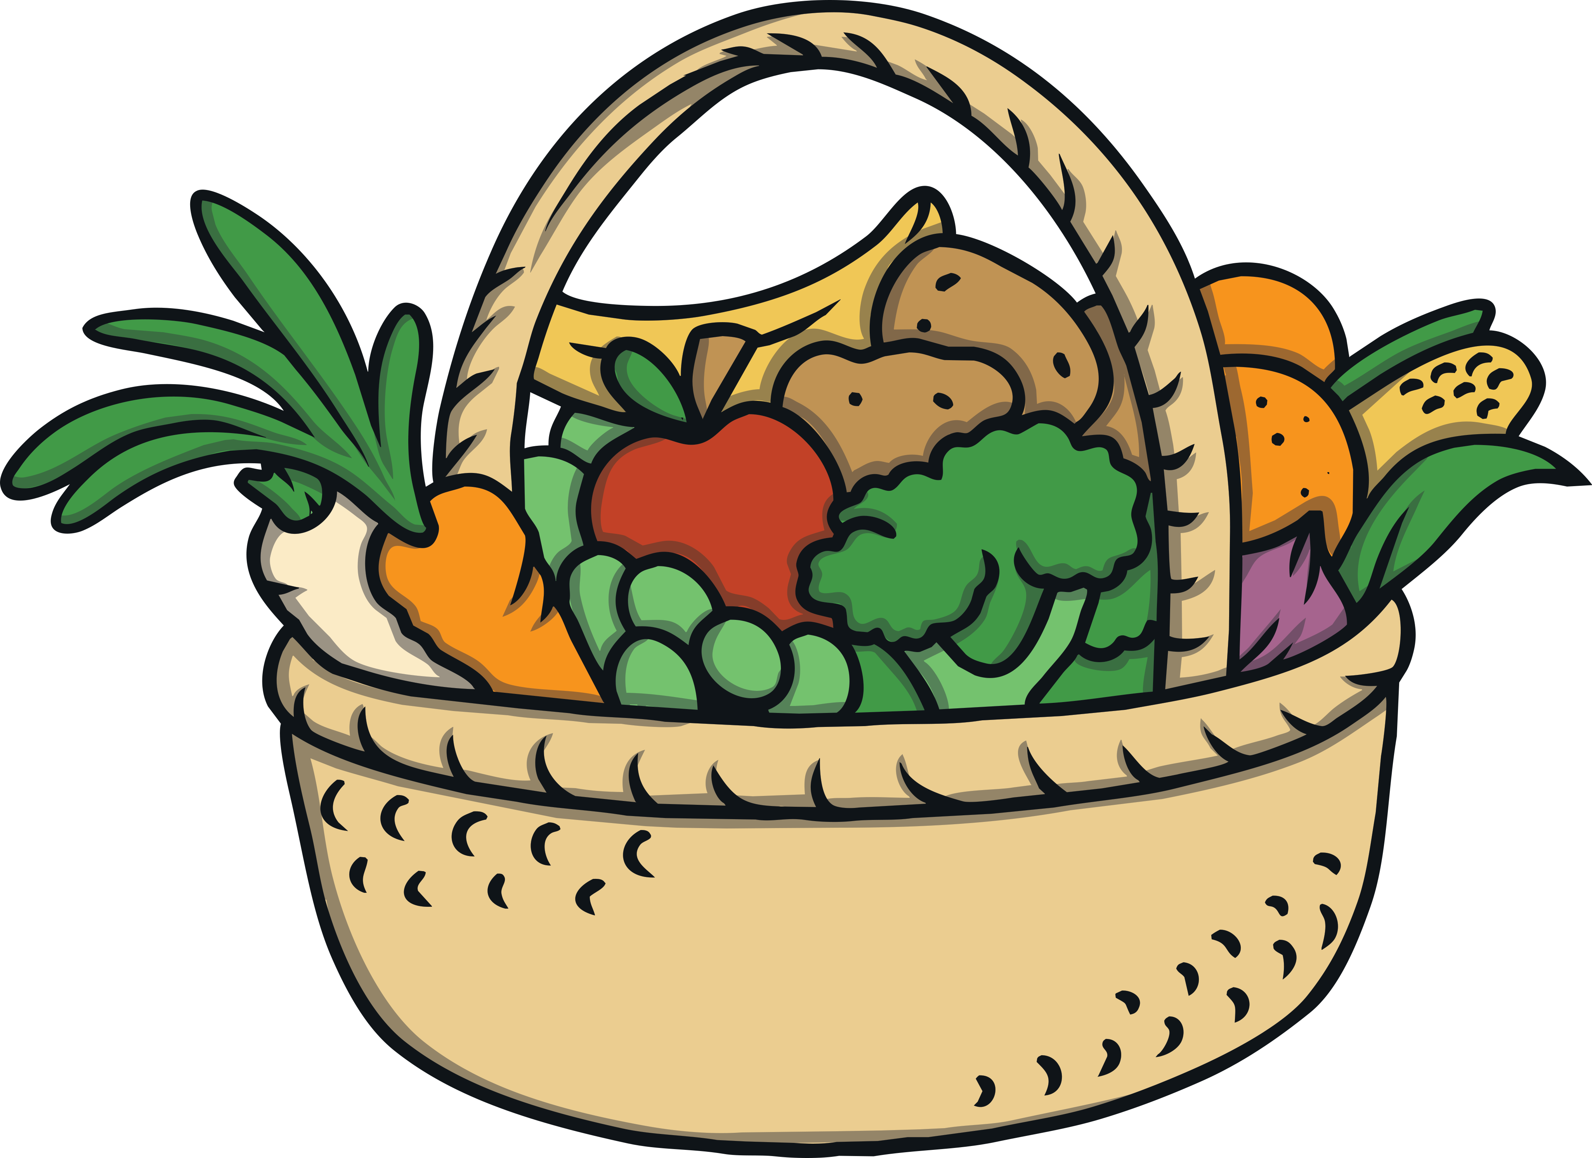
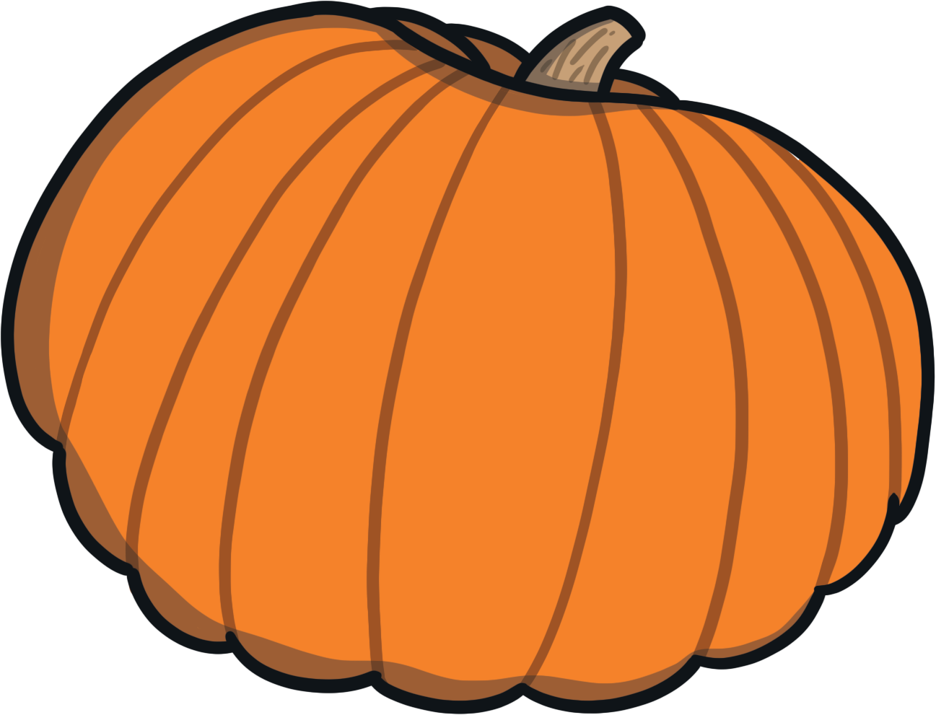
What Is Thanksgiving?
Thanksgiving is an American and Canadian holiday. It is celebrated to give thanks for the harvest and for the year ahead.
Today, Thanksgiving is celebrated in many countries around the world.

Slide 3
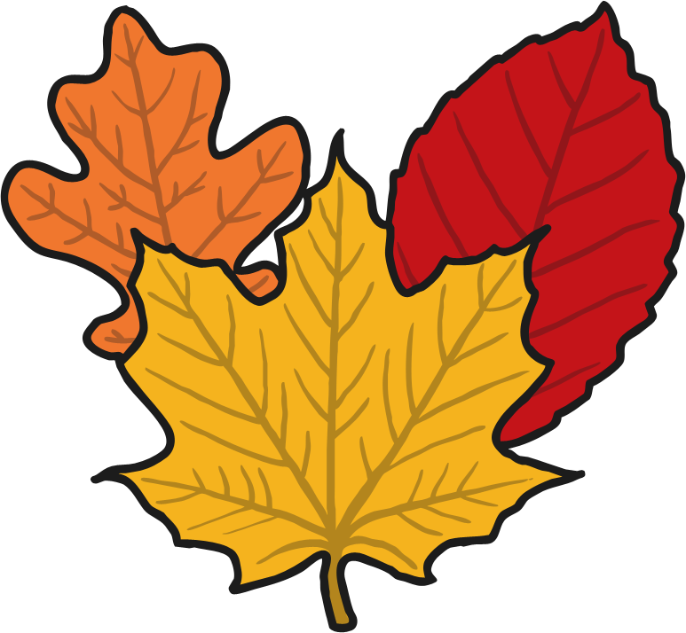
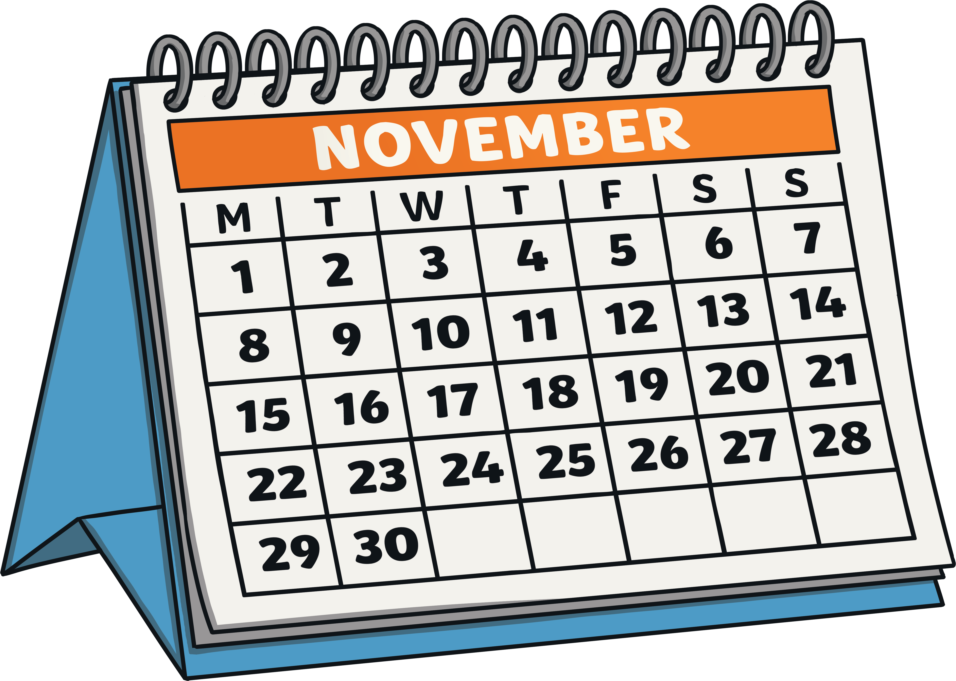
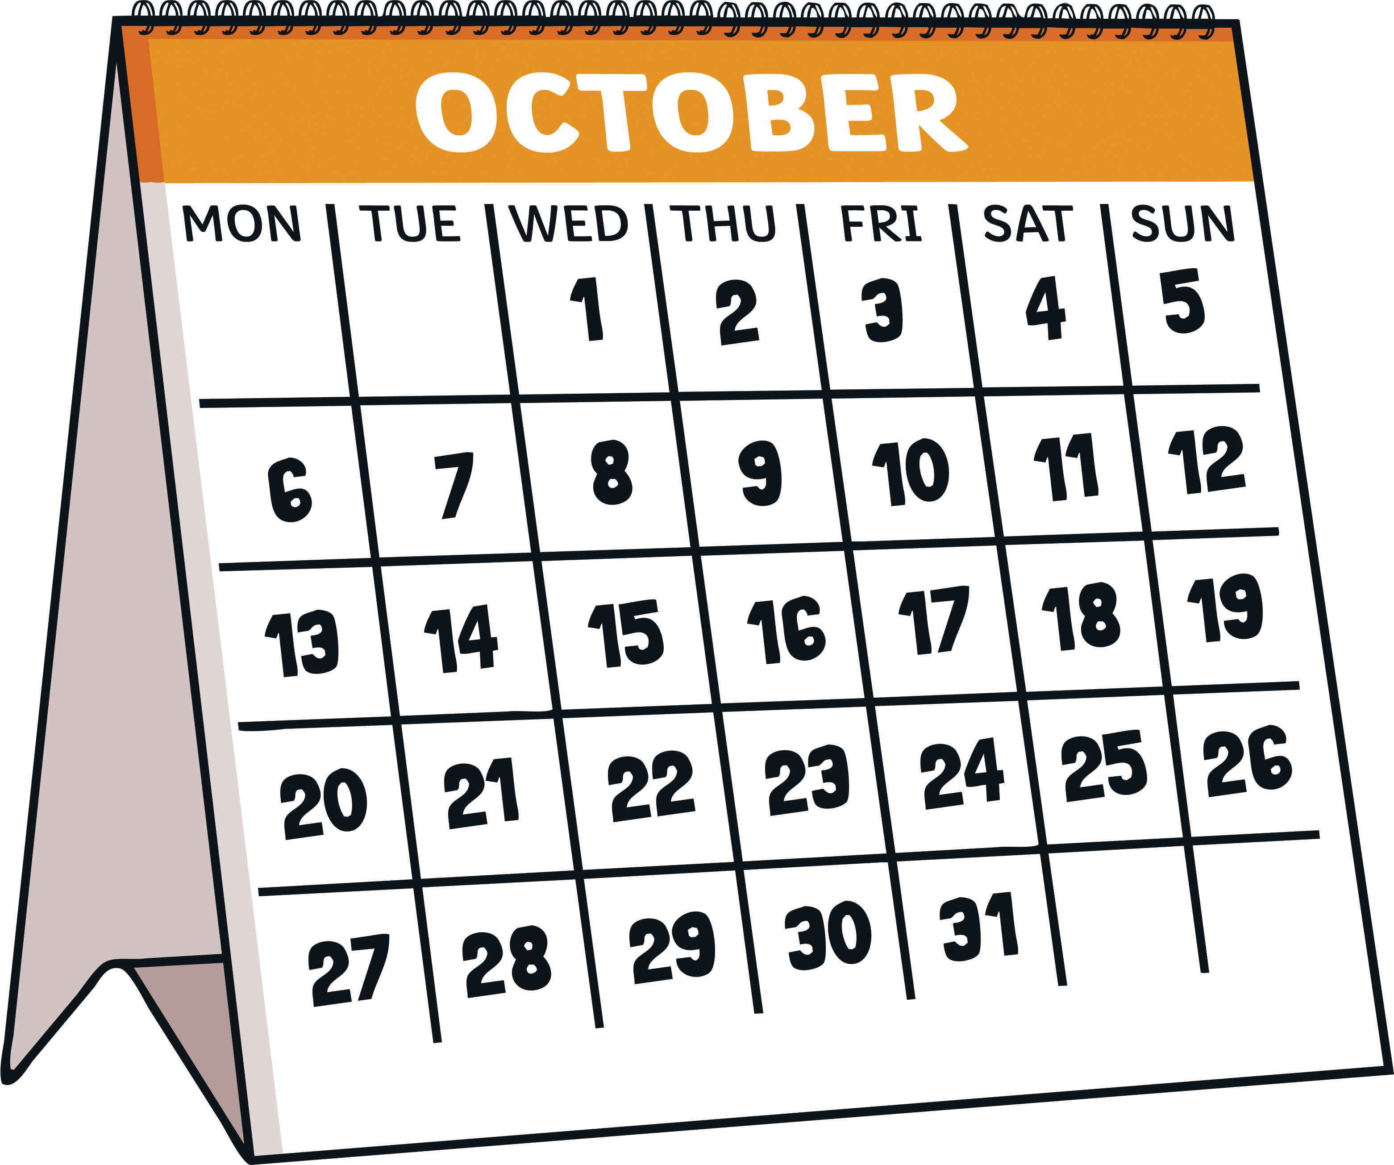
When Is Thanksgiving Celebrated?
Thanksgiving in America is celebrated on the fourth Thursday of November each year.
In Canada, Thanksgiving is celebrated on the second Monday of October.

Slide 4
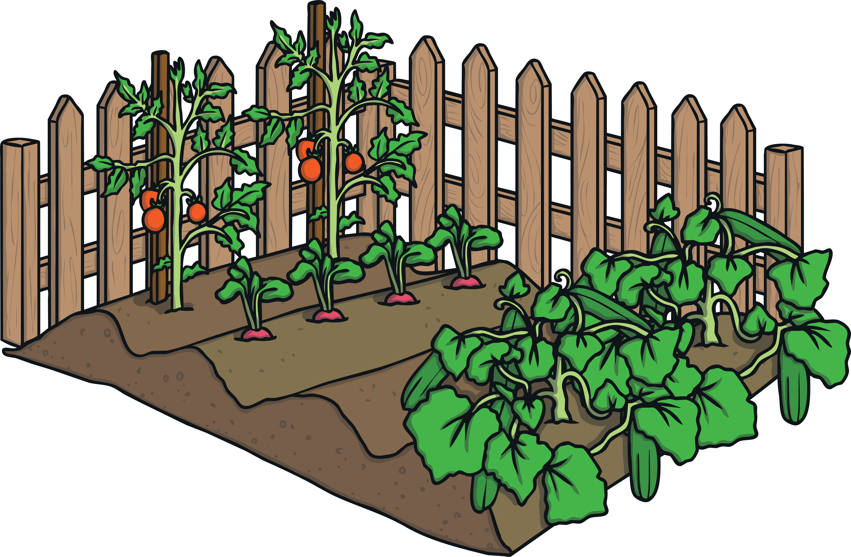
Thanksgiving
Thanksgiving is a harvest celebration, where people give thanks for all the food that the harvest has brought.
Harvest is the process of collecting crops that are ready as the growing season ends.

Slide 5
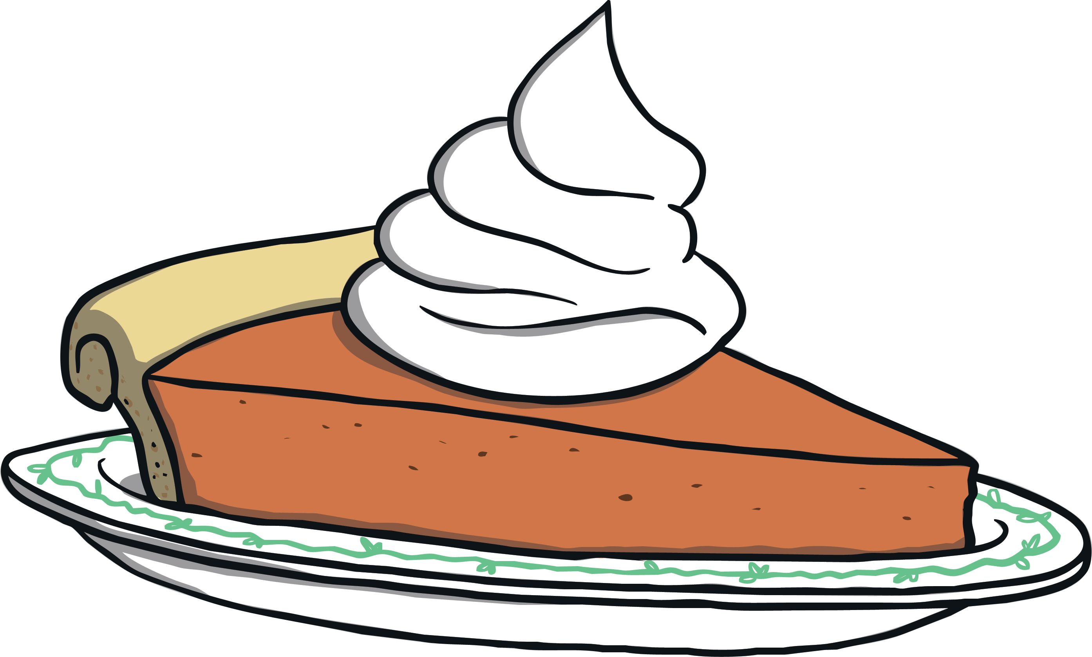
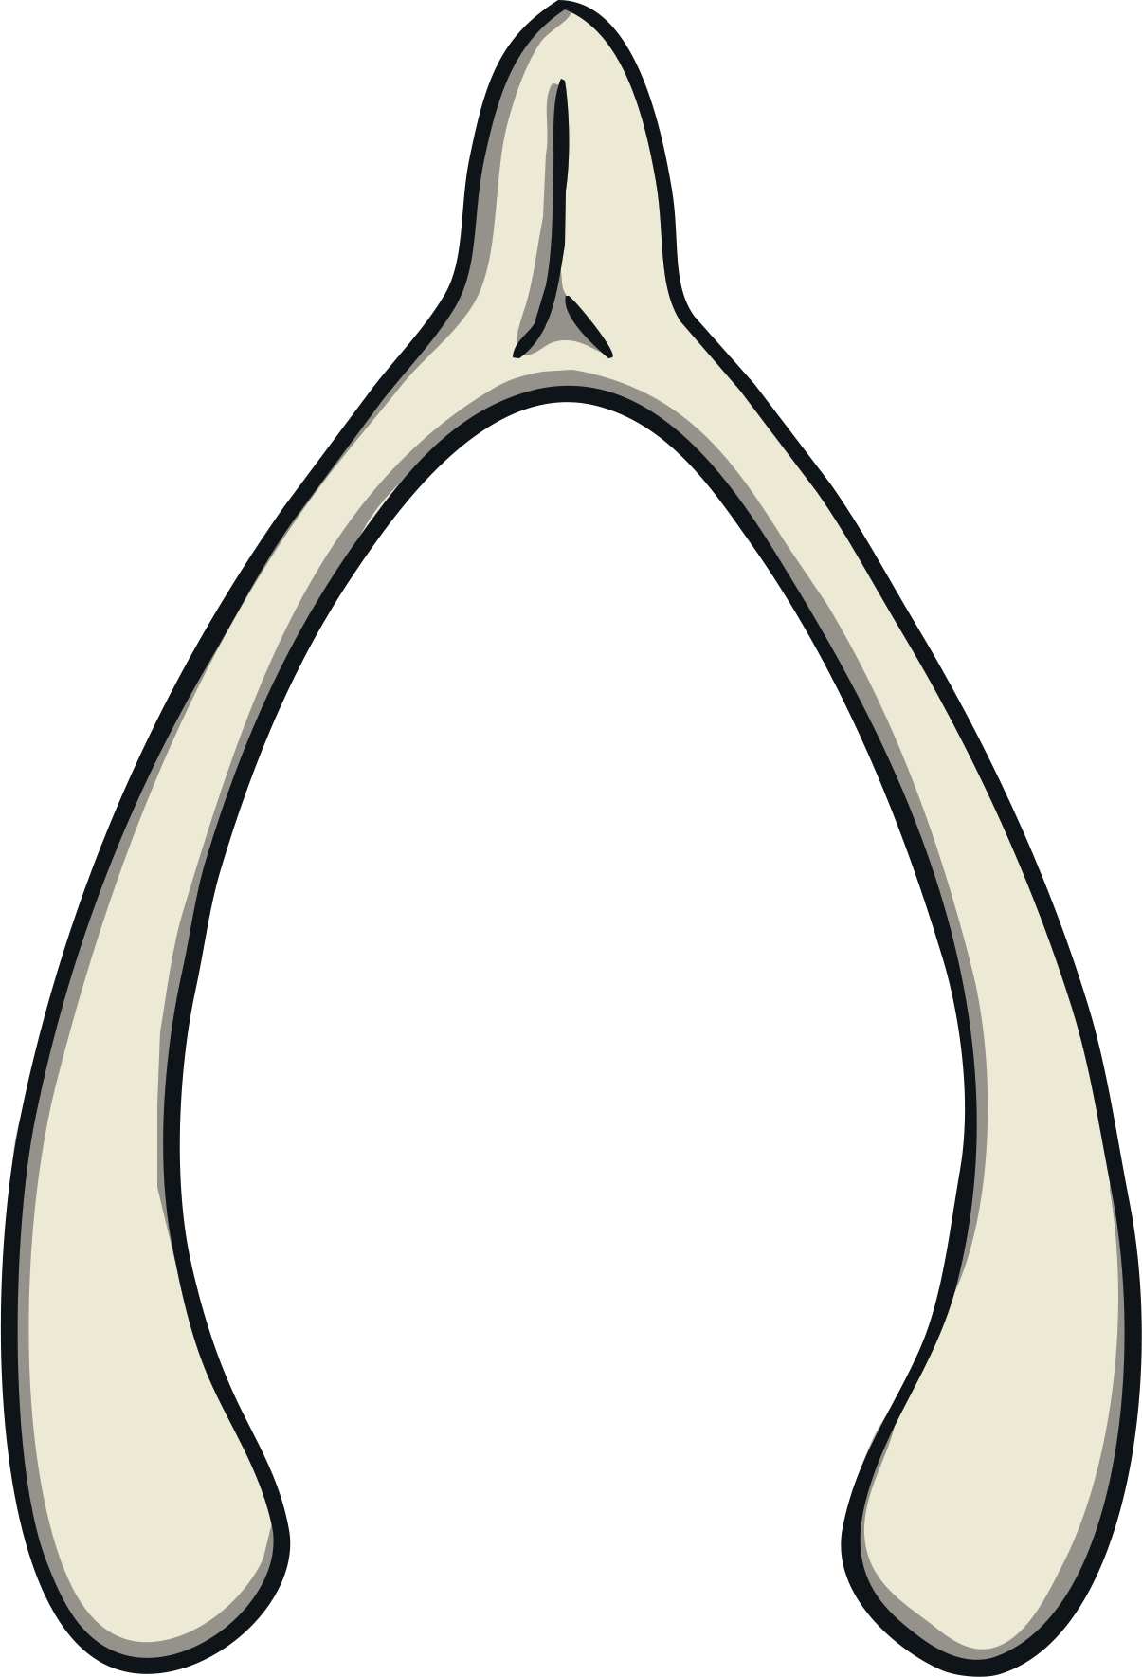
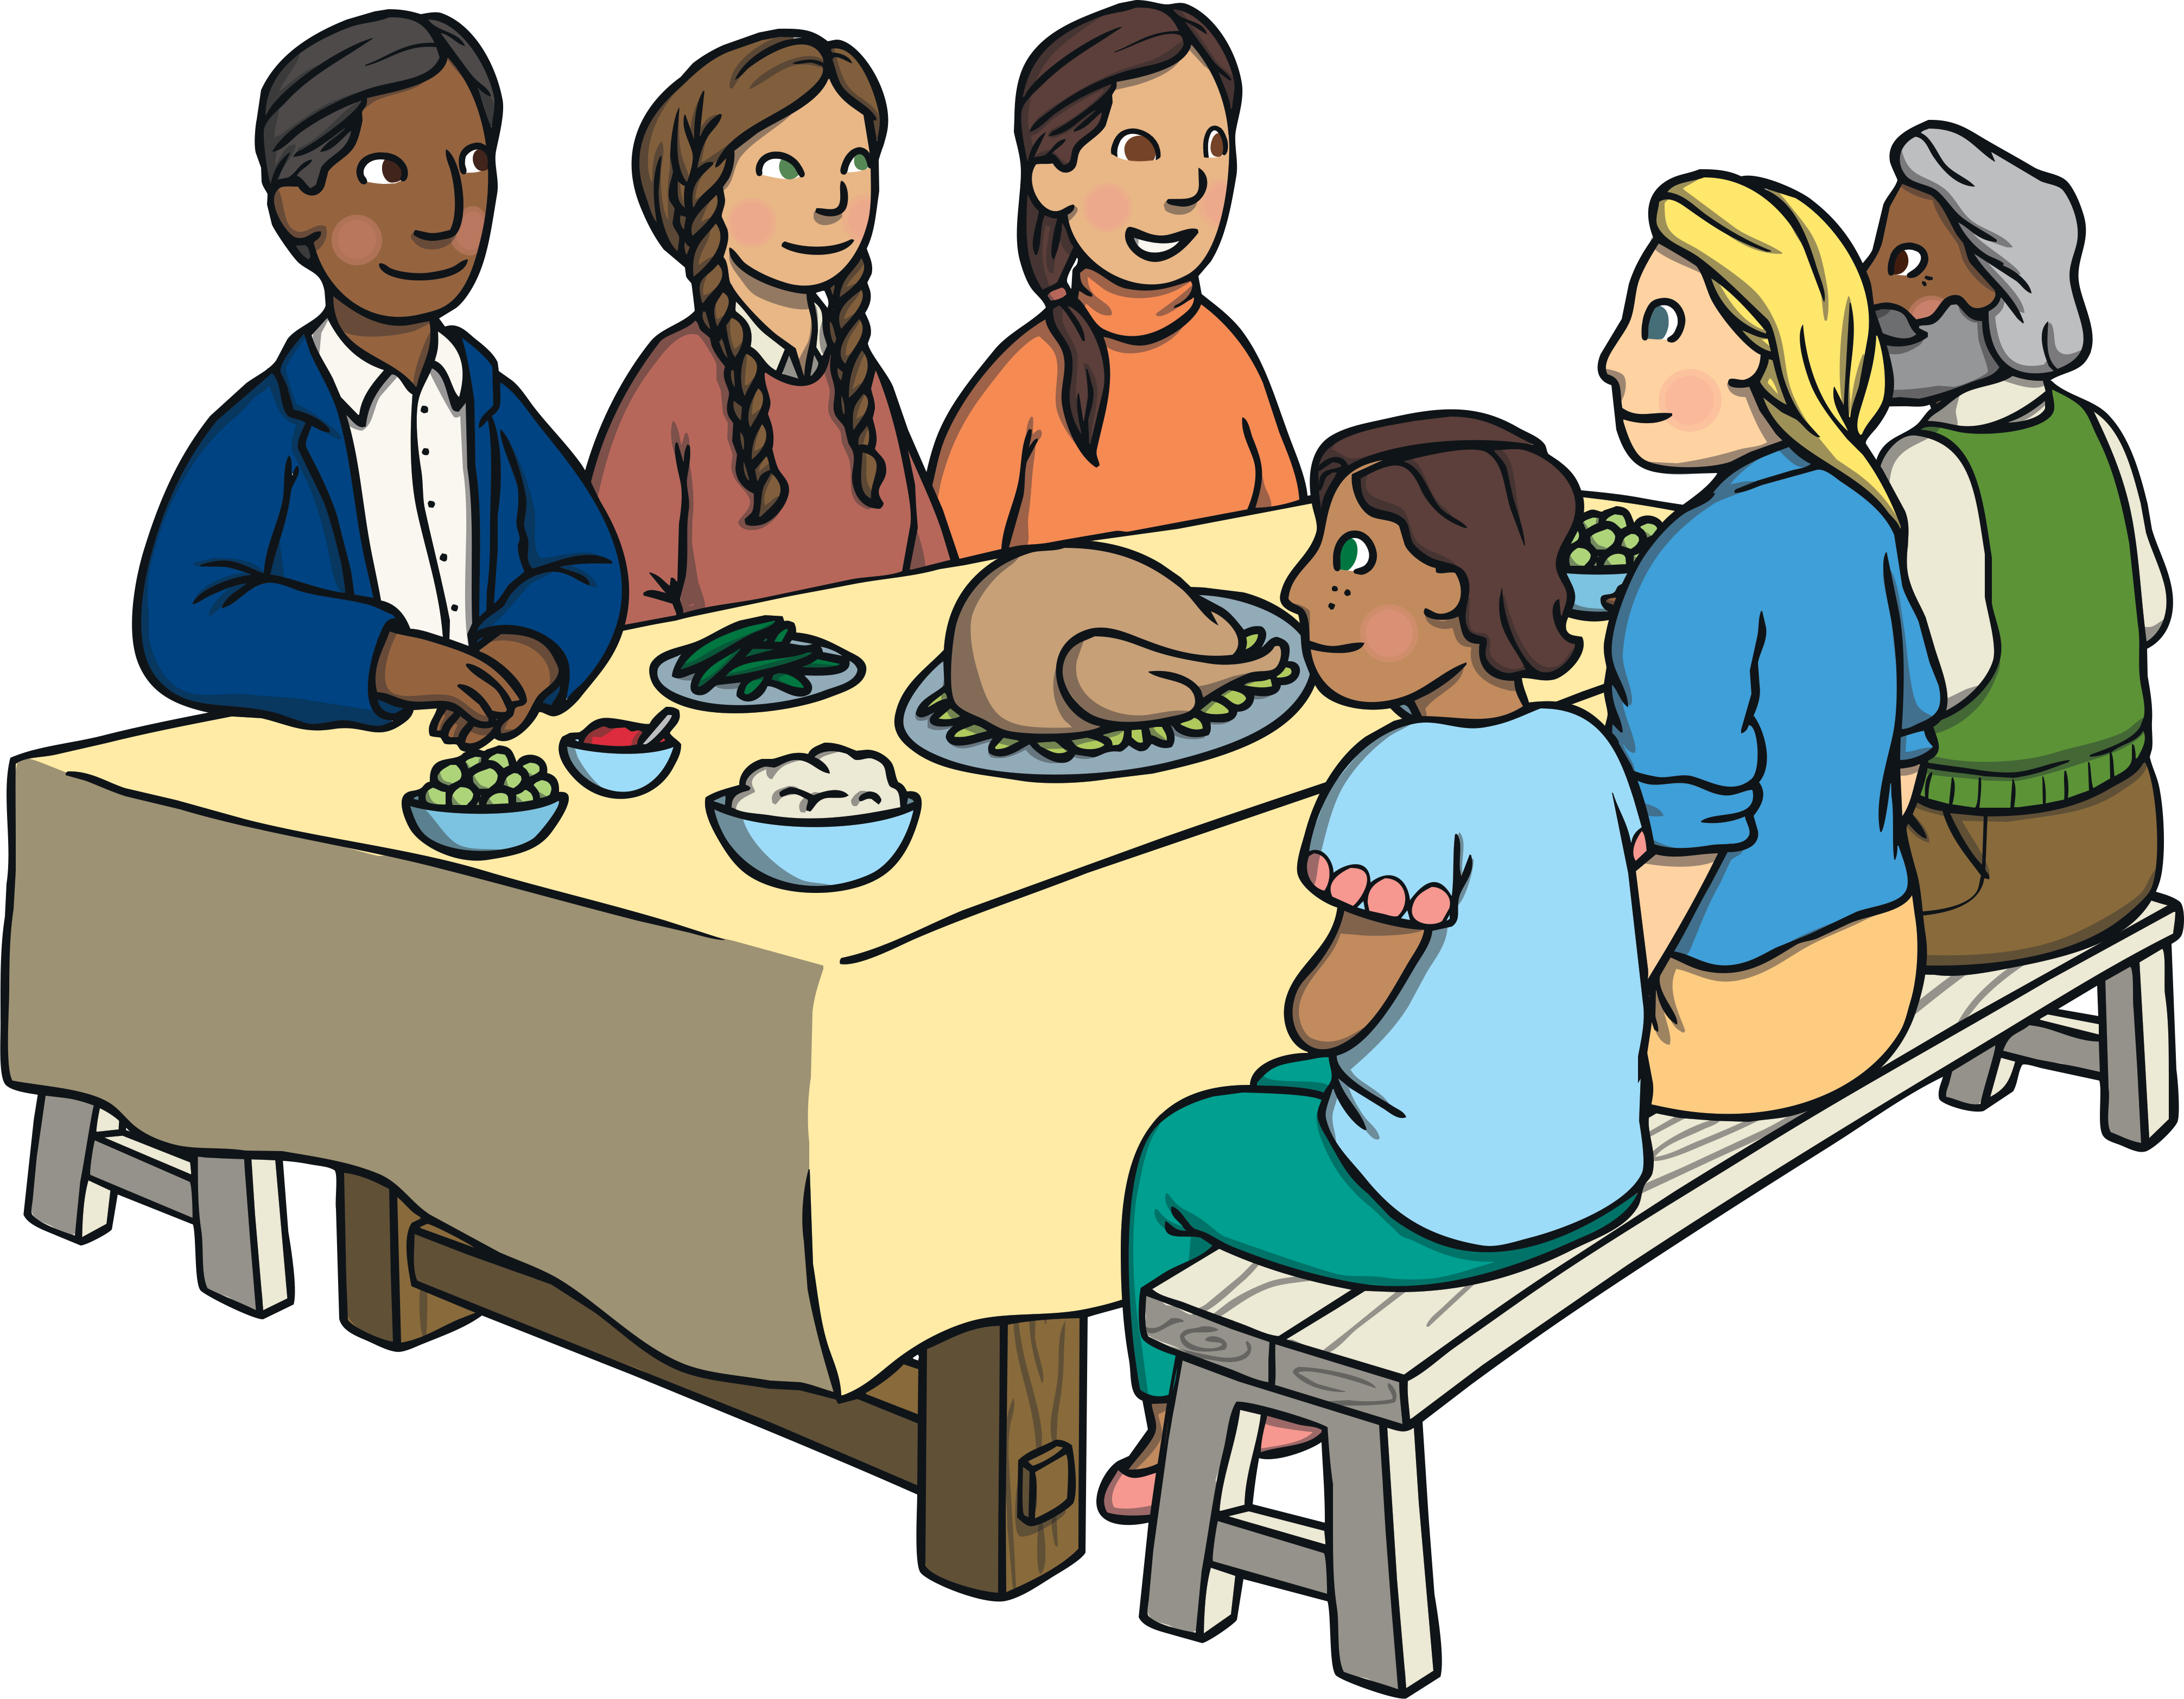
Thanksgiving Traditions Today
Families travel to be together for Thanksgiving, to have a feast with foods such as turkey, potatoes, cranberry sauce and pumpkin pie.
One of the bones of the turkey is called the wishbone. A common Thanksgiving tradition is for two people to hold either side of the cleaned wishbone, make a wish and pull. Whoever ends up with the larger part of the bone is said to have their wish come true.
Many families will practice gratitude by sharing something they are thankful for.

Slide 6
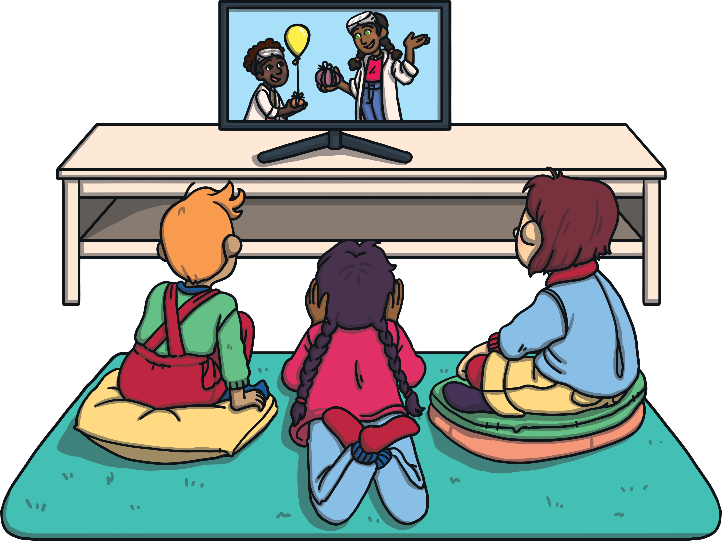
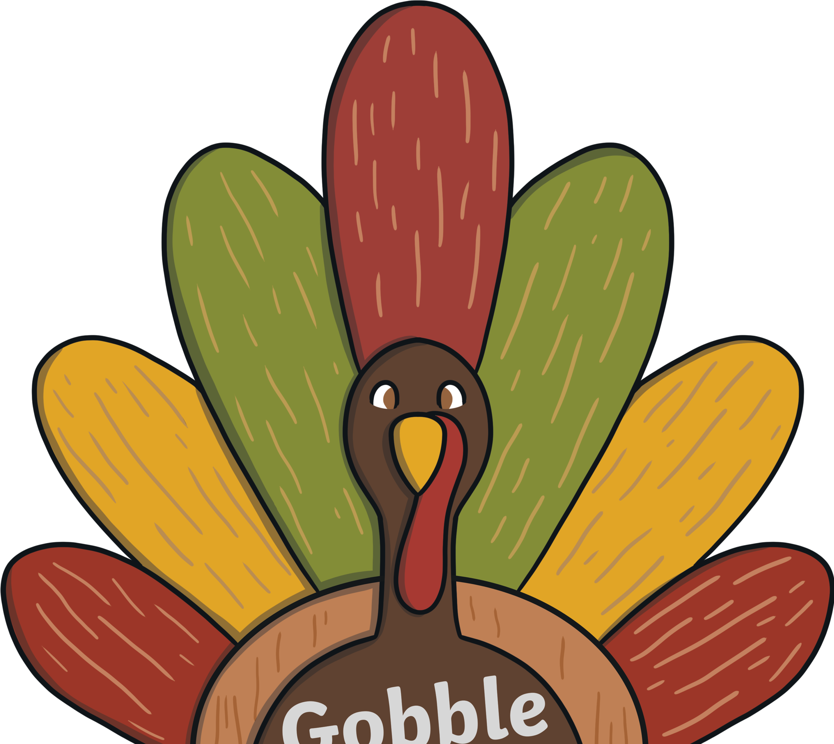
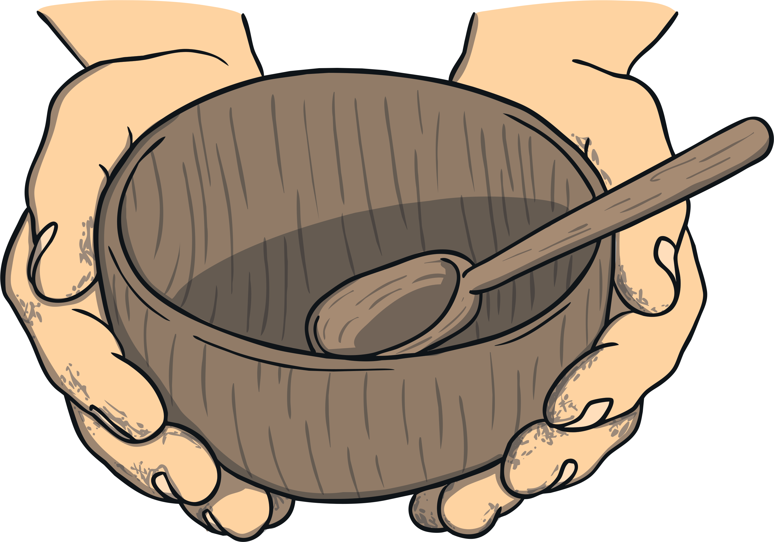
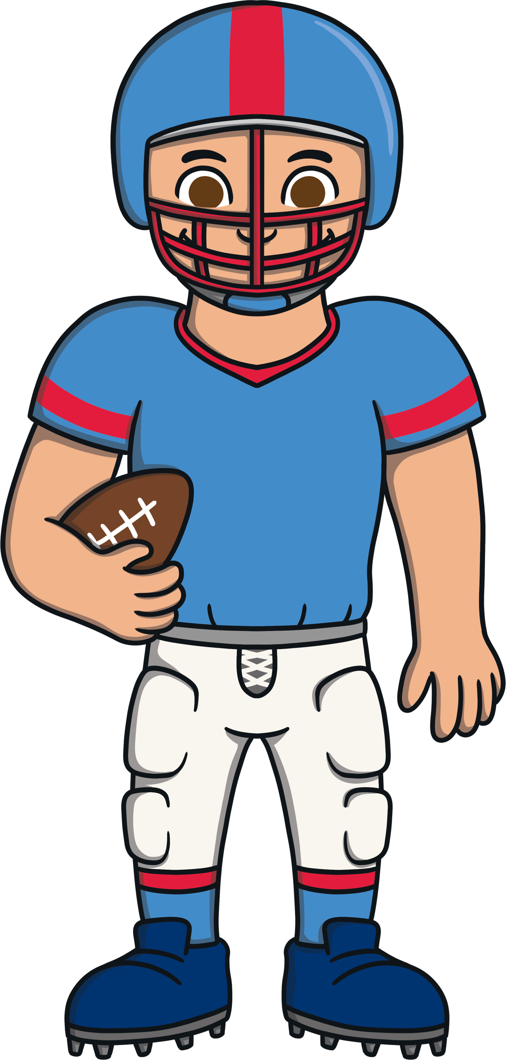
Thanksgiving Traditions Today
In New York, the Macy’s Thanksgiving Day Parade is held. Many people line the streets to watch the parade in person. Other people watch it on TV.
Thanksgiving is a great time to help others. It is common for people to volunteer for charities on Thanksgiving.
Every Thanksgiving, professional games of football are played. Many families enjoy attending the games or watching them on TV.

Slide 7
Do you celebrate Thanksgiving?
What would you like to eat at your Thanksgiving feast?
What is something you are thankful for?

