Slide 2
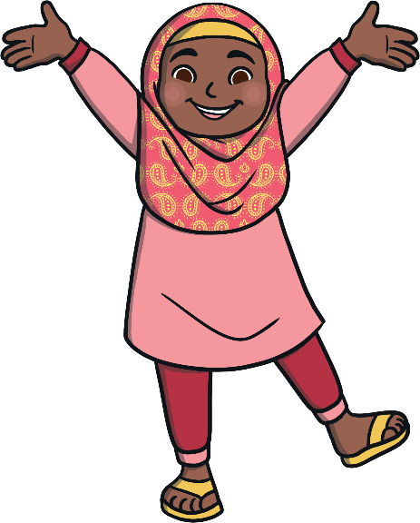
There are many different ways to stay healthy.
Some of these are:
Exercising regularly
Eating healthily
Having a happy attitude
Why do you think being healthy is important?

Slide 3
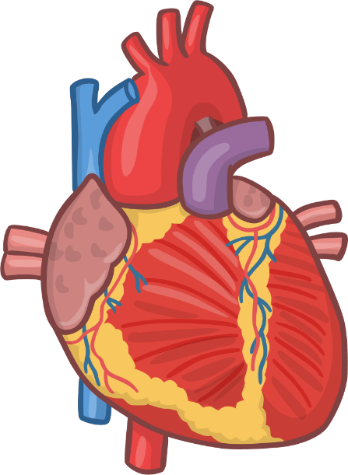
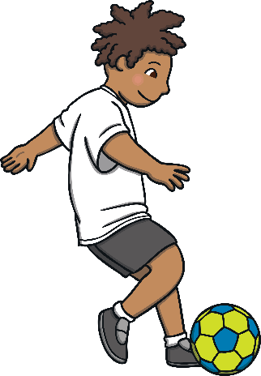
Exercising is fun!
Doing regular exercise will help us all feel great and keep our bodies strong!
Our hearts need to be kept active and pumping.
Exercise also burns fat.

Slide 4
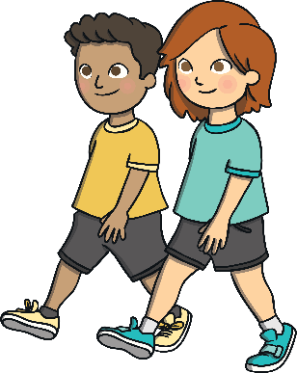
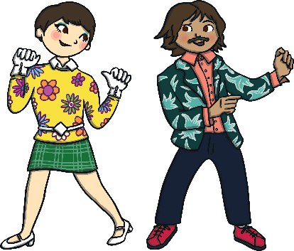
Here are a few easy ways to stay active
Walking
Playing games
Dancing
Can you think of any more?

Slide 5
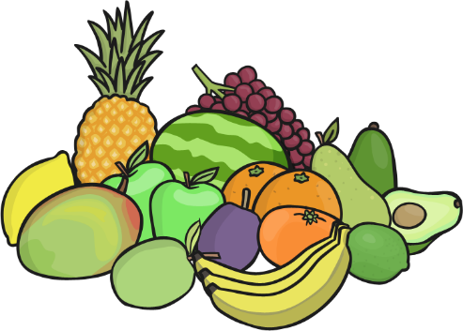
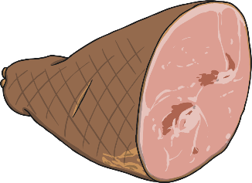
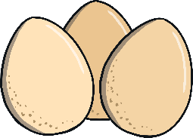
Healthy Eating
Here are some healthy and unhealthy foods. We should aim to eat at least 5 portions of fruit and vegetables a day.
Healthy Foods
Unhealthy Foods
Fruit and vegetables
Cakes and sweets
Fish and meat
Chocolate
Eggs, milk and cheese
Chips

Slide 6
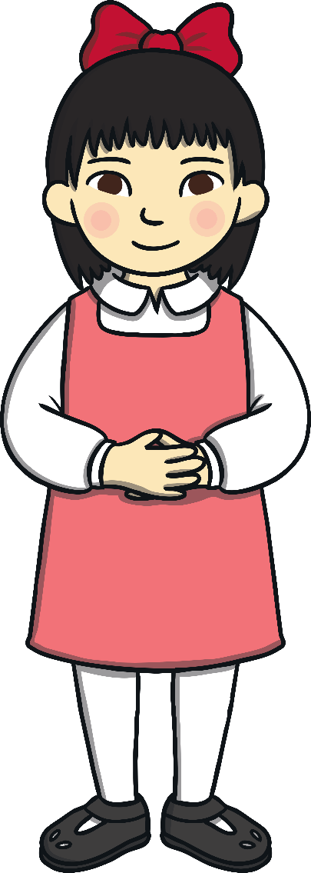
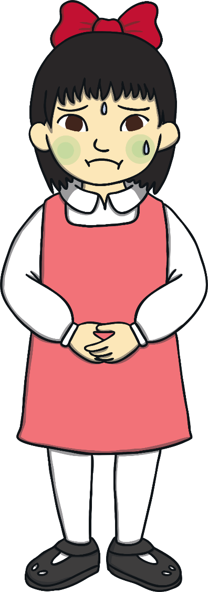
Healthy Eating
Can you think of any unhealthy things that people do?
It is perfectly fine to eat a little bit of unhealthy food.
Eating too much unhealthy food could make us over weight and not feel great.
Did you know that eating well and exercising also stops us from being ill?

