Slide 1
Number Talks
Teacher Guidance
In number talks, students are presented with a maths problem or image and are encouraged to share their strategy and thinking about it.
Encourage students not just to count the images but to work out strategies for each.
Number talks can be presented as an image or mental problem and open mathematical discussion between students is shared.
Number talks hand signals could be used for students to indicate how they would like to respond to each problem, or you can choose your own style to present each of the slides.
Great as a maths starter or at any time during the week as a 10-15 minute maths activity to build maths confidence and vocabulary.
These slides have been made editable so you can change or add to the questions on the slides.
The following presentation includes a number of mathematical images and questions.

Slide 3
Number Talks
How many dots do you see and how did you count them?
Share your strategy, is there another way of working out how many dots?

Slide 4
Number Talks
How many dots do you see and how did you count them?
Share your strategy, is there another way of working out how many dots?

Slide 5
Number Talks
What is your strategy for counting this dot image?

Slide 6
Number Talks
What is similar and what is different about the dot image on the left and on the right?

Slide 7
Number Talks
How many different ways can you make the number 8?
Is there just one correct answer?
Share your strategy.

Slide 8
Number Talks
How many different ways can you make the number 25?
Is there just one correct answer?
Share your strategy.

Slide 9
Number Talks
How many different ways can you make the number 30?
Is there just one correct answer?
Share your strategy.

Slide 10
Number Talks
These two arrays show the number 12. How do you count each one?
How are they different?
Is there another way to represent the number 12?

Slide 11
Number Talks
These two arrays show the number 20. How do you count each one?
How are they different?
Is there another way to represent the number 20?

Slide 12
Number Talks
What is your strategy for working out the total?

Slide 13
Number Talks
What is your strategy for working out the total?

Slide 14
Number Talks
23 + = 28
How would you work this out?
Is there more than one way?

Slide 15
Number Talks
34 - = 29
How would you work this out?
Is there more than one way?

Slide 16
Number Talks
8 + 13 = 21
What is another way of making the number 21?

Slide 17
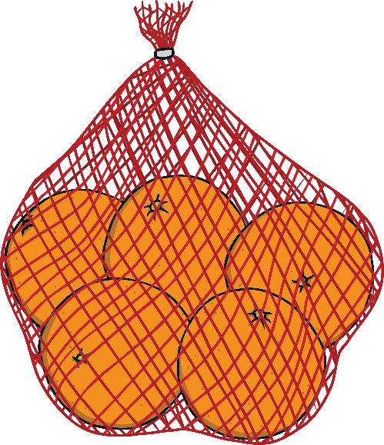
Number Talks
There are five oranges in each of these fruit bags.
How many oranges are there altogether?
What is your strategy for working this out?

Slide 18
Number Talks
There are 28 bananas in total on the supermarket shelf.
Each bunch has four bananas on it.
How many bunches are on the shelf?
What is your strategy for working out the answer?

Slide 19
Number Talks
Balance these calculations so the answer on each side is the same.
=
+ =
14 + 8

Slide 20
Number Talks
Balance these calculations so the answer on each side is the same.
=
+ =
18 + 7

Slide 21
Explain how you know 67 is 6 tens and 7 ones.

Slide 22
Explain how you know 82 is 8 tens and 2 ones.

