Slide 2
Disclaimer
We hope you find the information on our website and resources useful. This resource has been designed with animations on each slide to make it as fun and engaging as possible. To view the content in the correct formatting, please view the slideshow in ‘presentation mode’. If you view the slides without selecting ‘presentation mode’, you may find that some of the text and images overlap each other or are difficult to read.

Slide 3
Musical Terms
Beat/Pulse
This is the underlying beat of the music to help keep in time.
Rhythm
Combinations of long and short sounds and silences to create a pattern and show movement.
Tempo
The speed of the music.
Duration
The length of a sound or value of a note.
Pitch
How high or low a sound is.
Melody
A sequence of notes played to different rhythms.
Dynamics
How loud or soft a sound is.

Slide 4
Simple Rhythms and Note Values
Name:
Minim
”too”
2 beats
Crotchet
”ta”
1 beats
Quavers
”ti-ti”
2 sounds on 1 beat (half a beat each)
Rhythm syllable:
Value:
Rhythm syllables give students a set of words or nonsense syllables/sounds to associate with written notations to help them hear and play the rhythms correctly and in time to the beat.

Slide 5
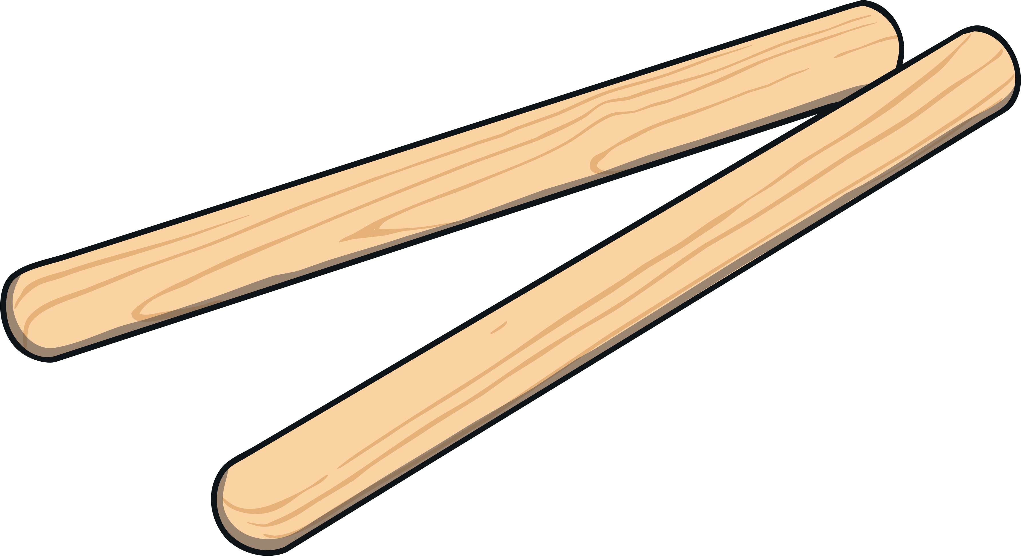
Ages: Foundation - Year 3
Freeze Conductor
The teacher taps claves or a drum at a steady pace (60 beats/min) and students walk around the room. When the tapping stops, the students must freeze.
You can make the game more challenging by reversing the rules, so, when the teacher says ‘hip’, children have to walk in the silence and freeze when the tapping starts. If the teacher says ‘hip’ again, it reverts to walking during the tapping and freezing in the silence.
Develops:
Concentration
Inner beat and tempo Listening/aural skills Spatial awareness
Counting skills
Focus & concentration
Memory
This game teaches the importance of using both auditory and visual senses. Students need to watch the ‘conductor’ tapping as well as listening for the beat, which is an important skill to develop as a musician.

Slide 6
Ages: Year 1 - Year 4
Stretch and Walk in Time
Teacher claps or taps the beat on claves and counts.
First start with counting up to 8. Students slowly stretch their arms from their sides to above their heads over the eight beats. Make sure they are slowly lifting their arms and taking the entire eight beats rather than rushing and moving their arms straight to the top. Then the next eight beats students walk around the classroom. Keep repeating the eight beats of stretching then eight beats of walking.
To make it more challenging, you can start decreasing the count – stretch for seven beats and walk for seven beats then stretch for six beats and walk for six beats until you’re down to one beat of stretching and one beat of walking.
Develops:
Concentration
Inner beat and tempo Listening/aural skills Spatial awareness
Counting skills
Motor skills
When you first play the game, begin with the teacher counting the beats to help the children, then increase the difficulty by just tapping the beats without counting the numbers. Children have to be able to judge their movements with the beats and keep in time with others, so it is a great game to help them start feeling the beat and develop their inner-beat and tempo.

Slide 7
Ages: Year 1 - Year 6
Musical Phrases
The children stand in a circle. The teacher chooses a child to start and as the music is played, the child walks across the circle to another student in time to the music. They must walk across in time with the musical phrase (musical sentence), so they start walking when the phrase starts and reach another child as it finishes. Then the child they walked to has a turn to walk to the next phrase and so forth.
This is more difficult than it sounds! Children will have to keep to the beat and judge the speed of their walking and size of their steps! Nursery rhymes are good songs to use as they have clear musical phrases. For example, the song ‘Twinkle Twinkle Little Star’ has eight beats per musical phrase or sentence. If needed, the teacher can tap the beats while singing to help the children as they walk.
Develops:
Singing Inner beat and tempo
Listening/aural skills
Spatial awareness
Counting skills
Motor skills

Slide 8
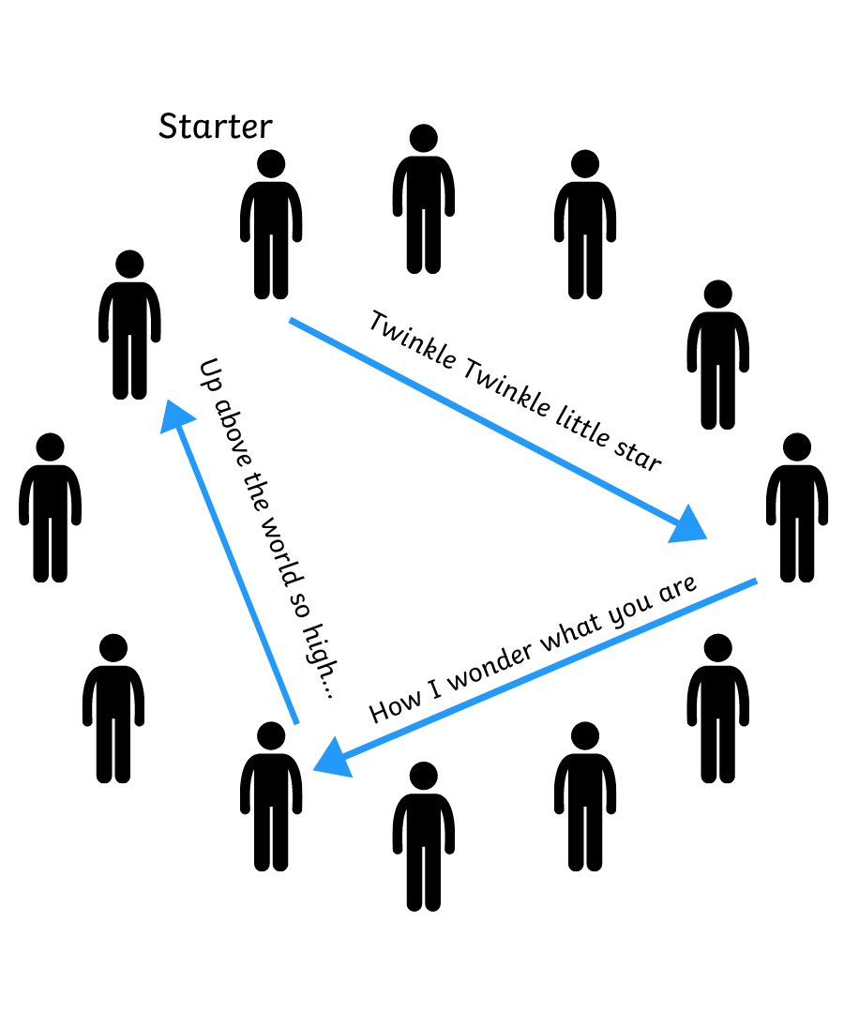
Ages: Year 1 - Year 6
Musical Phrases
Songs for young students:
Old McDonald (eight beats)
Incy Wincy Spider (eight beats)
Frère Jacques (eight beats or four beats)
The Grand Old Duke of York (eight beats or four beats)
Songs for older students:
Spring by Vivaldi (12 beats)
The Entertainer by Scott Joplin (eight beats – great call and response)
Eine Kleine Nachtmusik by Mozart (eight beats)

Slide 9

Ages: Year 3 - Year 6
Hand Clapping Positions
The teacher writes a four-bar rhythm on the board – four crotchets, then two minims followed by four crotchets, then finishing with eight quavers.
Develops:
Inner beat and tempo
Listening/aural skills
Spatial awareness
Counting skills
Motor skills
Rhythm playing & reading
Social skills
In pairs, children:
Bar 1: Tap crotchets (ta) on their legs (four taps)
Bar 2: Clap hands with partner (two long minim ‘too’ claps)
Bar 3: Tap crotchets (ta) on their legs (four taps)
Bar 4: Jog quavers (ti-ti) to another partner (eight steps)

Slide 10
Ages: Year 3 - Year 6
Hand Clapping Positions
When the students find a new partner, they then repeat the rhythm again. To start, the teacher can tap and say the rhythm syllables aloud to support children to keep in time.
This teaches students to prepare and always know what is approaching, just like when playing music. The trick to the game is to make eye contact with someone as you’re approaching the last bar, to confirm that you’re going to travel to them next! A great game to develop communication skills!

Slide 11
Ages: Year 3 - Year 6
Imitation Ball
Children sit in a circle and pass a ball around the circle. They can pass any way they choose such as bounce, roll or simply hand it to the next person. Whichever way is chosen, the next three people must do the same. So, each movement/pass lasts four times, before the movement has to change to something different.
Develops:
Inner beat and tempo
Listening/aural skills
Counting skills
Motor skills
Improvisation
Social skills
Quick thinking
Focus & concentration
Attention to detail
If children forget what number of passes they were up to and change the movement too early or if they forget to change the movement after four times, then they are out.
To make it even more challenging, you can add a rule that a person is out if they don’t copy the exact movement as the person before them. This includes using a different arm to the person you should be copying! It’s fun to get children to think of different ways to pass the ball. They might tap the ball three times then pass it or say something before passing it! Whatever they do, it must be copied exactly the next three times! Tricky, but it is lots of fun!

Slide 12
Ages: Year 3 - Year 6
Imitation Ball
This game emphasises the importance of imitation, phrasing and timing in music. It also teaches students focus, concentration and to always be aware of small details and elements.

Slide 13
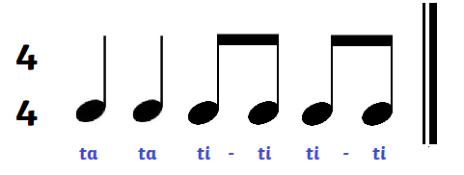
Ages: Year 3 - Year 6
Rhythm Whispers
Depending on class size, this can be played in small groups of five or six children or in two larger teams.
Each team chooses a leader. The teacher shows the leaders a four-beat rhythm.
For example:
Develops:
Inner beat and tempo
Rhythm knowledge
Listening/aural skills
Social skills
Focus & concentration
Memory
The teams line up in a straight line. The leader then has to whisper the rhythm to the next person and then that person whispers to the next and so forth. Once the final person is whispered to and has the rhythm, they need to go to the whiteboard and write the rhythm correctly using rhythmic notation (as above).
Alternatively, you might like to give each group a mini whiteboard or piece of paper to use.
This is a fun game that strengthens understanding of rhythmic notation and rhythm syllables.

Slide 14
Ages: Year 3 - Year 6
Circle Ball Rhythms
Children form a circle and the teacher introduces three different coloured balls. Each ball has a different way that it needs to be passed around the circle.
Develops:
Inner beat and tempo
Listening/aural skills
Visual skills Motor skills Social skills
Quick thinking
Focus & concentration
Memory
Multi-tasking skills
Blue Ball 1: is thrown to someone in the circle after their name is called. Make sure students call the person’s name before throwing it to them to give them warning.
Yellow Ball 2: is bounced to another person whilst yelling an angry ‘ha.’
Red Ball 3: is rolled along the ground to someone whilst saying ‘sssss.’

Slide 15
Ages: Year 3 - Year 6
Circle Ball Rhythms
The verbal sounds are important as they are a warning that each ball is about to move so students can use both their eyes and ears to track and focus on the three paths of the balls. When playing this game, you will need to slowly build to having the three balls moving at the same time. Practise with the first ball a number of times and get the children to keep the same order of people passing the ball around the class. This will test their memory skills but also give them one element that remains consistent and predictable when you slowly add the other two balls.
The first time you play, you may only be able to cope with the one ball. That is fine! If you only want to use one ball, you can make it more challenging by getting the children to pass it in the same order and time how fast they can get through one rotation of the class. Then if the teacher shouts ‘reverse,’ the children need to pass in the reverse order! So, they need to remember both who they received the ball from AND who they passed it to!
Children need to concentrate and always be aware, watching their surroundings so they are ready.

