Slide 2
s
a
t
p
Click on a letter to jump to the appropriate slides

Slide 3
s
Phase 2 Set 1

Slide 4
s
Sounds like…
s
s

Slide 5
s
Write the Sound

Slide 6
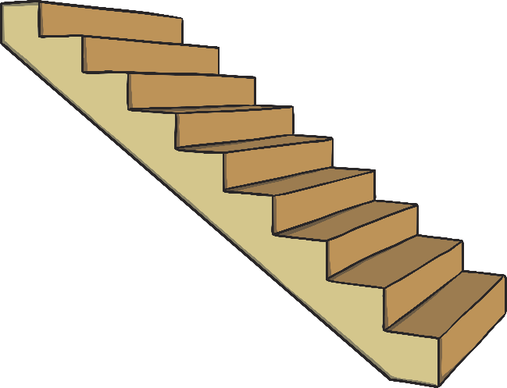
s
Click on the letter to see what starts with /s/.

Slide 7
Click to read through each word.
sap
as
sat

Slide 8
a
Phase 2 Set 1

Slide 9
a
Sounds like…
a
a

Slide 10
a
Write the Sound

Slide 11
a
Click on the letter to see what starts with /a/.

Slide 12
Click to read through each word.
pat
tap
sap
as
at
a

Slide 13
t
Phase 2 Set 1

Slide 14
t
Sounds like…
t
t

Slide 15
t
Write the Sound

Slide 16
t
Click on the letter to see what starts with /t/.

Slide 17
Click to read through each word.
at
tap
pat

Slide 18
p
Phase 2 Set 1

Slide 19
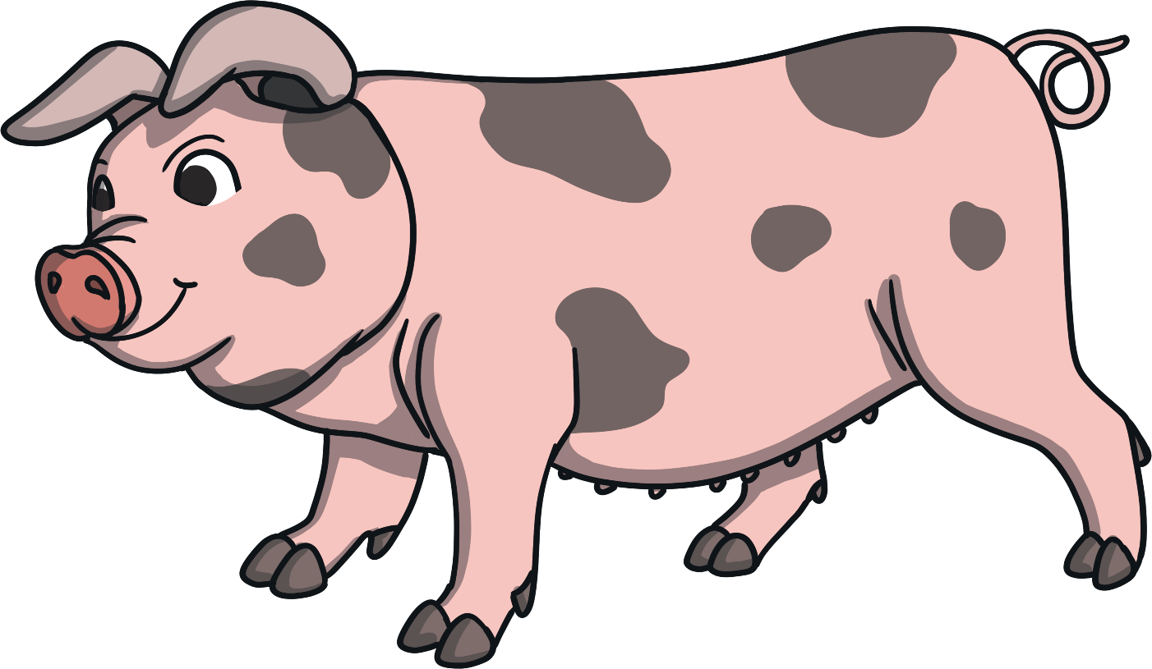
p
Sounds like…
p
p

Slide 20
p
Write the Sound

Slide 21
p
Click on the letter to see what starts with /p/.

Slide 22
Click to read through each word.
pat
tap
sap

