Slide 2
The Letter F Looks Like This…
f
F
Click on the pencil to see the letter formation.
Can you draw it with your finger?

Slide 3
The Letter F Sounds Like This…
F, F, F
Teaching Note: Say the sound /f/ and have children repeat it back multiple times.

Slide 4
It Can Also Look like This...

Slide 5
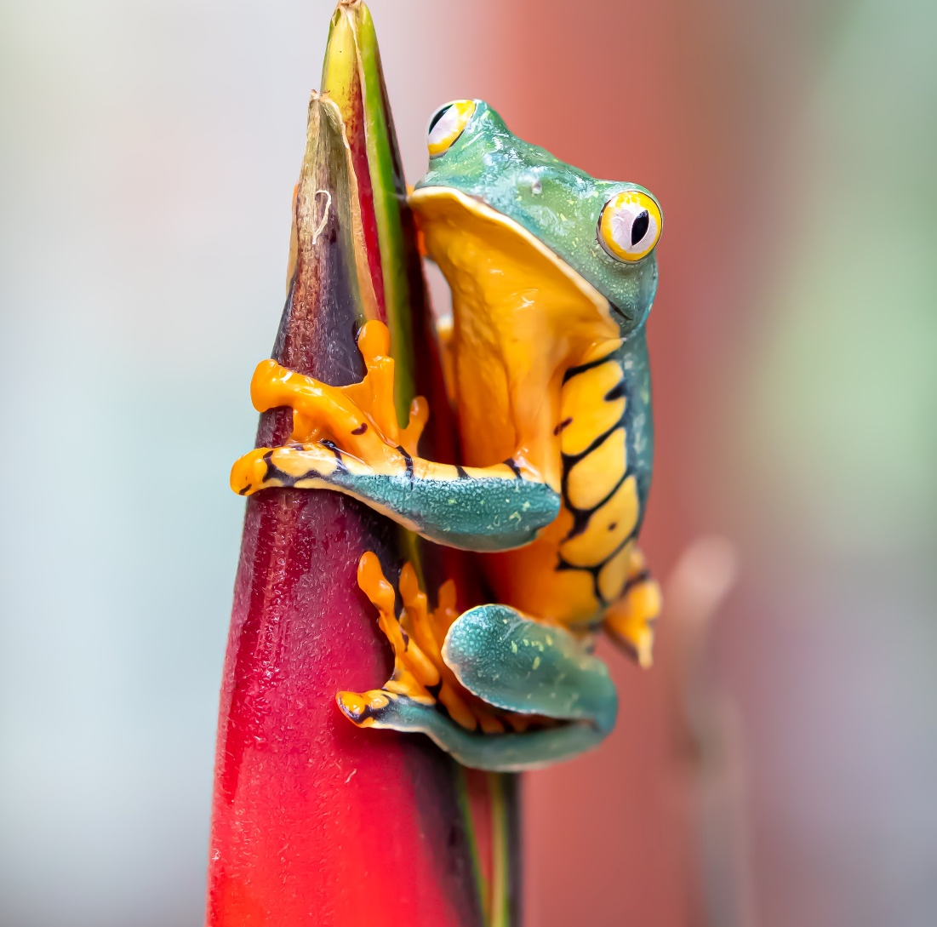
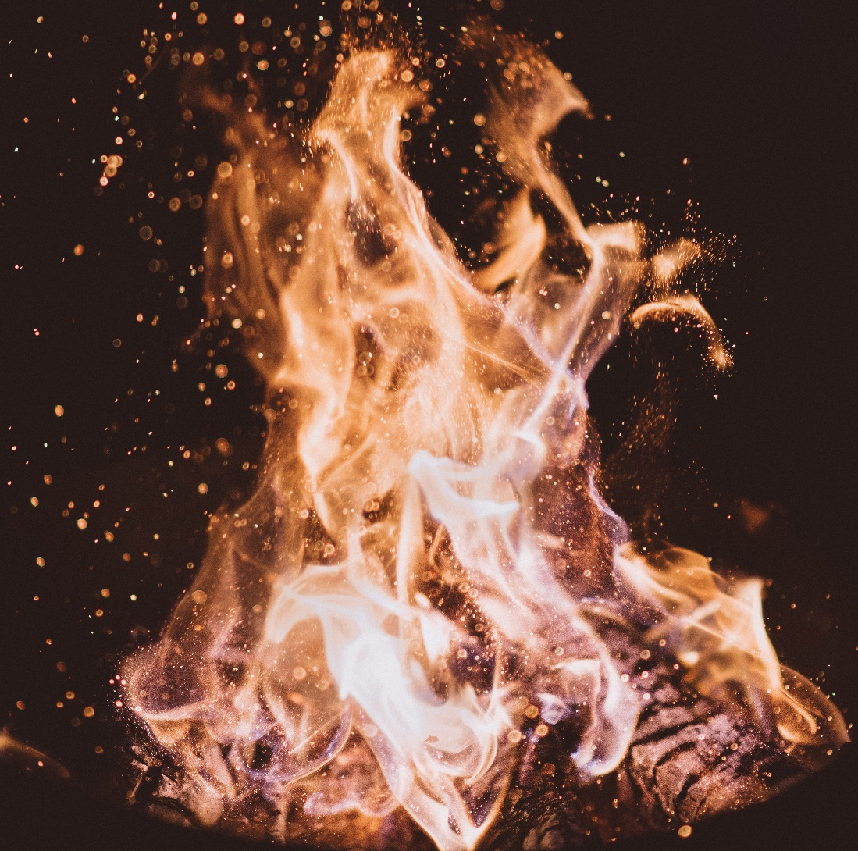
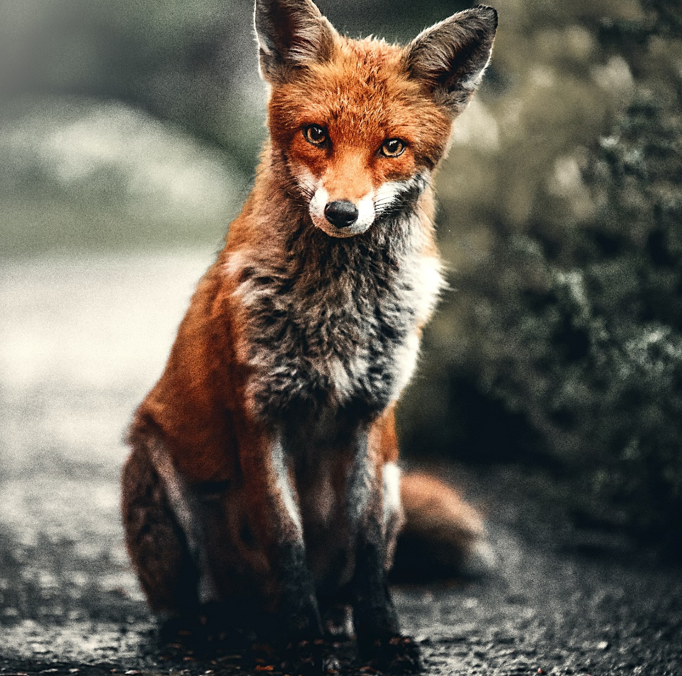
Some Things That Start With F Are…

Slide 6
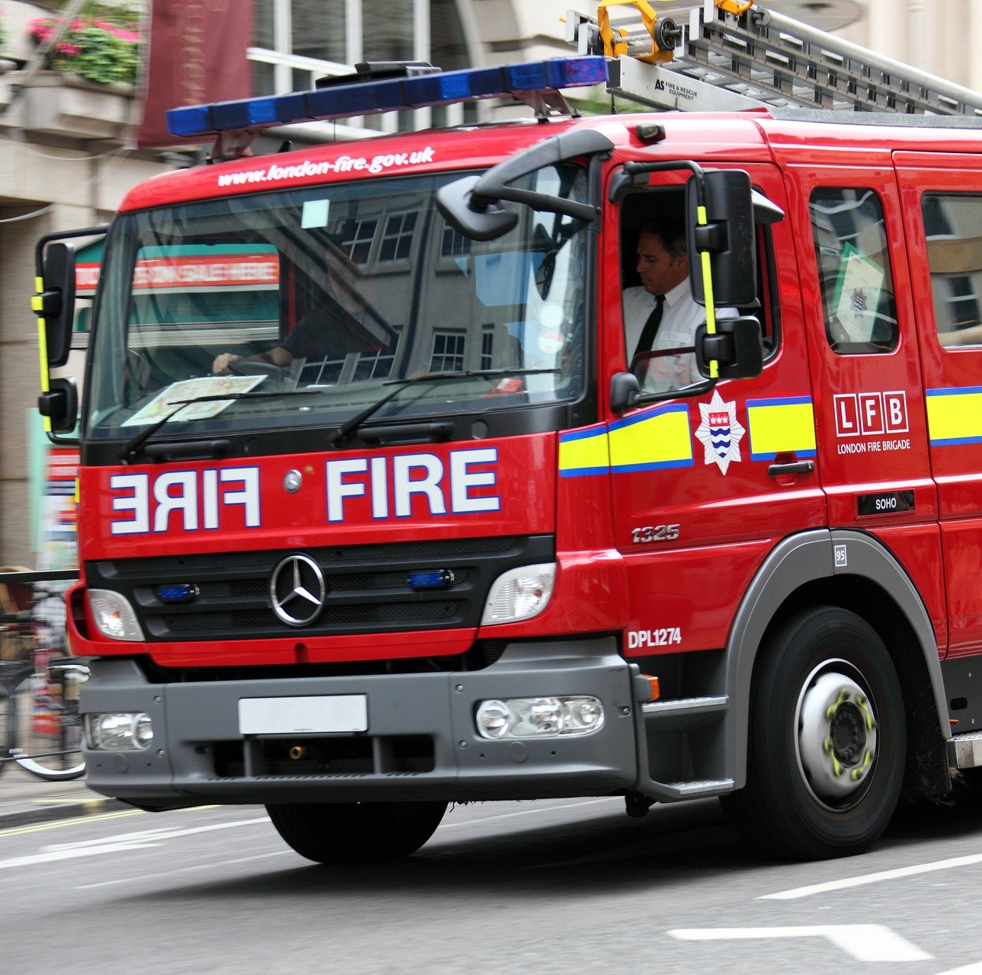
Some Things That Start With F Are…

Slide 7
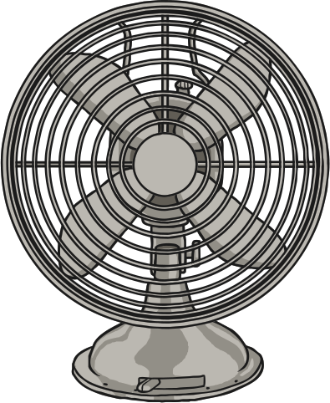
Which of These Start with F?
TRY AGAIN!
YES!
Teaching note: Pause briefly after the initial sound of each word to assist students to identify the sounds.

Slide 8
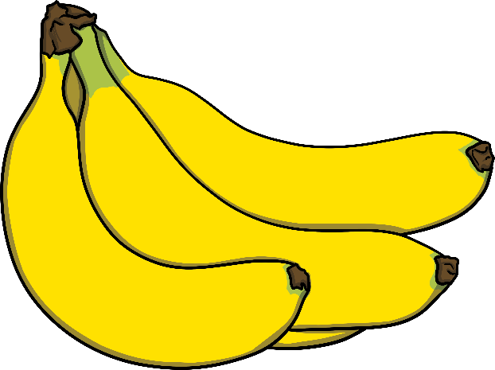
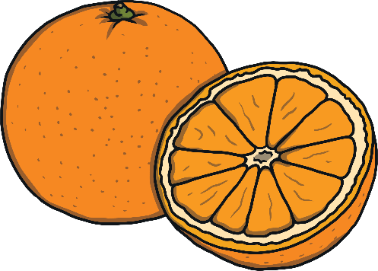
Which of These Start with F?
TRY AGAIN!
YES!
Teaching note: Pause briefly after the initial sound of each word to assist students to identify the sounds.

Slide 9
Which of These Start with F?
TRY AGAIN!
YES!
Teaching note: Pause briefly after the initial sound of each word to assist students to identify the sounds.

Slide 10
Which of These Start with F?
TRY AGAIN!
YES!
Teaching note: Pause briefly after the initial sound of each word to assist students to identify the sounds.

