Slide 2
The Letter B Looks like This…
B
b
Click on the pencil to see the letter formation.
Can you draw it with your finger?

Slide 3
The Letter B Sounds like This…
B, B, B
Teaching note: Say the sound /b/ and have children repeat it back multiple times.

Slide 4
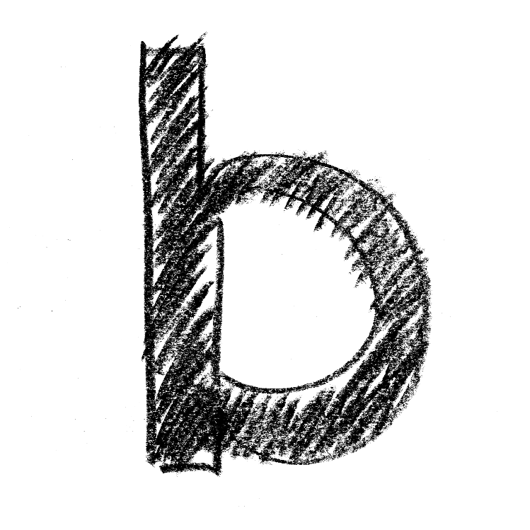
It Can Also Look like This…

Slide 5
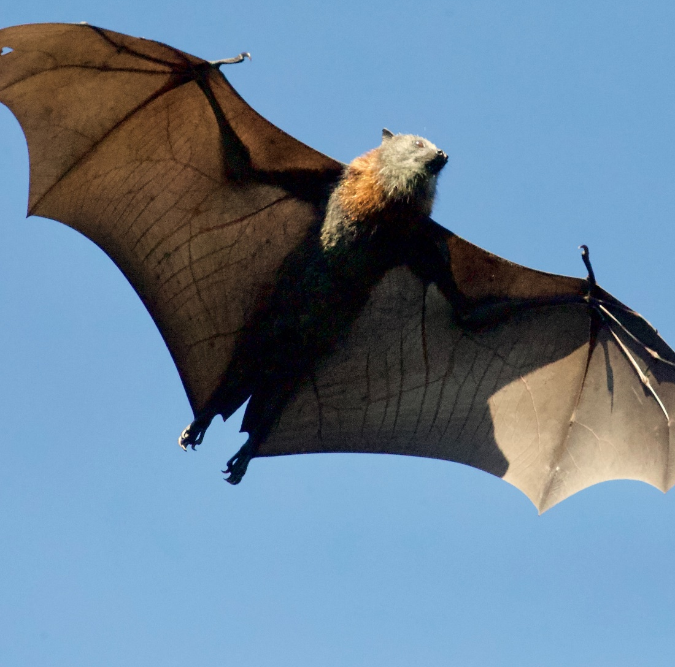
Some Things That Start with B Are…

Slide 6
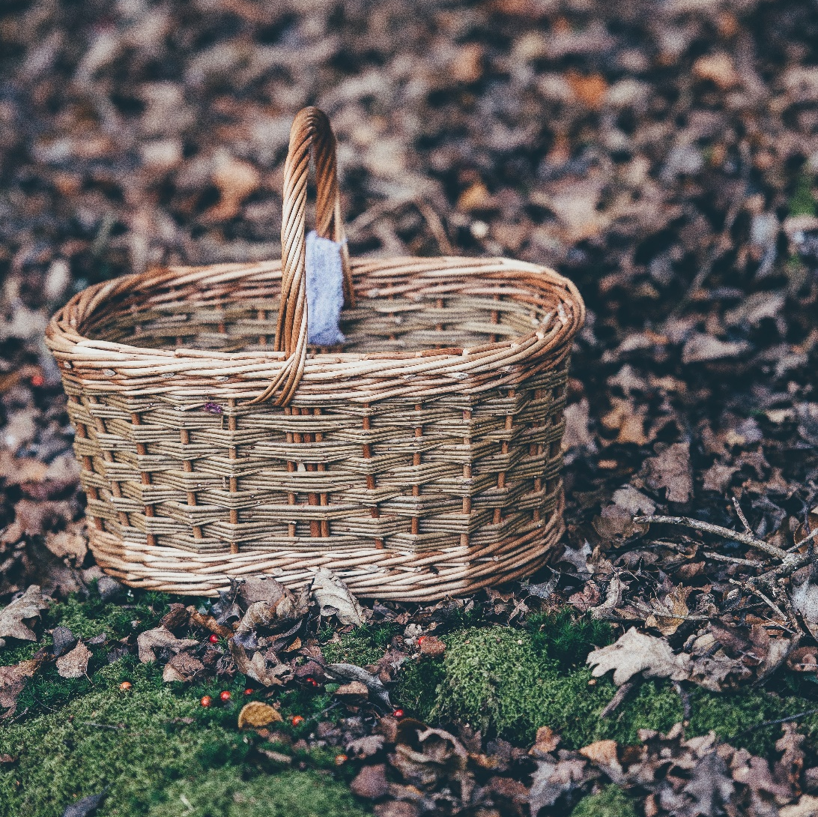
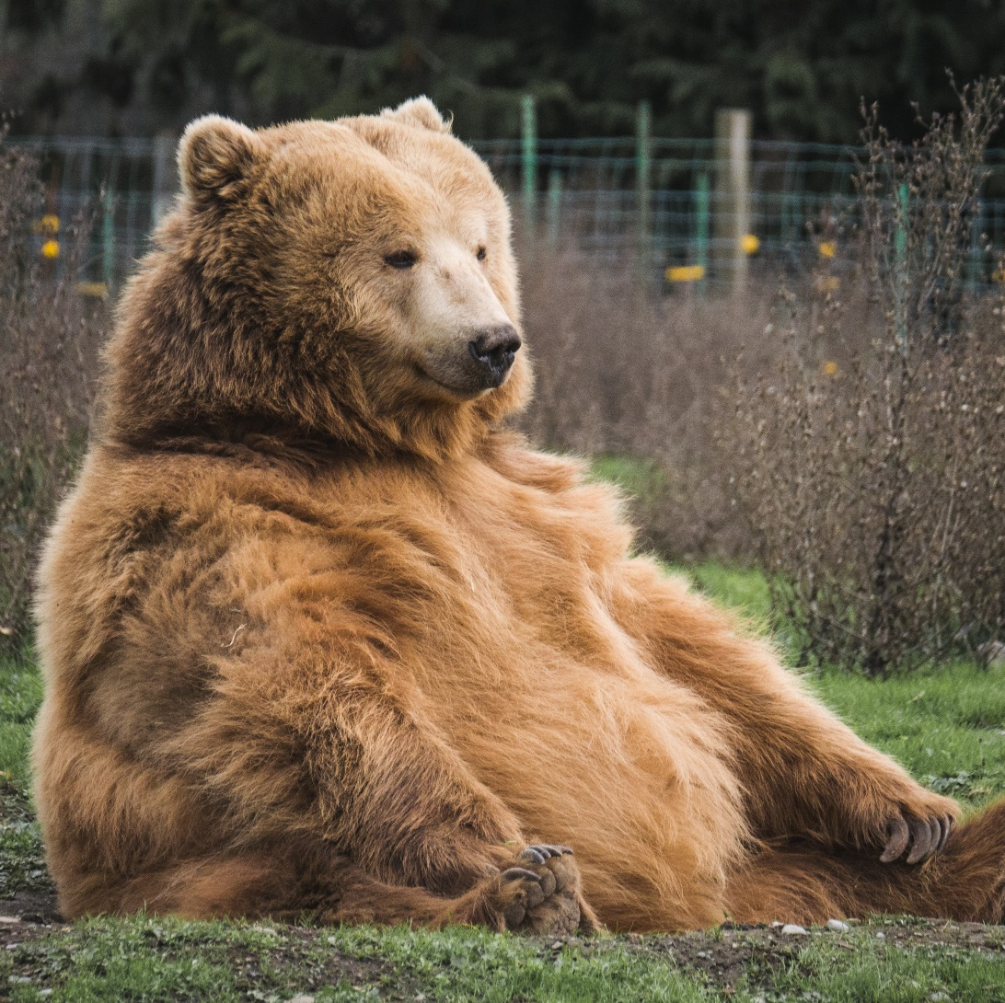
Some Things That Start with B Are…

Slide 7
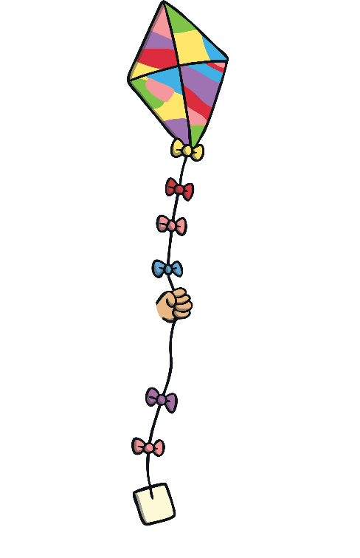
Which of These Start with B?
TRY AGAIN!
YES!
Teaching note: Pause briefly after the initial sound of each word to assist students to identify the sounds.

Slide 8
Which of These Start with B?
TRY AGAIN!
YES!
Teaching note: Pause briefly after the initial sound of each word to assist students to identify the sounds.

Slide 9
Which of These Start with B?
TRY AGAIN!
YES!
Teaching note: Pause briefly after the initial sound of each word to assist students to identify the sounds.

Slide 10
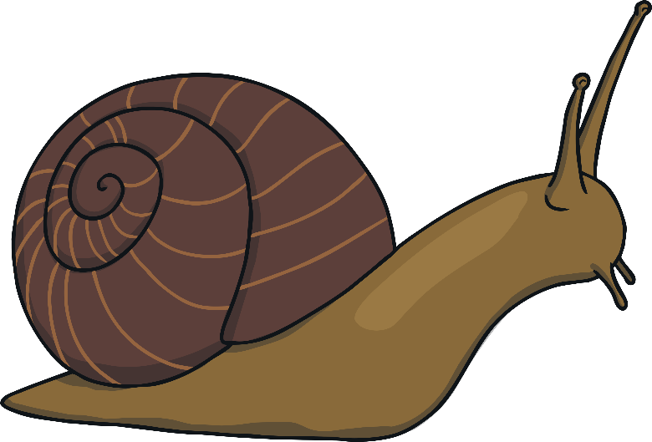
Which of These Start with B?
TRY AGAIN!
YES!
Teaching note: Pause briefly after the initial sound of each word to assist students to identify the sounds.

