Slide 1
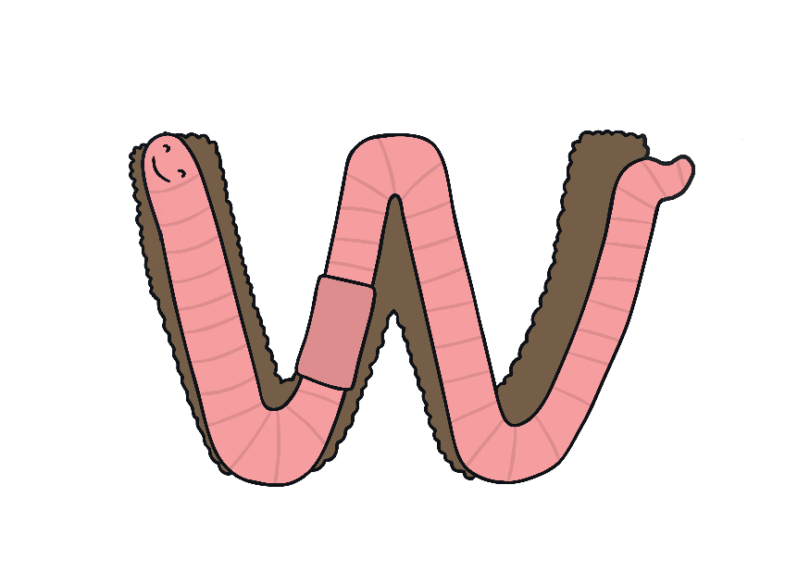
W

Slide 2
The Letter W Looks like This…
W
w
Can you draw it with your finger?

Slide 3
The Letter W Sounds like This…
W, W, W
Notes:
Say the sound /w/ and have children repeat it back multiple times.

Slide 4
It Can Also Look like This…

Slide 5
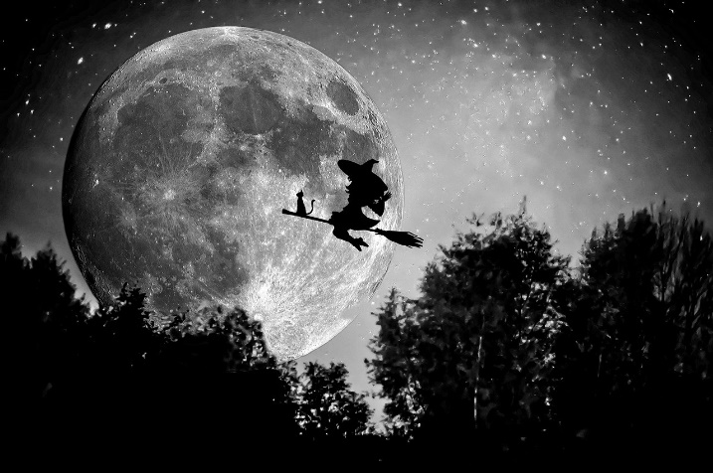
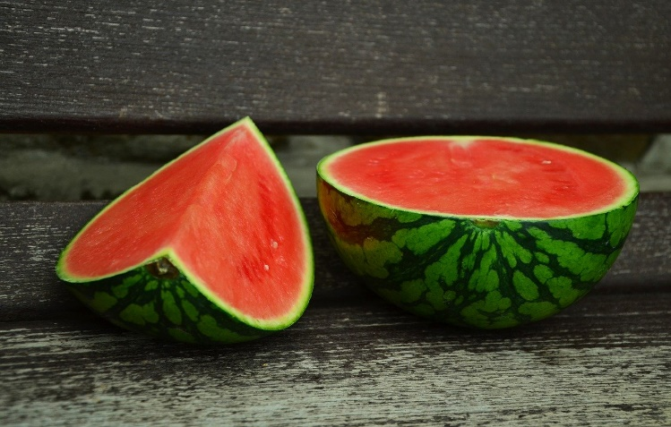
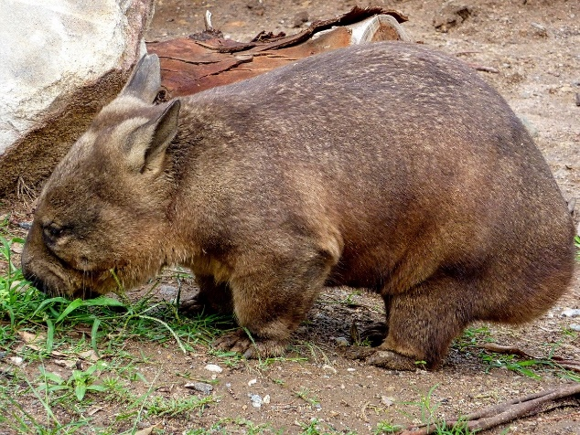
Some Things That Start with W Are…

Slide 6
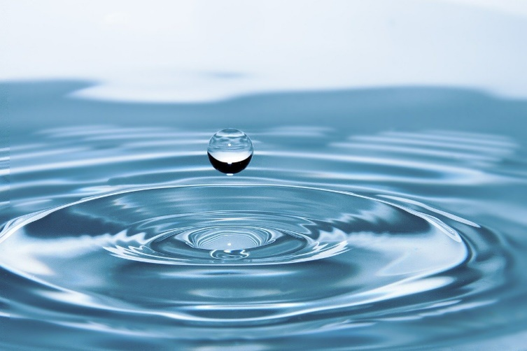
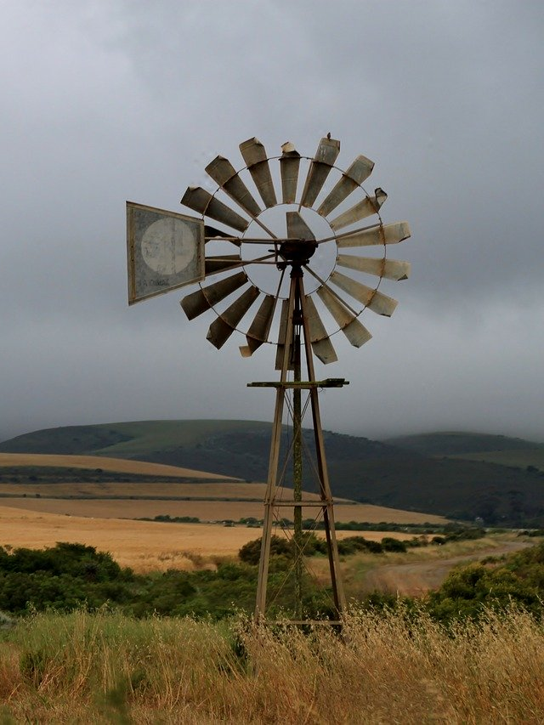
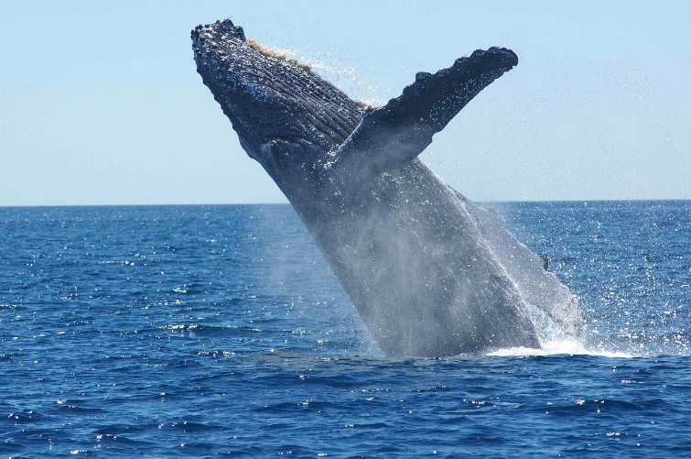
Some Things That Start with W Are…

Slide 7
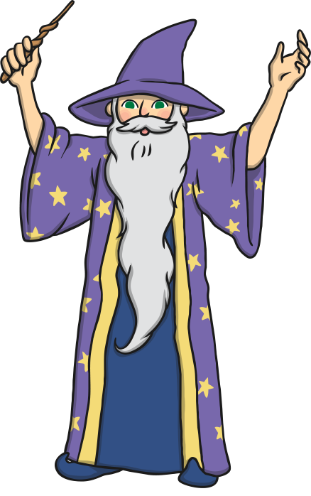
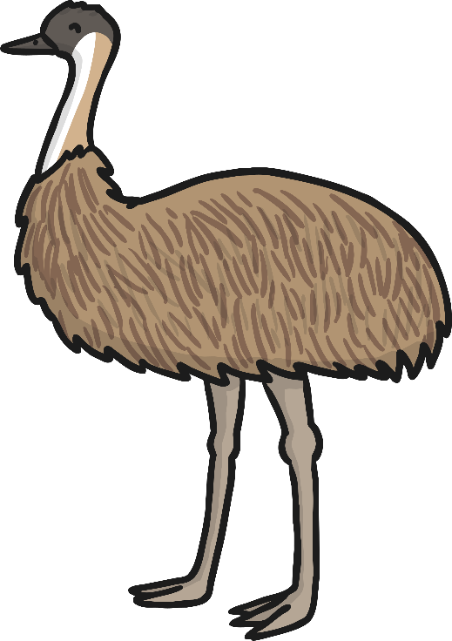
Which of These Start with W?
TRY AGAIN!
YES!
Notes:
Pause briefly after the initial sound of each word to assist students to identify the sounds.

Slide 8
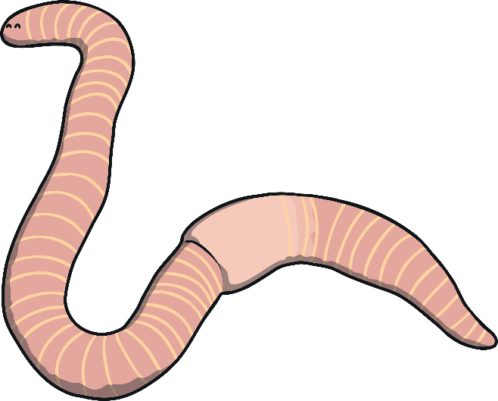
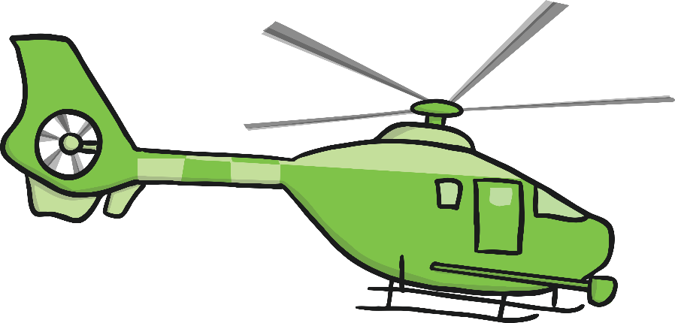
Which of These Start with W?
TRY AGAIN!
YES!

Slide 9
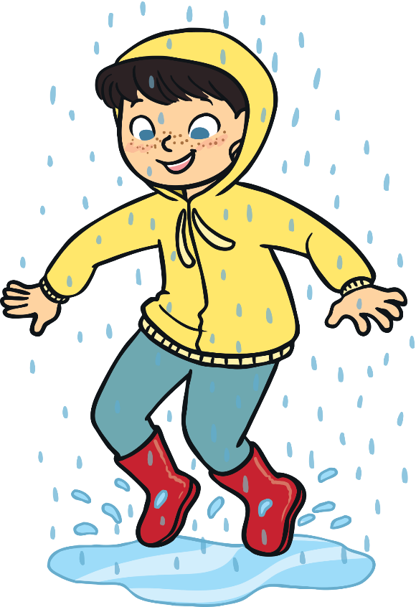
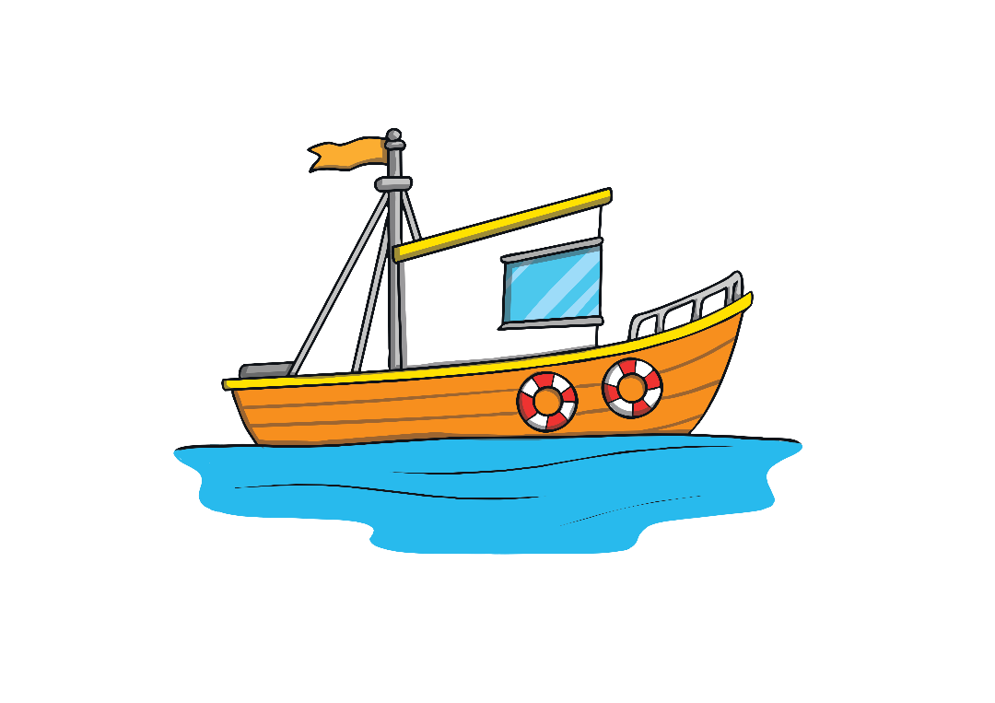
Which of These Start with W?
TRY AGAIN!
YES!

Slide 10
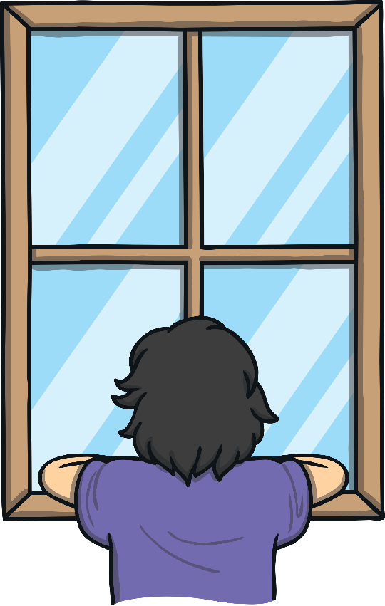
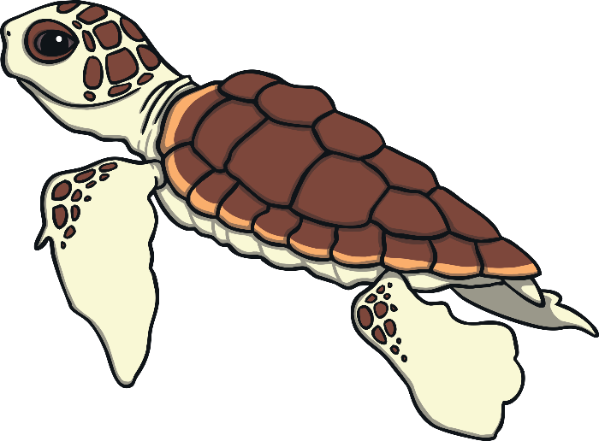
Which of These Start with W?
TRY AGAIN!
YES!

