Slide 1
H

Slide 2
The Letter H Looks like This…
H
h
Can you draw it with your finger?

Slide 3
The Letter H Sounds like This…
H, H, H
Notes:
Say the sound /h/ and have children repeat it back multiple times.

Slide 4
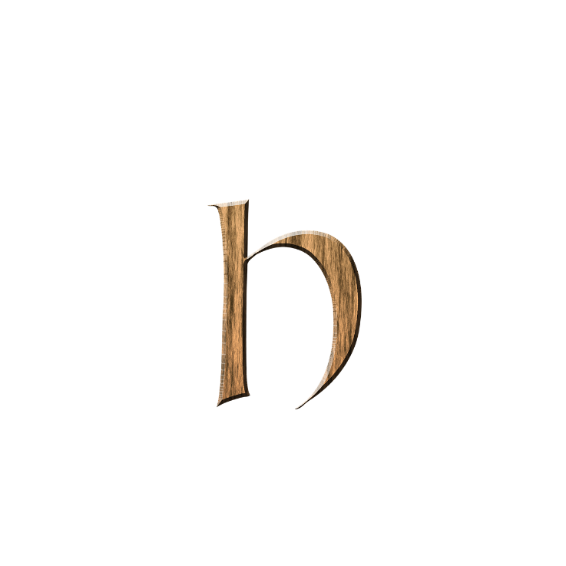
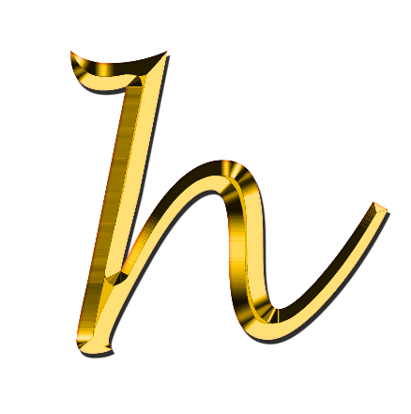
It Can Also Look like This…

Slide 5
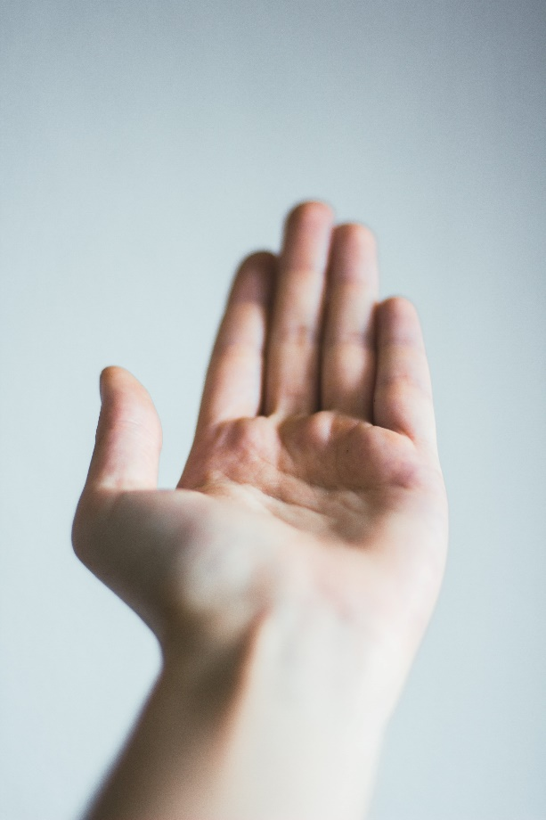
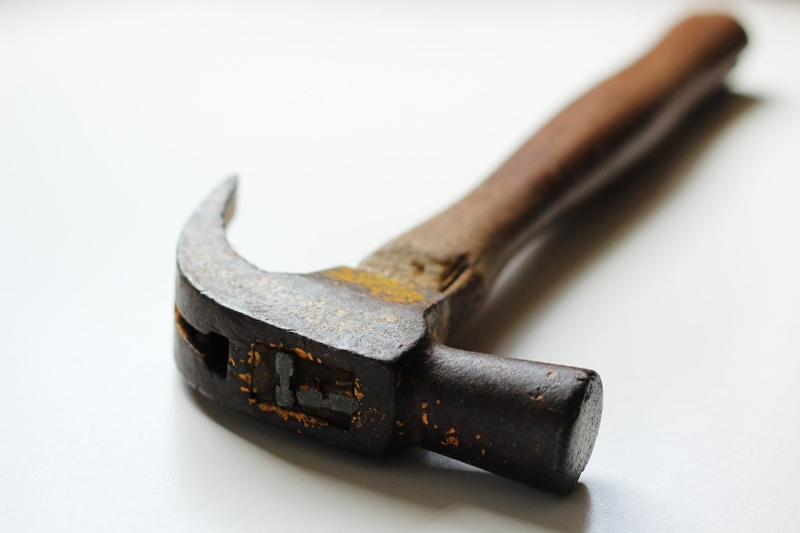
Some Things That Start with H Are…
Notes:
Heart, hand, hammer

Slide 6
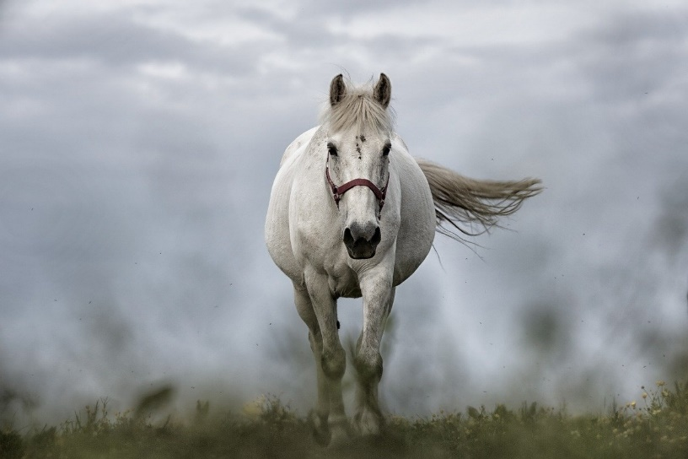
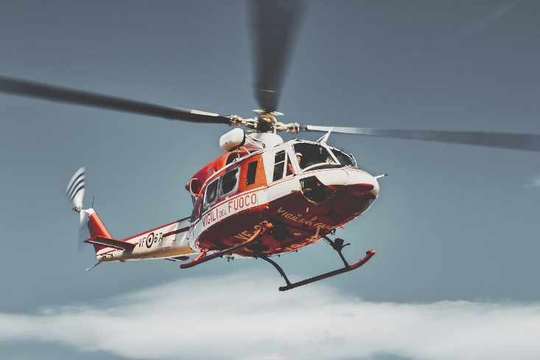
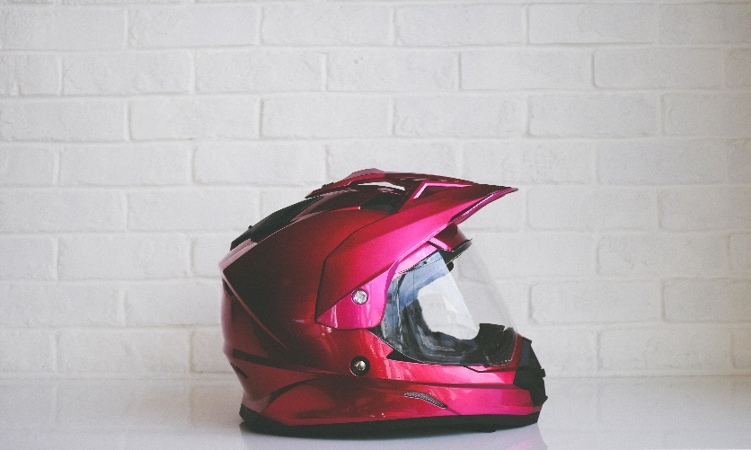
Some Things That Start with H Are…
Notes:
Horse, helicopter, helmet

Slide 7
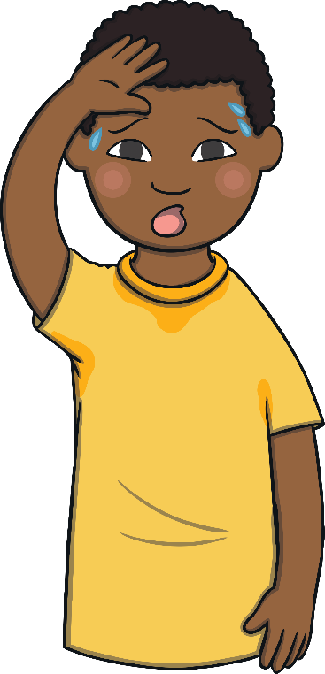
Which of These Start with H?
TRY AGAIN!
YES!
Notes:
Pause briefly after the initial sound of each word to assist students to identify the sounds.
Piano, hot

Slide 8
Which of These Start with H?
TRY AGAIN!
YES!
Notes:
House, sausage

Slide 9
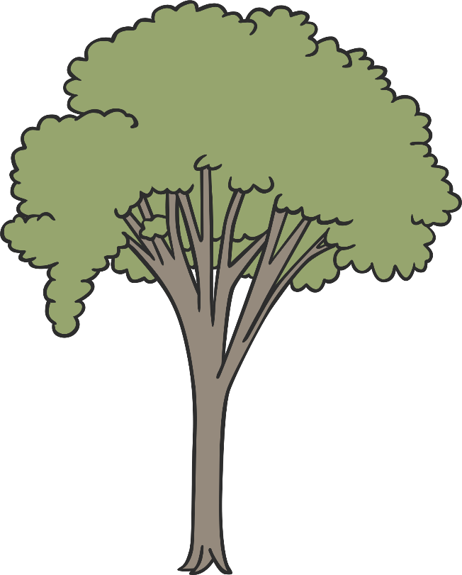
Which of These Start with H?
TRY AGAIN!
YES!
Notes:
Happy, tree

Slide 10
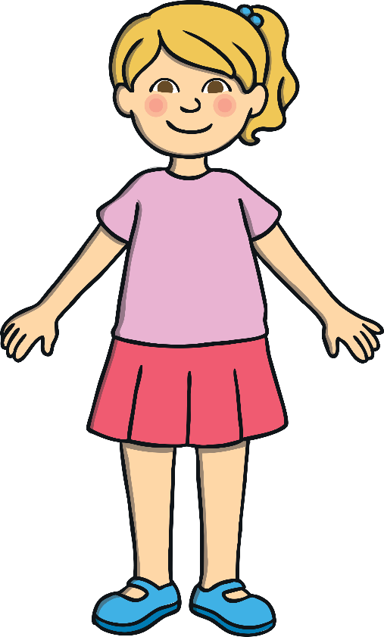
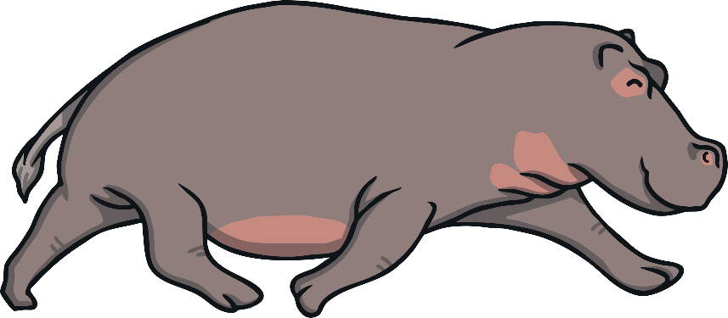
Which of These Start with H?
TRY AGAIN!
YES!
Notes:
Hippo, girl

