Slide 1
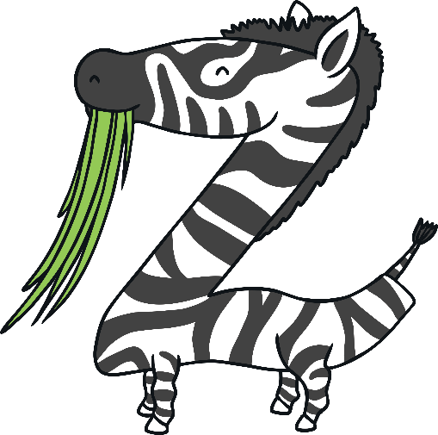
Z

Slide 2
The Letter Z Looks like This…
Z
z
Can you draw it with your finger?

Slide 3
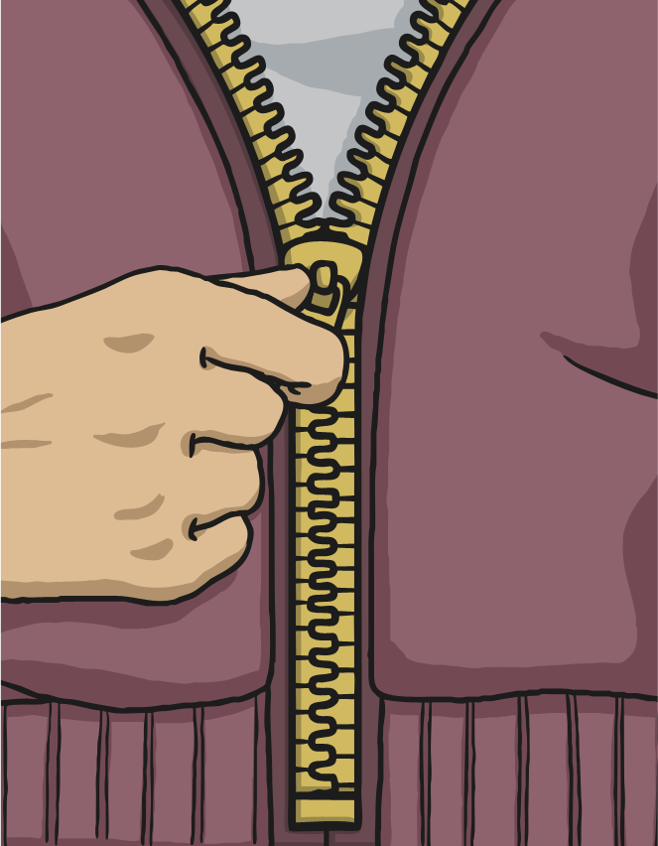
The Letter Z Sounds like This…
Z, Z, Z
Notes:
Say the sound /z/ and have children repeat it back multiple times.

Slide 4
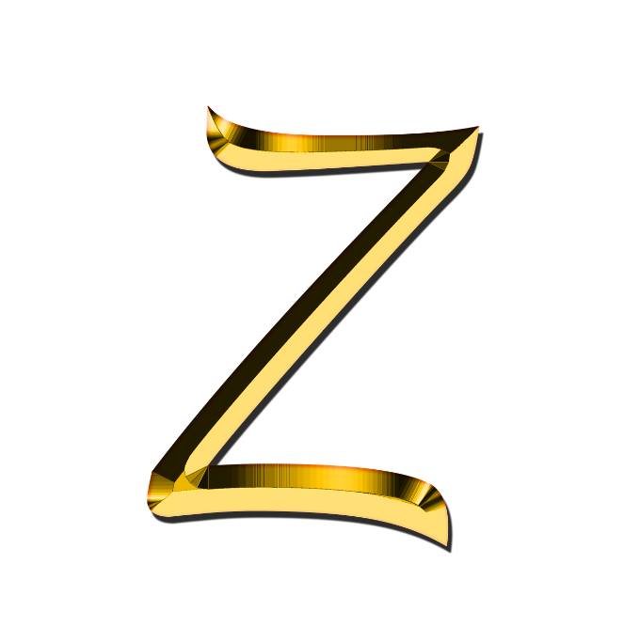
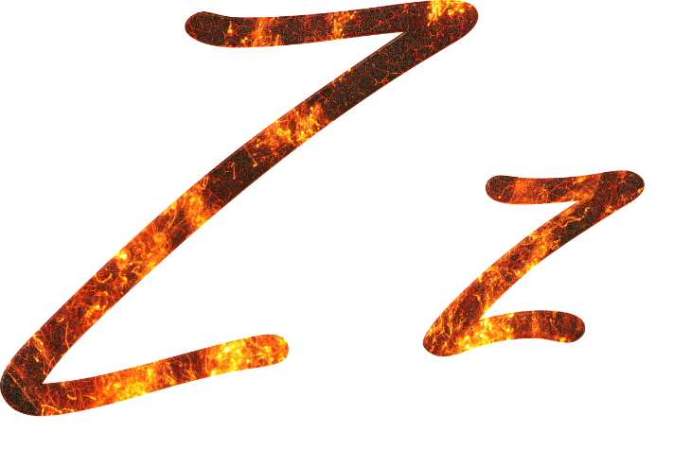
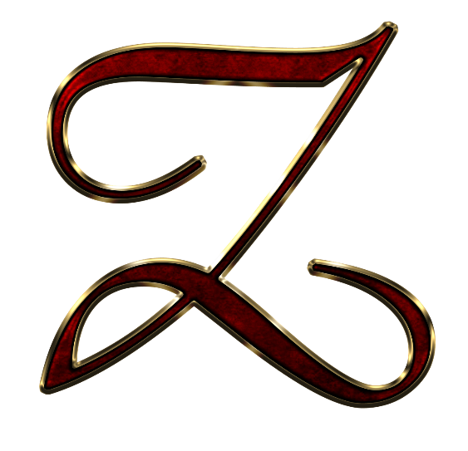
It Can Also Look like This…

Slide 5
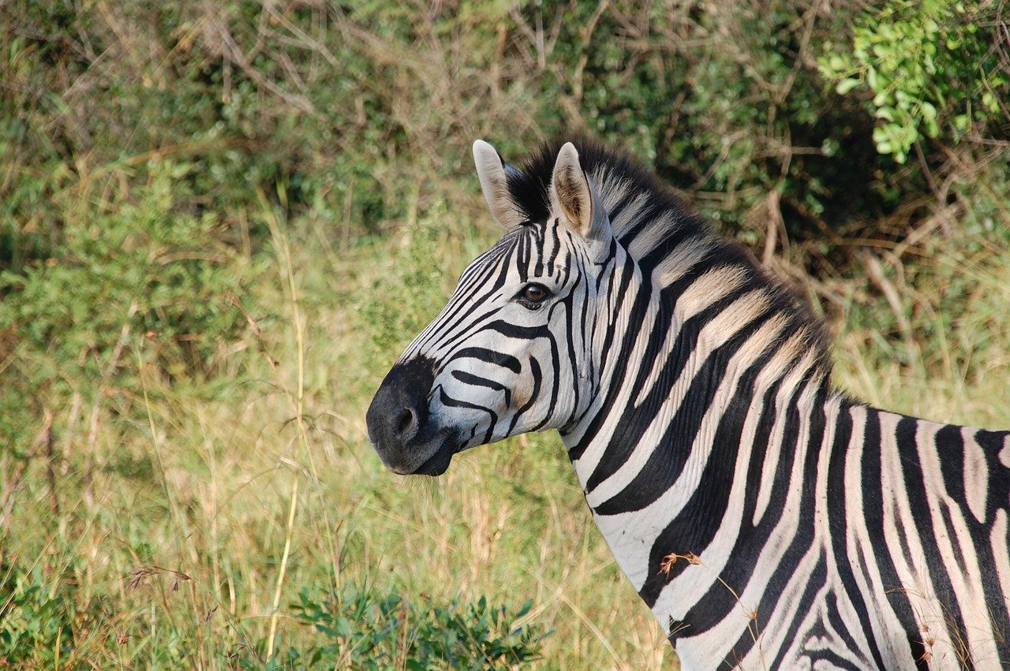
Some Things That Start with Z Are…
Notes:
Zebra, zigzag

Slide 6
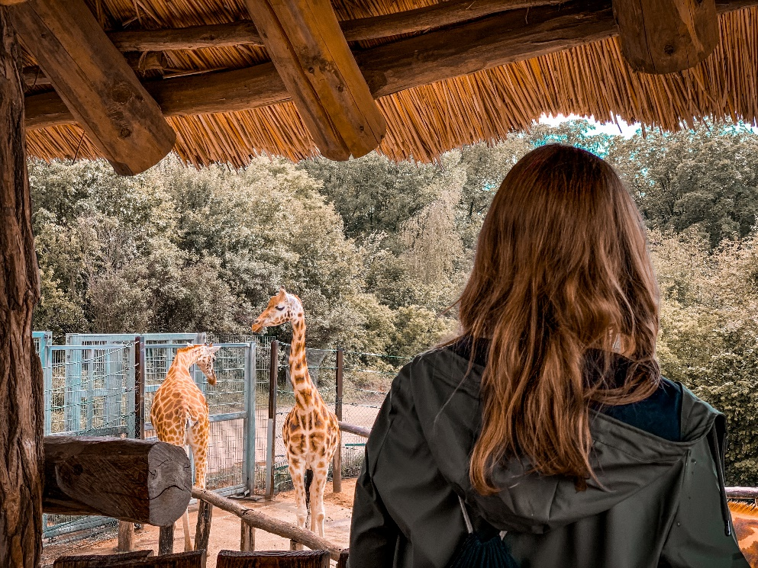
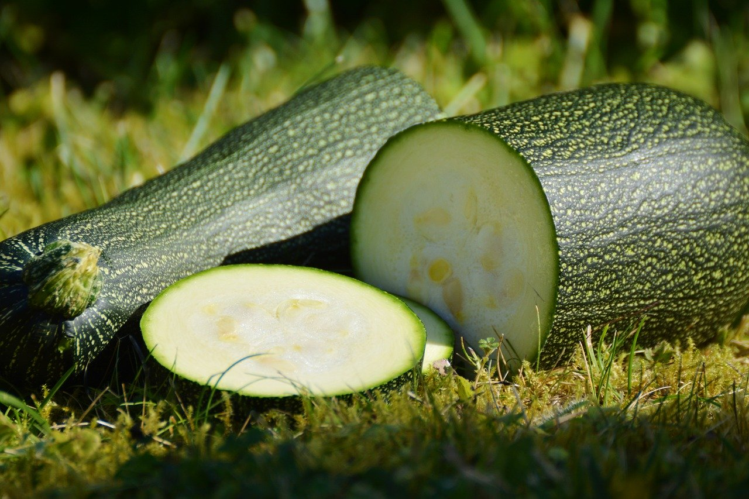
Some Things That Start with Z Are…
Notes:
zoo, zuchinni

Slide 7
Which of These Start with Z?
Try
Again!
0
Yes!
Notes:
Pause briefly after the initial sound of each word to assist students to identify the sounds
Zero, trampoline

Slide 8
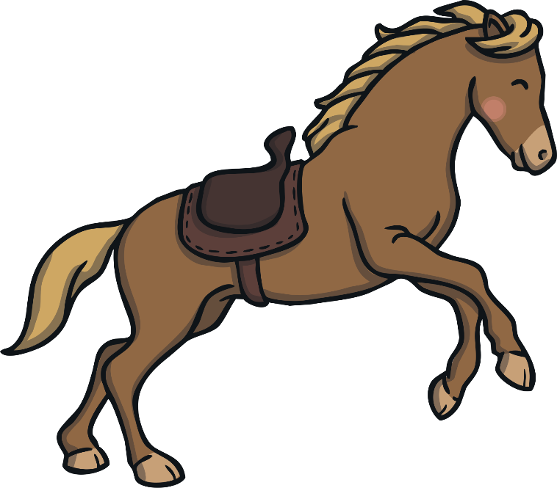
Which of These Start with Z?
Try
Again!
Yes!
Notes:
Zap, horse

Slide 9
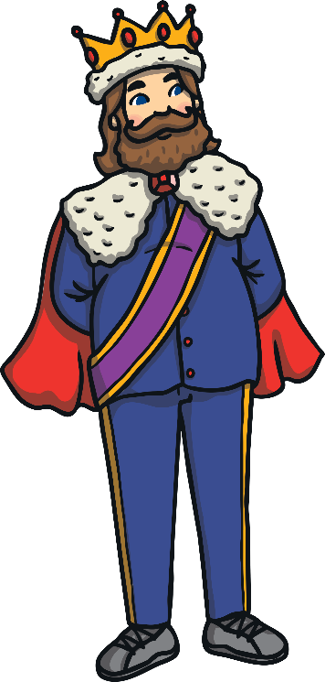
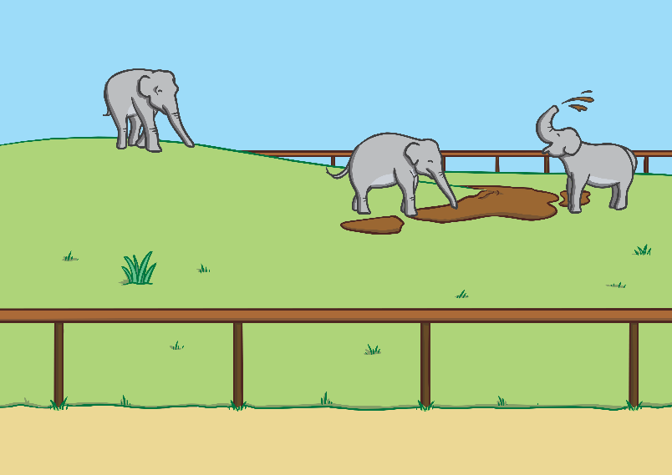
Which of These Start with Z?
Try
Again!
Yes!
Notes:
Zoo, king

Slide 10
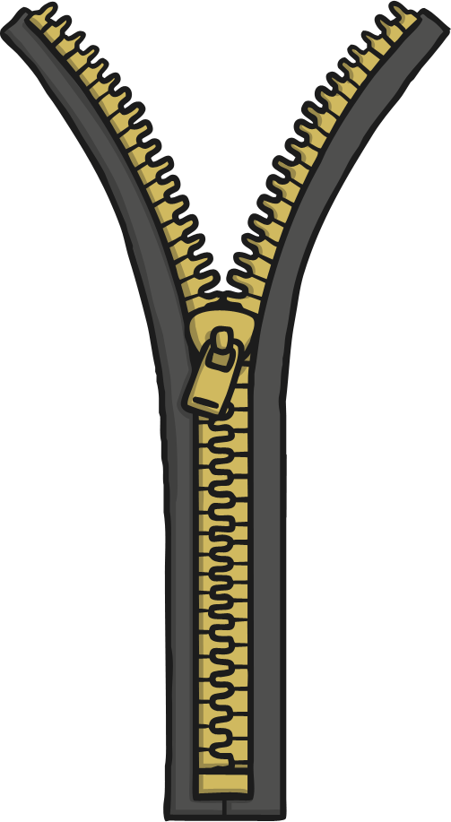
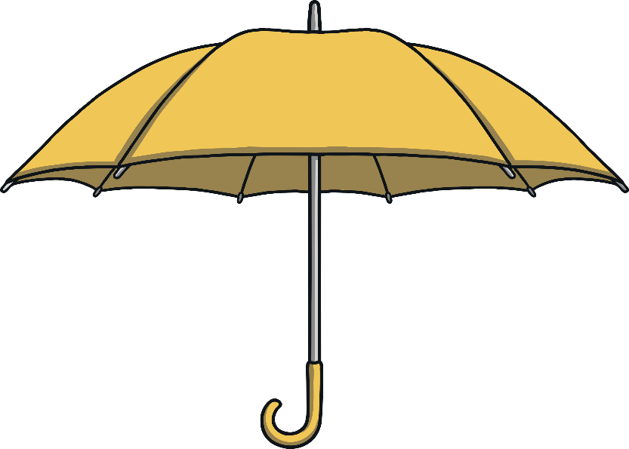
Which of These Start with Z?
Try
Again!
Yes!
Notes:
Zip, umbrella

