Slide 2
The Letter S Looks like This…
S
Click on the pencil to see the letter formation.
Can you draw it with your finger?

Slide 3
The Letter S Sounds like This…
S, S, S
Notes:
Teaching note: Say the sound /s/ and have children repeat it back multiple times.

Slide 4
It Can Also Look like This…

Slide 5
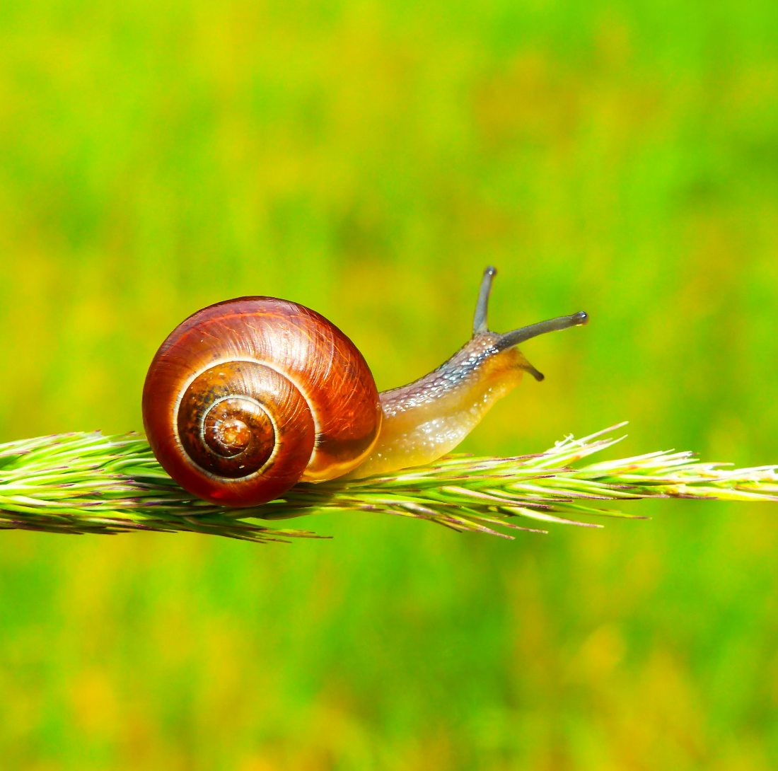
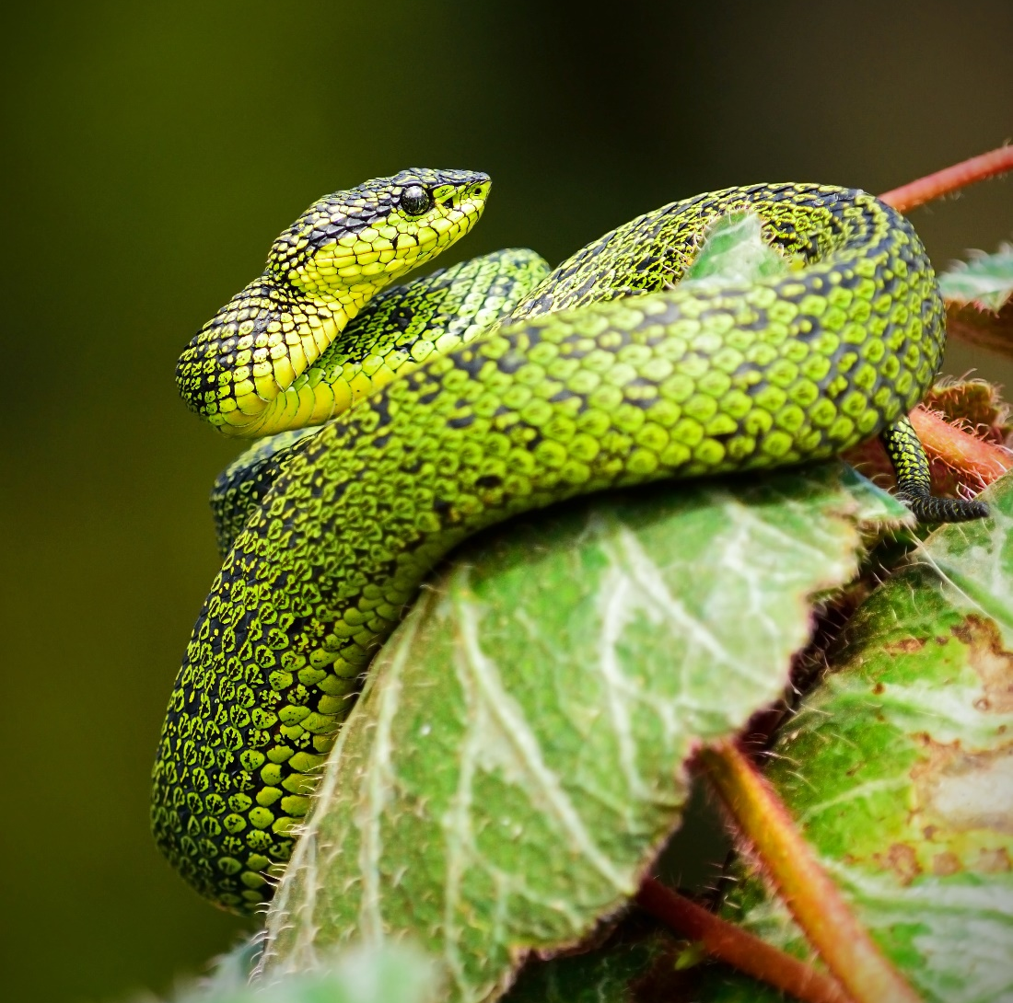
Some Things That Start with S Are…

Slide 6
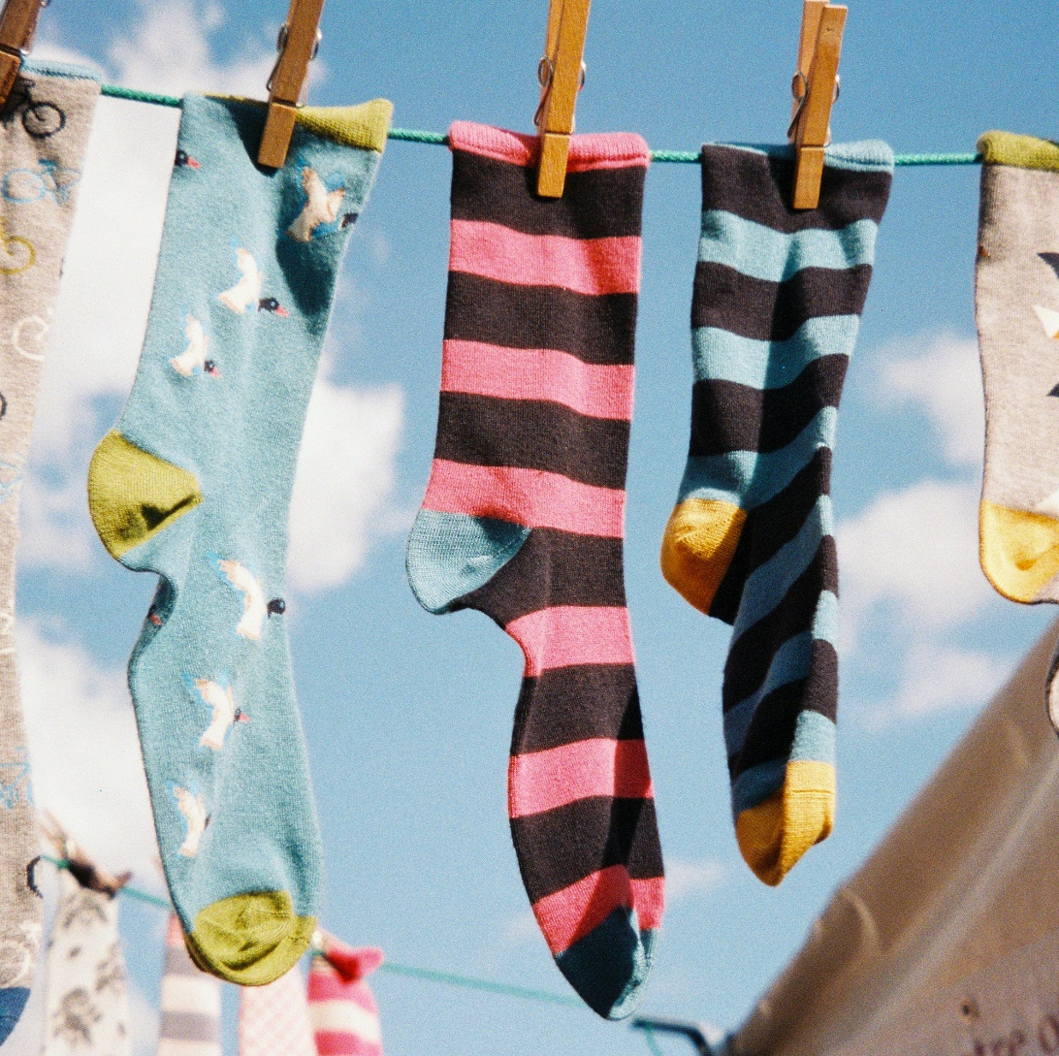
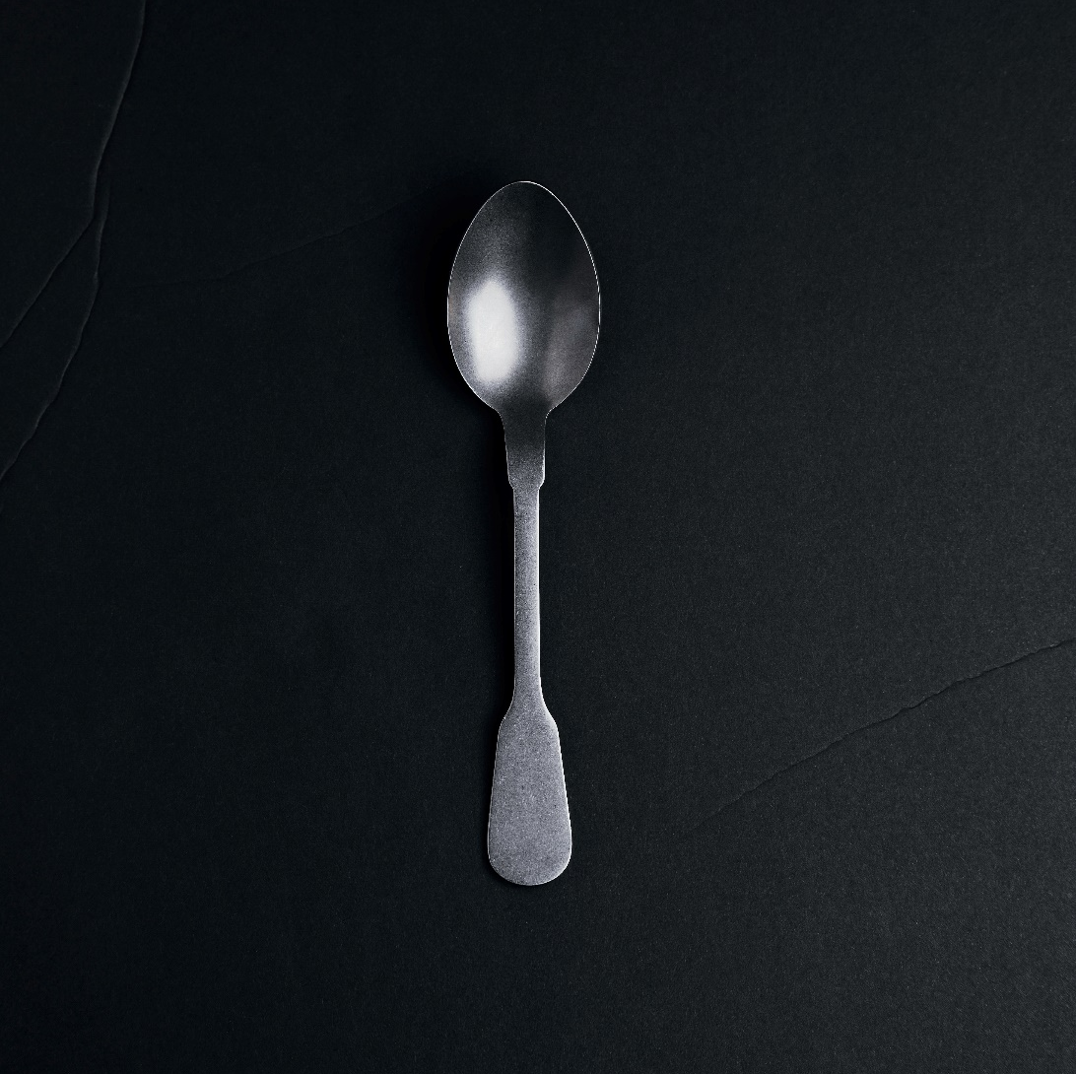
Some Things That Start with S Are…

Slide 7
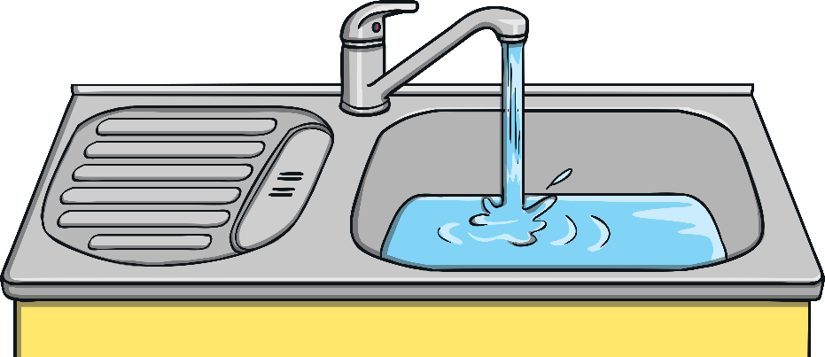
Which of These Start with S?
TRY AGAIN!
YES!
Notes:
Teaching note: Pause briefly after the initial sound of each word to assist students to identify the sounds.

Slide 8
Which of These Start with S?
TRY AGAIN!
YES!
Notes:
Teaching note: Pause briefly after the initial sound of each word to assist students to identify the sounds.

Slide 9
Which of These Start with S?
TRY AGAIN!
YES!
Notes:
Teaching note: Pause briefly after the initial sound of each word to assist students to identify the sounds.

Slide 10
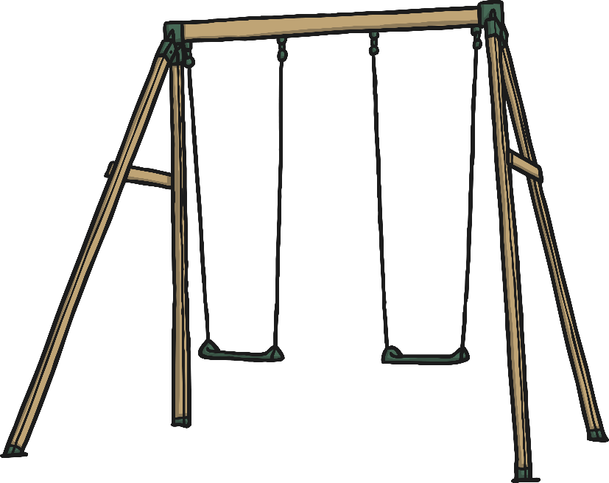
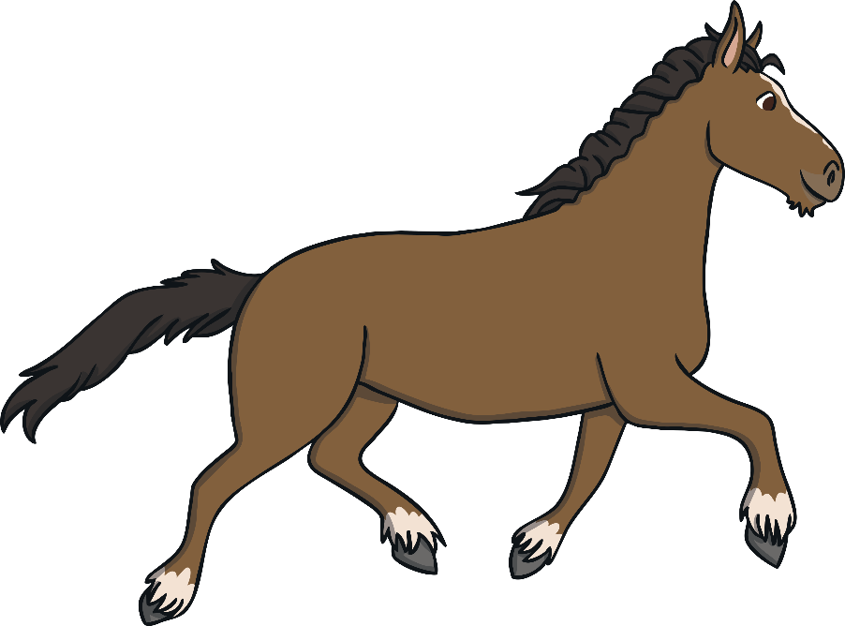
Which of These Start with S?
TRY AGAIN!
YES!
Notes:
Teaching note: Pause briefly after the initial sound of each word to assist students to identify the sounds.

