Slide 2
The Letter L Looks Like This…
l
Click on the pencil to see the letter formation.
Can you draw it with your finger?

Slide 3
The Letter L Sounds Like This…
L, L, L
Teaching note: Say the sound /l/ and have children repeat it back multiple times

Slide 4
It Can Also Look Like This…

Slide 5
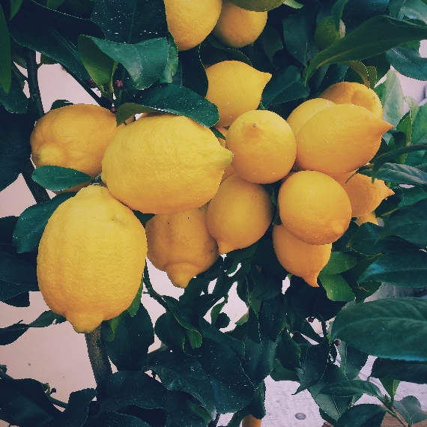
Some Things That Start With L Are…

Slide 6
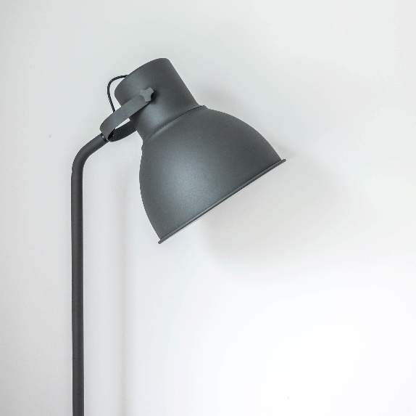
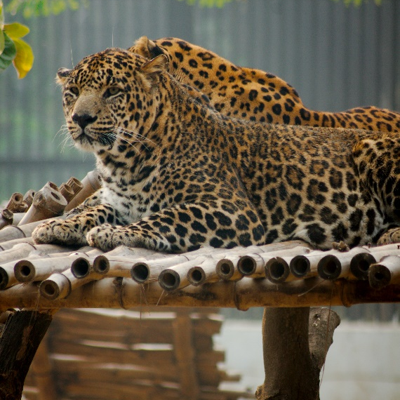
Some Things That Start With L Are…

Slide 7
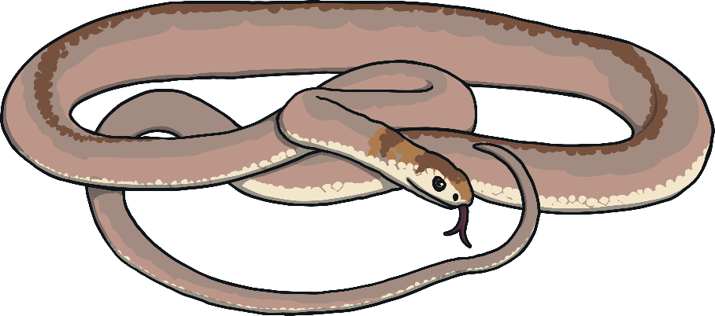
Which of These Start With L?
TRY AGAIN!
YES!
Teaching note: Pause briefly after the initial sound of each word to assist students to identify the sounds

Slide 8
Which of These Start With L?
TRY AGAIN!
YES!
Teaching note: Pause briefly after the initial sound of each word to assist students to identify the sounds

Slide 9
Which of These Start With L?
TRY AGAIN!
YES!
Teaching note: Pause briefly after the initial sound of each word to assist students to identify the sounds

Slide 10
Which of These Start With L?
TRY AGAIN!
YES!
Teaching note: Pause briefly after the initial sound of each word to assist students to identify the sounds

