Slide 2
a-e
i-e
o-e
e-e
u-e
These sounds are called split digraphs.
They are made up of a vowel, the letter e, plus another consonant letter in between them - splitting them apart!
When you say these split digraph sounds, the first vowel sounds like it’s saying its name.

Slide 3
i-e
a-e
e-e
u-e
o-e
Click on a sound to learn more about it!

Slide 4
a-e
Phase 5 Vowel Digraphs

Slide 5
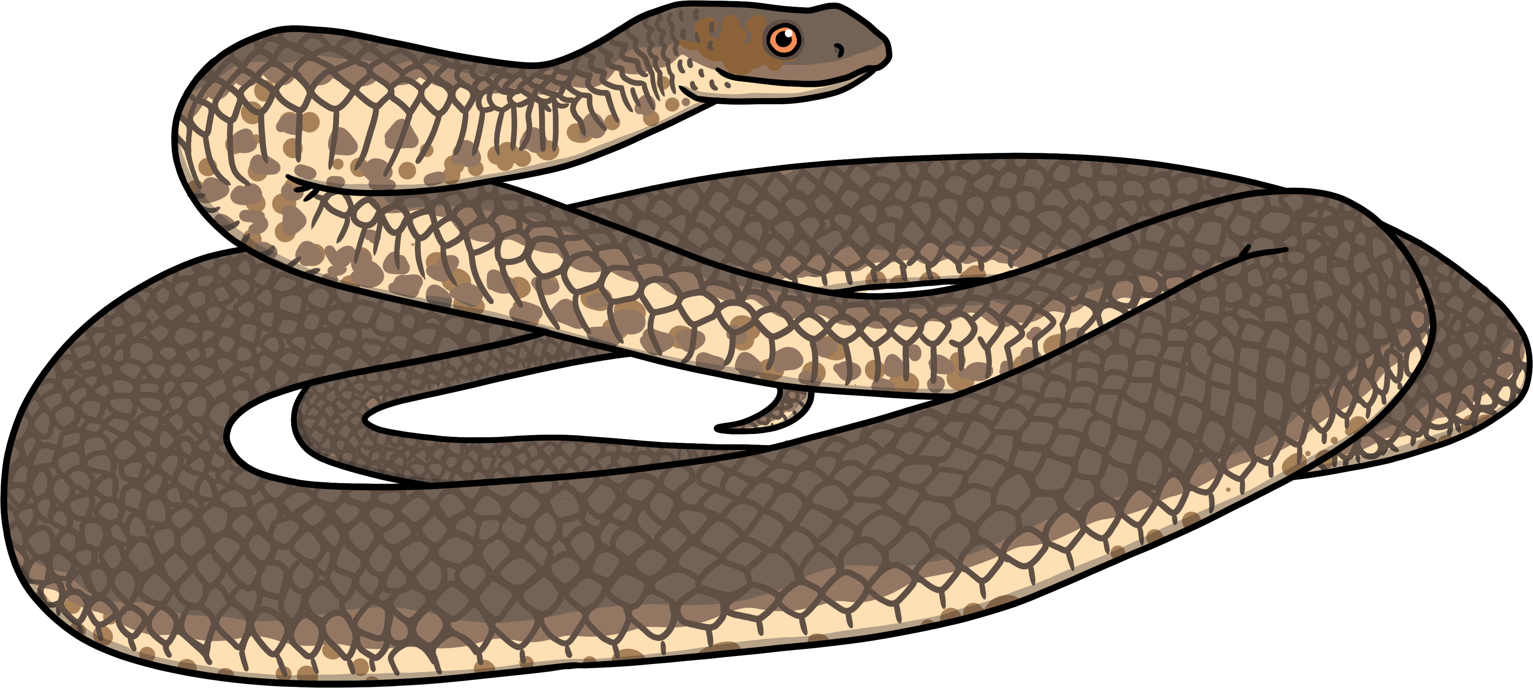
a-e a-e a-e
Sounds like…
Notes:
snail

Slide 6
a-e
Write the Sound
Practise writing the sound with your finger in the air and then on the floor.

Slide 7
a-e
The split digraph a-e makes two slightly different sounds. Can you hear the difference?
Click on the letters to see which words have the ‘a-e’ sound.
Notes:
train, nail, paint, tail

Slide 8
Click to read through each word.
cake
face
game
plane
safe
snake
grapes
rake
tape

Slide 9
i-e
a-e
e-e
u-e
o-e
Click on a sound to learn more about it!

Slide 10
e-e
Phase 5 Vowel Digraphs

Slide 11
e-e e-e e-e
Sounds like…
Notes:
snail

Slide 12
e-e
Write the Sound
Practise writing the sound with your finger in the air and then on the floor.

Slide 13
e-e
The split digraph e-e makes two slightly different sounds. Can you hear the difference?
2
4
6
8
10
Click on the letters to see which words have the ‘e-e’ sound.
Notes:
train, nail, paint, tail

Slide 14
Click to read through each word.
these
even
delete
athlete
evening
concrete
complete

Slide 15
i-e
a-e
e-e
u-e
o-e
Click on a sound to learn more about it!

Slide 16
i-e
Phase 5 Vowel Digraphs

Slide 17
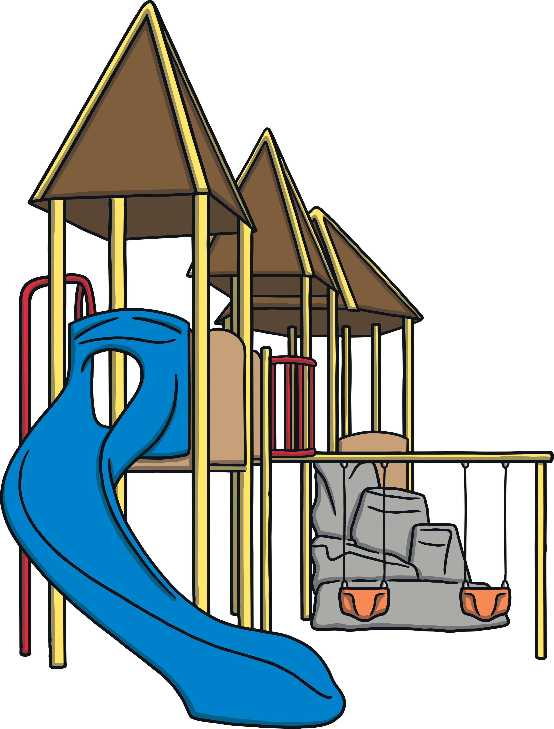
i-e i-e i-e
Sounds like…
Notes:
snail

Slide 18
i-e
Write the Sound
Practise writing the sound with your finger in the air and then on the floor.

Slide 19
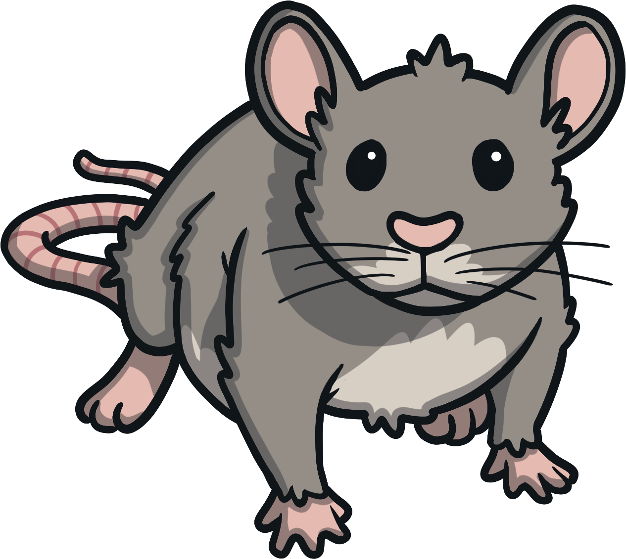
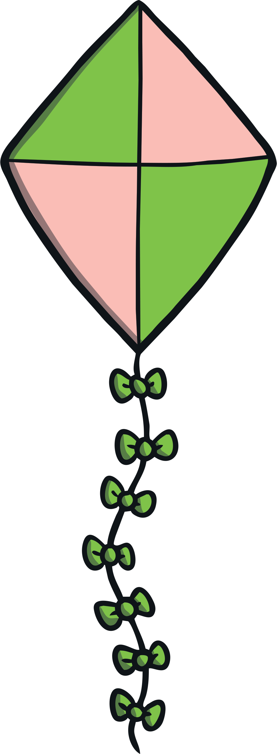
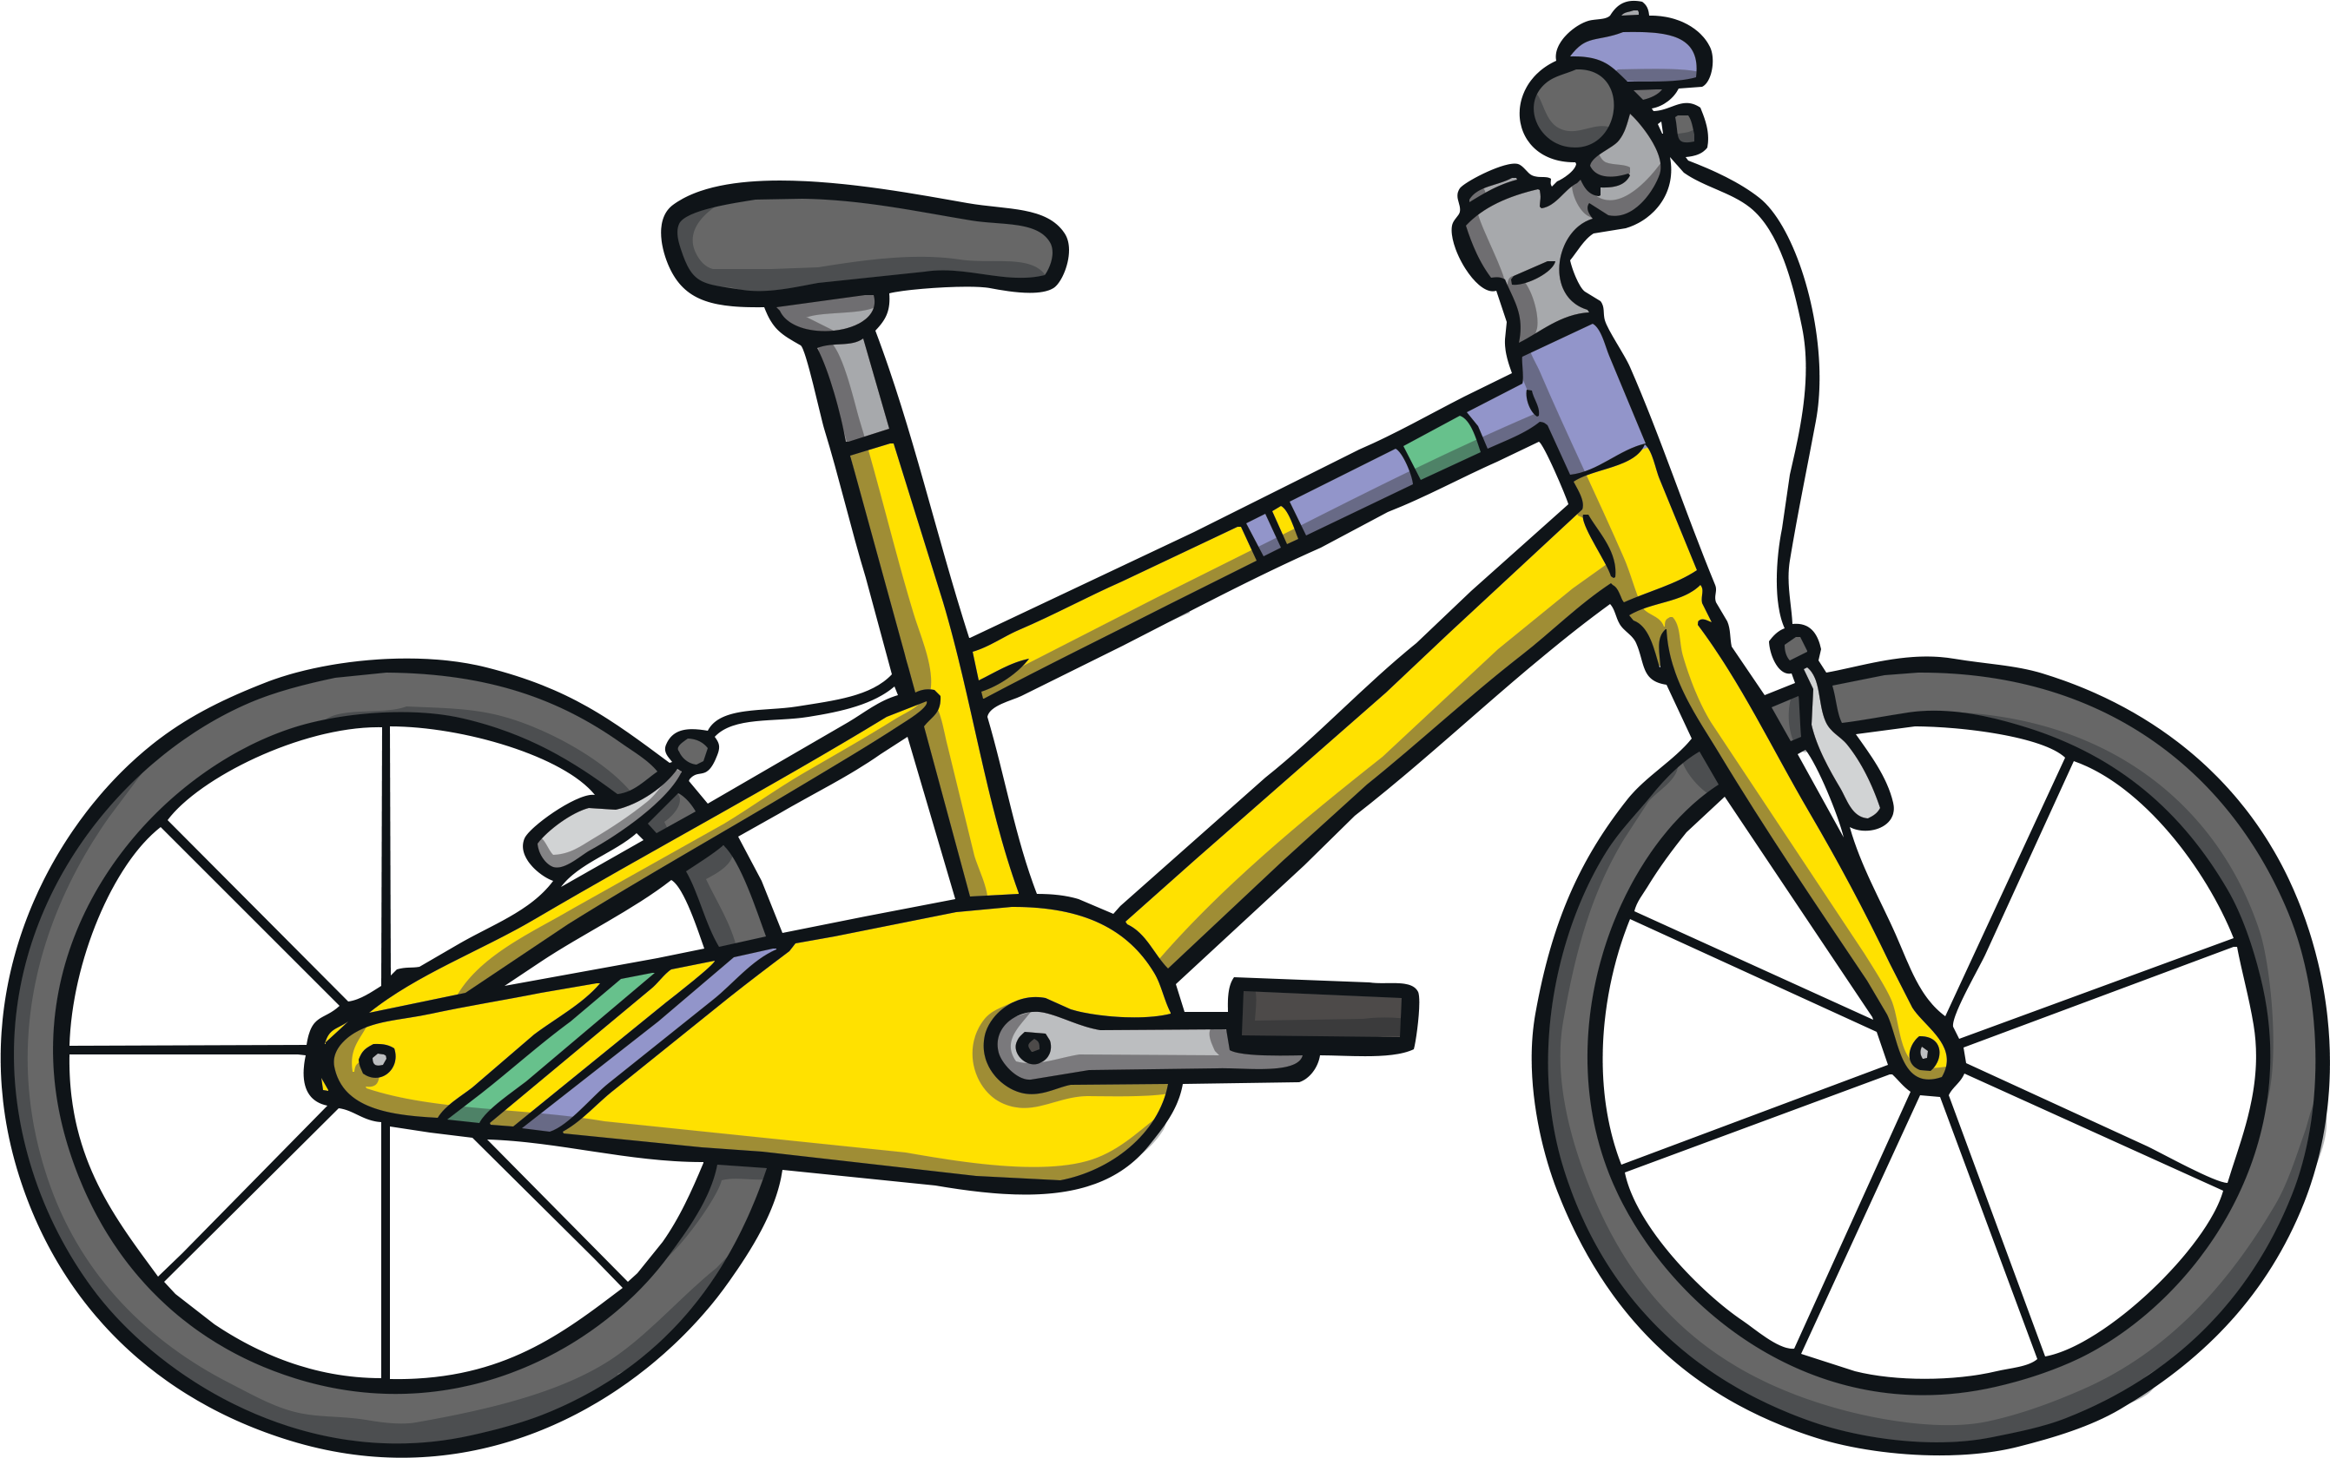
i-e
The split digraph i-e makes two slightly different sounds. Can you hear the difference?
Click on the letters to see which words have the ‘i-e’ sound.
Notes:
train, nail, paint, tail

Slide 20
Click to read through each word.
bike
rice
kite
five
dive
hive
ice
slide
fire
mice

Slide 21
i-e
a-e
e-e
u-e
o-e
Click on a sound to learn more about it!

Slide 22
o-e
Phase 5 Vowel Digraphs

Slide 23
o-e o-e o-e
Sounds like…
Notes:
snail

Slide 24
o-e
Write the Sound
Practise writing the sound with your finger in the air and then on the floor.

Slide 25
o-e
The split digraph o-e makes two slightly different sounds. Can you hear the difference?
Click on the letters to see which words have the ‘o-e’ sound.
Notes:
train, nail, paint, tail

Slide 26
Click to read through each word.
hose
rope
nose
bone
cone
hope
globe
rose

Slide 27
i-e
a-e
e-e
u-e
o-e
Click on a sound to learn more about it!

Slide 28
u-e
Phase 5 Vowel Digraphs

Slide 29
u-e u-e u-e
Sounds like…
Notes:
snail

Slide 30
u-e
Write the Sound
Practise writing the sound with your finger in the air and then on the floor.

Slide 31
u-e
The split digraph u-e makes two slightly different sounds. Can you hear the difference?
Click on the letters to see which words have the ‘u-e’ sound.
Notes:
train, nail, paint, tail

Slide 32
Click to read through each word.
tube
tune
mule
cube
prune
ruler
flute
cute
flume

Slide 33
i-e
a-e
e-e
u-e
o-e
Click on a sound to learn more about it!

