Slide 2
ay
ir
au
oe
ie
ea
ew
oy
ey
aw
ou
ue
Click on a letter combination to jump to the appropriate slides

Slide 3
ay
Phase 5 Vowel Digraphs

Slide 4
ay ay ay
Sounds like…
Notes:
snail

Slide 5
ay
Write the Sound
Practise writing the sound with your finger in the air and then on the floor.

Slide 6
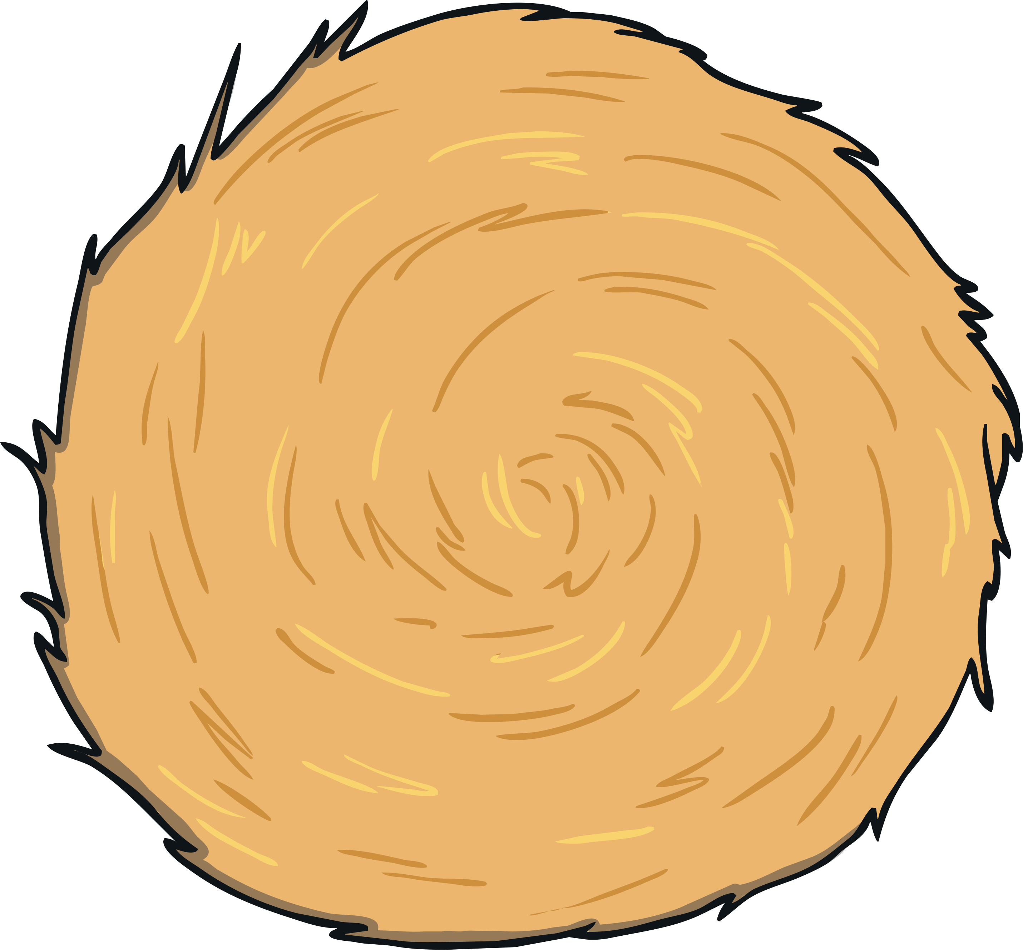
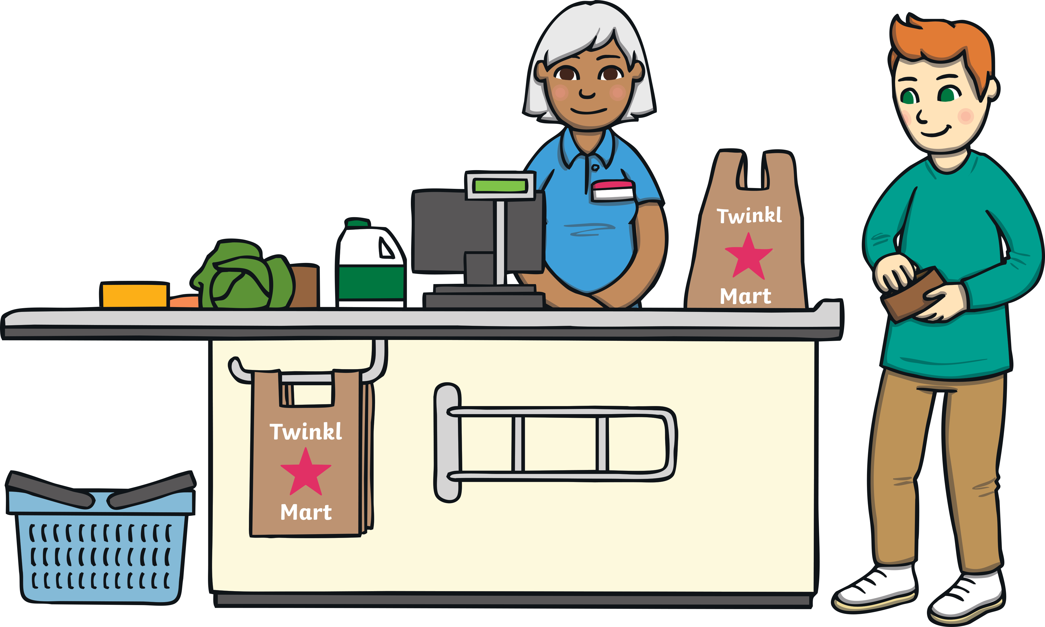
ay
Click on the letters to see which words have the ‘ay’ sound.
Notes:
train, nail, paint, tail

Slide 7
Click to read through each word.
hay
pay
say
ray
day
bay
play
stay
tray
maybe
crayon

Slide 8
ay
ir
au
oe
ie
ea
ew
oy
ey
aw
ou
ue
Click on a letter combination to jump to the appropriate slides

Slide 9
ou
Phase 5 Vowel Digraphs

Slide 10
ou ou ou
Sounds like…
Notes:
snail

Slide 11
ou
Write the Sound
Practise writing the sound with your finger in the air and then on the floor.

Slide 12
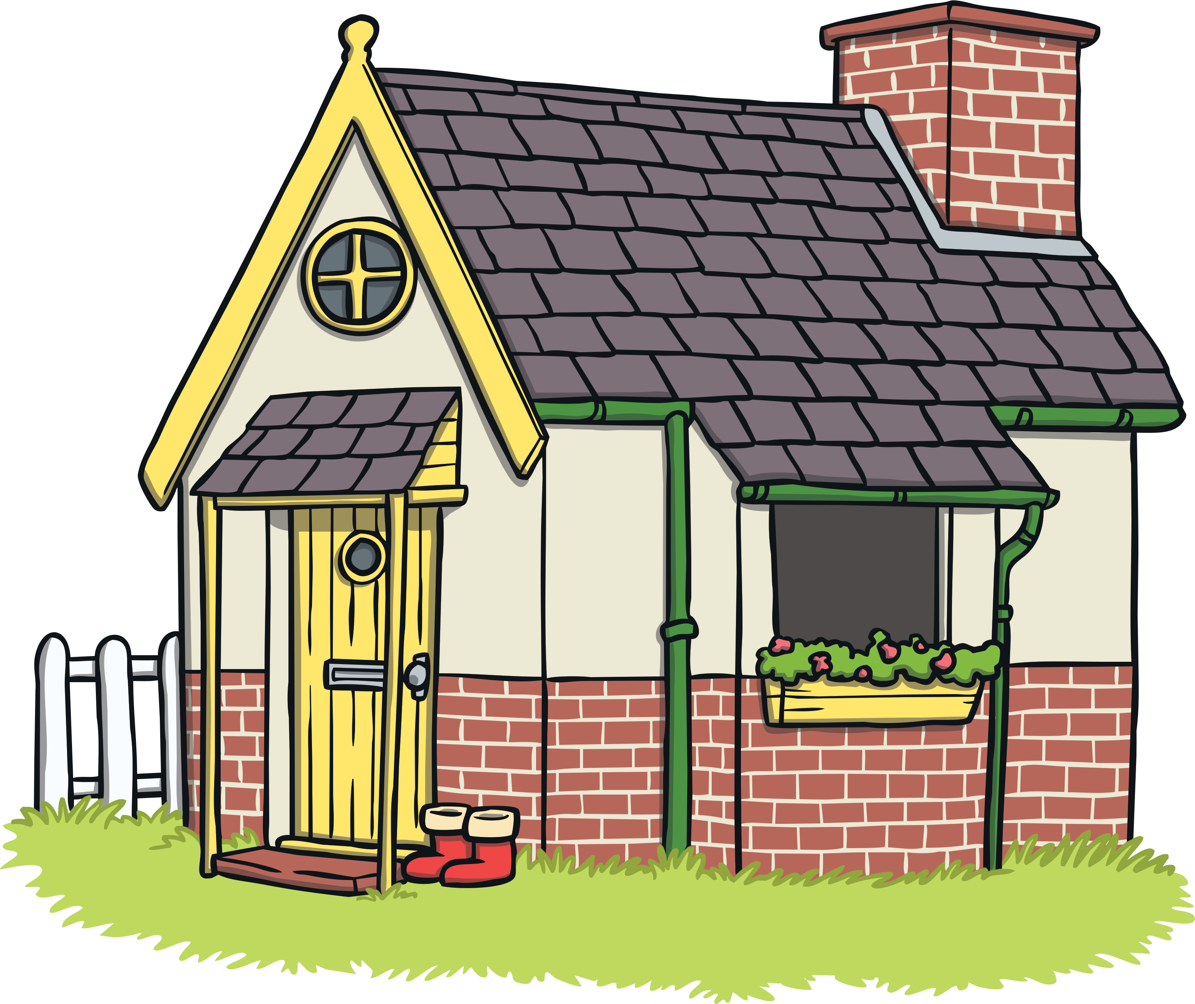
ou
Click on the letters to see which words have the ‘ou’ sound.

Slide 13
Click to read through each word.
ground
found
count
round
mouth
sound
cloud
house
couch

Slide 14
ay
ir
au
oe
ie
ea
ew
oy
ey
aw
ou
ue
Click on a letter combination to jump to the appropriate slides

Slide 15
ie
Phase 5 Vowel Digraphs

Slide 16
ie ie ie
Sounds like…
Notes:
snail

Slide 17
ie
Write the Sound
Practise writing the sound with your finger in the air and then on the floor.

Slide 18
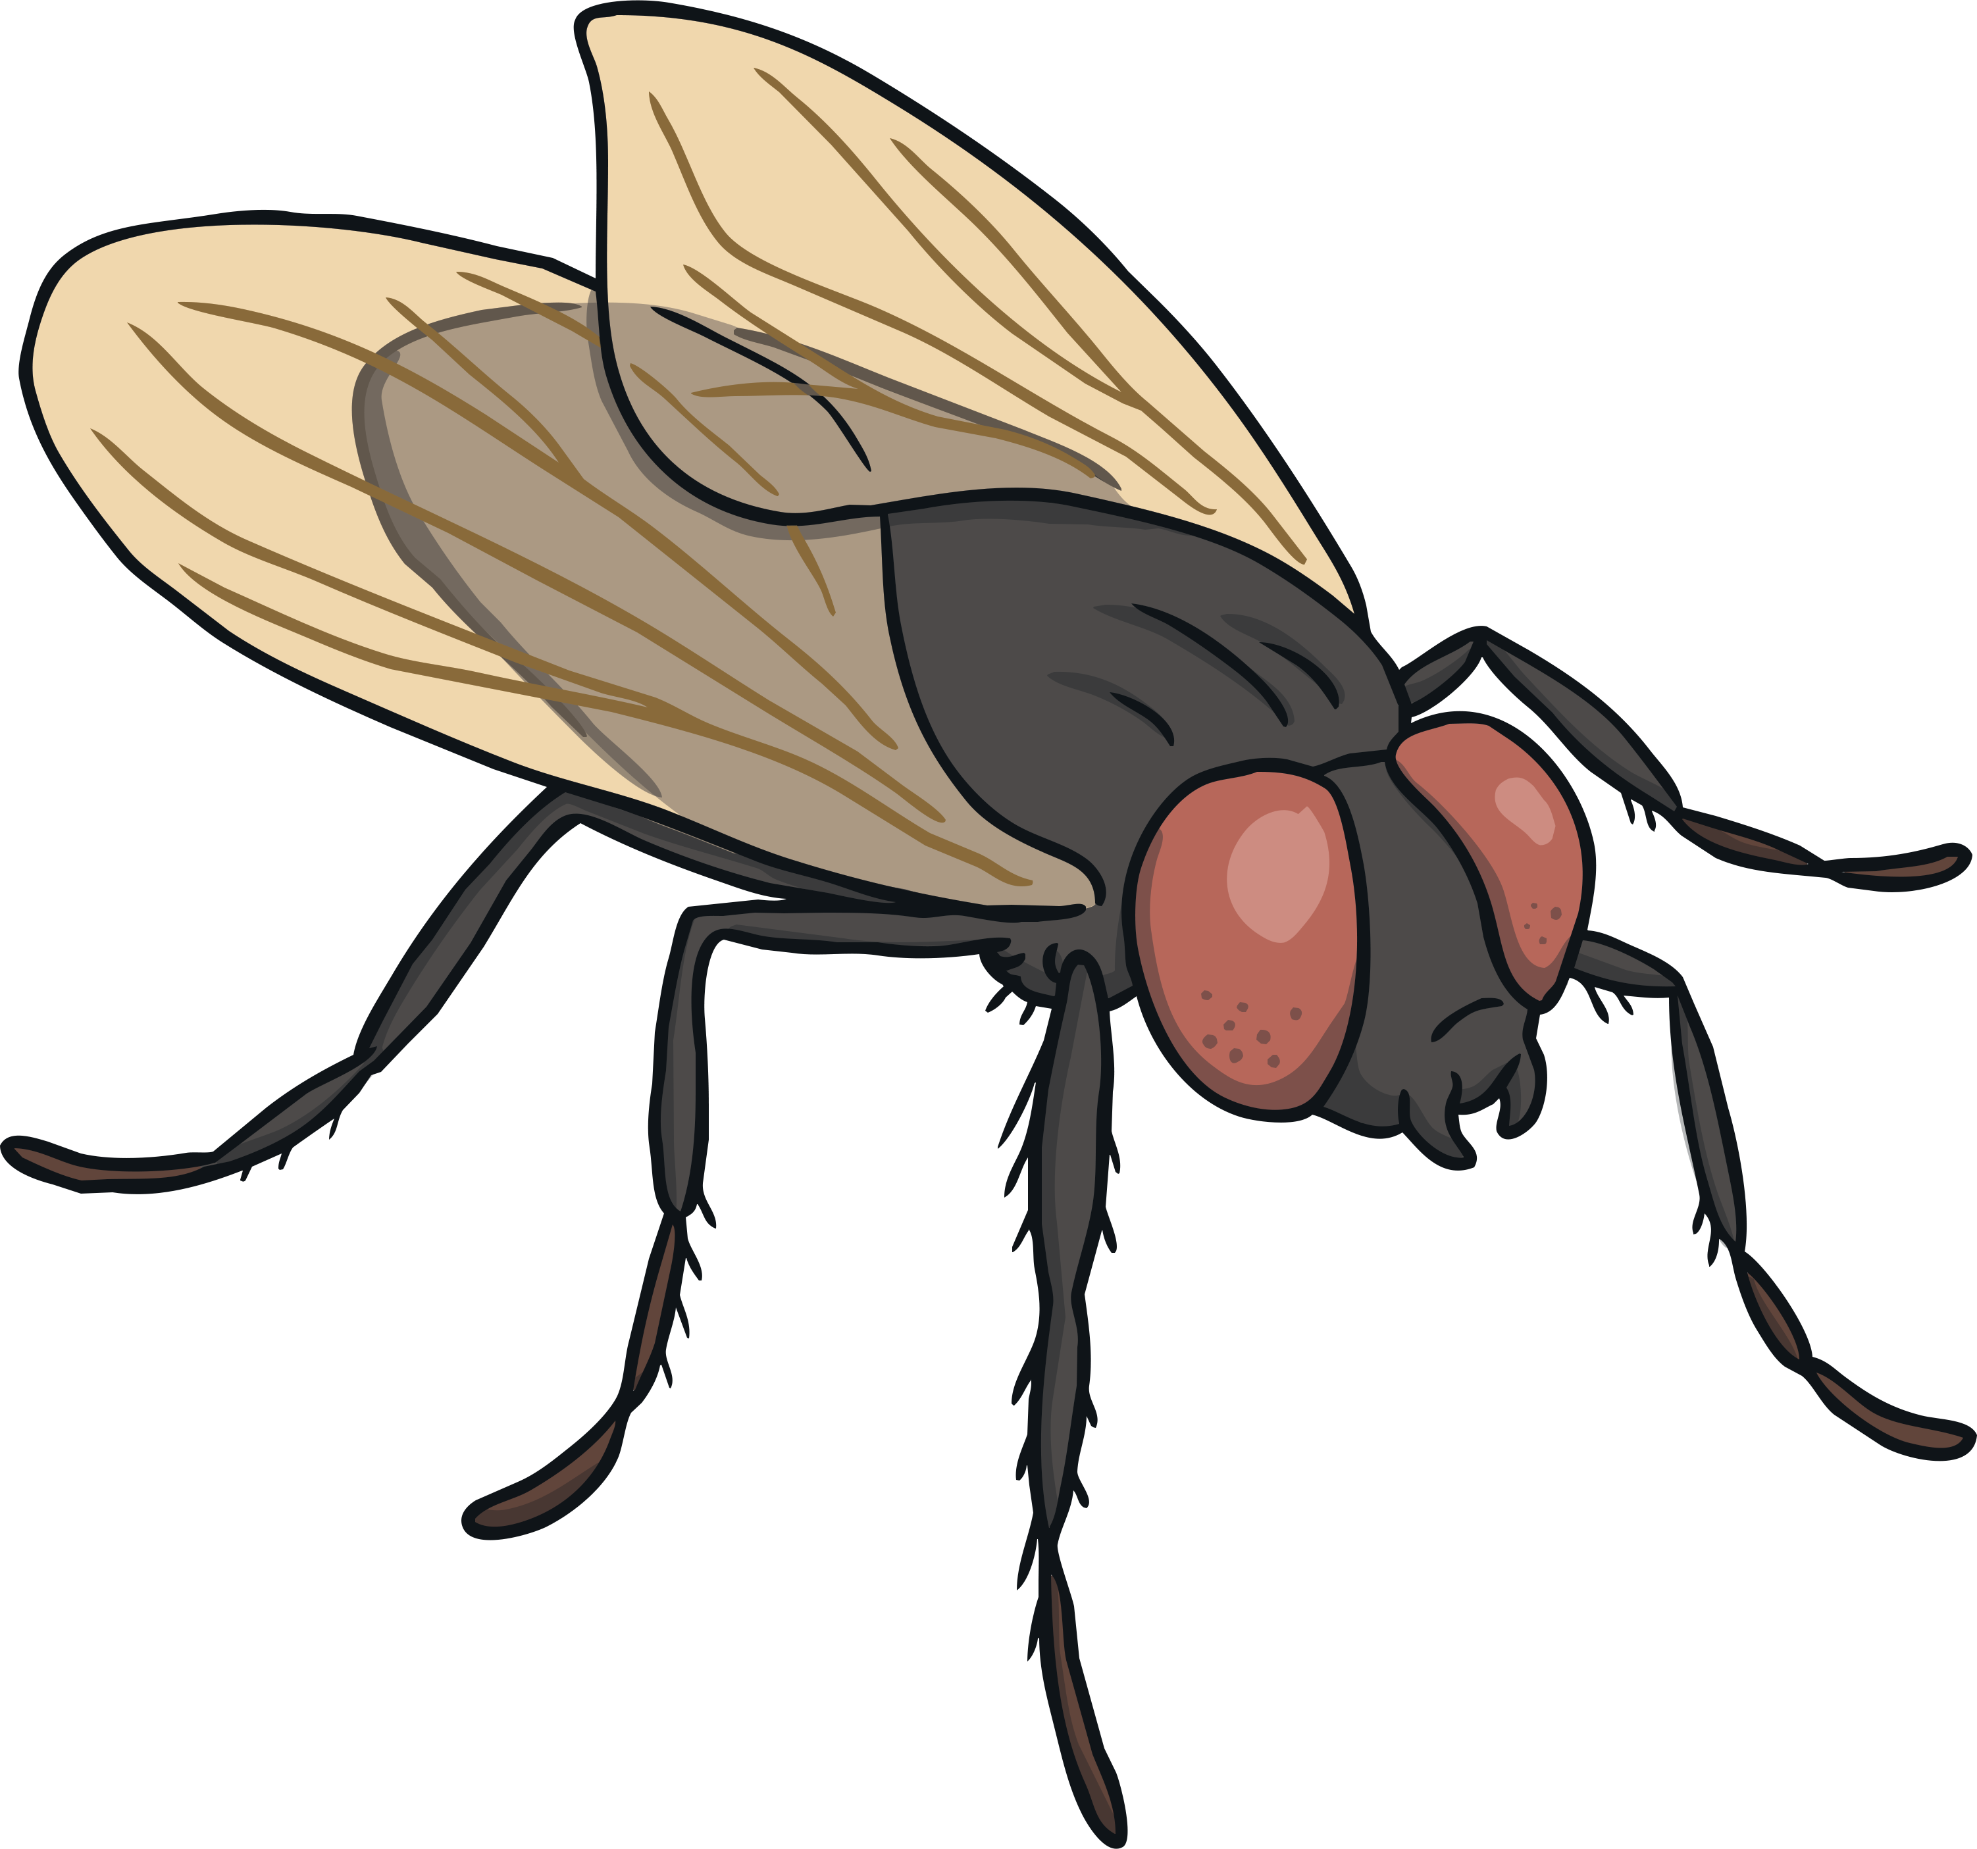
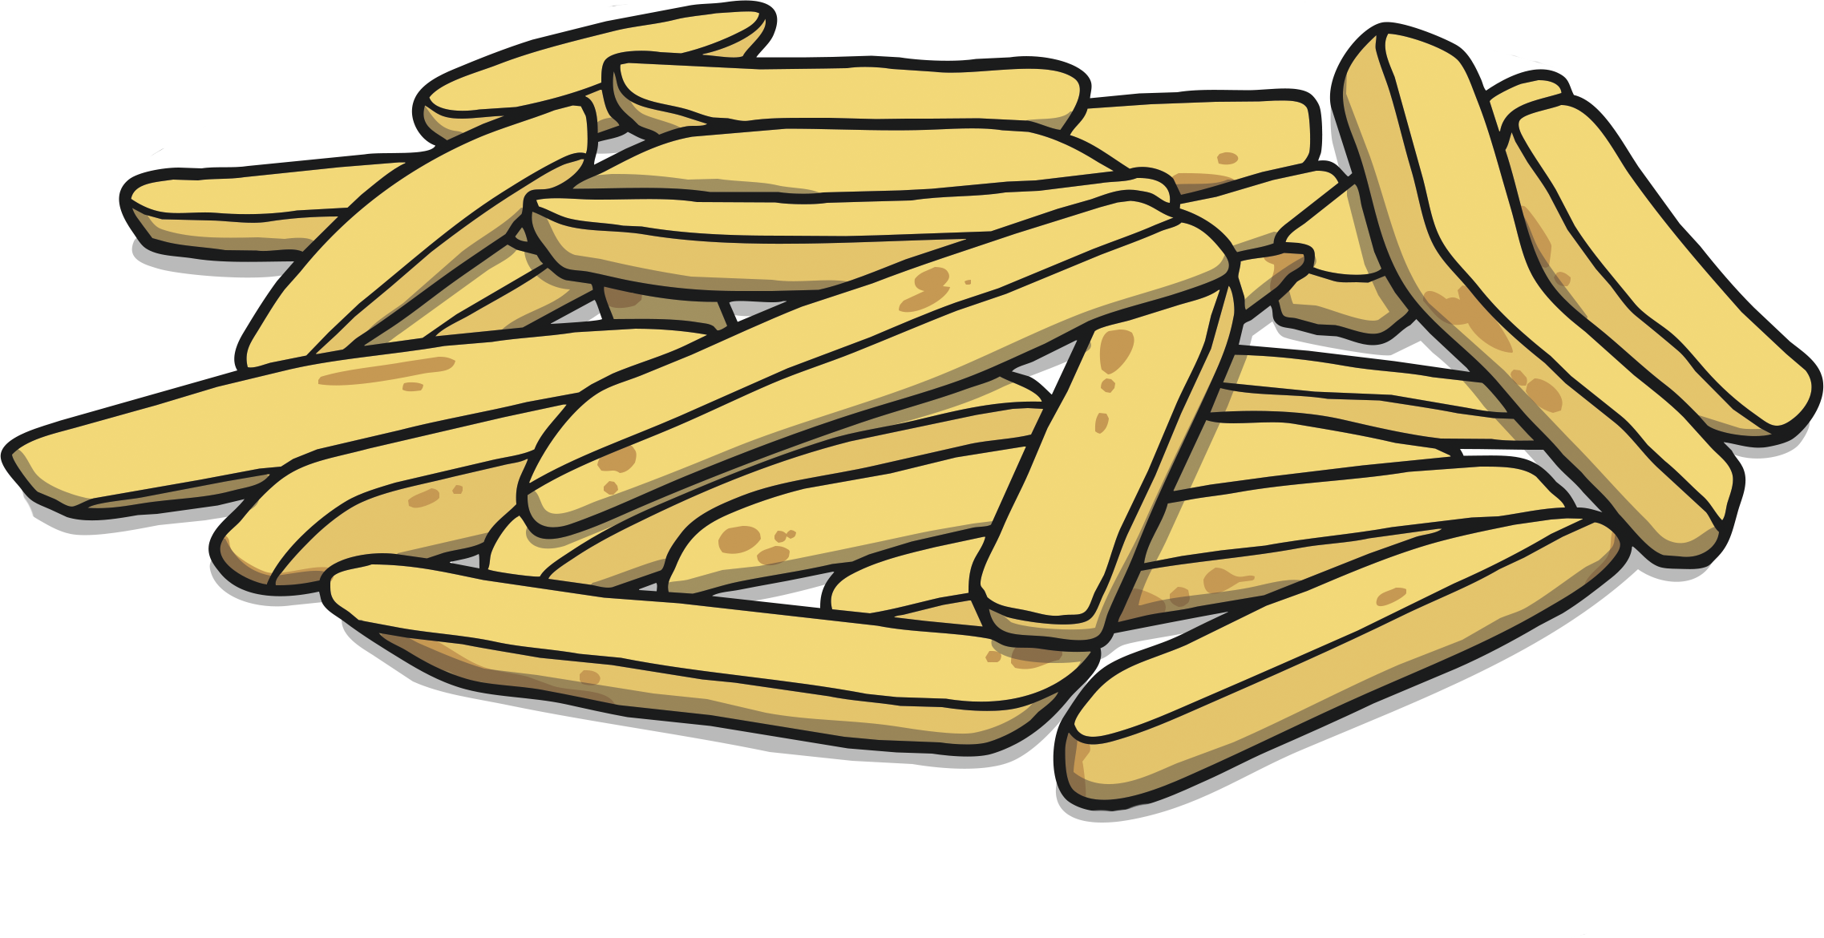
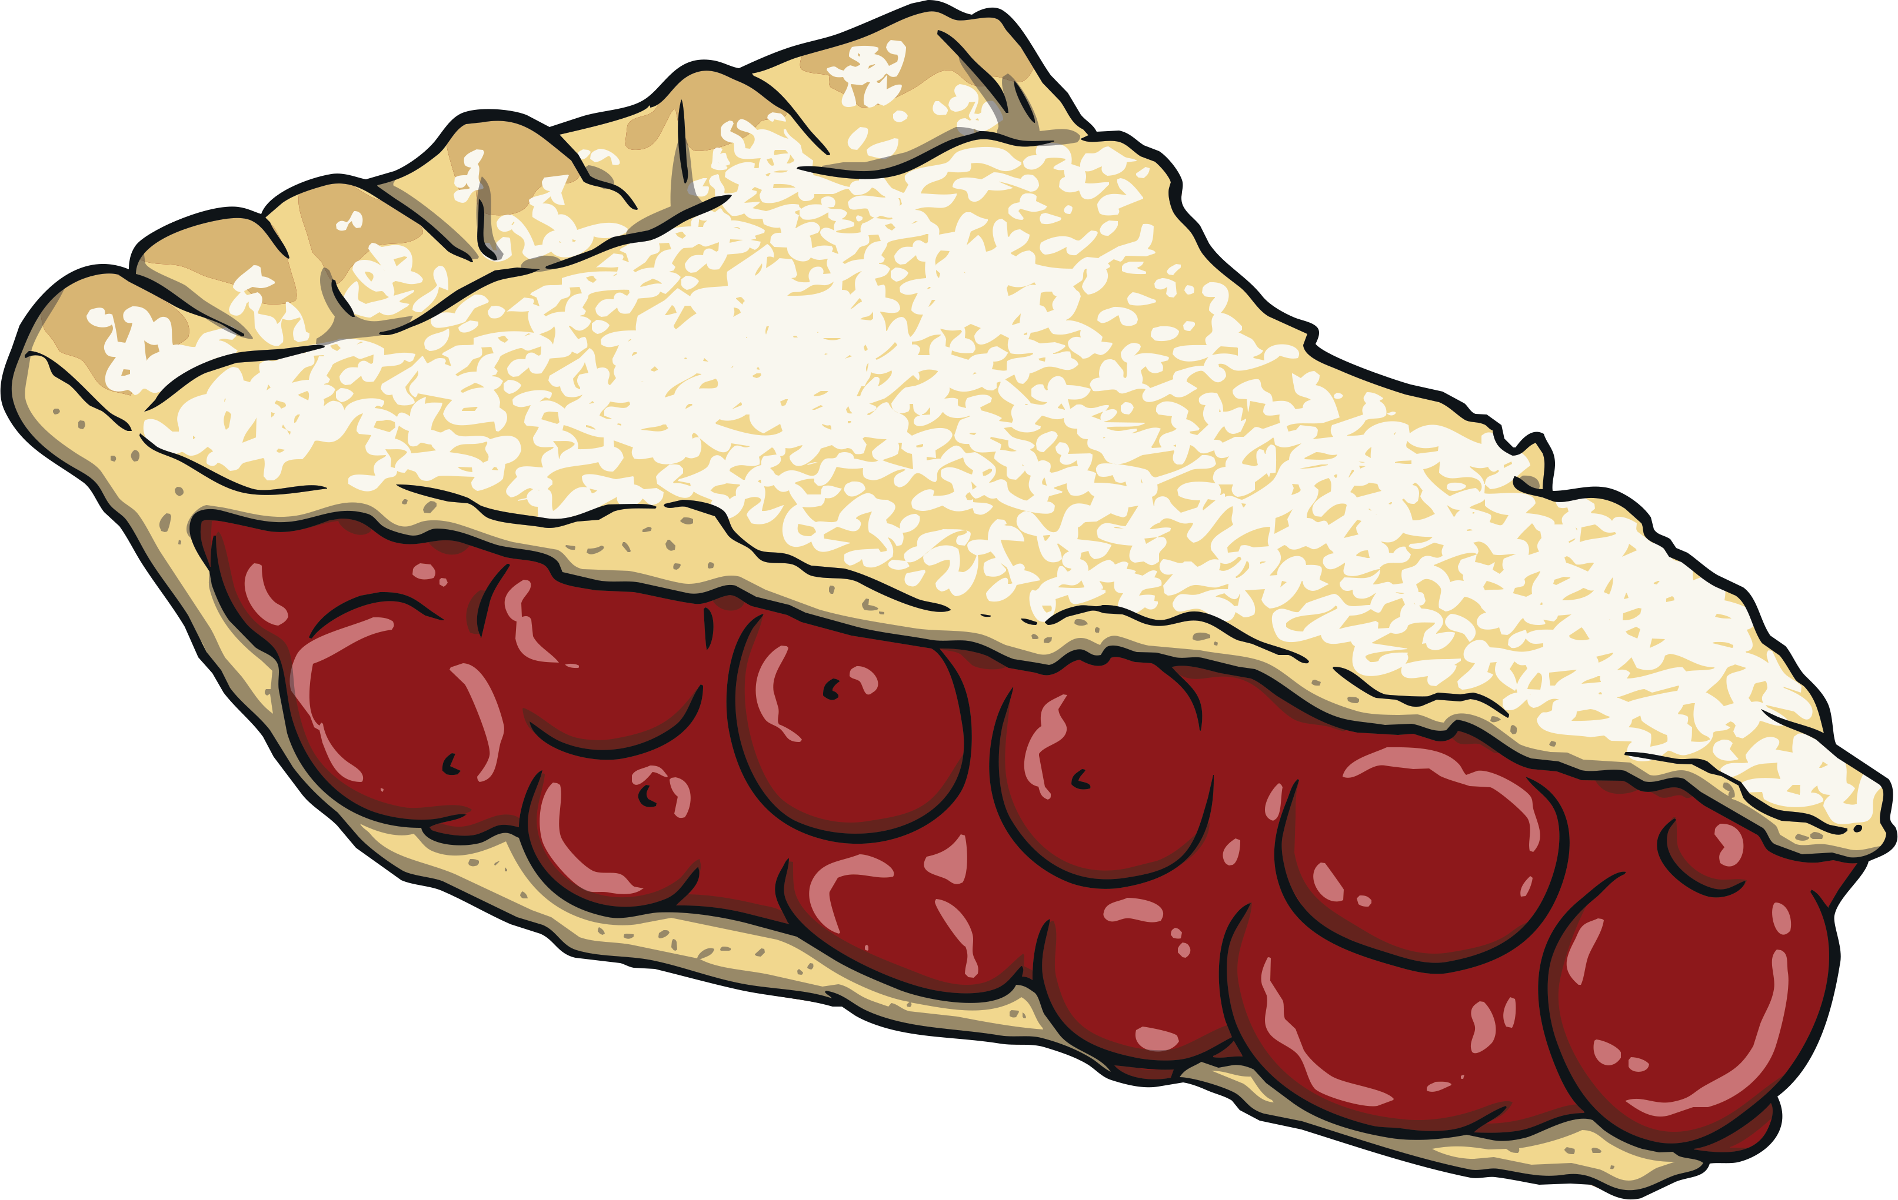
ie
Click on the letters to see which words have the ‘ie’ sound.
Notes:
train, nail, paint, tail

Slide 19
Click to read through each word.
cried
flies
fries
fried
tie
lie
pie
spied
die
tried

Slide 20
ay
ir
au
oe
ie
ea
ew
oy
ey
aw
ou
ue
Click on a letter combination to jump to the appropriate slides

Slide 21
oy
Phase 5 Vowel Digraphs

Slide 22
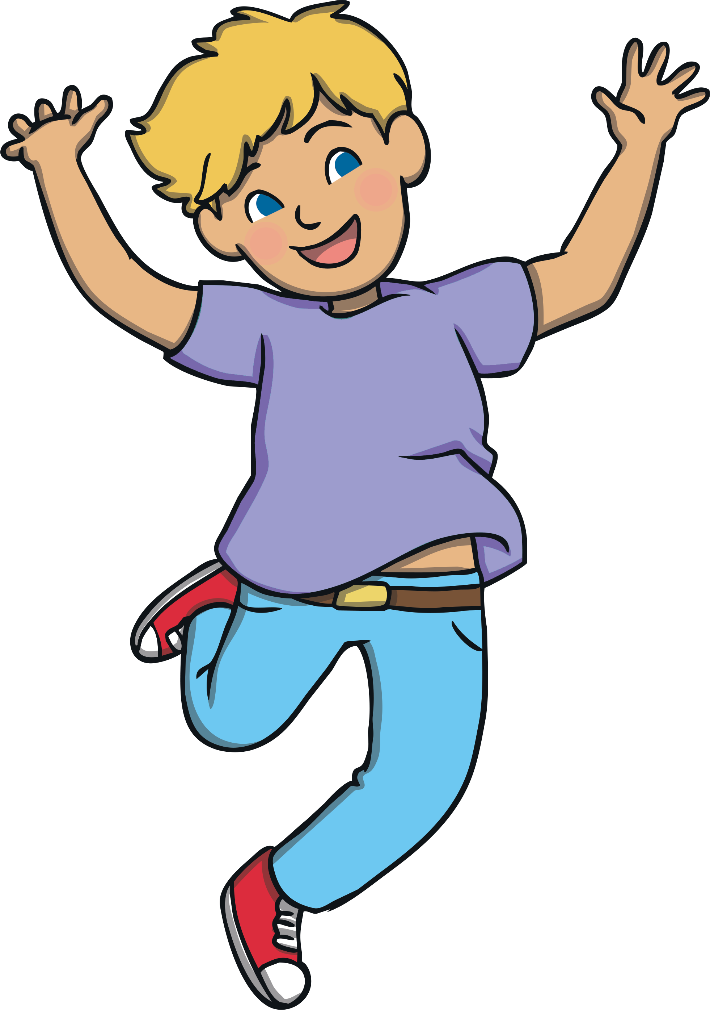
oy oy oy
Sounds like…
Notes:
snail

Slide 23
oy
Write the Sound
Practise writing the sound with your finger in the air and then on the floor.

Slide 24
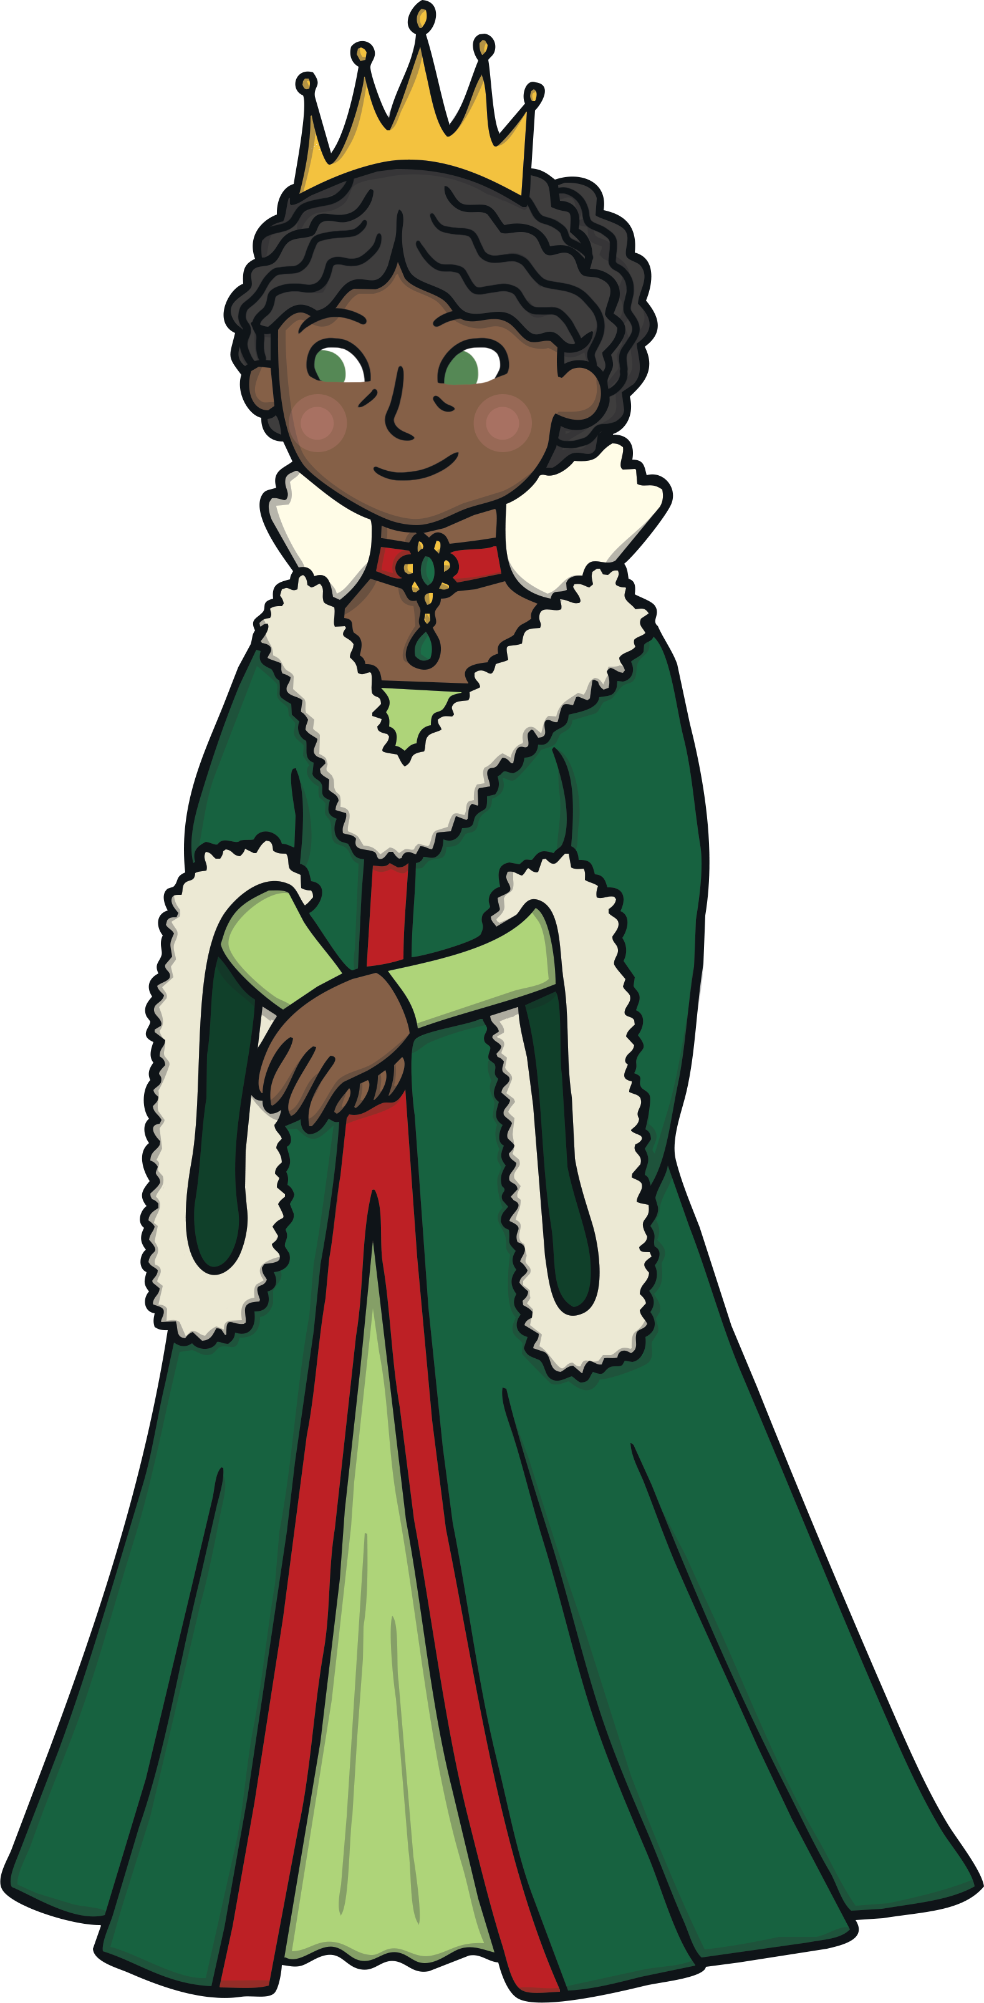
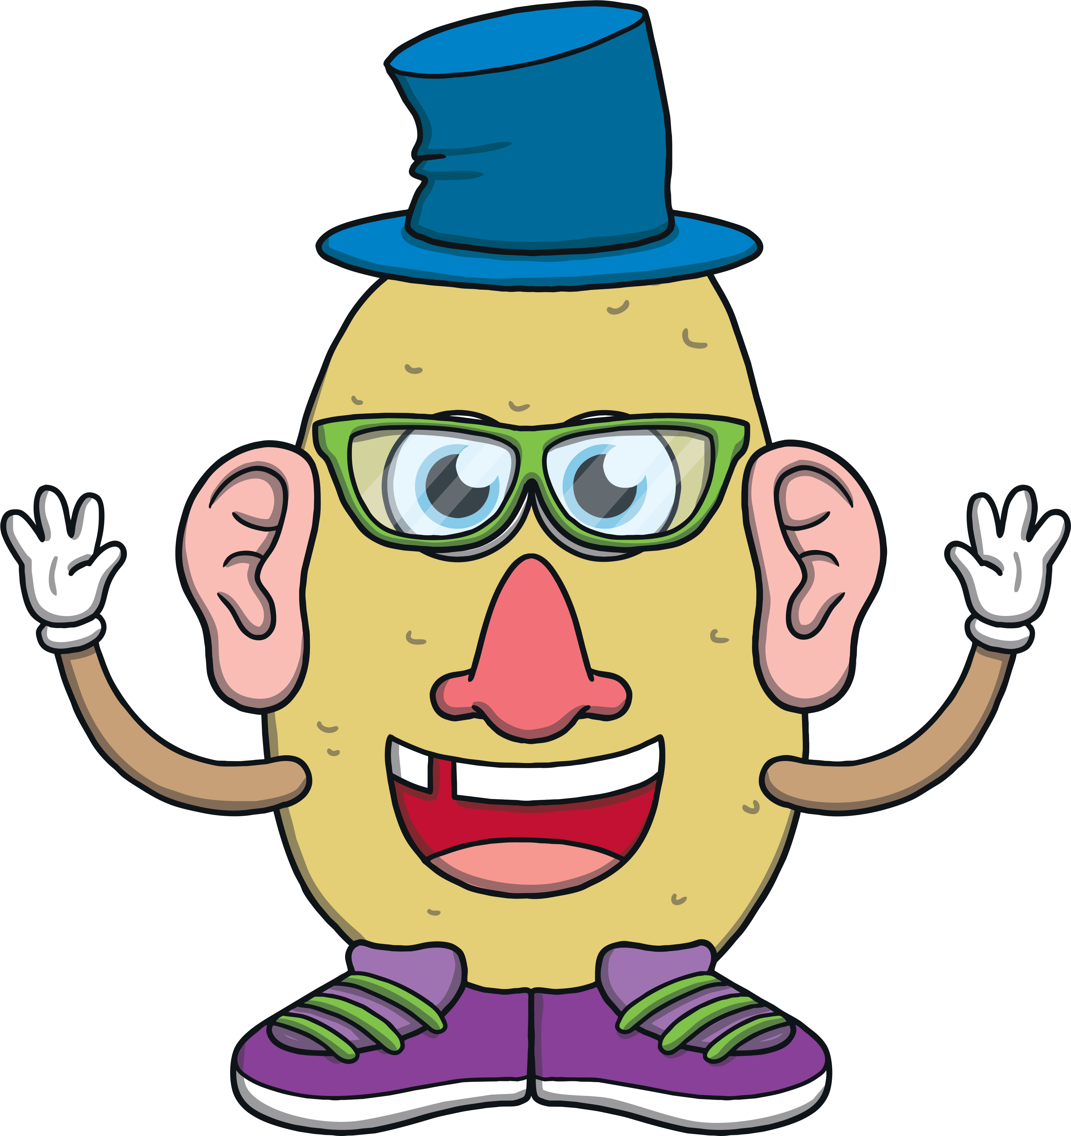
oy
Click on the letters to see which words have the ‘oy’ sound.
Notes:
train, nail, paint, tail

Slide 25
Click to read through each word.
royal
toy
boy
enjoy
joy
soy
annoyed
oyster
destroy
loyal

Slide 26
ay
ir
au
oe
ie
ea
ew
oy
ey
aw
ou
ue
Click on a letter combination to jump to the appropriate slides

Slide 27
ir
Phase 5 Vowel Digraphs

Slide 28
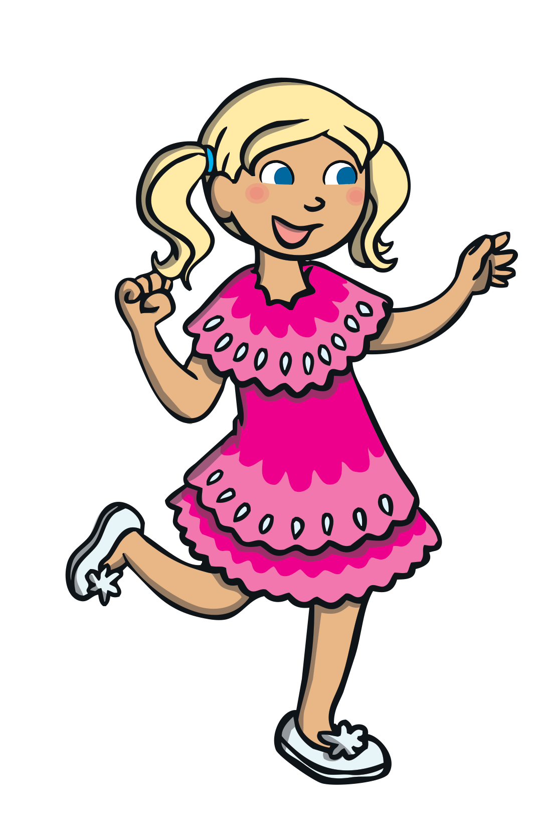
ir ir ir
Sounds like…
Notes:
snail

Slide 29
ir
Write the Sound
Practise writing the sound with your finger in the air and then on the floor.

Slide 30
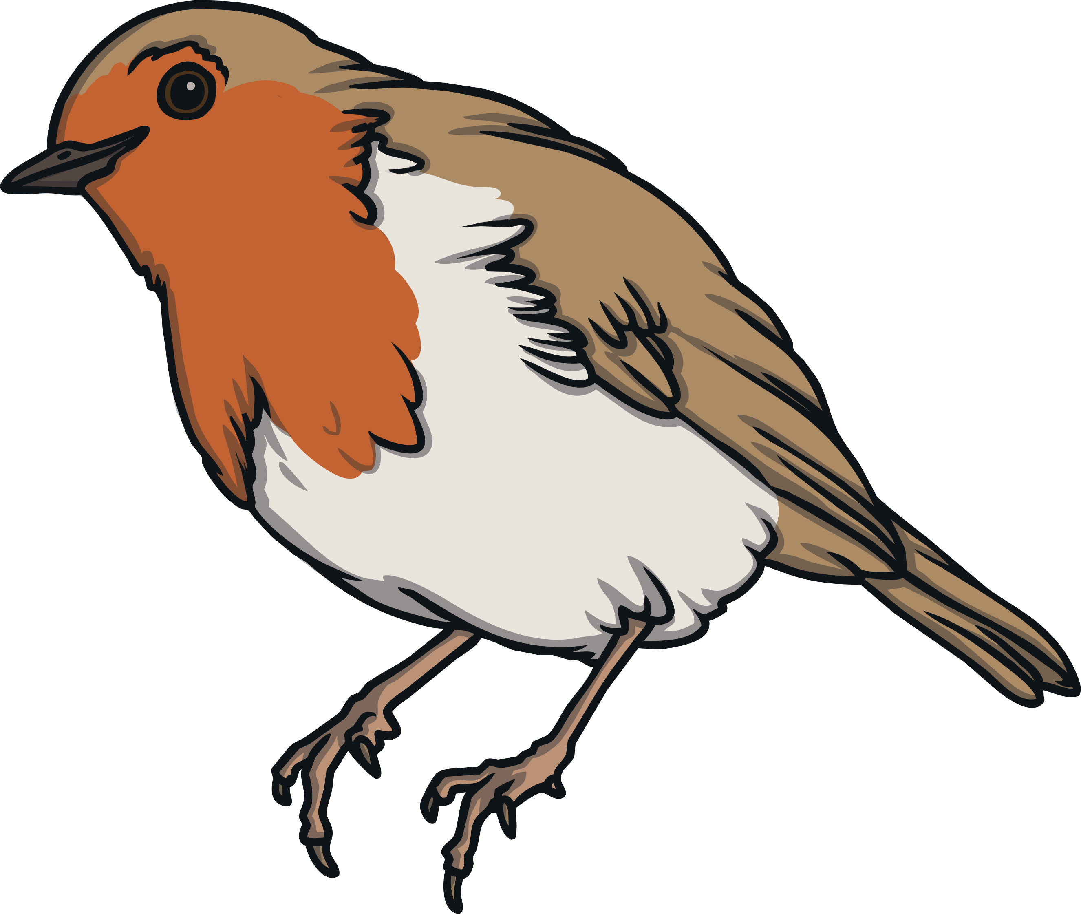
ir
Click on the letters to see which words have the ‘ir’ sound.
Notes:
train, nail, paint, tail

Slide 31
Click to read through each word.
skirt
first
bird
sir
thirst
girl
shirt
birth
dirt
firm

Slide 32
ay
ir
au
oe
ie
ea
ew
oy
ey
aw
ou
ue
Click on a letter combination to jump to the appropriate slides

Slide 33
ue
Phase 5 Vowel Digraphs

Slide 34
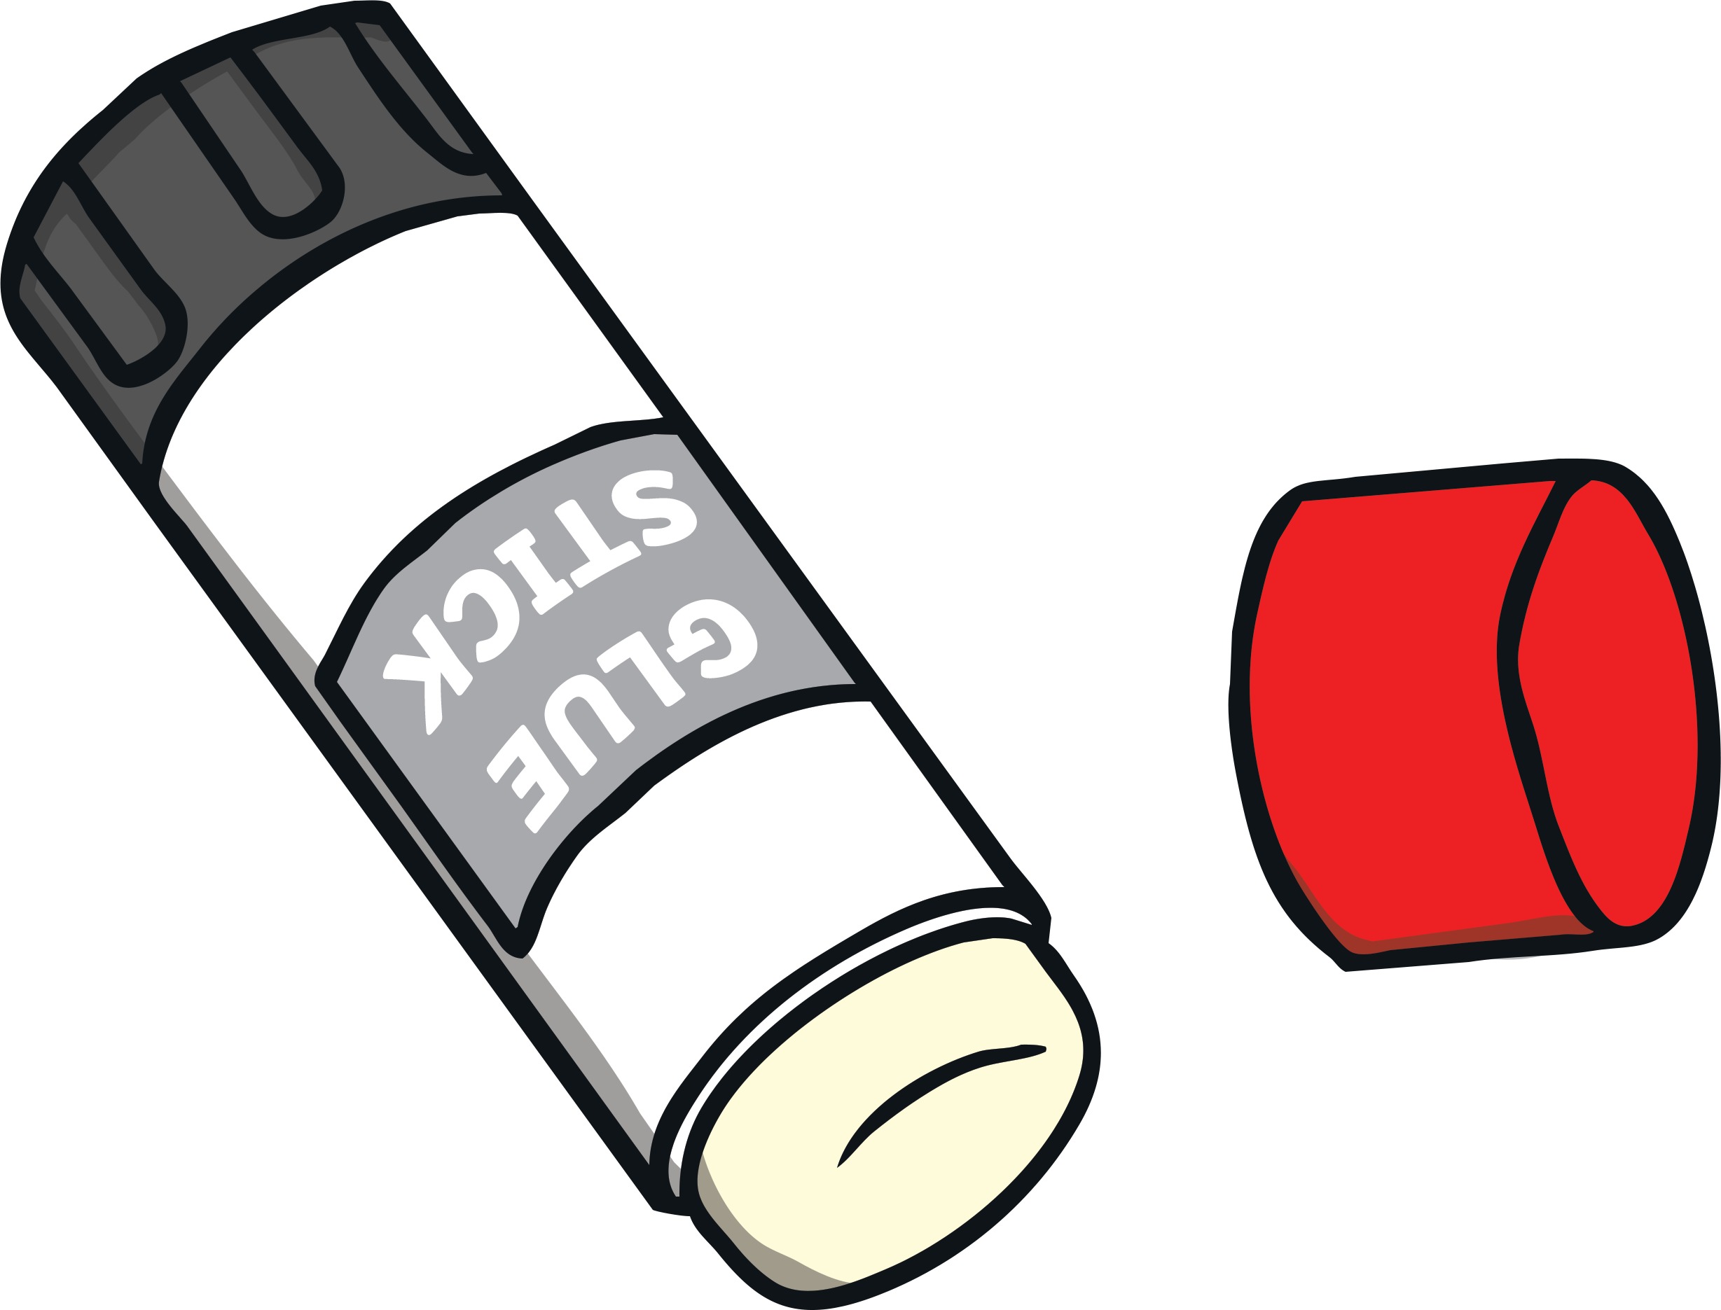
ue ue ue
Sounds like…
Notes:
snail

Slide 35
ue
Write the Sound
Practise writing the sound with your finger in the air and then on the floor.

Slide 36
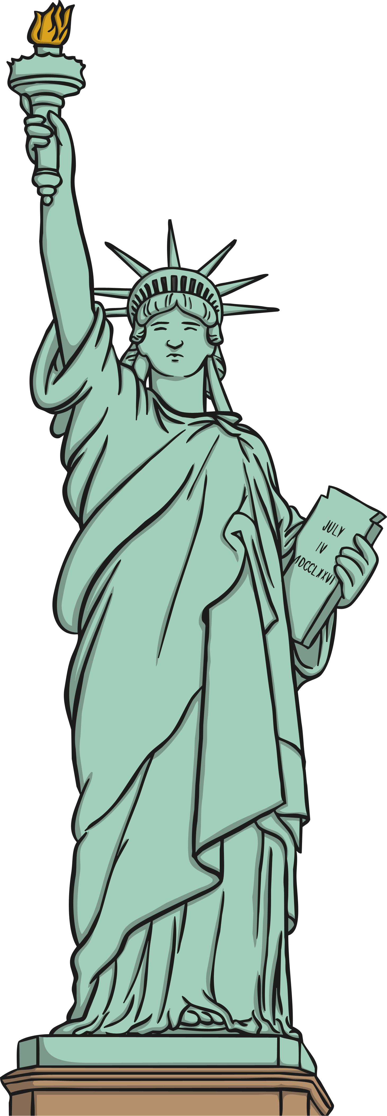
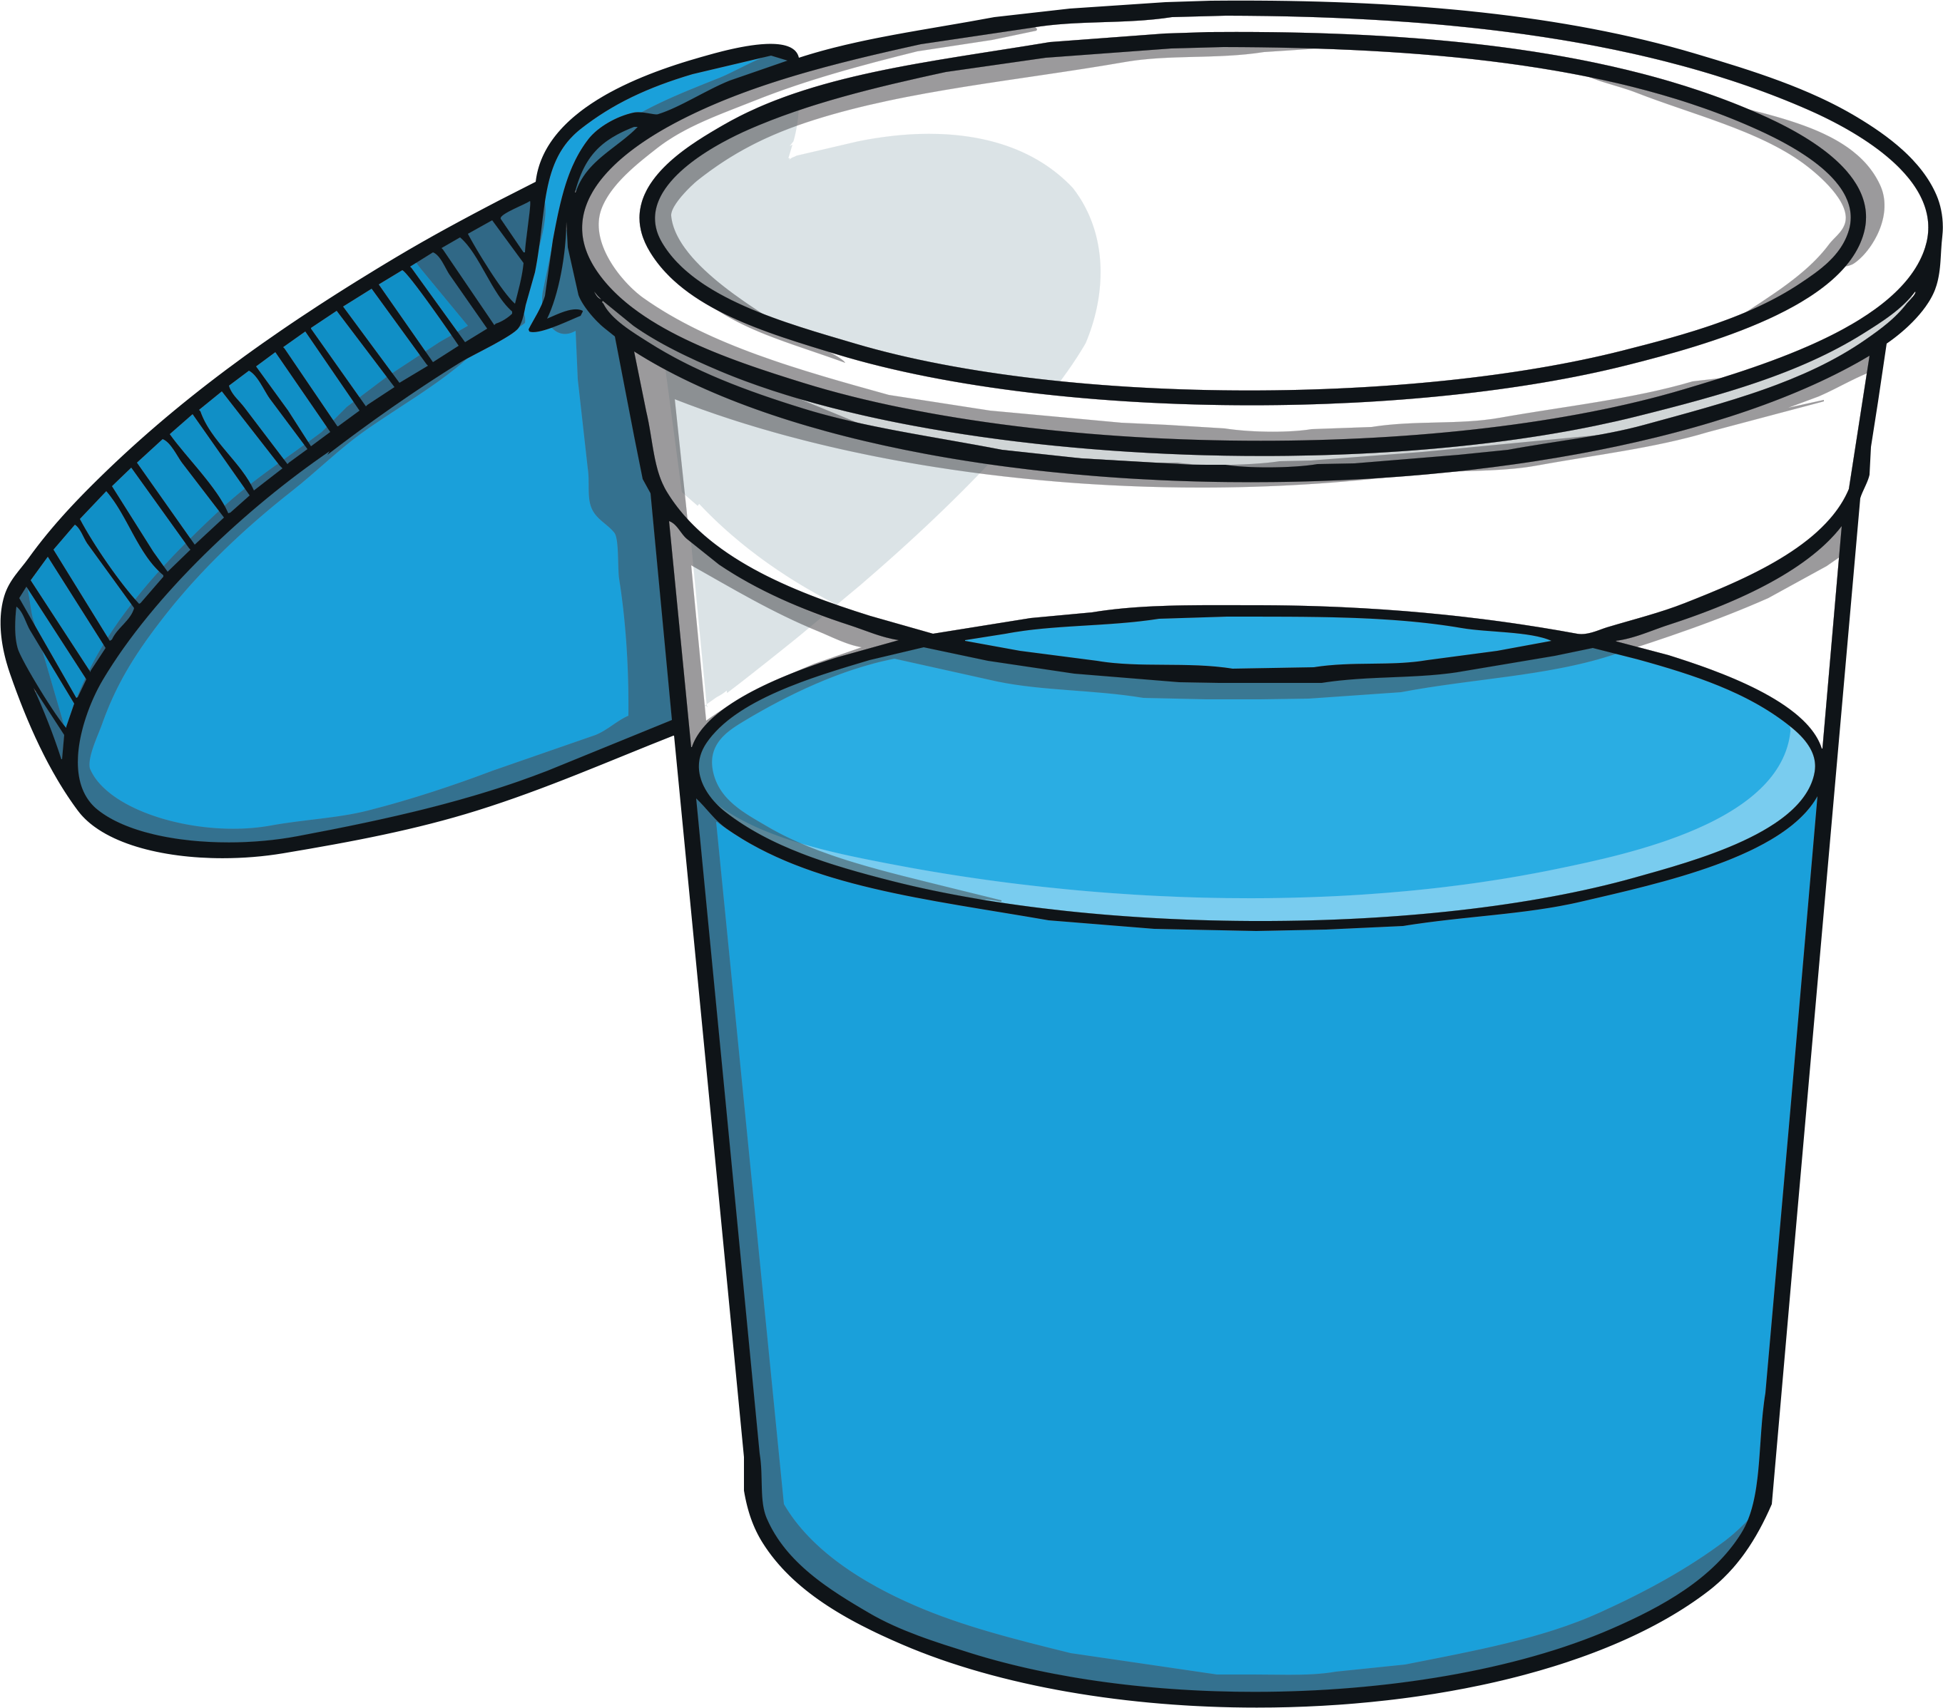
ue
Click on the letters to see which words have the ‘ue’ sound.

Slide 37
Click to read through each word.
statue
queue
argue
rescue
glue
blue
true
tissue

Slide 38
ay
ir
au
oe
ie
ea
ew
oy
ey
aw
ou
ue
Click on a letter combination to jump to the appropriate slides

Slide 39
ea
Phase 5 Vowel Digraphs

Slide 40
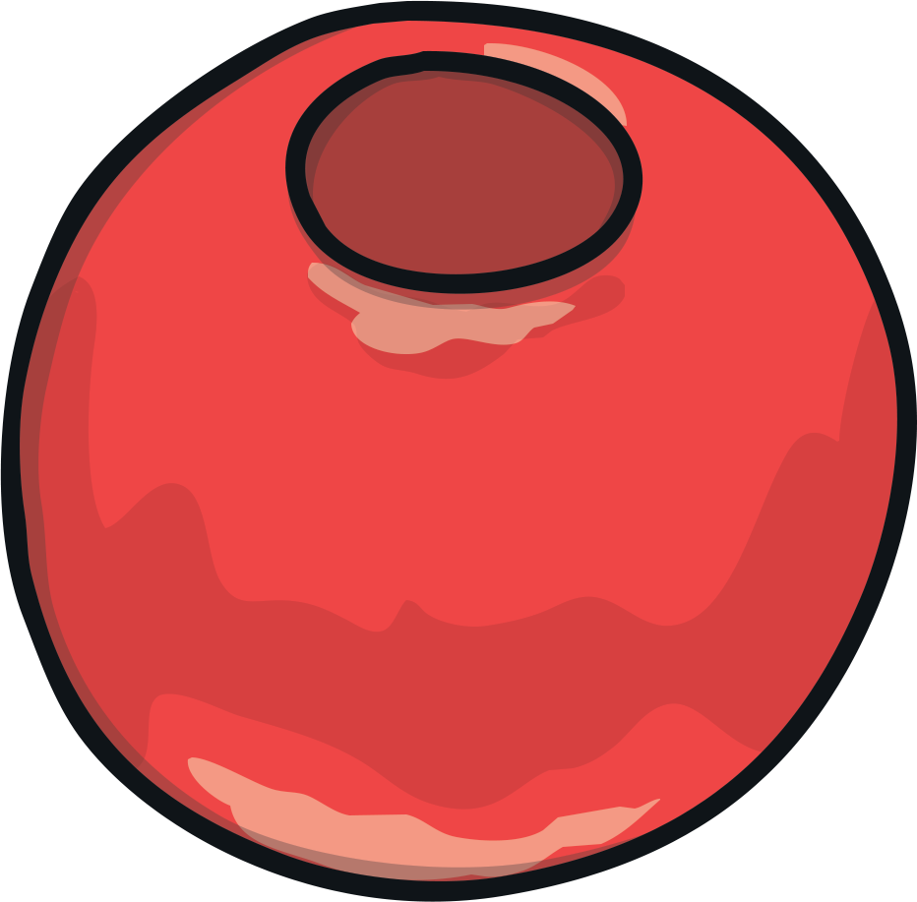
ea ea ea
Sounds like…
Notes:
snail

Slide 41
ea
Write the Sound
Practise writing the sound with your finger in the air and then on the floor.

Slide 42
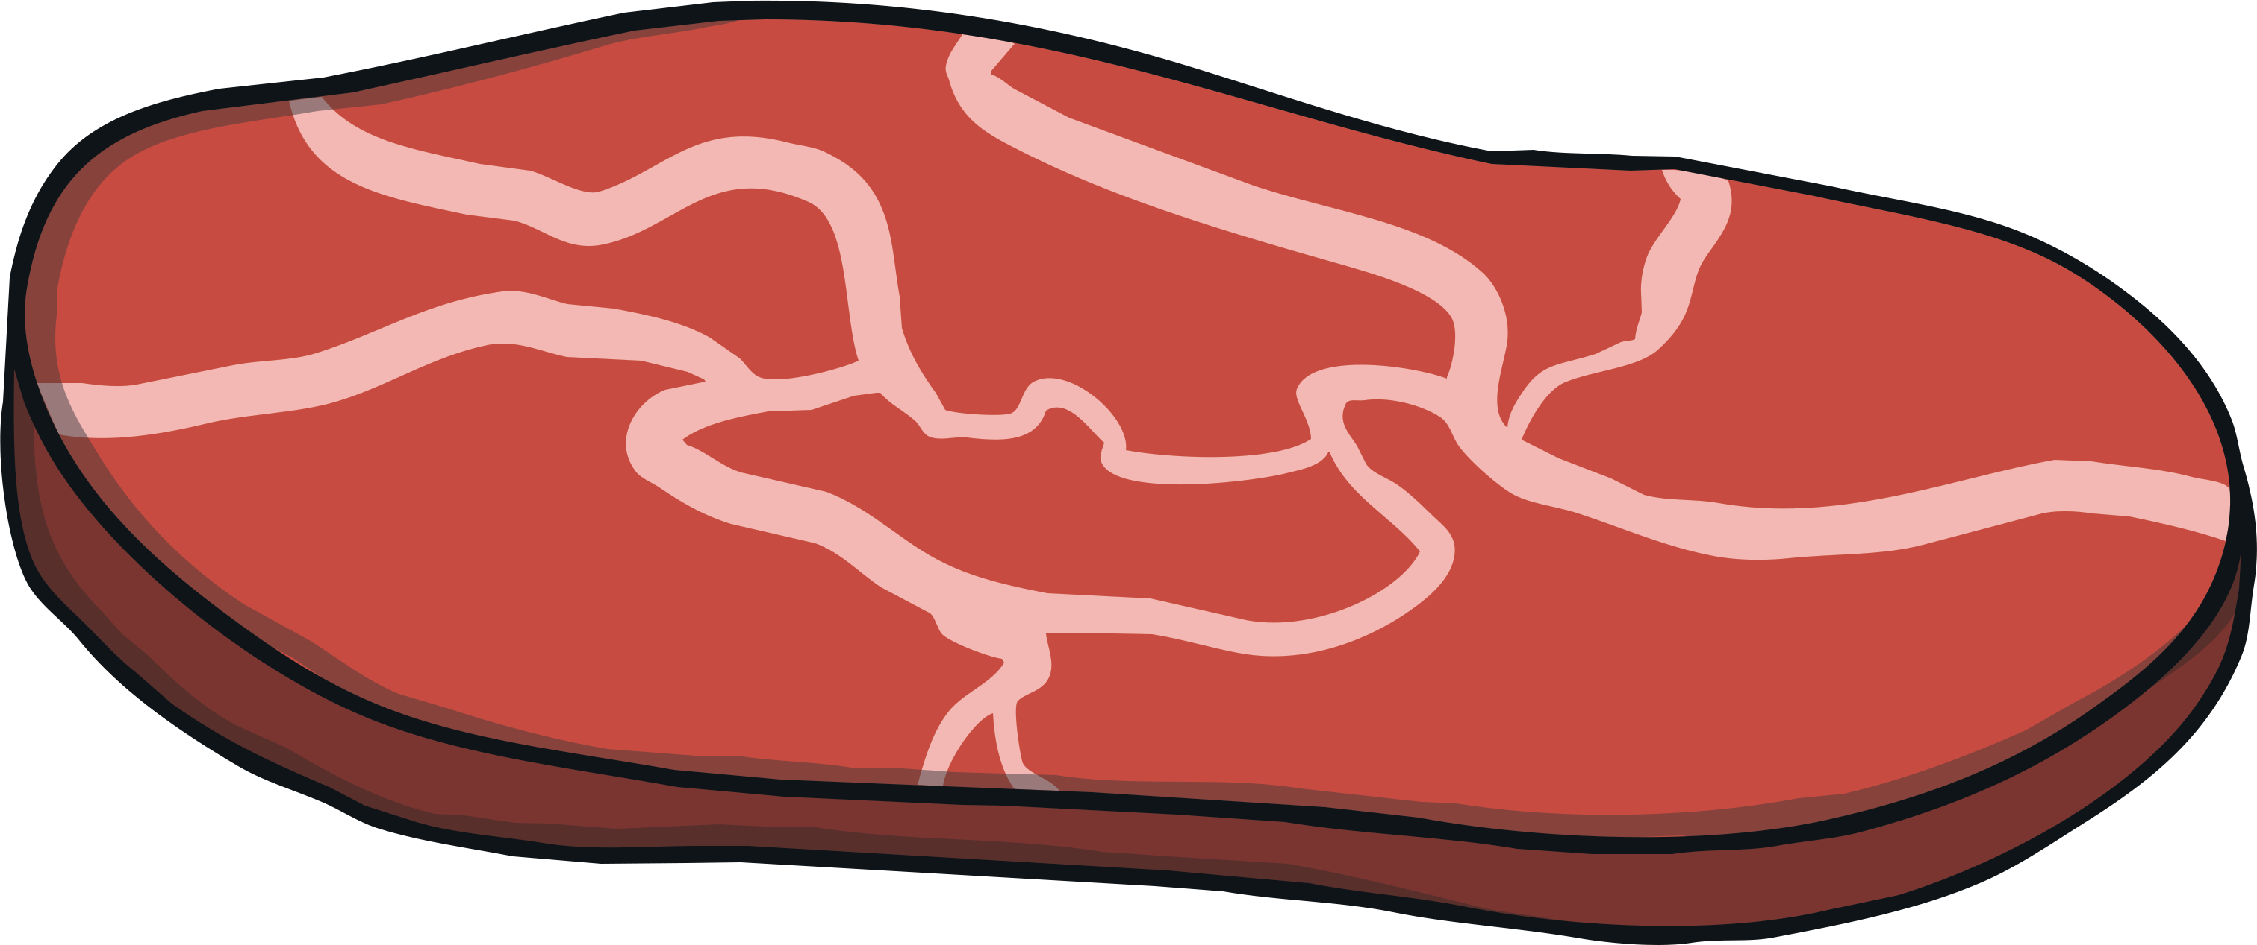
ea
Click on the letters to see which words have the ‘ea’ sound.
Notes:
train, nail, paint, tail

Slide 43
Click to read through each word.
treat
peak
meat
heat
leaf
read
lead
bead
beak
speak

Slide 44
ay
ir
au
oe
ie
ea
ew
oy
ey
aw
ou
ue
Click on a letter combination to jump to the appropriate slides

Slide 45
aw
Phase 5 Vowel Digraphs

Slide 46
aw aw aw
Sounds like…
Notes:
snail

Slide 47
aw
Write the Sound
Practise writing the sound with your finger in the air and then on the floor.

Slide 48
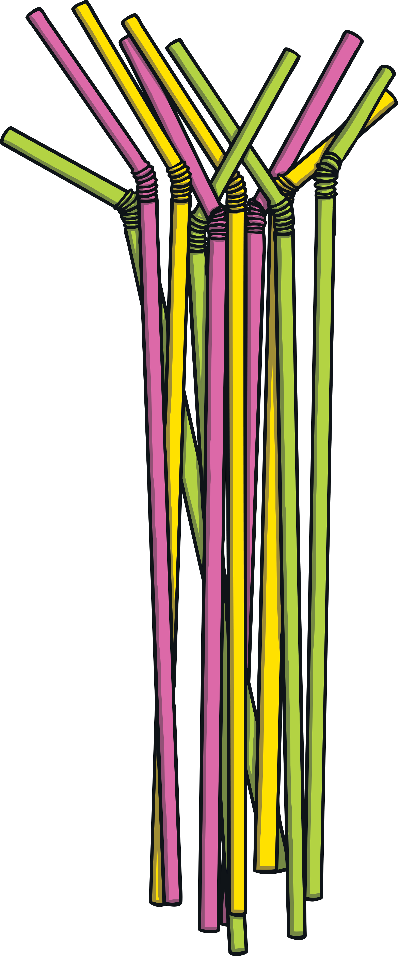
aw
Click on the letters to see which words have the ‘aw’ sound.

Slide 49
Click to read through each word.
straw
crawl
draw
yawn
lawn
paw
saw
raw
claws
law
jaw

Slide 50
ay
ir
au
oe
ie
ea
ew
oy
ey
aw
ou
ue
Click on a letter combination to jump to the appropriate slides

Slide 51
ew
Phase 5 Vowel Digraphs

Slide 52
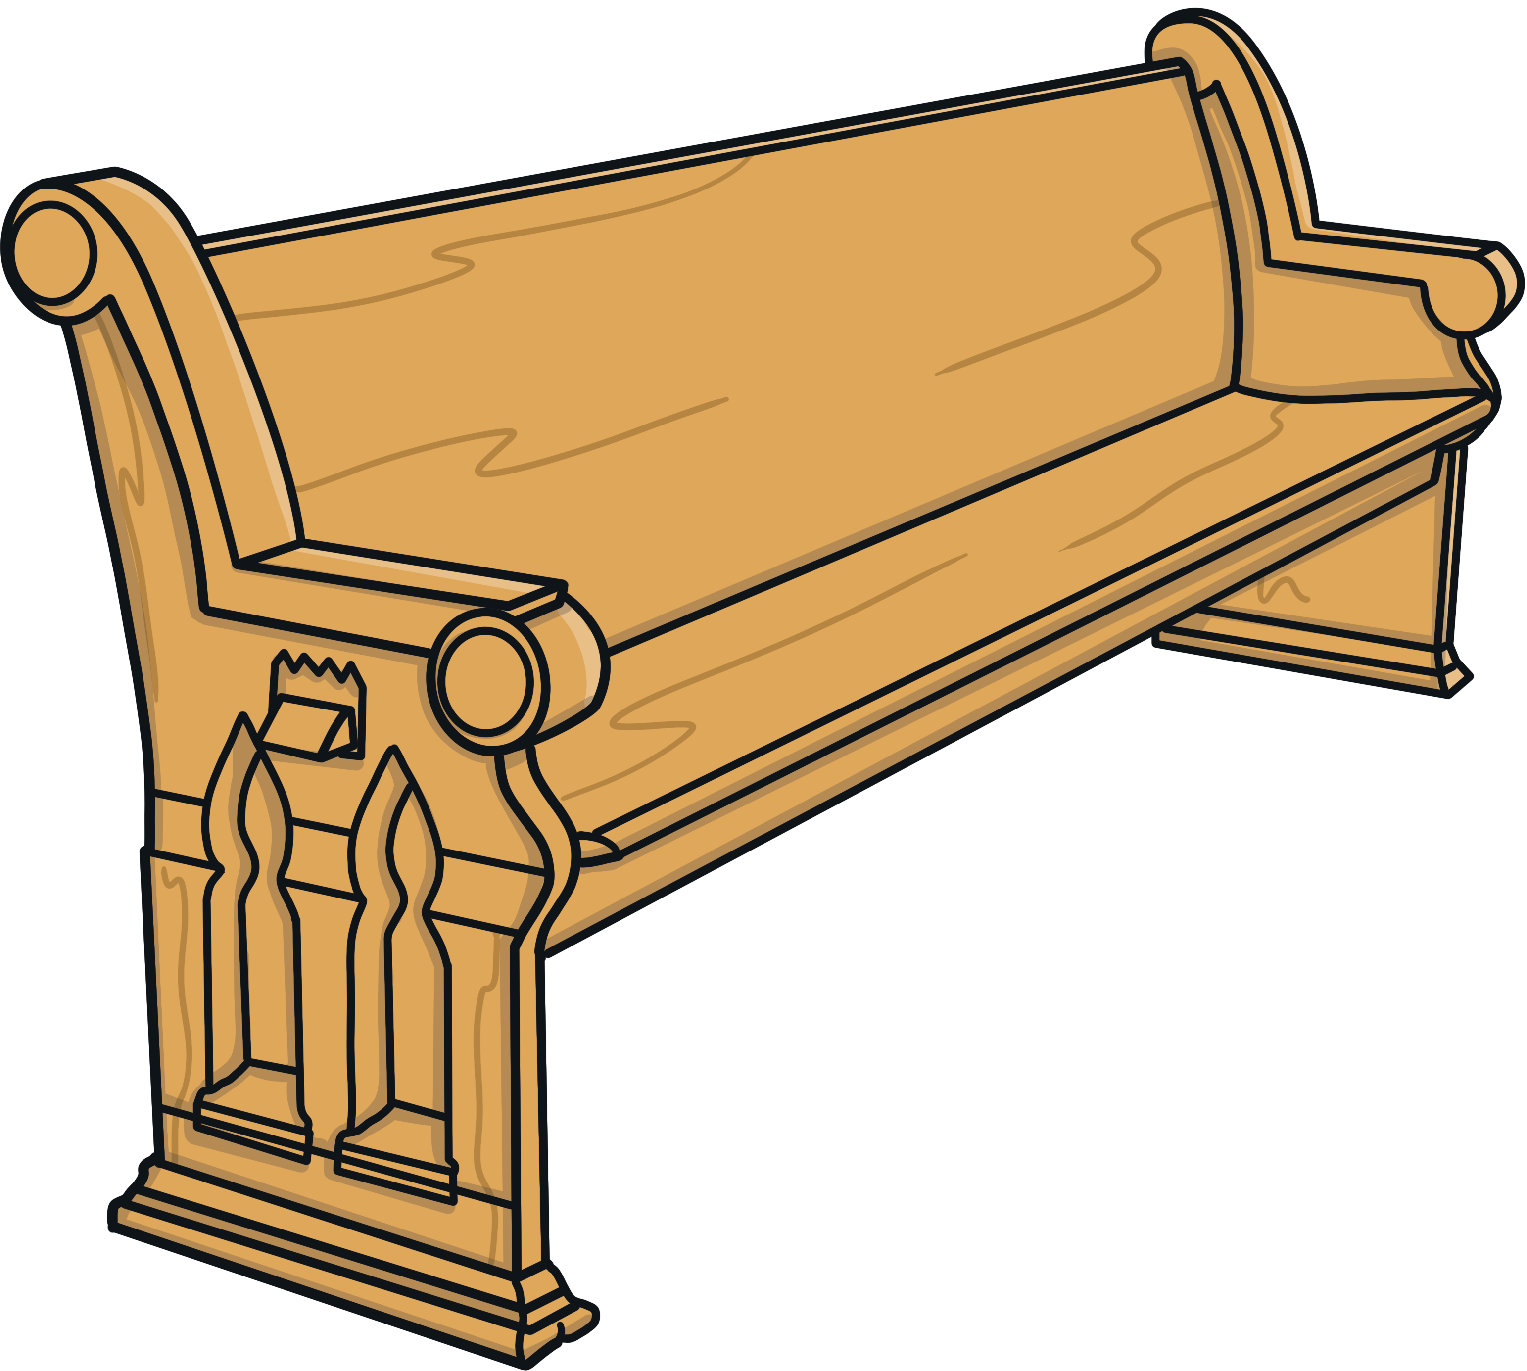
ew ew ew
Sounds like…
Notes:
snail

Slide 53
ew
Write the Sound
Practise writing the sound with your finger in the air and then on the floor.

Slide 54
ew
Click on the letters to see which words have the ‘ew’ sound.

Slide 55
Click to read through each word.
drew
screw
threw
few
chew
grew
pew
dew
stew
jewel
news

Slide 56
ay
ir
au
oe
ie
ea
ew
oy
ey
aw
ou
ue
Click on a letter combination to jump to the appropriate slides

Slide 57
oe
Phase 5 Vowel Digraphs

Slide 58
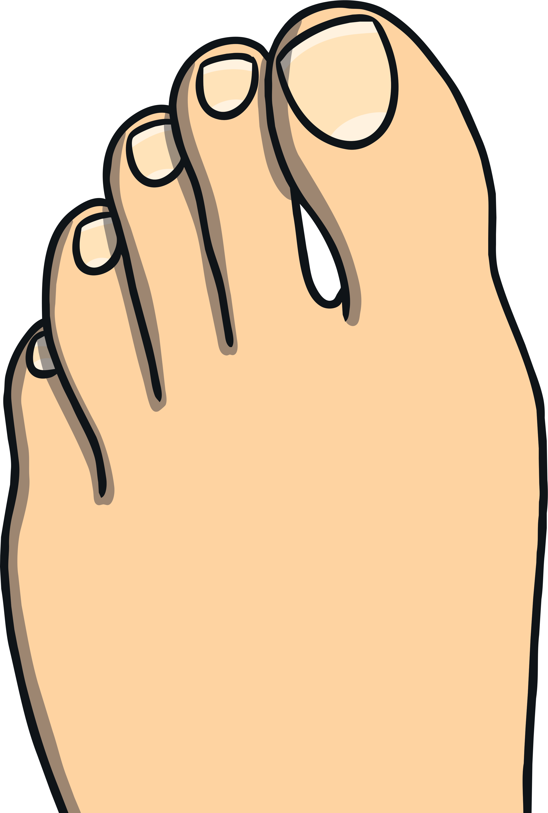
oe oe oe
Sounds like…
Notes:
snail

Slide 59
oe
Write the Sound
Practise writing the sound with your finger in the air and then on the floor.

Slide 60
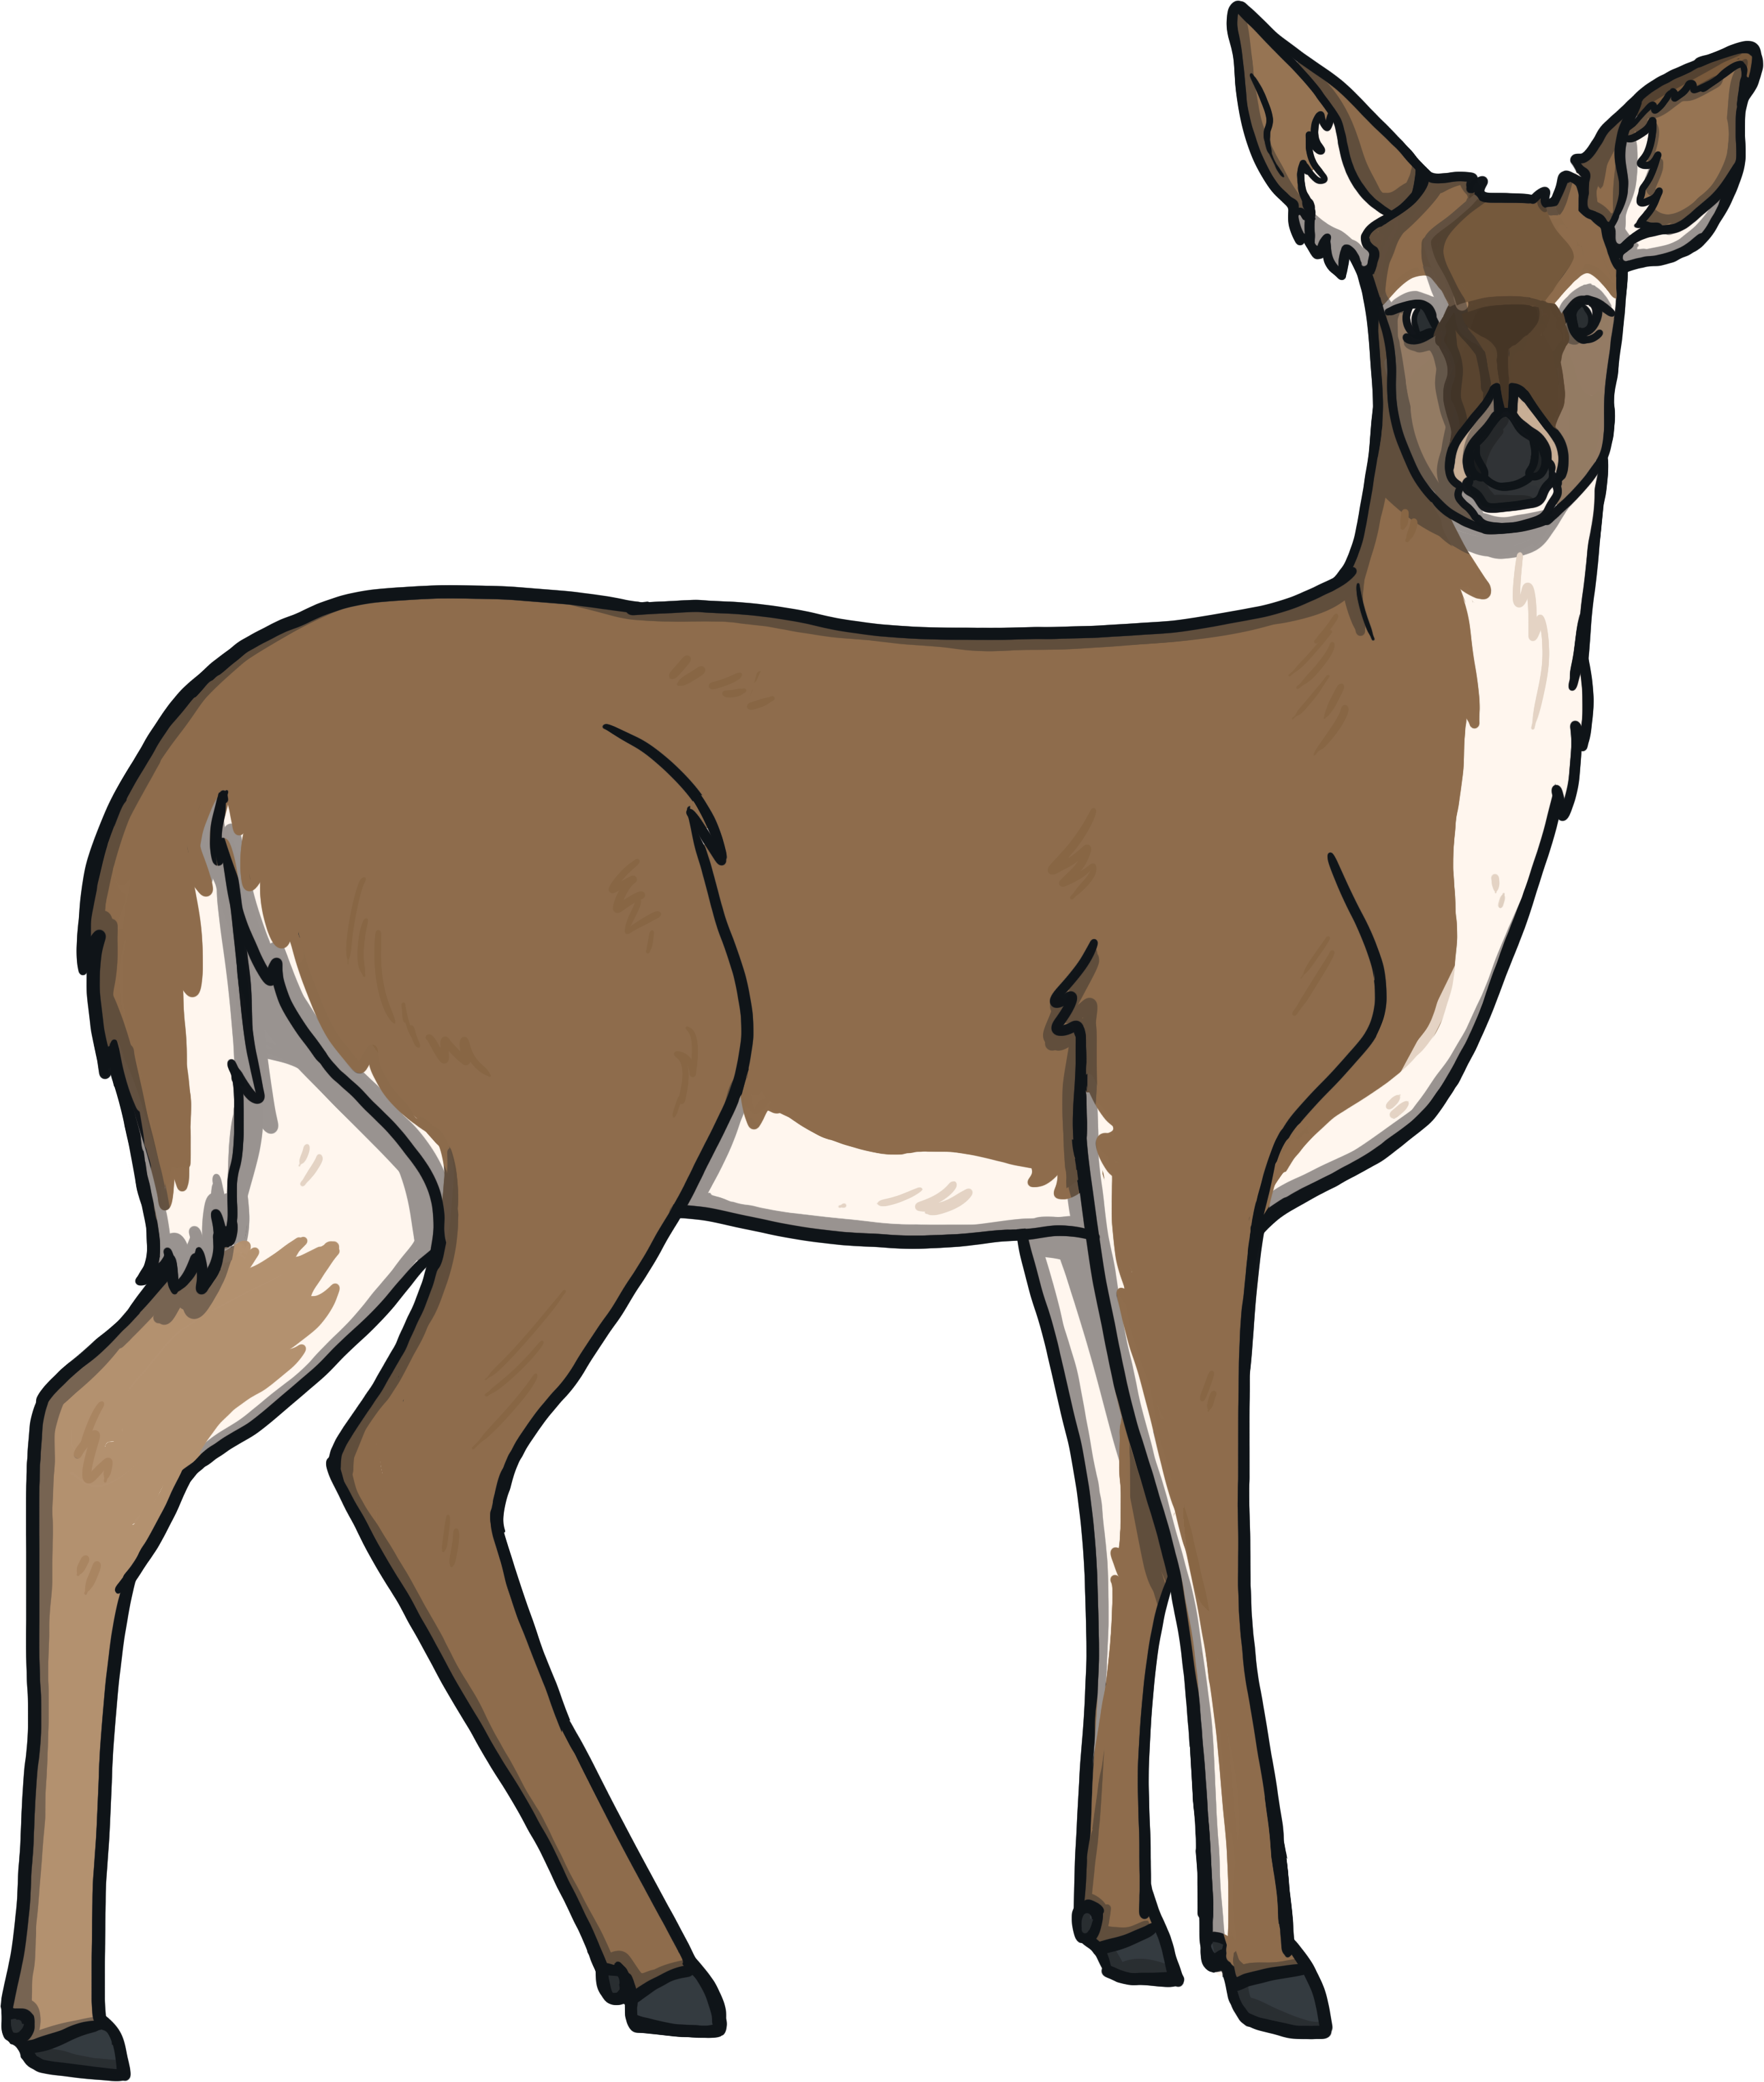
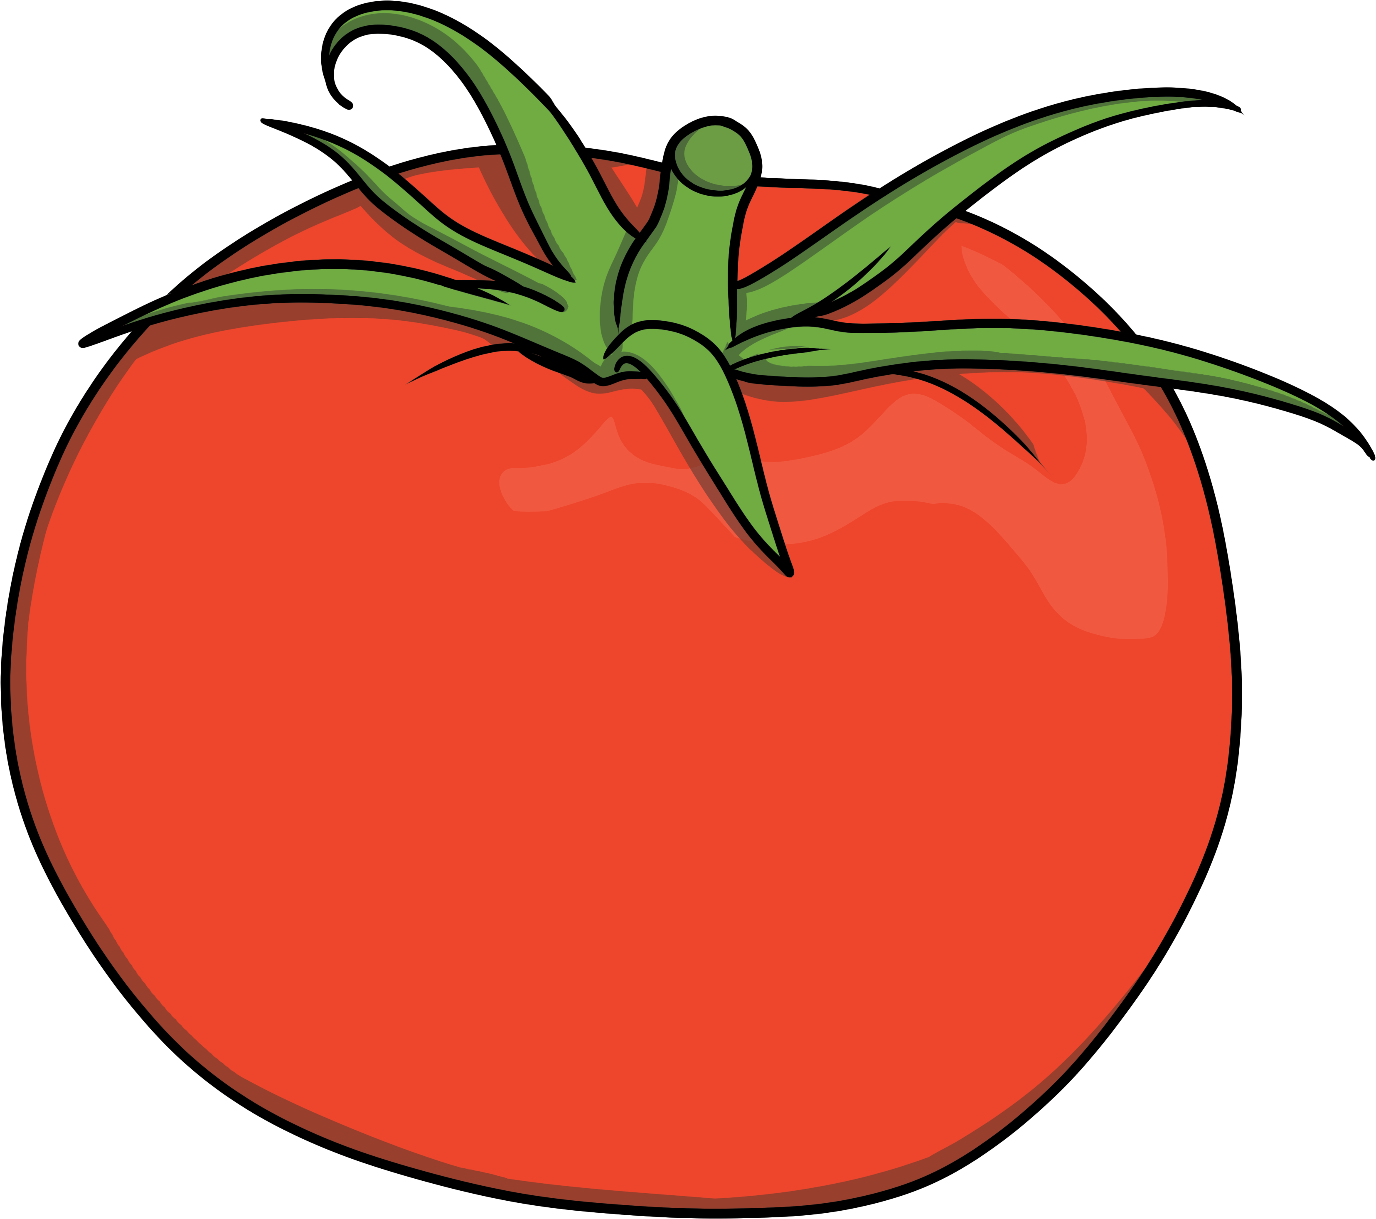
oe
Click on the letters to see which words have the ‘oe’ sound.

Slide 61
Click to read through each word.
toe
potatoes
dominoes
tomatoes
heroes
doe
foe

Slide 62
ay
ir
au
oe
ie
ea
ew
oy
ey
aw
ou
ue
Click on a letter combination to jump to the appropriate slides

Slide 63
au
Phase 5 Vowel Digraphs

Slide 64
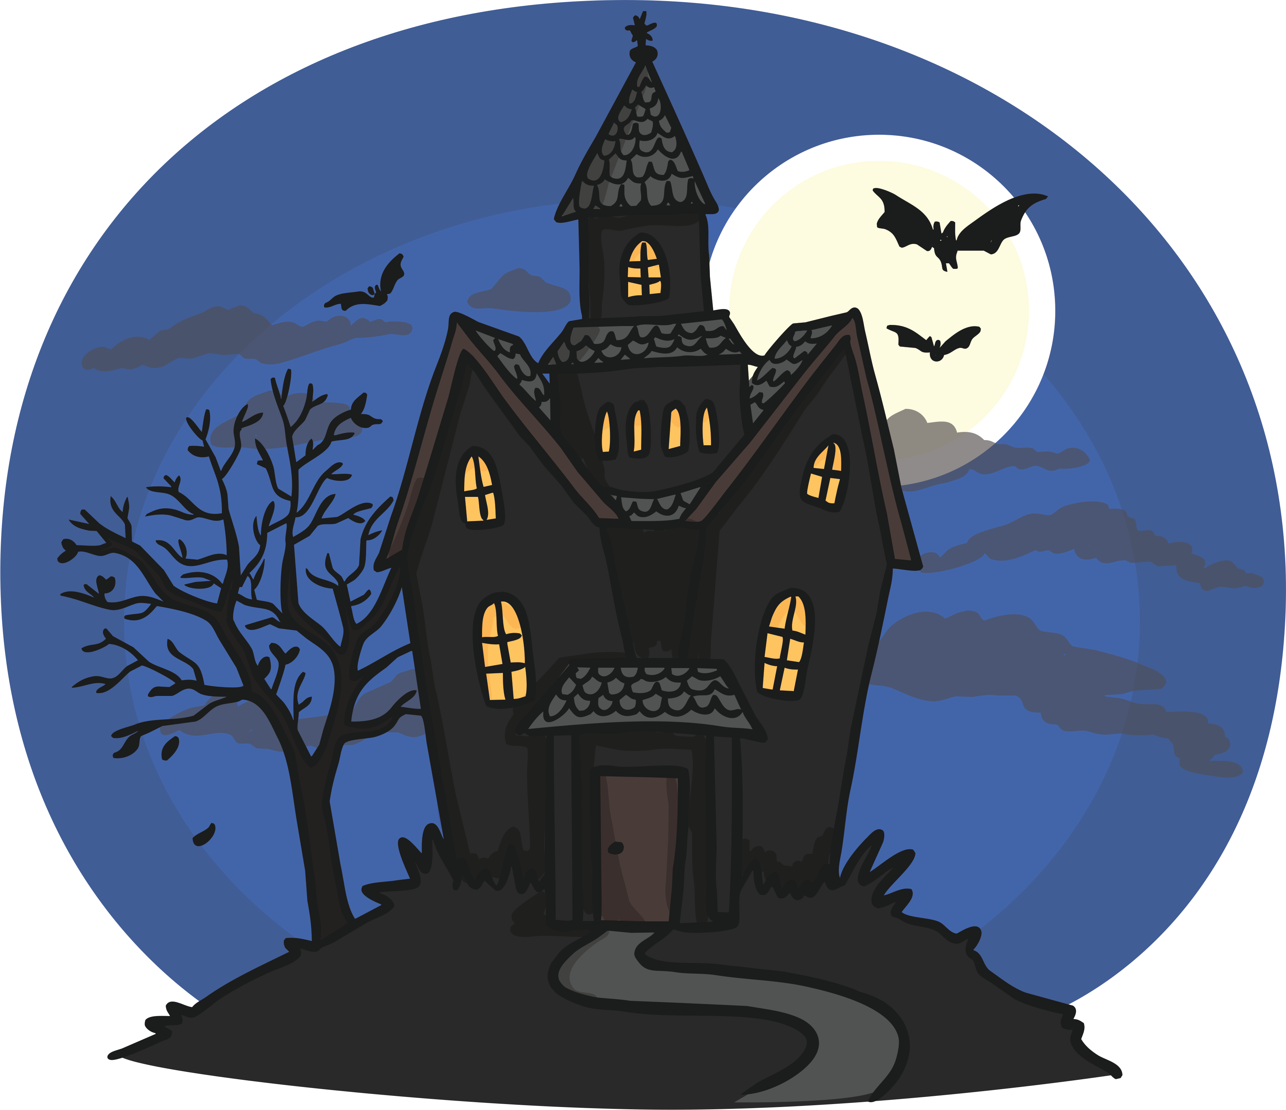
au au au
Sounds like…
Notes:
snail

Slide 65
au
Write the Sound
Practise writing the sound with your finger in the air and then on the floor.

Slide 66
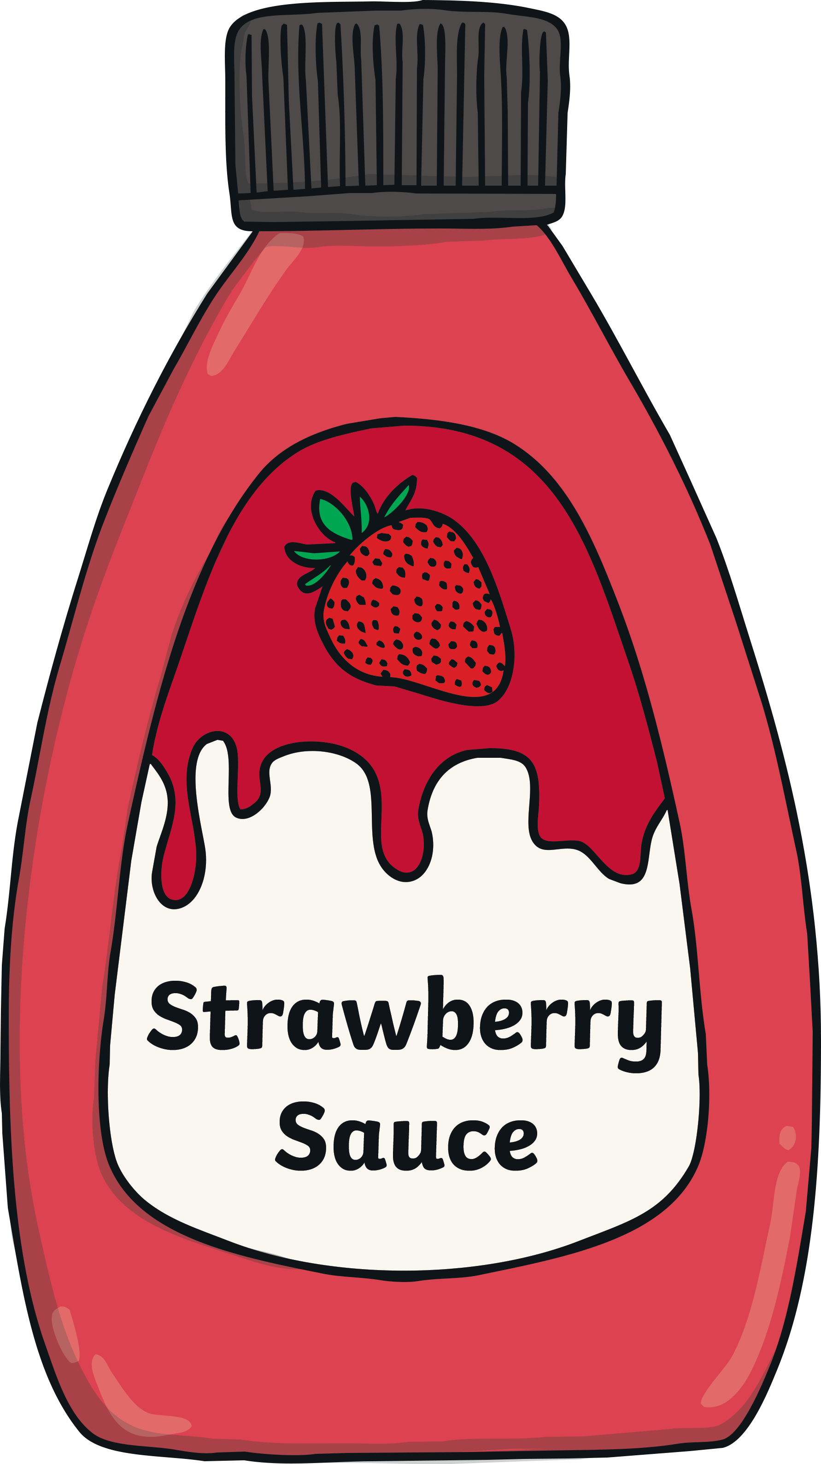
au
Click on the letters to see which words have the ‘au’ sound.

Slide 67
Click to read through each word.
author
pause
sauce
haul
august
because
haunted
autumn

Slide 68
ay
ir
au
oe
ie
ea
ew
oy
ey
aw
ou
ue
Click on a letter combination to jump to the appropriate slides

Slide 69
ey
Phase 5 Vowel Digraphs

Slide 70
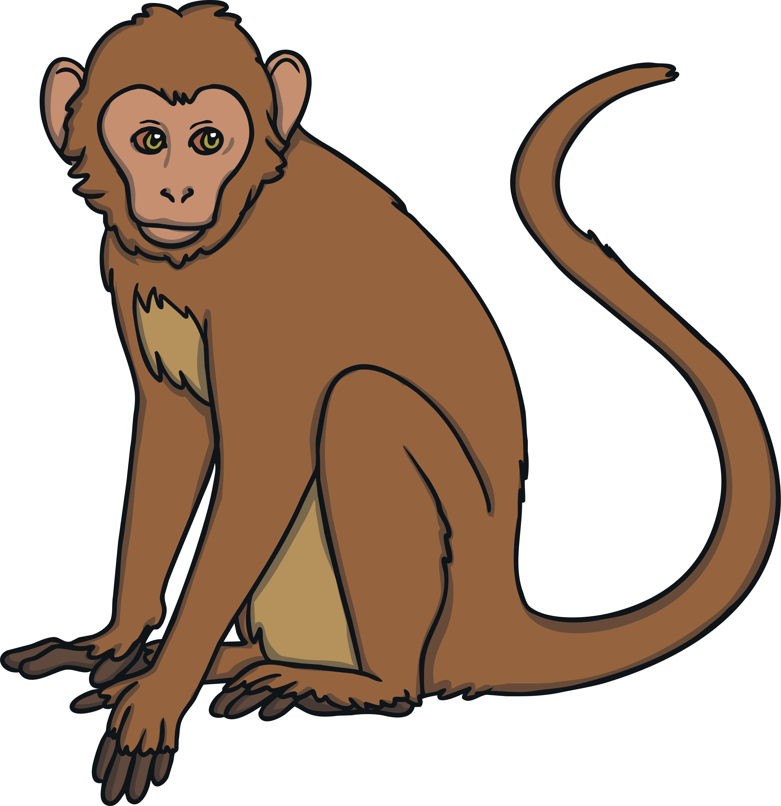
ey ey ey
Sounds like…
Notes:
snail

Slide 71
ey
Write the Sound
Practise writing the sound with your finger in the air and then on the floor.

Slide 72
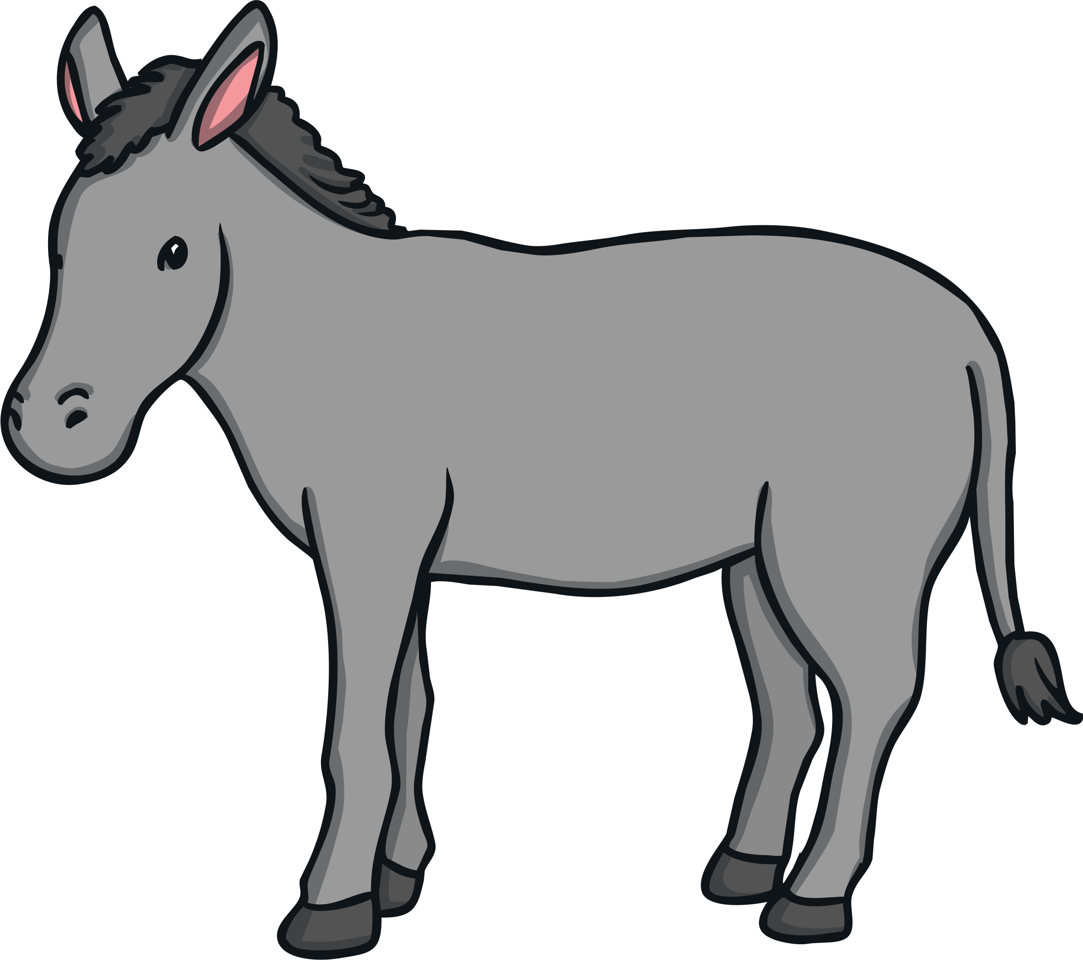
ey
Click on the letters to see which words have the ‘ey’ sound.

Slide 73
Click to read through each word.
honey
valley
trolley
money
donkey
key
turkey
monkey

Slide 74
ay
ir
au
oe
ie
ea
ew
oy
ey
aw
ou
ue
Click on a letter combination to jump to the appropriate slides

