Slide 2
How to play
Choose the adjective that is missing from each sentence. Click on them to put them in the correct place in the sentence, remember to think about the order of adjective in a sentence!

Slide 3
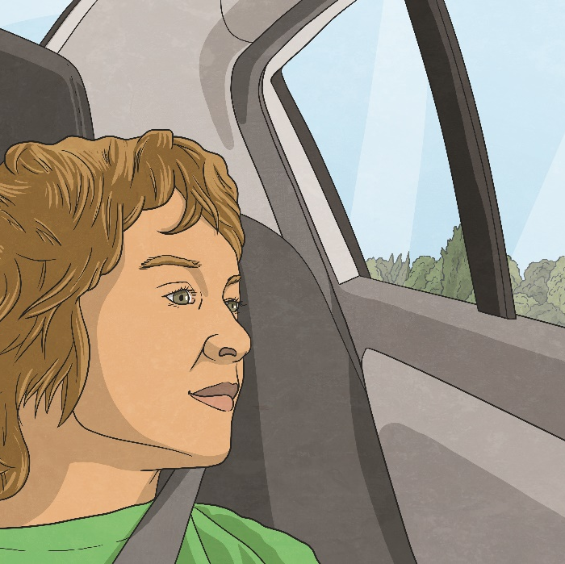
Click on the words to add them to the sentence
There were
,
kids in the car
six
happy

Slide 4
Click on the words to add them to the sentence
This is my
scarf
red
favourite
knitted

Slide 5
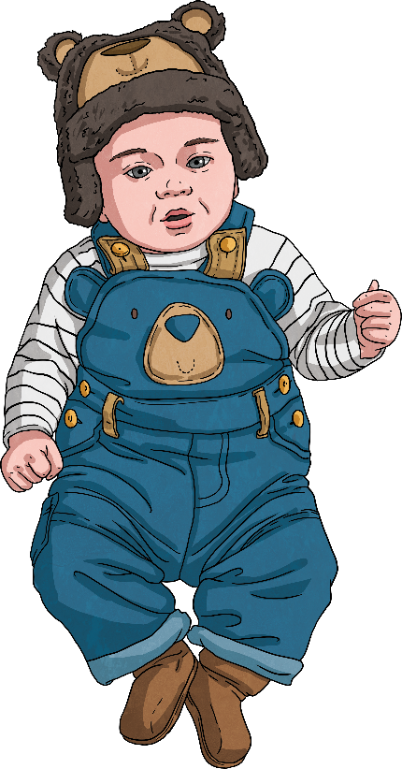
Click on the words to add them to the sentence
The baby boy was
and
healthy
adorable
bored
orange

Slide 6
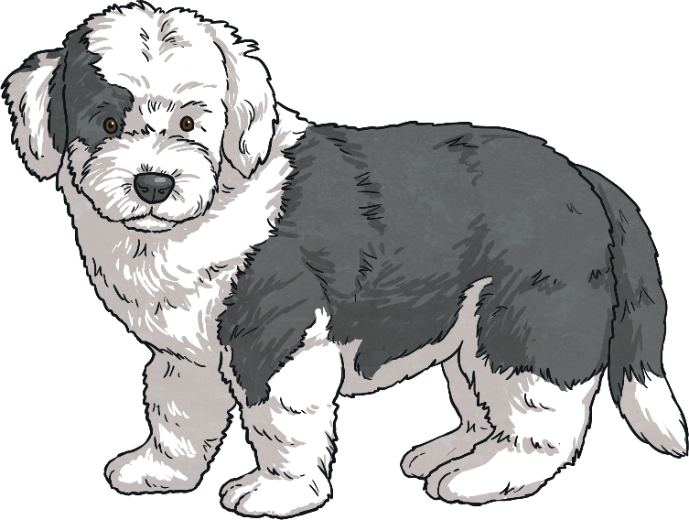
Click on the words to add them to the sentence
My new puppy is
and
spotless
tiny
rapid
excitable

Slide 7
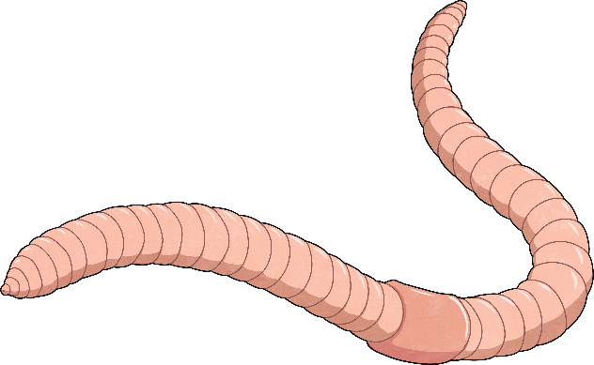
Click on the words to add them to the sentence
There was a
,
and
earthworm in the corridor.
fat
clumsy
slimy
boring
joyful
long

Slide 8
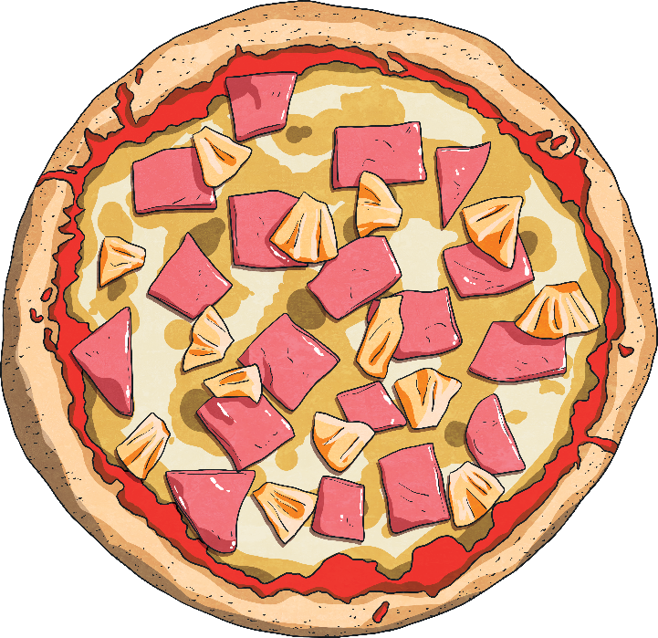
Click on the words to add them to the sentence
The pizza was
with
and
pieces of pineapple on it.
handsome
huge
confused
slow
big
tasty

Slide 9
Click on the words to add them to the sentence
There was a
,
,
fish on the end of my fishing line.
caring
blue
cheerful
beautiful
relieved
gigantic
early
late

Slide 10
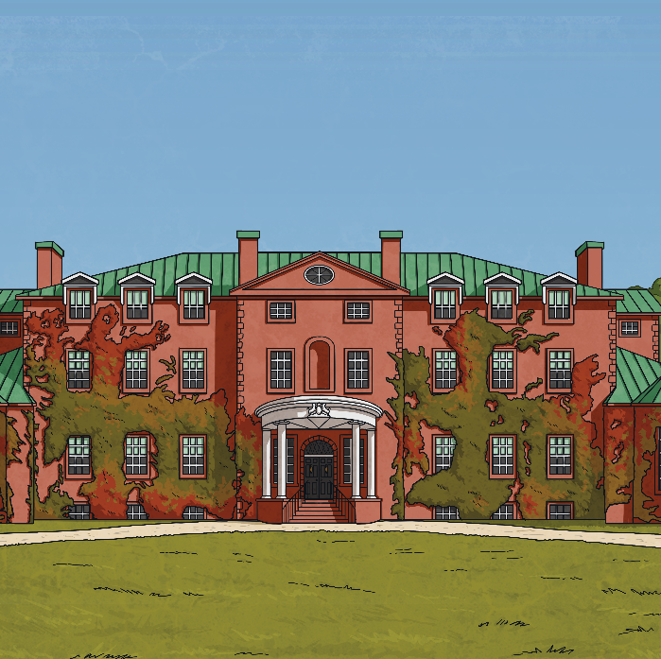
Click on the words to add them to the sentence
The
,
,
house stood
in the garden.
glamorous
slow
old
bored
red
brick
tall
caring

