Slide 2
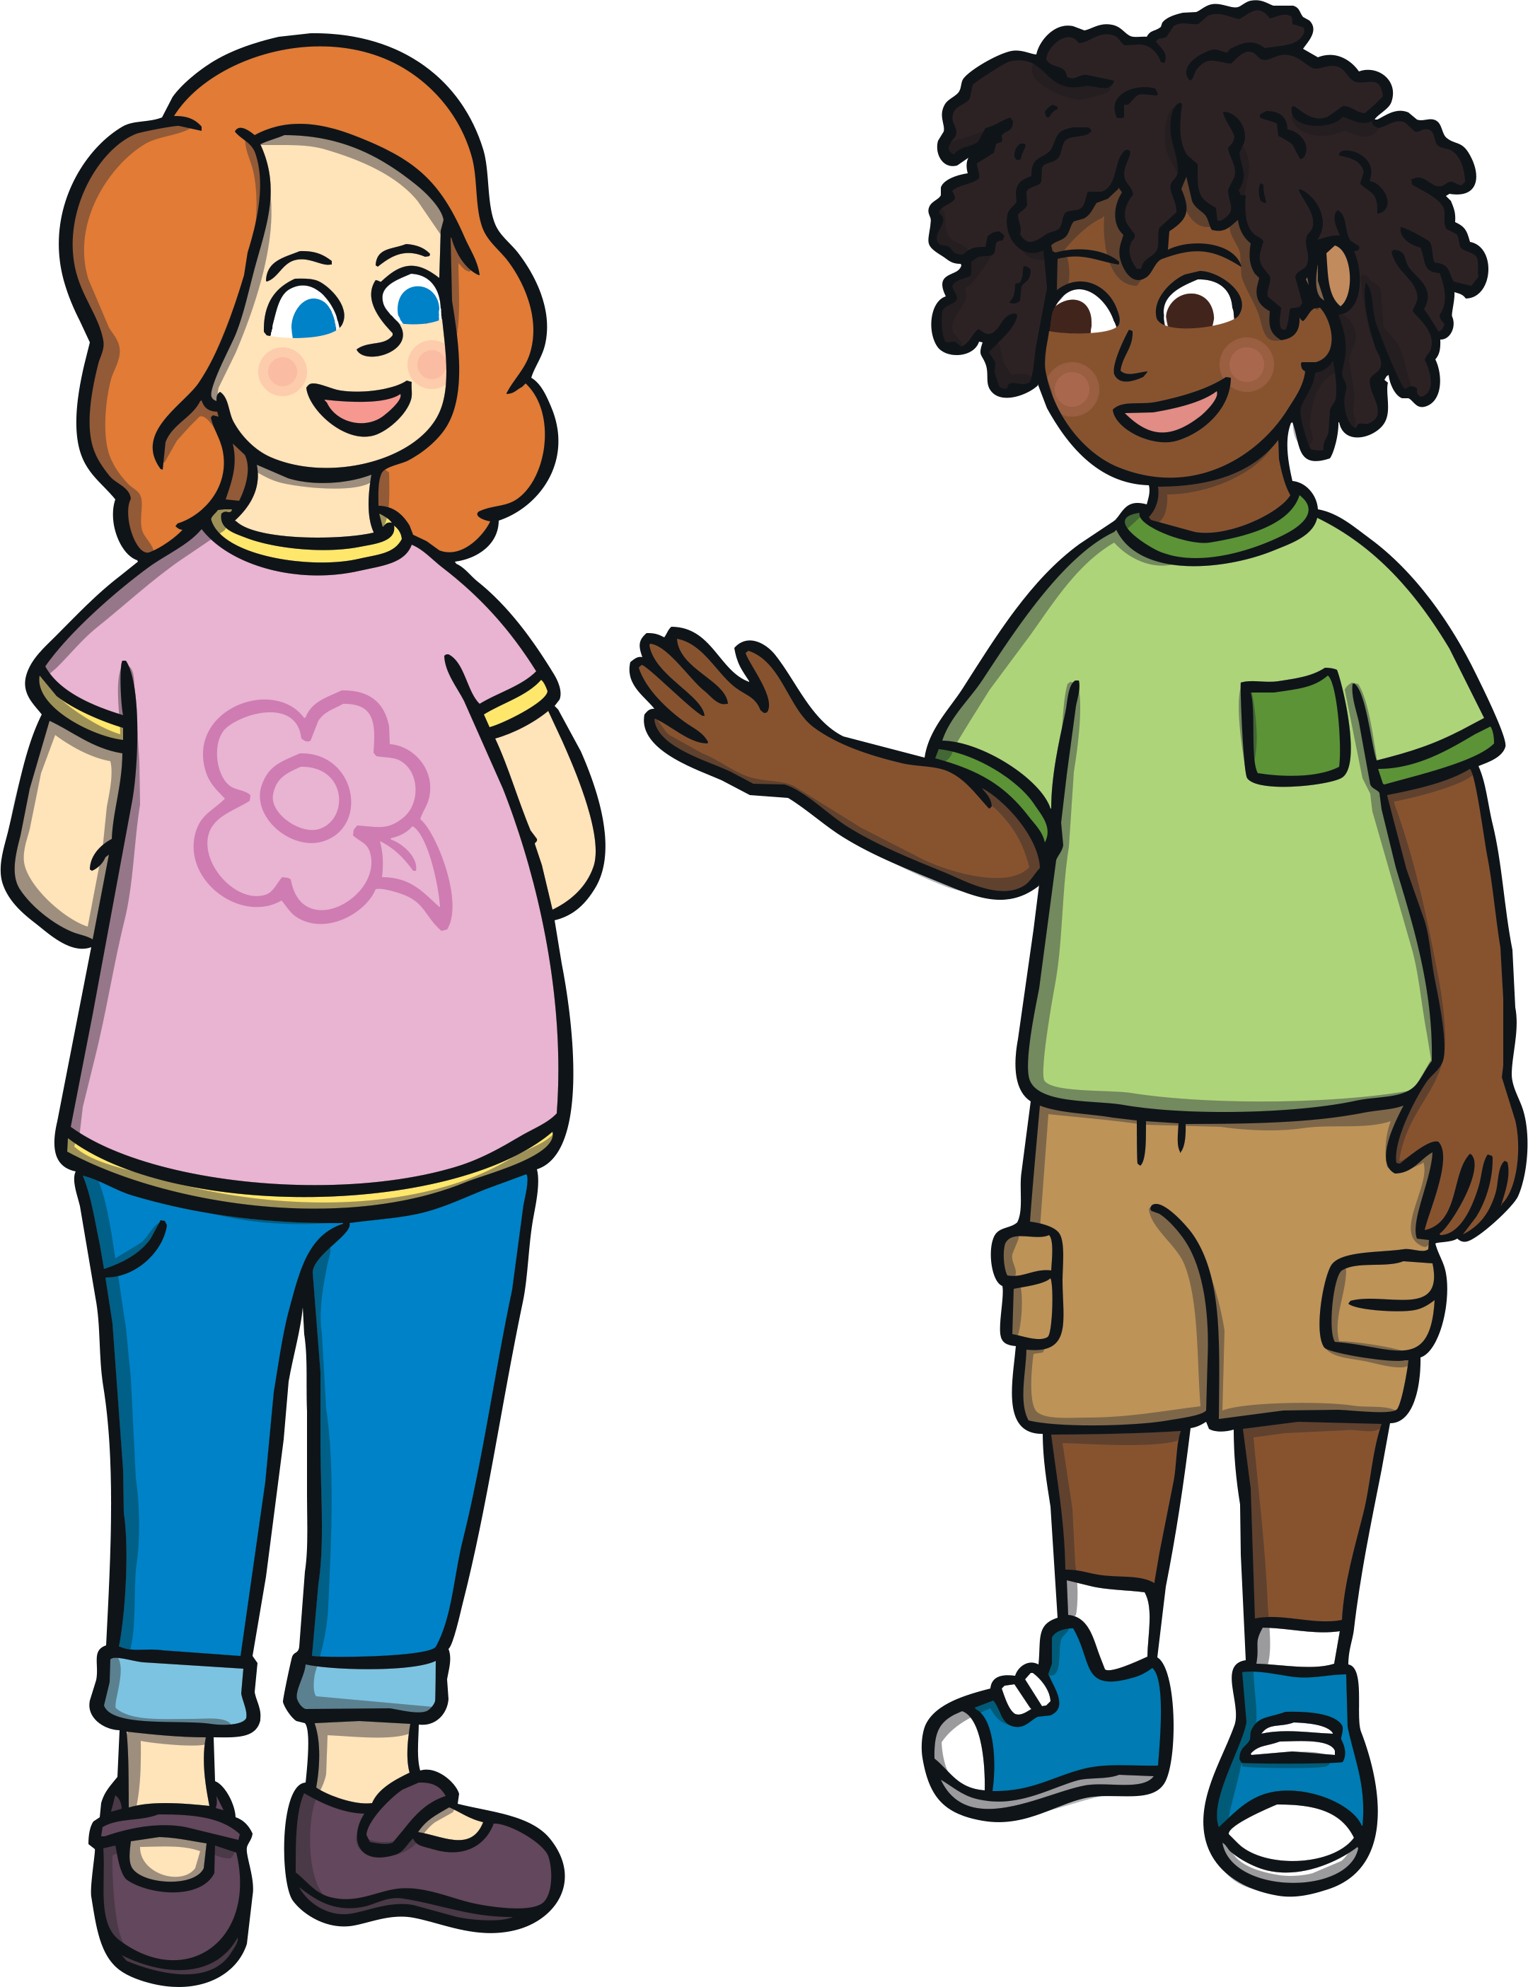
Communication
We can use body language to communicate with others when we are with them.

Slide 3
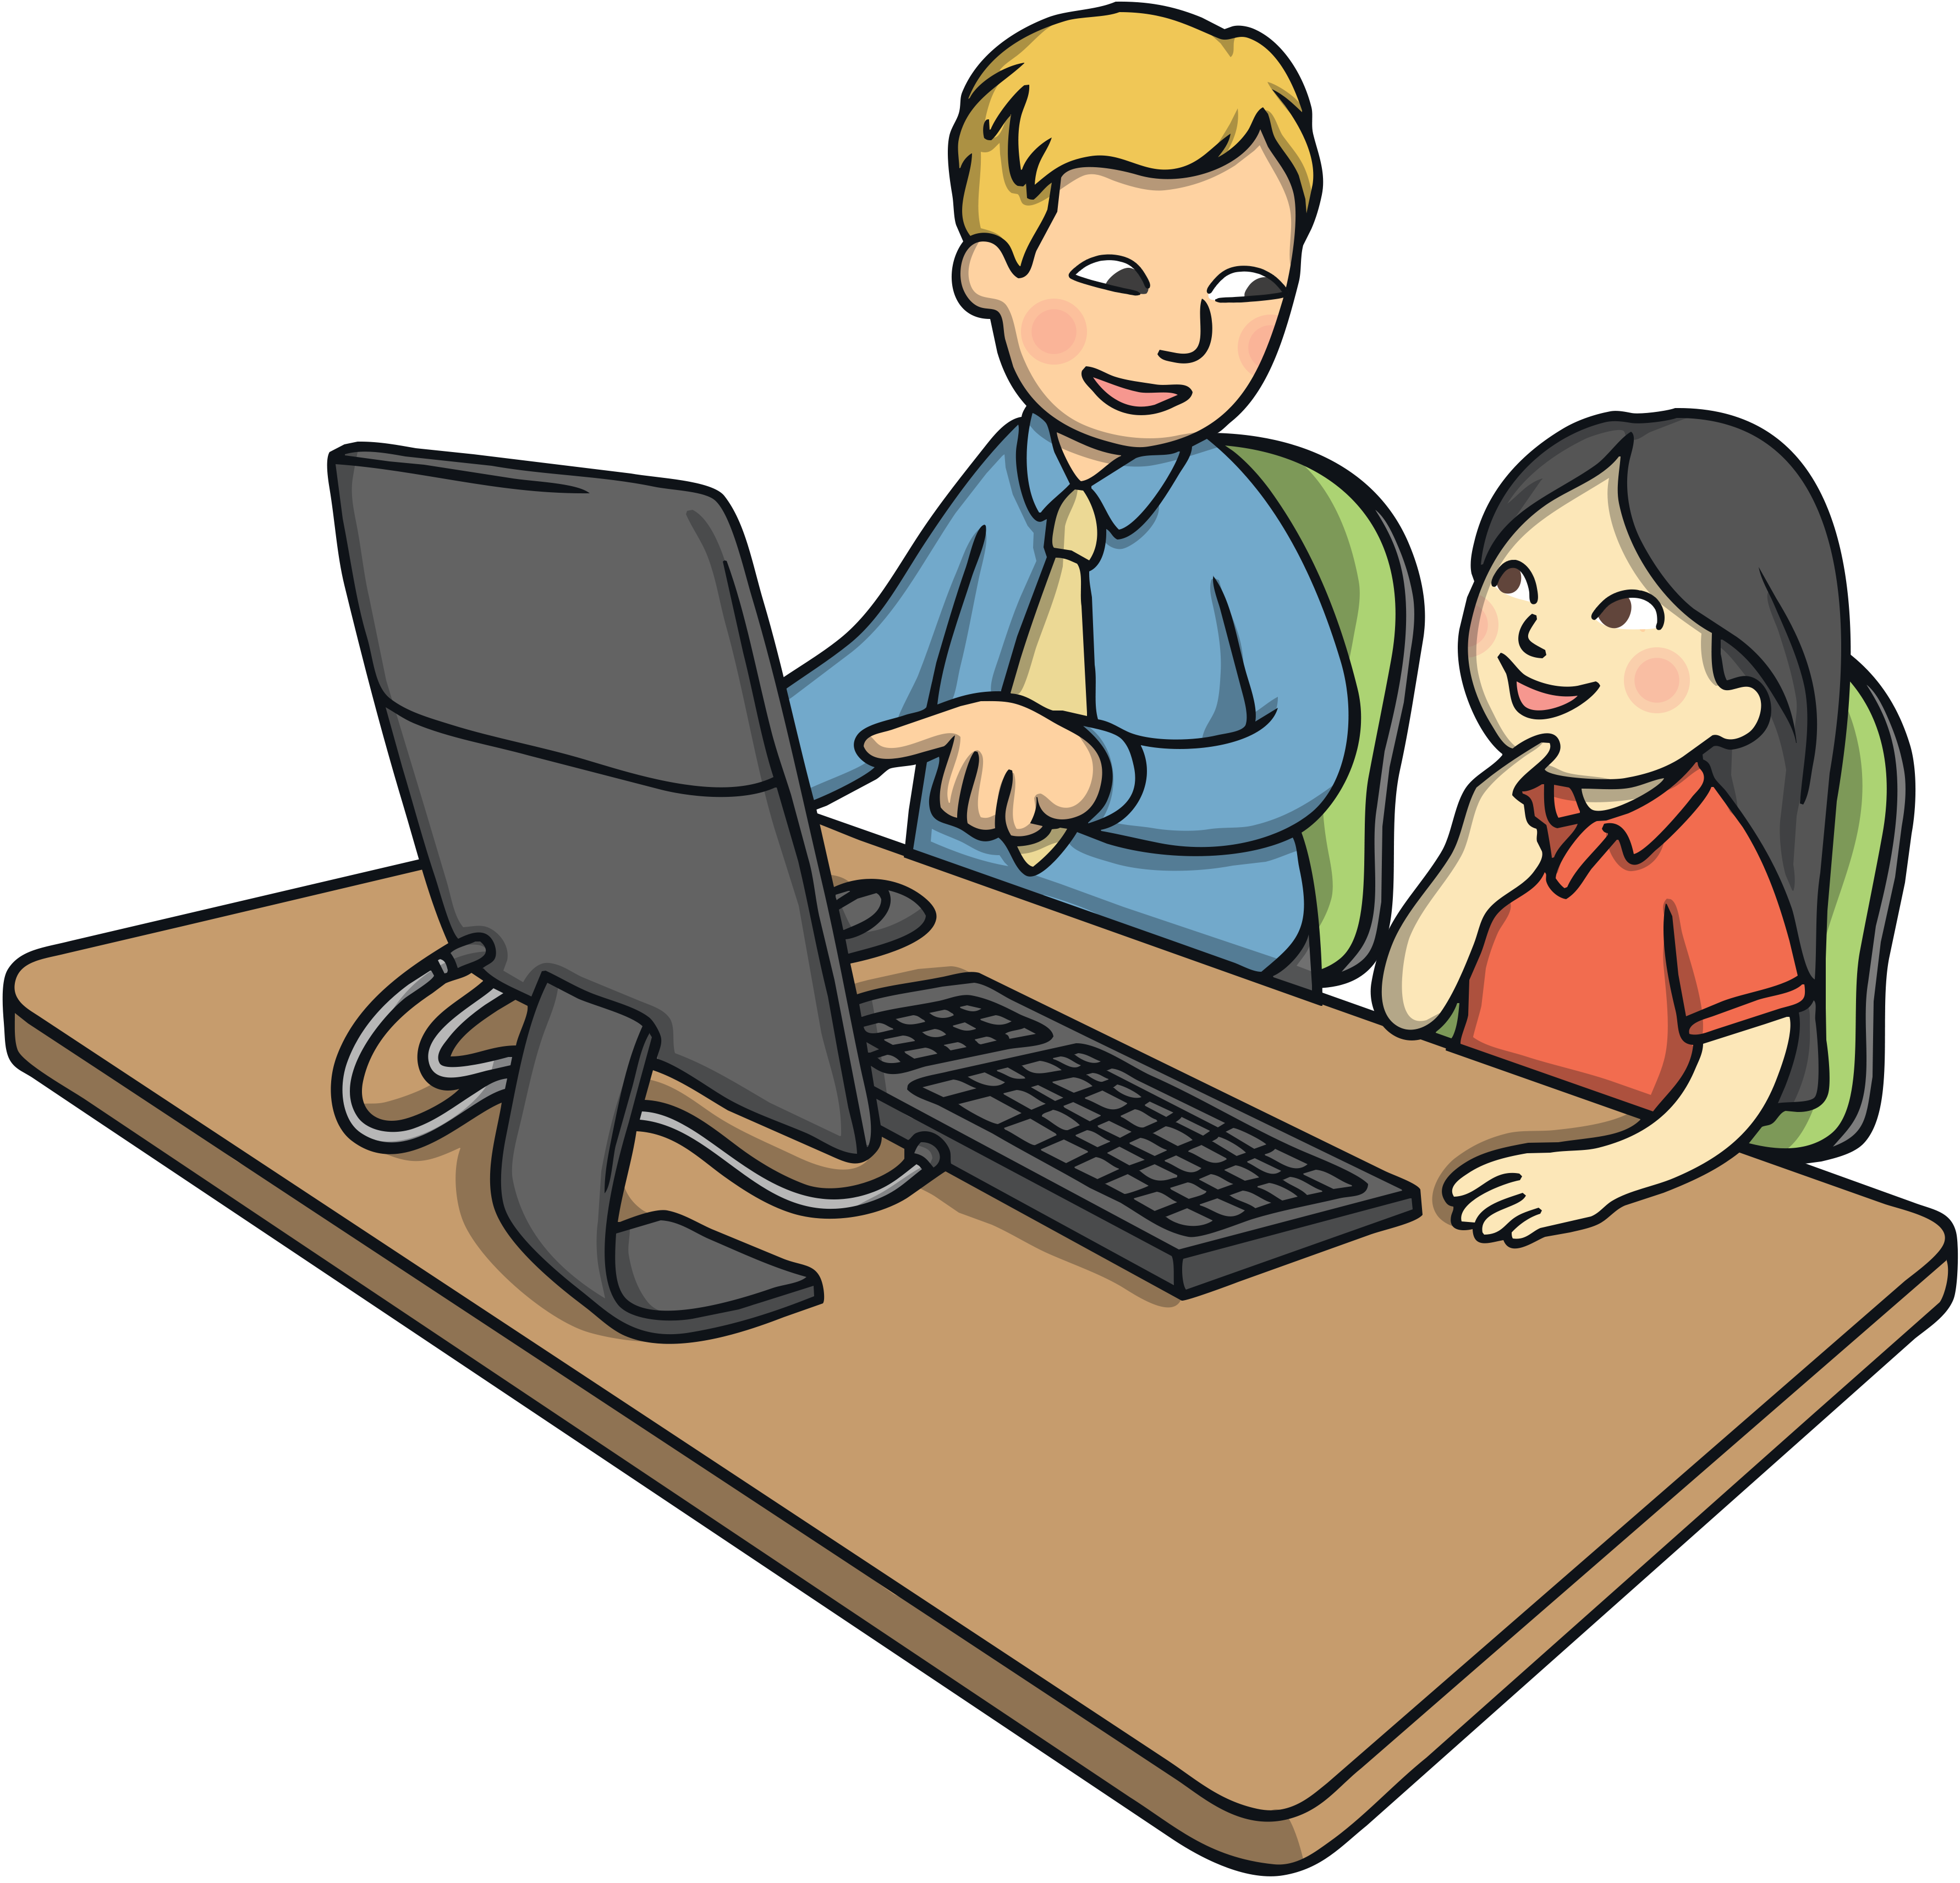
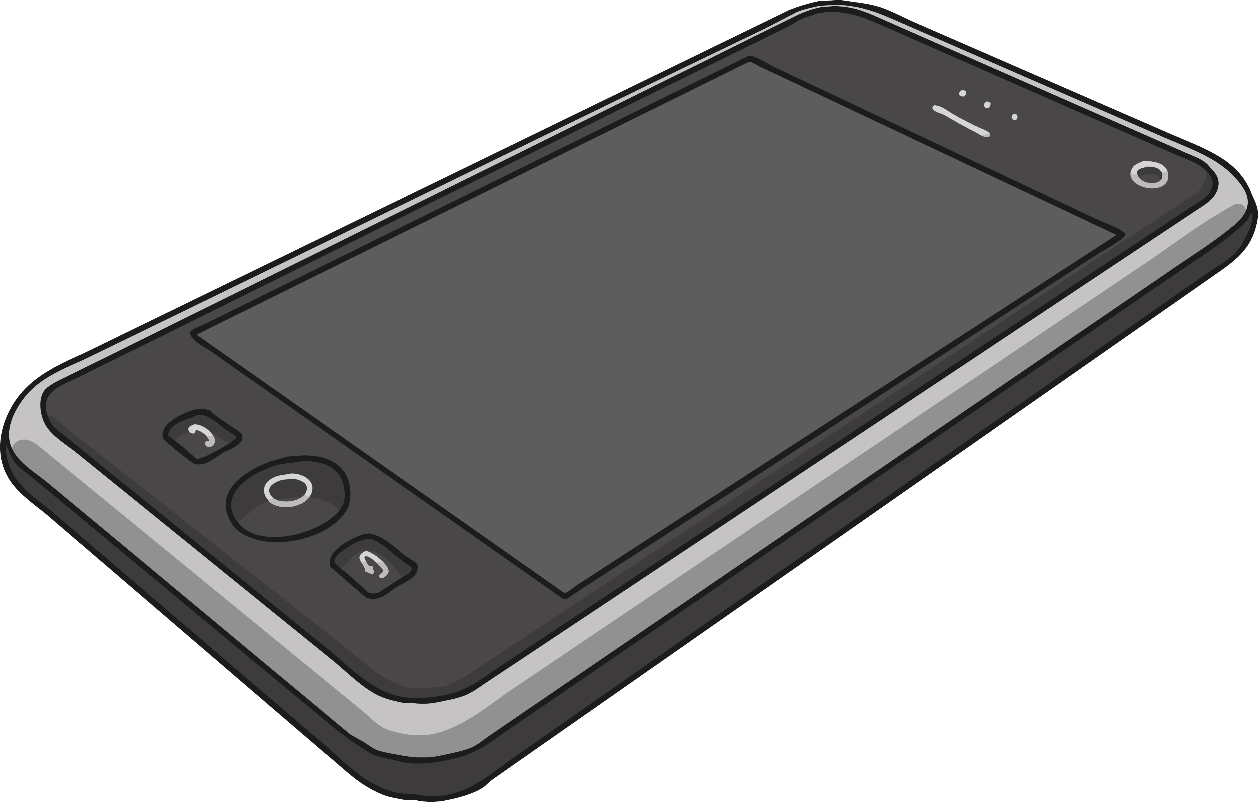
Communication
When we are a long way from someone, we can communicate with them by phone, letters, email and social media.

Slide 4
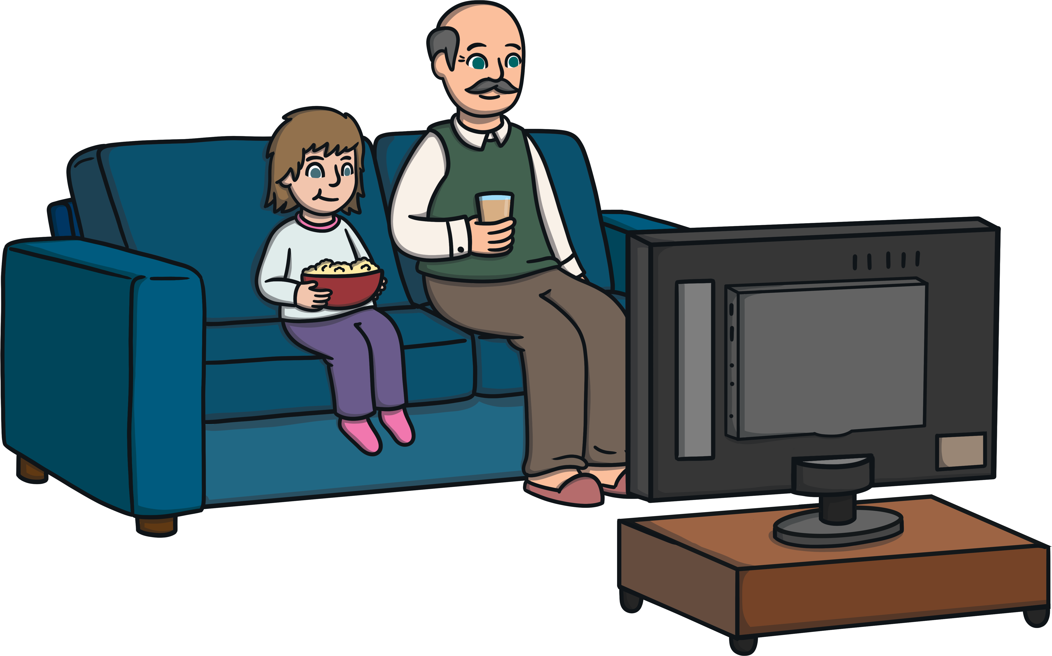
Communication
Sometimes, you don’t need to know a person to communicate.
Authors who write stories communicate with us.
Television shows and movies communicate with us.

