Slide 2
Learning Objective
To understand the places people live in and their familiar features. (ACHASSK015).
Success Criteria
I can recognise different places people live.
I can name their familiar features.
I can identify how places provide people with their basic needs (for example, water, food and shelter) and why they should be looked after for the future.

Slide 3
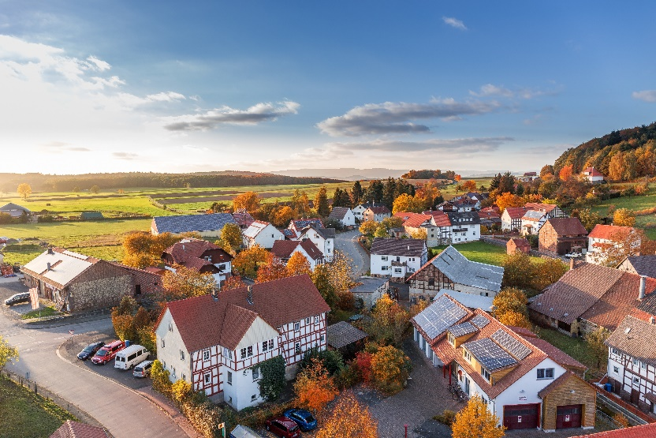
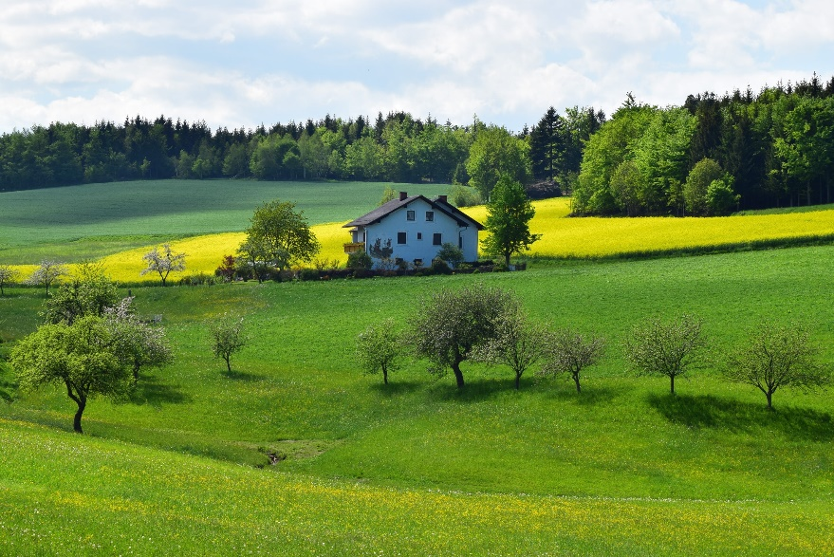
Different Places People Live
Some people live in the country.
Others live in towns,
or very busy cities.

Slide 4
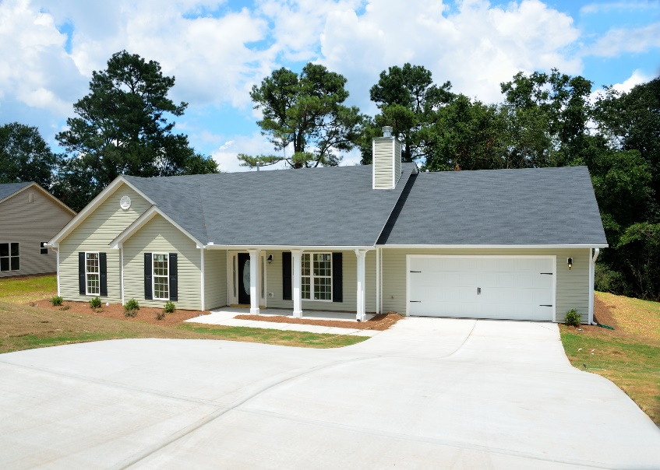
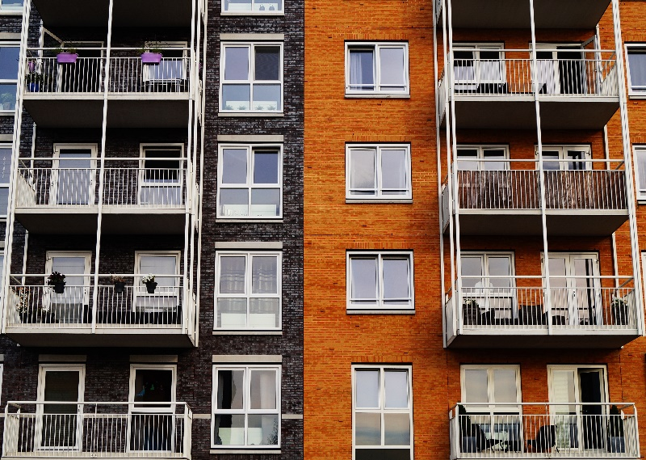
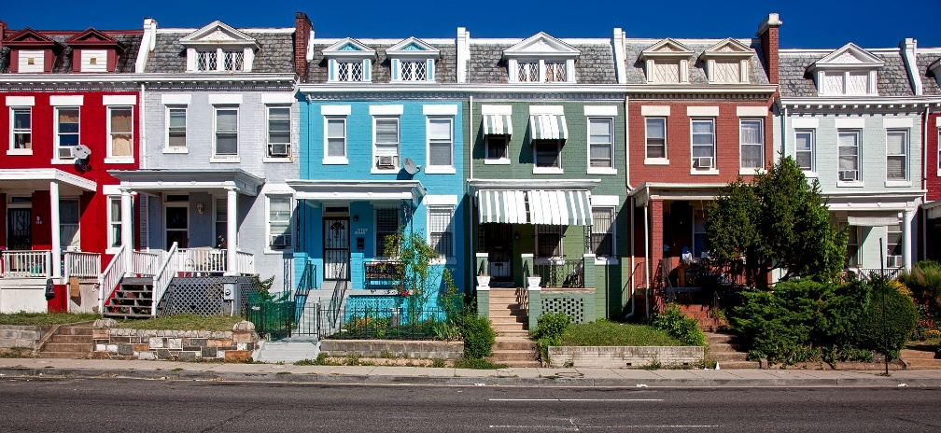
Different Places People Live In
apartment
house
townhouse

Slide 5
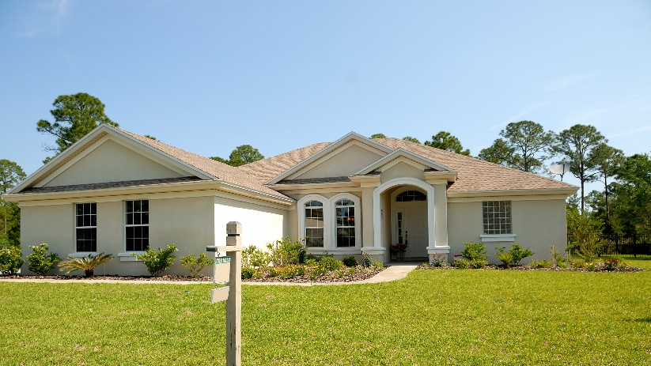
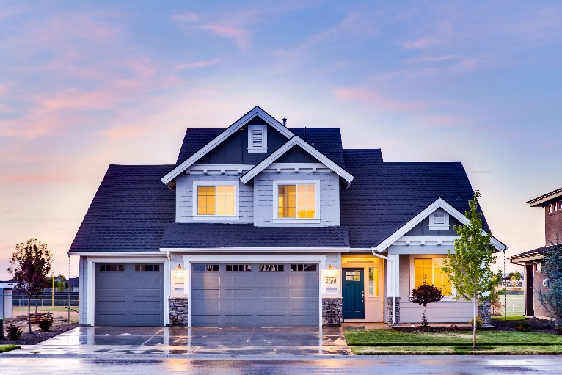
Different Places People Live In
Some houses have one level
and some have more.
What kind of house do you live in?

Slide 6
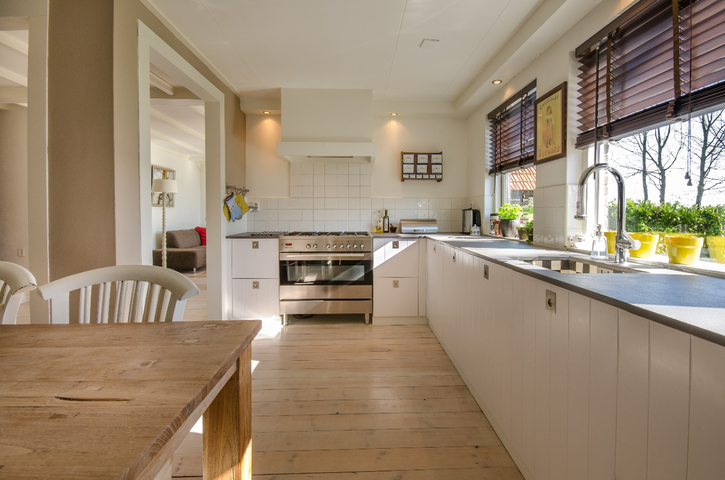
Features of Houses
Does your house have a
kitchen?
What is in your kitchen?

Slide 7
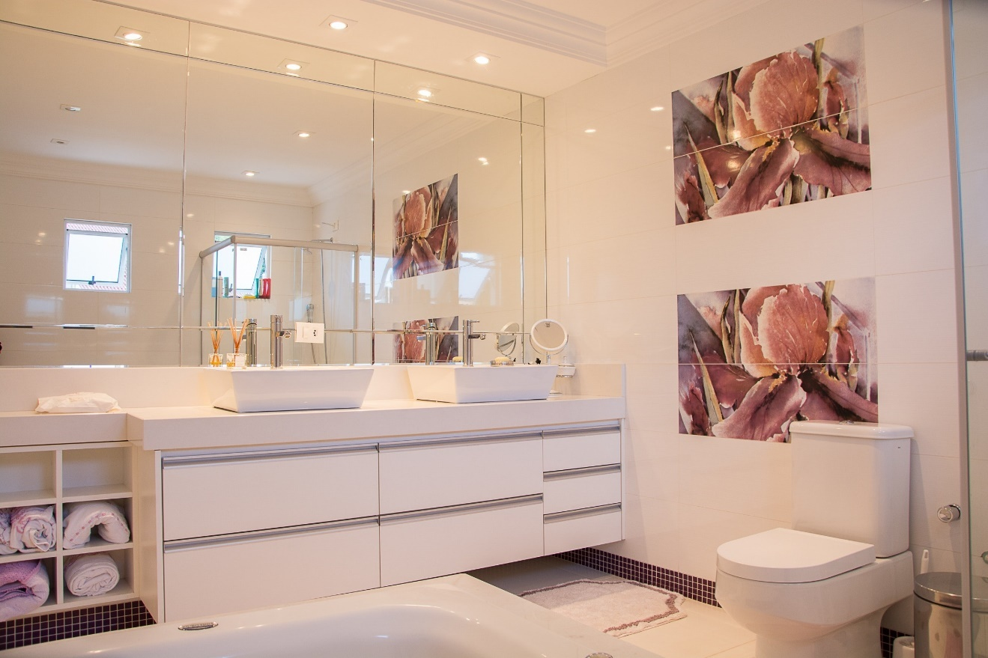
Features of Houses
Does your house have a
bathroom?
What is in your bathroom?

Slide 8
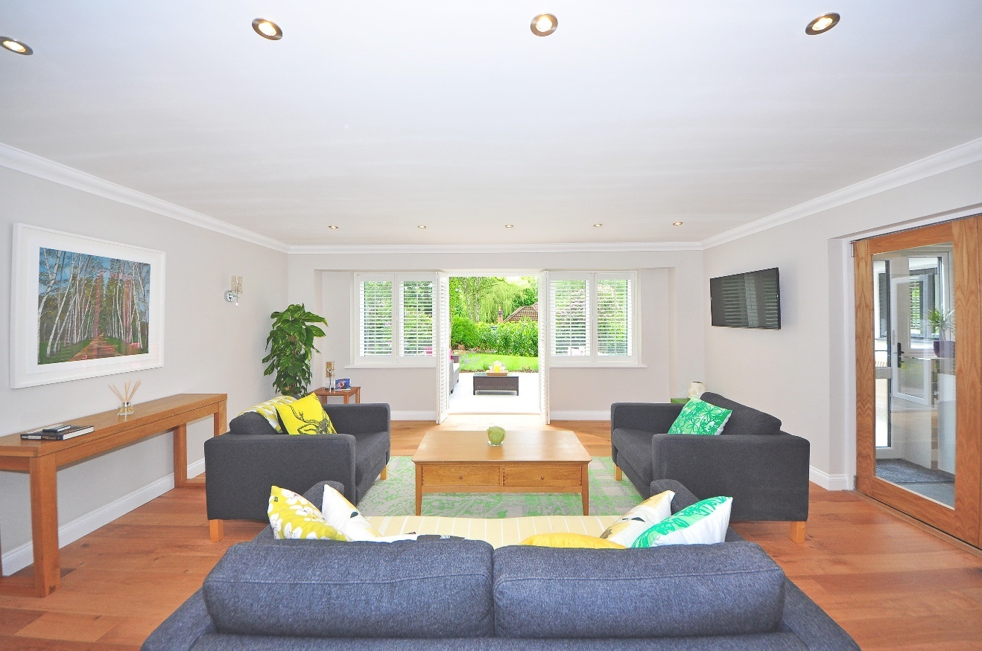
Features of Houses
Does your house have a
lounge-room?
What is in your lounge-room?

Slide 9
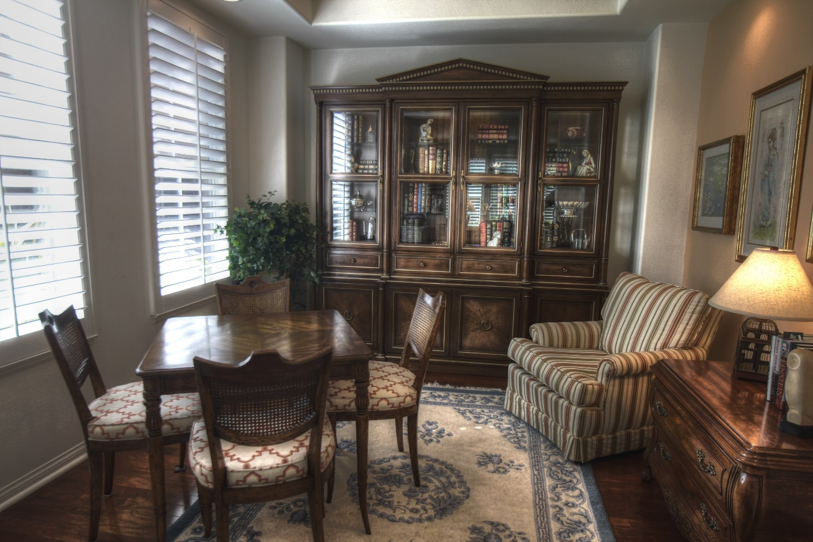
Features of Houses
Does your house have a
dining room?
What is in your dining room?

Slide 10
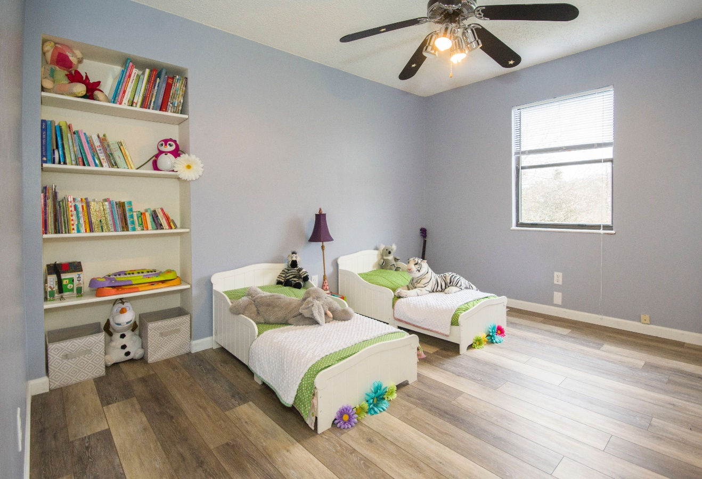
Features of Houses
Does your house have a
bedroom?
What is in your bedroom?

Slide 11
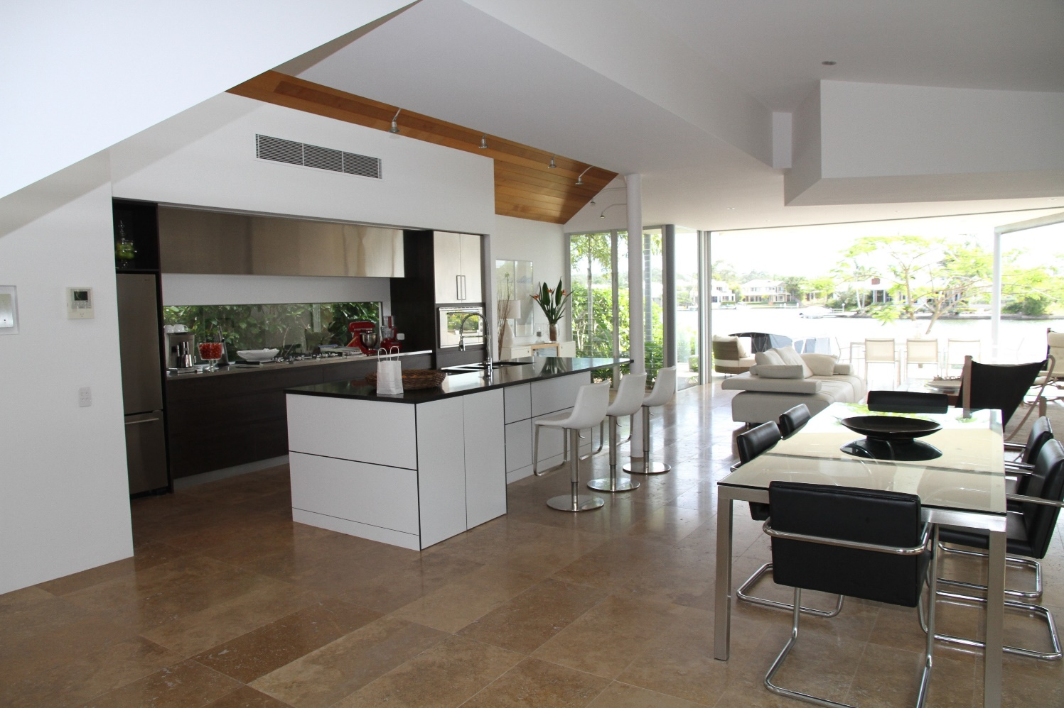
Features of Houses
Some houses have open spaces.

Slide 12
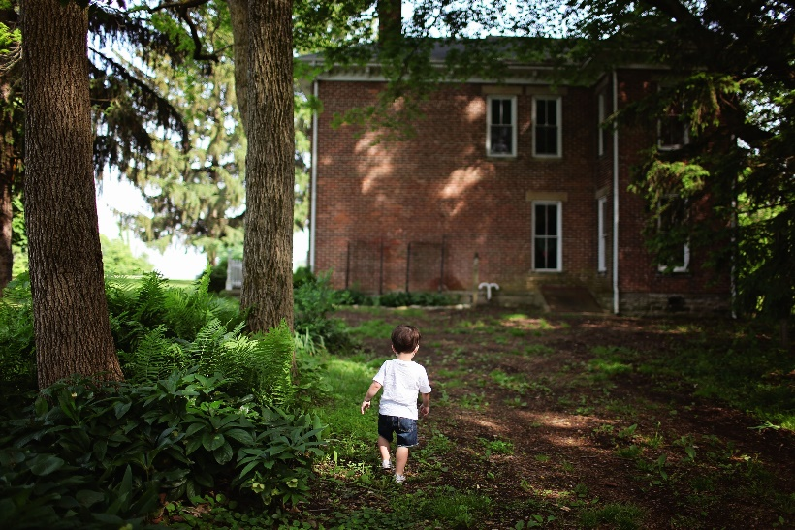
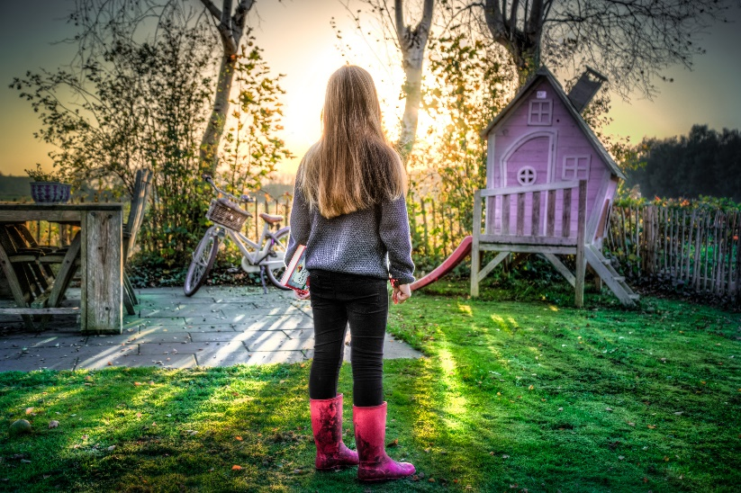
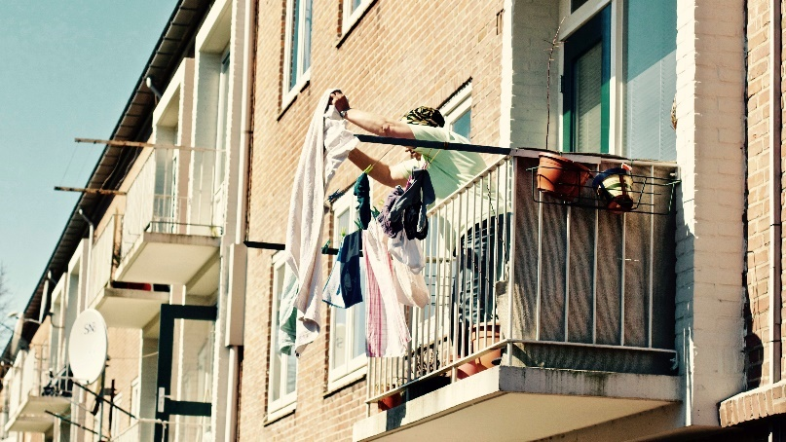
Features of Houses
Houses can have big backyards.
Others might have small backyards
What is your favourite part
of your home?
or a balcony.

Slide 13
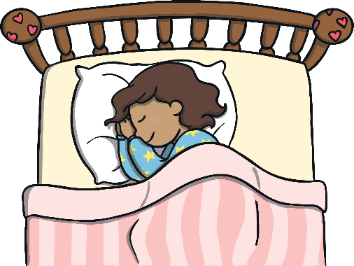
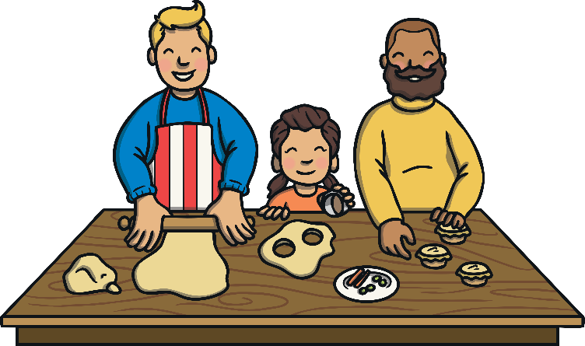
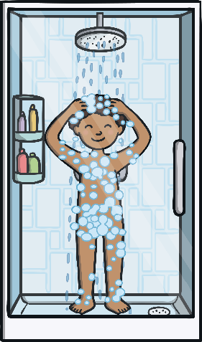
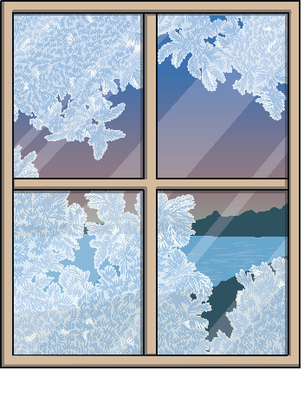
We need a home, so we have somewhere
to sleep,
to prepare food,
to clean and
to keep us safe from the weather.

Slide 14
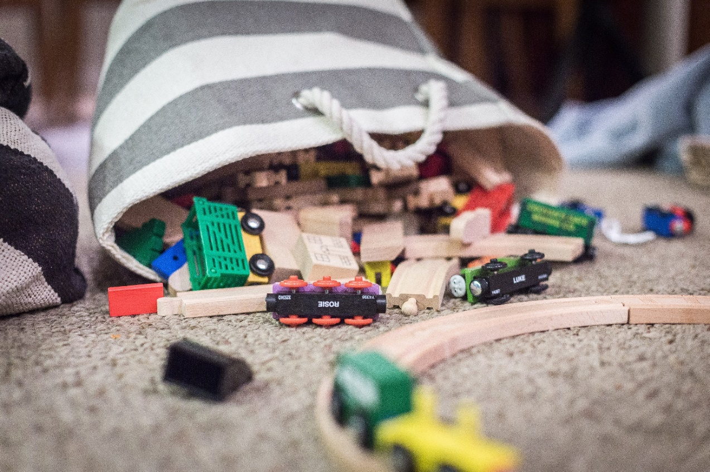
What would happen if we didn’t look after our home?
It would not be a safe place to live.

Slide 15
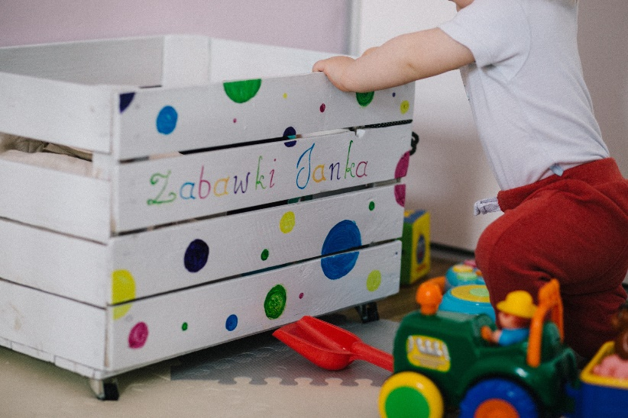
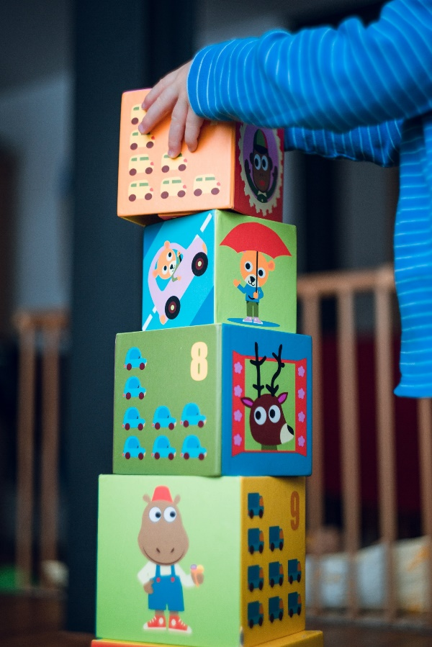
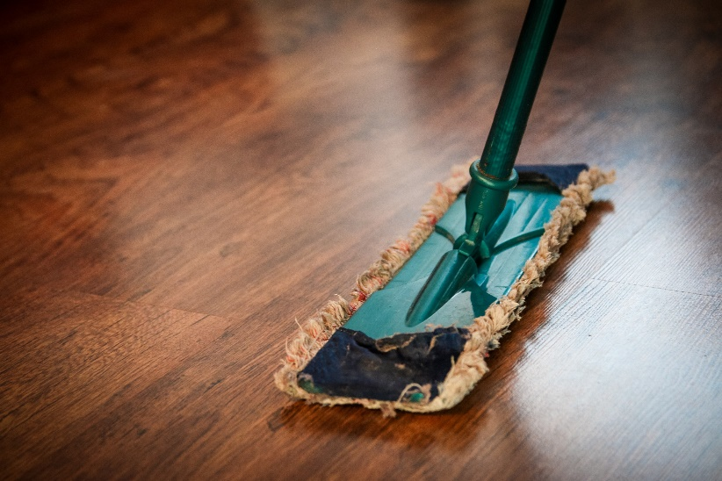
How can we look after our home?
We can put away our belongings and
clean up our mess.

Slide 16
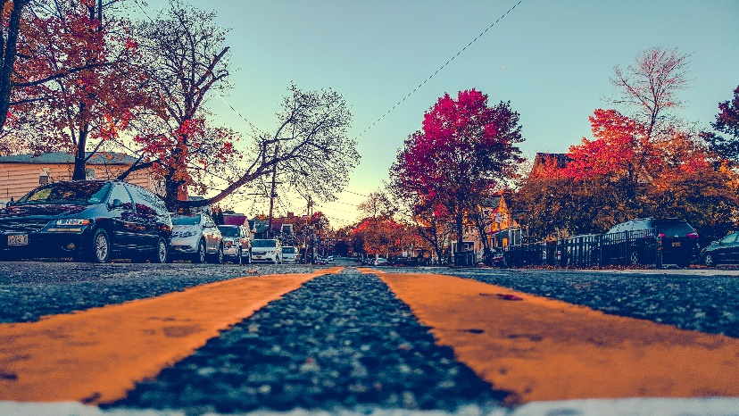
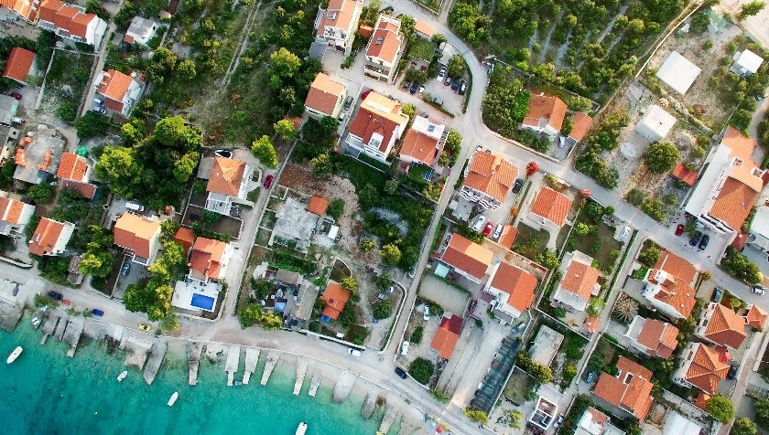
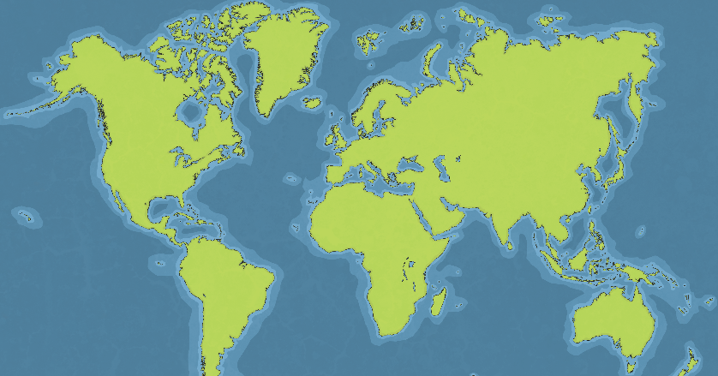
We might live
on a different street,
in a different suburb,
in a different city/town,
or in a different country.

Slide 17
But we all live on
Planet Earth.

