Slide 2
Spring Themed Self Registration
This is a lovely, editable Self Registration PowerPoint for all the class to use to show that they are in school. There are also weather symbols for you to drag on if you wish!
Change the names and date to suit and add a weather symbol out of presentation mode. Do not ungroup anything as this will alter the animation and the PowerPoint may not work any more.
The spring themed images will appear in the circles when a student clicks their name or the circle above it in presentation mode.

Slide 3
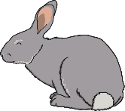
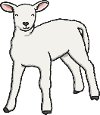
Name 1
Name 2
Name 3
Name 4
Name 5
Name 6
Name 7
Name 8
Name 9
Name 10
Name 11
Name 12
Name 13
Name 14
Name 15
Name 16
Name 17
Name 18
Name 19
Name 20
Name 21
Name 22
Name 23
Name 24
Name 25
Name 26
Name 27
Name 28
Name 29
Name 30
Name 31
Name 32
Name 33
Today is Monday 7th March 2021
The weather is:

Slide 4
Great Barrier Reef Themed Self Registration
This is a lovely, editable self registration resource for all the class to use to show that they are in school.
Simply click on the white circles and the image will appear to symbolise the student being present. Edit the names as you wish!
There is also an alternative slide with an editable date box. Enjoy!

Slide 5
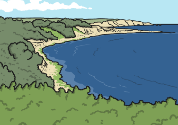
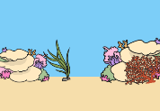
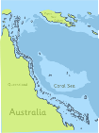
Name 1
Name 2
Name 3
Name 4
Name 5
Name 6
Name 7
Name 8
Name 9
Name 10
Name 11
Name 12
Name 13
Name 14
Name 15
Name 16
Name 17
Name 18
Name 19
Name 20
Name 21
Name 22
Name 23
Name 24
Name 25
Name 26
Name 27
Name 28
Name 29
Name 30
Name 31
Name 32
Name 33
Name 34
Name 35

Slide 6
Name 1
Name 2
Name 3
Name 4
Name 5
Name 6
Name 7
Name 8
Name 9
Name 10
Name 11
Name 12
Name 13
Name 14
Name 15
Name 16
Name 17
Name 18
Name 19
Name 20
Name 21
Name 22
Name 23
Name 24
Name 25
Name 26
Name 27
Name 28
Date: Monday 3rd February 2021
Name 29
Name 30

Slide 7
Australian Animal-Themed Self-Registration
This is a lovely, editable Self-Registration PowerPoint for all the class to use to show that they are in school. There are also animal symbols for you to drag on if you wish!
Change the names and date to suit and add a animal symbol out of presentation mode. Do not ungroup anything as this will alter the animation and the PowerPoint may not work any more.
The animal-themed images will appear in the circles when a student clicks their name or the circle above it in presentation mode.

Slide 8
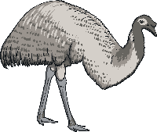
Name 1
Name 2
Name 3
Name 4
Name 5
Name 6
Name 7
Name 8
Name 9
Name 10
Name 11
Name 12
Name 13
Name 14
Name 15
Name 16
Name 17
Name 18
Name 19
Name 20
Name 21
Name 22
Name 23
Name 24
Name 25
Name 26
Name 27
Name 28
Name 29
Name 30
Name 31
Name 32
Name 33
Today is 18th January 2021

Slide 9
Space Themed Self-Registration
This is a lovely, editable self registration resource for all the class to use to show that they are in school.
Simply click on the name boxes or planets and a superhero will appear to indicate the student being present. Edit the names as you wish.
There is also an alternative slide with an editable date box. Enjoy!

Slide 10
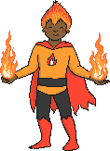
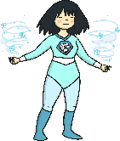
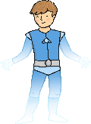
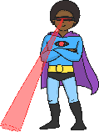
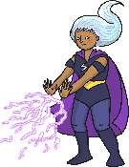
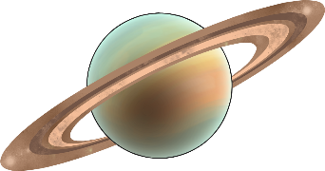
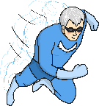
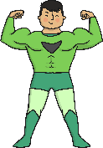
Name 1
Name 2
Name 3
Name 4
Name 5
Name 6
Name 7
Name 8
Name 9
Name 10
Name 11
Name 12
Name 13
Name 14
Name 15
Name 16
Name 17
Name 18
Name 19
Name 20
Name 21
Name 22
Name 23
Name 24
Name 25
Name 26
Name 27
Name 28
Name 29
Name 30
Name 31
Name 32
Name 33
Name 34
Name 35

Slide 11
Name 1
Name 2
Name 3
Name 4
Name 5
Name 6
Name 7
Name 8
Name 9
Name 10
Name 11
Name 12
Name 13
Name 14
Name 15
Name 16
Name 17
Name 18
Name 19
Name 20
Name 21
Name 22
Name 23
Name 24
Name 25
Name 26
Name 27
Name 28
Date: Monday 27th October 2021
Name 29
Name 30
Name 31

Slide 12
Minibeast Themed Self-Registration
This is a lovely, editable Self Registration resource
for all the class to use to show that they are in school. There are also weather symbols off the screen for you to drag on if you wish!
The minibeast will ‘land’ on the leaf when you click it to show that the student is in school. You will need to run it as a slide show and edit the text in the date and name boxes.

Slide 13
Name 1
Name 2
Name 3
Name 4
Name 5
Name 6
Name 7
Name 8
Name 9
Name 10
Name 11
Name 12
Name 13
Name 14
Name 15
Name 16
Name 17
Name 18
Name 19
Name 20
Name 21
Name 22
Name 23
Name 24
Name 25
Name 26
Name 27
Name 28
Name 29
Name 30
Name 31
Name 32
Today is 15th July 2021
The weather is:

Slide 14
How Am I Feeling Themed Self-Registration
This is a lovely, editable self registration resource for all the class to use to show that they are in school.
Simply click on the name boxes and a thumb will appear to indicate the student’s feelings. Click again to change. Edit the names as you wish.

Slide 15
Today is Tuesday 8th March 2021
The weather is:
Name 1
Name 2
Name 3
Name 4
Name 5
Name 6
Name 7
Name 8
Name 9
Name 10
Name 11
Name 12
Name 13
Name 14
Name 15
Name 16
Name 17
Name 18
Name 19
Name 20
Name 21
Name 22
Name 23
Name 24
Name 25
Name 26
Name 27
Name 28
Name 29
Name 30
Name 31
Name 32
Name 33

Slide 16
Daily Date and Weather Chart

Slide 17
Today is
Monday
Tuesday
Wednesday
Thursday
Friday
Today’s weather is…
January
July
1
4
st
February
August
1
5
nd
2
6
rd
March
September
2
7
th
April
October
3
8
9
May
November
3
0
June
December

Slide 18
Today is
Monday
Tuesday
Wednesday
Thursday
Friday
Today’s weather is…
January
July
1
4
st
February
August
1
5
nd
2
6
rd
March
September
2
7
th
April
October
3
8
9
May
November
3
0
June
December

Slide 19
Today is
Monday
Tuesday
Wednesday
Thursday
Friday
Today’s weather is…
January
July
1
4
st
February
August
1
5
nd
2
6
rd
March
September
2
7
th
April
October
3
8
9
May
November
3
0
June
December

Slide 20
Today is
Monday
Tuesday
Wednesday
Thursday
Friday
Today’s weather is…
January
July
1
4
st
February
August
1
5
nd
2
6
rd
March
September
2
7
th
April
October
3
8
9
May
November
3
0
June
December

Slide 21
Today is
Monday
Tuesday
Wednesday
Thursday
Friday
Today’s weather is…
January
July
1
4
st
February
August
1
5
nd
2
6
rd
March
September
2
7
th
April
October
3
8
9
May
November
3
0
June
December

Slide 22
Today is
Monday
Tuesday
Wednesday
Thursday
Friday
Today’s weather is…
January
July
1
4
st
February
August
1
5
nd
2
6
rd
March
September
2
7
th
April
October
3
8
9
May
November
3
0
June
December

Slide 23
Australia Day Daily Timetable
Drag the activity images on slide 3 into the white boxes in the order you need. There are also weather images you can drag in to the weather box. Edit the date and schedule each day as needed. Resource includes a space for the date and a range of visual timetable images.
This resource is editable. You can copy and paste images if you need an image to be repeated in the day. You can also insert your own images to place in the boxes, if you wish to. Automatic clicking has been disabled on this slide show so you will need to navigate via the buttons.

Slide 24
STEM
Music Time
Geography Time
Recess
Visitor
Assembly
Languages Time
Home Time
Today’s weather is:
Today is:
Sunday 7th January 2021
Register
Excursion
HASS
Drama Time
Wake and Shake
Science
Reading
SURPRISE
Group Work
Outdoor Play
Morning Activities
Phonics
Independent Work
Writing
I.T.
Plan, Do, Review
Sensory Play
Afternoon Activities
Art
P.E.
Lunchtime
iPads
Number Work
Literacy Time
Maths
Snack Time
Choosing

Slide 25
Birthday Graph
Date: 00/00/00
Insert names here
Insert names here
Insert names here
Insert names here
Insert names here
Insert names here
January
February
March
April
May
June
Insert names here
Insert names here
Insert names here
Insert names here
Insert names here
Insert names here
July
August
September
October
November
December

Slide 26
Water Colours Monitor
and Job Cards

Slide 27
Book Monitor
Water Monitor
Bin Monitor
Chair Monitor
Office Monitor
End of the Line Monitor
Fruit Monitor
Packed Lunches Out
Pencil Monitor
Line Leader
Feeling Chart Ready
Eco Monitor

Slide 28
Lunchbox Monitor
Class Helper
Sports Equipment Monitor
Lunch Order Monitor
Book Bag Monitor
Art Monitor
Library Helper
Ipad/Computer Monitor
Book Corner Monitor
Pet Monitor
Table Monitor
Locker Monitor

Slide 29
Roll Book Monitor
Student Representative
School Buddy
Traffic Monitor
Noise Monitor
Whiteboard Monitor

