Slide 2
Aim
To use the present perfect form of verbs in contrast to the simple past tense.
Success Criteria
I can identify verbs in a sentence.
I know if a verb tense refers to past or present activity.
I understand the terms ‘present perfect tense’ and ‘simple past tense’.
I can choose the appropriate tense for my sentence.

Slide 3
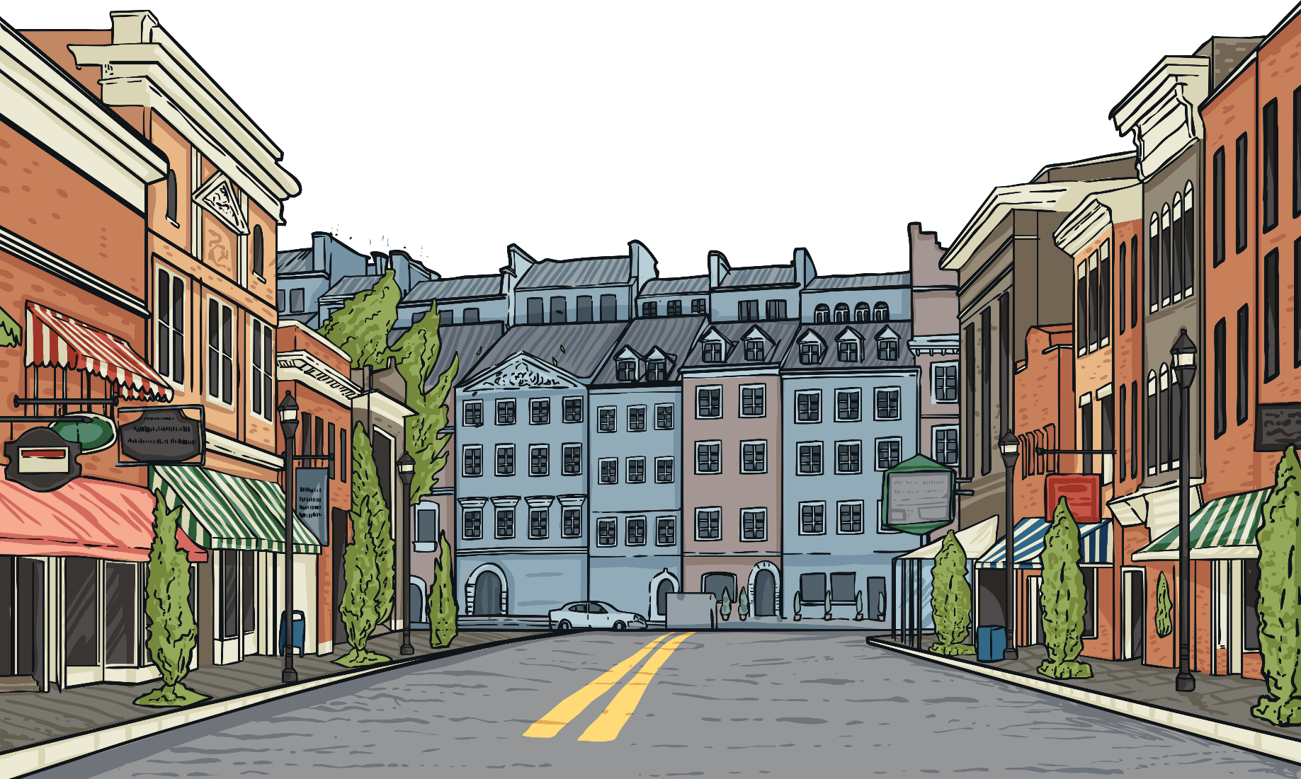
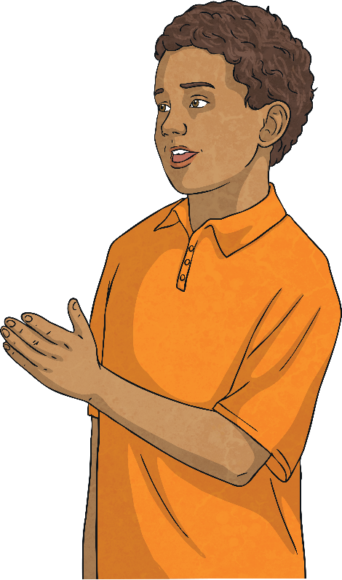
Starter Activity
My friend Kashaan has lived in this town for five years and we have been best friends all that time. Before he came to our town, he was in Birmingham but his mum got a new job so the family moved here. When I met Kashaan, he spoke with a ‘brummie’ accent, but his dad says he has taken on the way I speak, so now he sounds as if he has been here all his life!
Spot the Verb!
Can you find the verbs in this paragraph?
Separate the verbs into ‘past ideas’ and ‘present ideas’.

Slide 4
What’s the Difference?
Before he came to our town, Kashaan was in Birmingham.
His mum got a new job so the family moved here.
When I met Kashaan, he spoke with a ‘Brummie’ accent.
My friend Kashaan has lived in this town for five years.
We have been best friends all that time.
His dad says he has taken on the way I speak.
past
now
future
It’s all about the timing…
Present perfect tense is used for activities that started in the past but are still true now, or have an effect on what is happening now.
Past tense is used for activities or events that started and finished in the past.

Slide 5
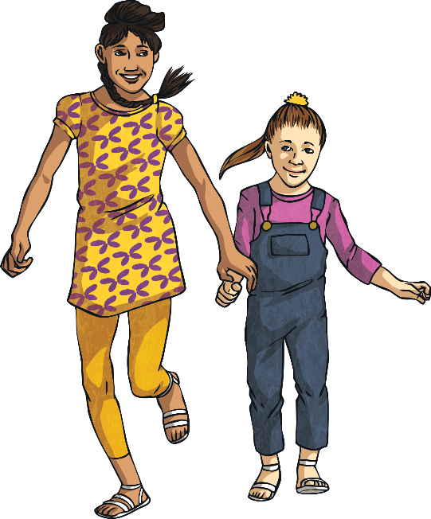
Your Turn!
Can you decide which verb form is correct?
1.
I went to the zoo yesterday.
I have been to the zoo yesterday.
Use simple past tense here!
2.
When you have eaten your dinner, you can go and play.
When you ate your tea, you can go and play.
Use present perfect tense here!
3.
I have lost my pencil during the last lesson.
I lost my pencil during the last lesson.
Use simple past tense here!
4.
Wait for me! I haven’t put my coat on yet.
Wait for me! I didn’t put my coat on yet.
Use present perfect tense here!
past
now
future

Slide 6
Your Turn!
Can you decide which verb form is correct?
1.
My mum has grown her hair very long, it’s now down to her waist!
My mum grew her hair very long; it’s now down to her waist!
Use present perfect tense here!
2.
The plane has arrived but they have not opened the doors yet.
The plane arrived but they have not opened the doors yet.
Use present perfect tense here!
3.
On my birthday, I had a party and all my friends slept over.
On my birthday, I have had a party and all my friends have slept over.
Use simple past tense here!
past
now
future

Slide 7
Making the Present Perfect Tense
A little extra word…
Present perfect tense uses the auxiliary verb HAVE before the main verb.
Use ‘have’ for I / you / we / they.
Use ‘has’ for he / she / it.
has
My friend Kashaan _____ lived in this town for five years.
We _____ been best friends all that time.
His dad says he _____ taken on the way I speak.
Unfortunately, the cat _____ been sick on the carpet – yuk!
Mum asked, “Where _____ you been all this time?”
What a shame; Sports Day _____ been postponed because of the rain.
_____ every person chosen a partner now?
“What ____ happened to all my pencils?” asked the teacher.
have
has
has
have
has
Has
has

Slide 8
Making the Present Perfect Tense
do…did…done
Present perfect tense uses the past participle (third form) of the main verb after the auxiliary ‘have’.
Make sure you choose the correct form!
My hair has really grew / grown recently, hasn’t it?
Wow; look how much work you’ve did / done today!
Dad didn’t put the washing out because it has was / been raining all day.
Mum, Josh has came / come round – can I go out to play for a bit?
Oh no, I have forgot / forgotten my homework book!
The teacher has blew / blown her whistle for the end of playtime.
Shh! The film has began / begun already.
Would you like to see the portrait I’ve drew / drawn of you?
My hair has really grown recently, hasn’t it?
Wow; look how much work you’ve done today!
Dad didn’t put the washing out because it has been raining all day.
Mum, Josh has come round – can I go out to play for a bit?
Oh no, I have forgotten my homework book!
The teacher has blown her whistle for the end of playtime.
Shh! The film has begun already.
Would you like to see the portrait I’ve drawn of you?

Slide 9
Plenary
What have we learned?
We use the simple past tense to talk about events that are completely in the past.
e.g. Cassie went to school yesterday.
The present perfect tense is for events which are still true now or affect us in the present.
e.g. Where’s Cassie? Well, it’s 9am, so she has gone to school.
e.g. Cassie’s exhausted because she has been on a school trip all day.
past
now
future

Slide 10
Aim
To use the present perfect form of verbs in contrast to the simple past tense.
Success Criteria
I can identify verbs in a sentence.
I know if a verb tense refers to past or present activity.
I understand the terms ‘present perfect tense’ and ‘simple past tense’.
I can choose the appropriate tense for my sentence.

