Slide 2
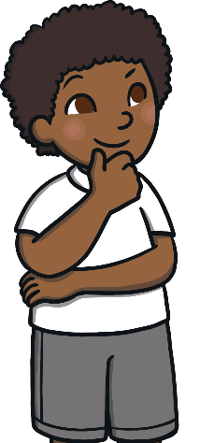
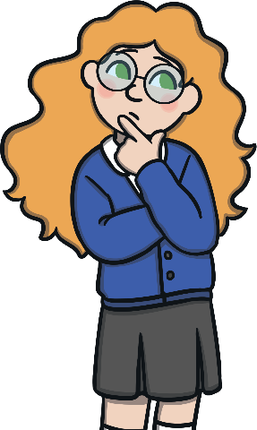
What Could I Be?
As you get older, you will start to think about what career or job you would like to do as an adult. You might change your mind lots of times and this is ok. It’s usually a good idea to choose a job that relates to something you are interested in and because this can change over time, your ideas for the job you would like might too.
It’s important to remember that jobs can be done by anyone - no matter who they are, their gender, where they are from, what they look like or how they choose to live their lives.
How many jobs can you think of?
Let’s all share our ideas together.
Share your ideas with your partner.

Slide 3
The A-Z of Jobs
Let’s explore some different jobs and see how many you have heard of before.
Select a letter of the alphabet and uncover jobs that begin with that letter.
A
C
E
G
I
B
D
F
H
J
L
N
P
R
K
M
O
Q
S
U
W
Y
T
V
X
Z

Slide 4
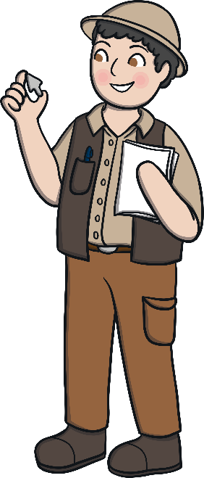
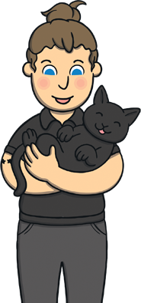
A Is For...
Archaeologists learn how people lived in the past by studying the buildings, settlements and objects they left behind.
Archaeologist
Animal care assistants look after animals by making sure they are kept clean, comfortable, exercised and fed. They look after all kinds of animals, such as cats, dogs, rabbits, hamsters, guinea pigs or birds.
Animal Care Assistant
Back

Slide 5
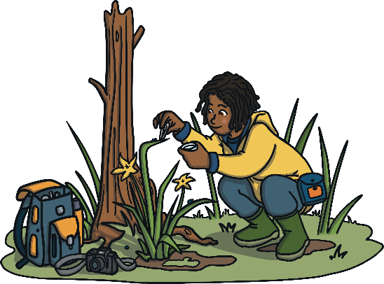
B Is For...
Botanists, or plant biologists, study all forms of plant life in a laboratory or in their natural environment.
Botanists
Bank Customer Service
Bank customer service advisers work with customers in a bank. They help them with their money.
Back

Slide 6
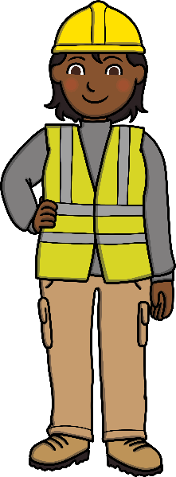
C Is For...
A chef or cook plans, prepares and cooks food. A chef will usually work in a hotel or a restaurant. Cooks are more likely to work in hospitals, schools, works canteens and cafes.
Chef or Cook
A construction manager makes sure that everything runs smoothly on a building site. They organise and supervise the building of houses and other buildings, making sure that everyone is safe.
Construction Manager
Back

Slide 7
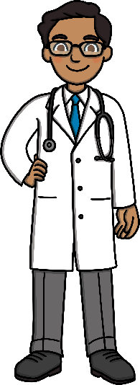
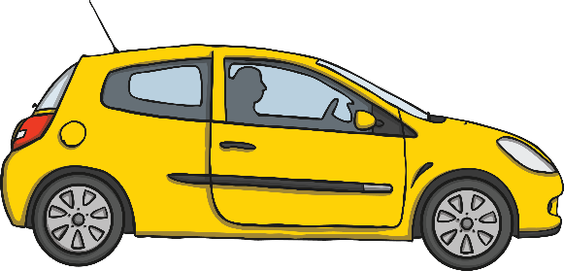
D Is For...
Doctors help us to stay healthy. They also look after us when we are ill or injured. Doctors can work in a doctor’s surgery or a hospital.
Doctor
Driving instructors teach learner drivers how to drive so that they can pass their driving test. A driving instructor has to be an excellent driver and know all the rules for driving on the roads.
Driving Instructor
Talk About It
What kind of rules do you think people have to follow while they are driving a car?
Back

Slide 8
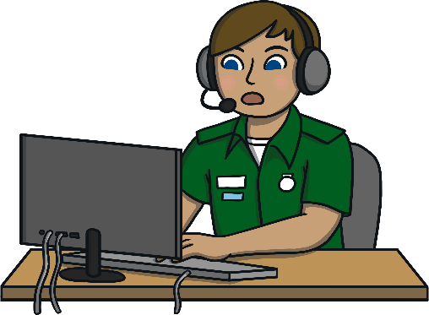
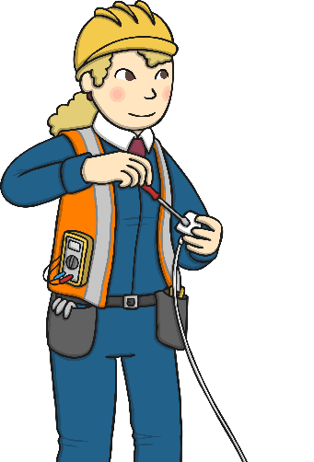
E Is For...
When someone has an emergency and needs an ambulance, fire engine or the police, they usually use the phone to call 999 for help. The emergency call handler is the person that will pick up the phone and send the help that is needed.
Emergency Call Handler
Electricians make sure that houses and other buildings have the correct wiring to make our lights and plug sockets work safely. They also repair broken electric items to make them safe.
Electrician
Back

Slide 9
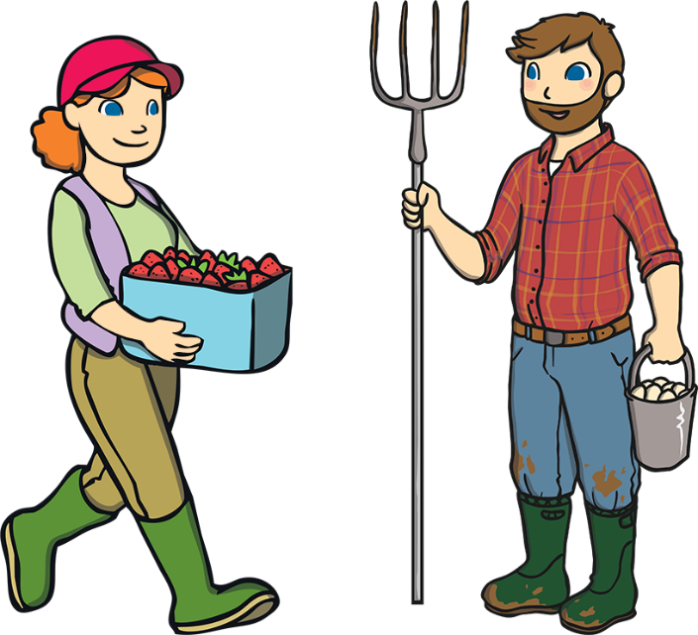
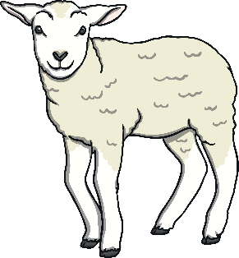
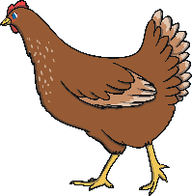
F Is For...
Farmers are extremely important as they produce our food. Farmers grow crops and keep farm animals that produce milk, eggs and meat. Farmers have a very busy job.
Farmer
Talk About It
How many different things do you think a farmer has to do?
Back

Slide 10
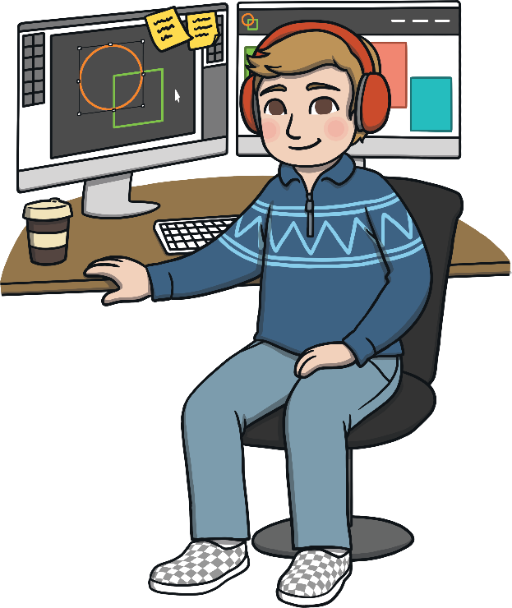
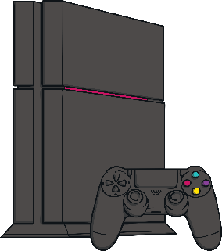
G Is For...
A games tester has a super fun job. They try out all the new games that are developed before they go to the shops for people to buy. It is also a very important job, as they need to make sure that the games work correctly.
Game Tester
Talk About It
Would you like to be a games tester? Why?
Back

Slide 11
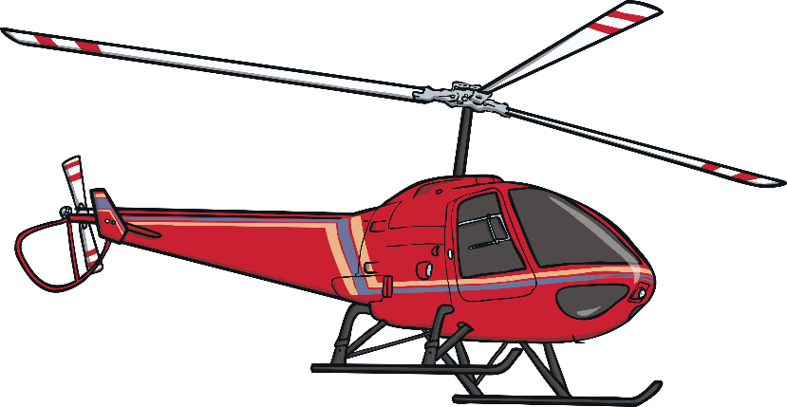
H Is For...
Helicopter pilots can fly different kinds of helicopters. There are many kinds of helicopters used for different things.
Helicopter Pilots
Talk About It
What different things can you think of that helicopters might be used for?
Back

Slide 12
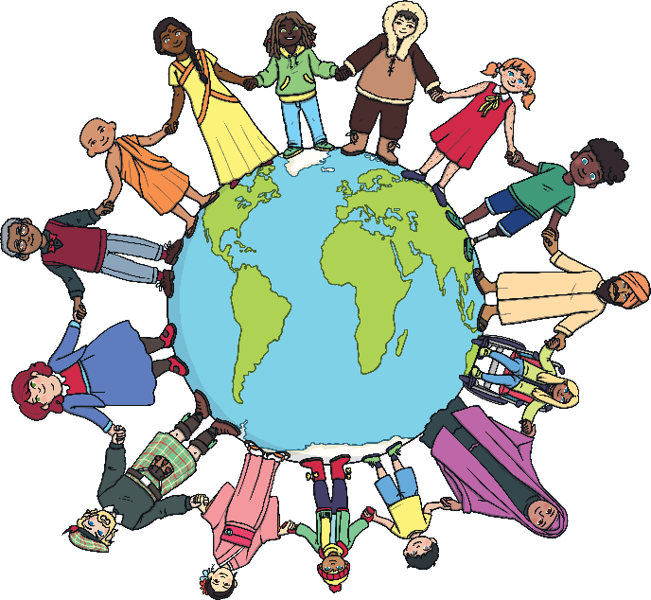
I Is For...
An interpreter is someone who can speak more than one language. This means that they can help people who speak different languages to understand each other by telling them what they are saying.
Interpreter
Talk About It
Can you speak and understand more than one language?
Back

Slide 13
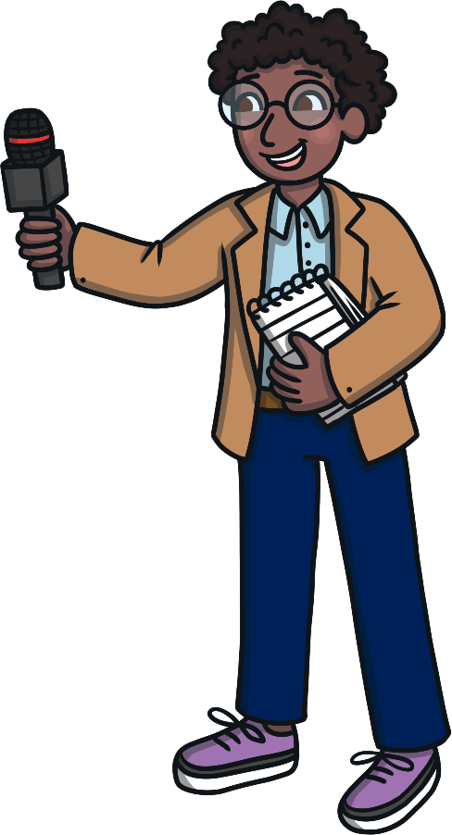
J Is For...
A journalist or reporter gathers information on news, important events and things that might interest people. They write articles about them for newspapers, magazines and the Internet. Journalists can also appear on television and radio news programmes.
Journalist
Back

Slide 14
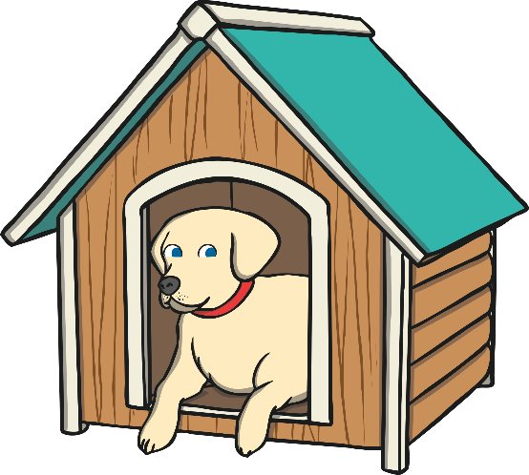
K Is For...
Kennel managers are responsible for making sure all the dogs, cats and sometimes other animals are well looked-after while in their care. They need to make sure that the animals are exercised, fed and in good health.
Kennel managers should have a real love of animals.
Kennel Manager
Back

Slide 15
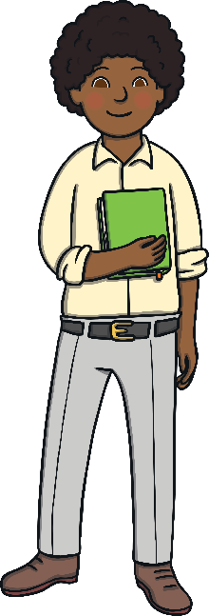
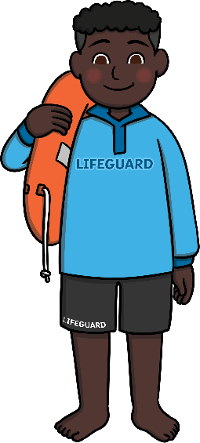
L Is For...
A librarian looks after the books in a library. They make sure that all books are in the correct places on the shelves. Librarians can help you to find the book that you are looking for.
Librarian
Lifeguards make sure that people are safe when they are in the water at the swimming baths, seaside or in a lake. They make sure that people are being sensible.
Lifeguard
Talk About It
How can you be safe in the water?
Back

Slide 16
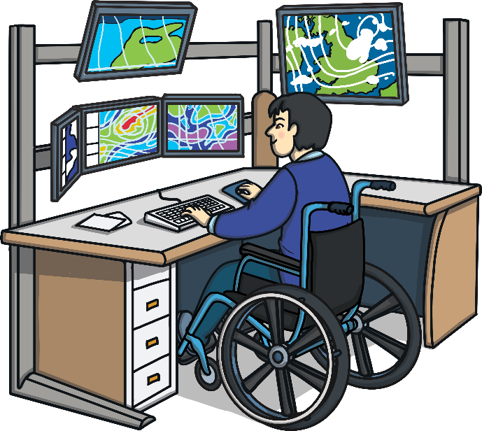
M Is For...
Meteorologists study the Earth's atmosphere to forecast the weather. This information helps people out at sea and farmers to do their jobs. Meteorologists can also guide us to understand how and why the Earth’s climate is changing.
Meteorologist
Back

Slide 17
N Is For...
Nature conservationists look after the countryside. They work to protect natural areas, such as woodlands, fields, rivers, mountains, forests or coastal areas. A lot of a nature conservationist’s work is to make sure that people know all about the countryside and how they can help to look after it.
Nature Conservationist
Talk About It
What ideas do you have for helping to take care of the countryside?
Back

Slide 18
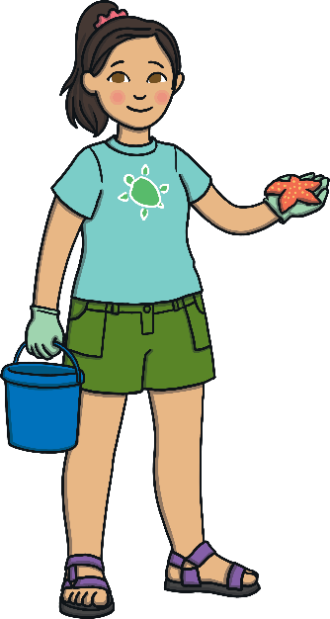
O Is For...
An oceanographer studies everything about the oceans including the plants and marine life that live in the sea. Oceanographers study the waves and the temperatures of our seas so that the effects of climate change can be measured.
Oceanographer
Talk About It
What do you know about climate change?
Back

Slide 19
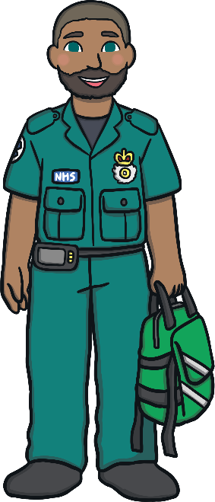
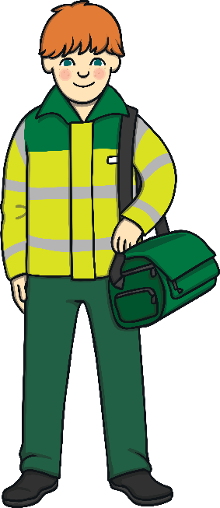
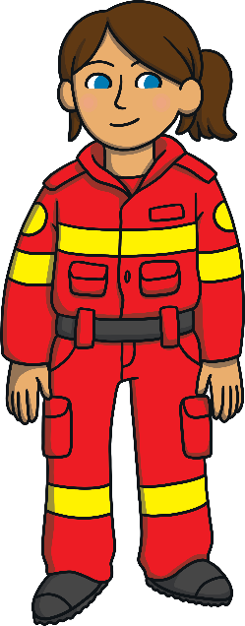
P Is For...
A paramedic responds to emergency calls as part of an emergency team. They usually work in a two-person crew in an ambulance or an air ambulance (helicopter). A paramedic can also work on their own using a motorbike or a special car to help someone.
Paramedic
Talk About It
Which paramedic do you think works in an air ambulance?
How do you know?
Back

Slide 20
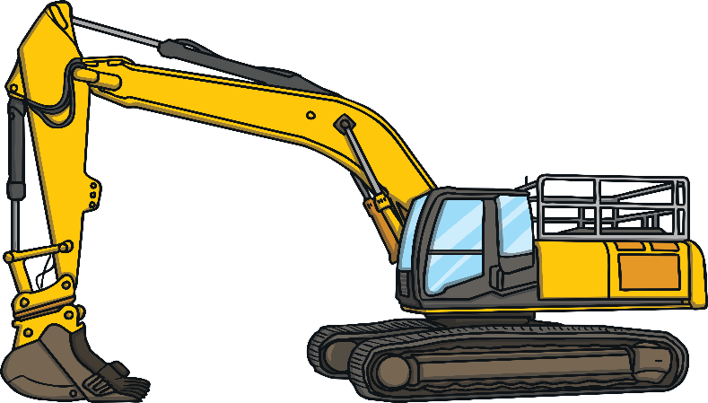
Q Is For...
A quarry is a deep pit where rock, sand and stones are removed. A quarry worker digs to find and remove different natural materials. These are then used for building work or decorative things like statues.
Quarry Worker
Back

Slide 21
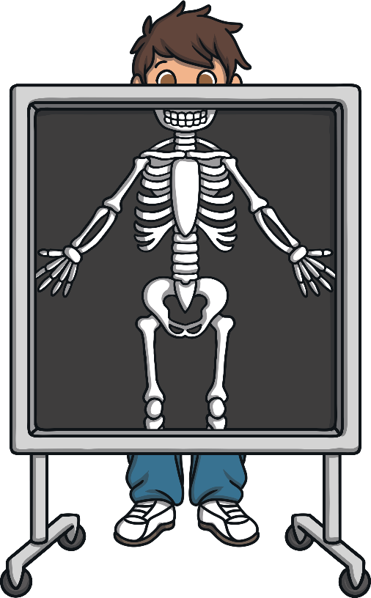
R Is For...
A radiographer uses special equipment to take a picture of people’s bones. They examine the images to see if there are any injuries to the bones so that they can be repaired.
Radiographer
Back

Slide 22
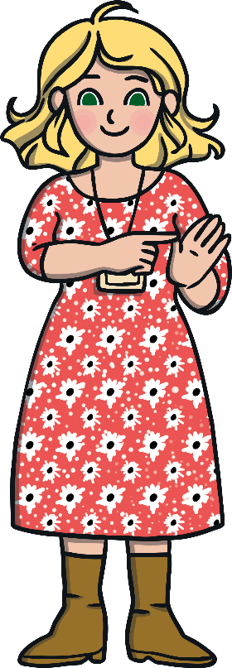
S Is For...
People who cannot hear or speak can use sign language to communicate. Sign language teachers help people to learn how to use sign language correctly.
Sign Language Teacher
Talk About It
Can you follow the instructions in the picture to ask how someone is in British Sign Language?
Back

Slide 23
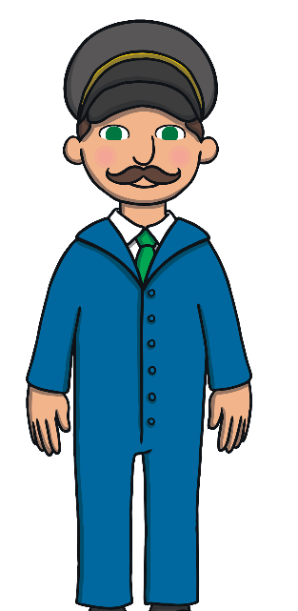
T Is For...
A train driver doesn’t just drive the train. They need to check the train is safe before they start driving and make sure that their communication radio and signals all work. The train driver needs to keep an eye on the signals that are along the train track and make announcements to the passengers.
Train Driver
Talk About It
Have you ever been on a train? Where did you go?
Back

Slide 24
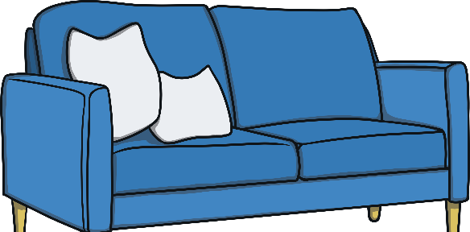
U Is For...
An upholsterer is someone who makes and repairs furniture - mainly furniture that is covered in fabric. They cover the frames of furniture with padding and fabric or leather. An upholsterer makes beds, mattresses, chairs and sofas. Some upholsterers will even make the seats of cars, buses and trains.
Upholsterer
Back

Slide 25
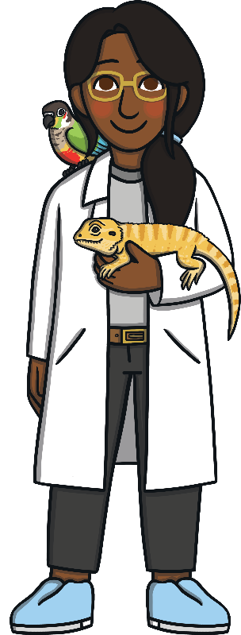
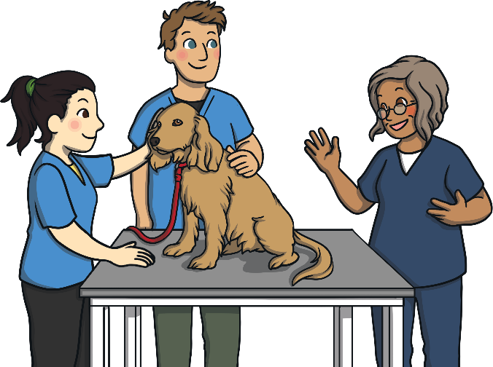
V Is For...
Veterinary nurses work alongside veterinary surgeons (vets) to look after sick and injured animals. Most veterinary nurses work mainly with small animals at a veterinary practice but others care for larger animals, such as farm animals, horses and even zoo animals.
Veterinary Nurse
Back

Slide 26
W Is For...
Wind turbine technicians keep the wind turbines running smoothly. They test how well they are working and repair the turbines when they break. Wind turbine technicians work on wind farms that may be on land or at sea.
Wind Turbine Technicians
Talk About It
Why do you think we need wind turbines?
Back

Slide 27
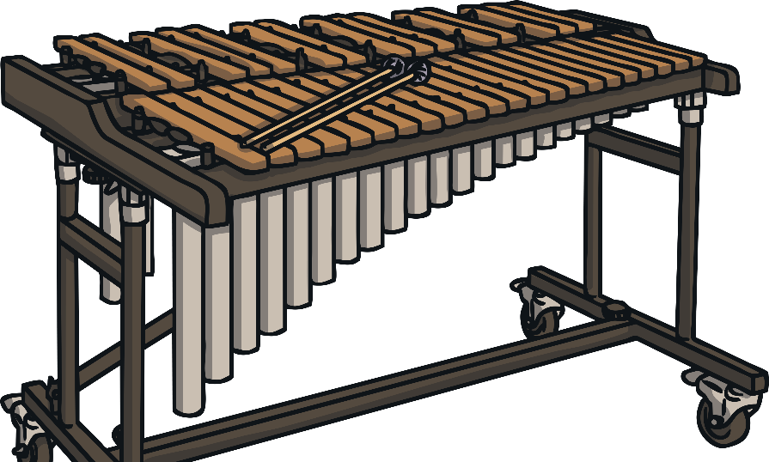
X Is For...
A xylophonist is someone who plays the xylophone. A xylophonist might play in a band, an orchestra or a marching band.
Xylophonist
Back

Slide 28
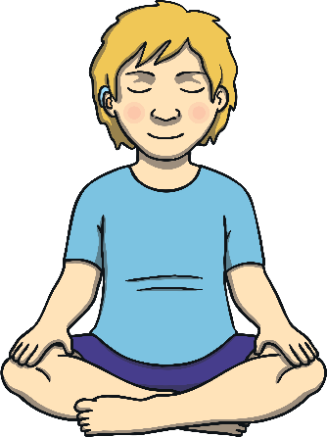
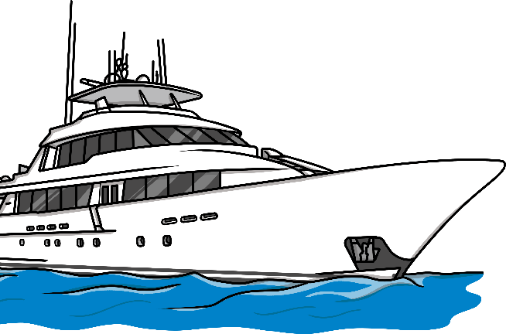
Y Is For...
A yoga teacher is a specialist in yoga. They teach other people how to do yoga safely.
Yoga Teacher
A yacht captain is responsible for sailing a yacht. They need excellent knowledge of the sea.
Yacht Captain
Back

Slide 29
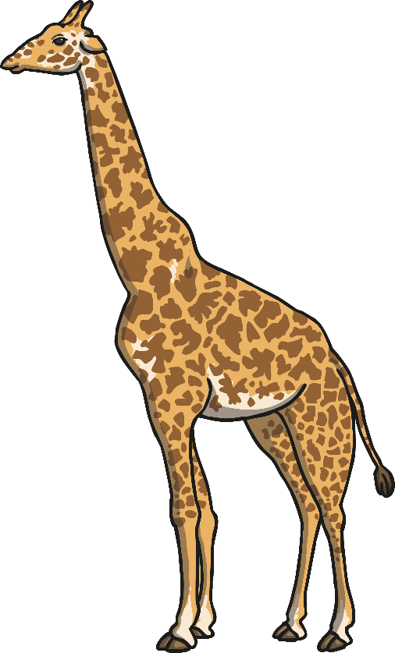
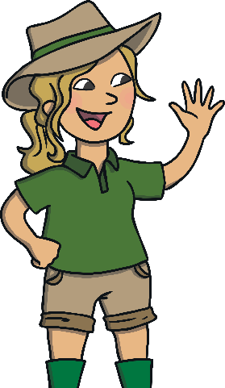
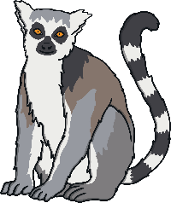
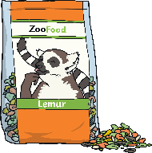
Z Is For...
A zookeeper is responsible for the animals in their care.
They need to make sure that the animals stay healthy and get help for them if they are unwell. A zookeeper needs to know a lot about exotic animals.
Zookeeper
Back

