Slide 2
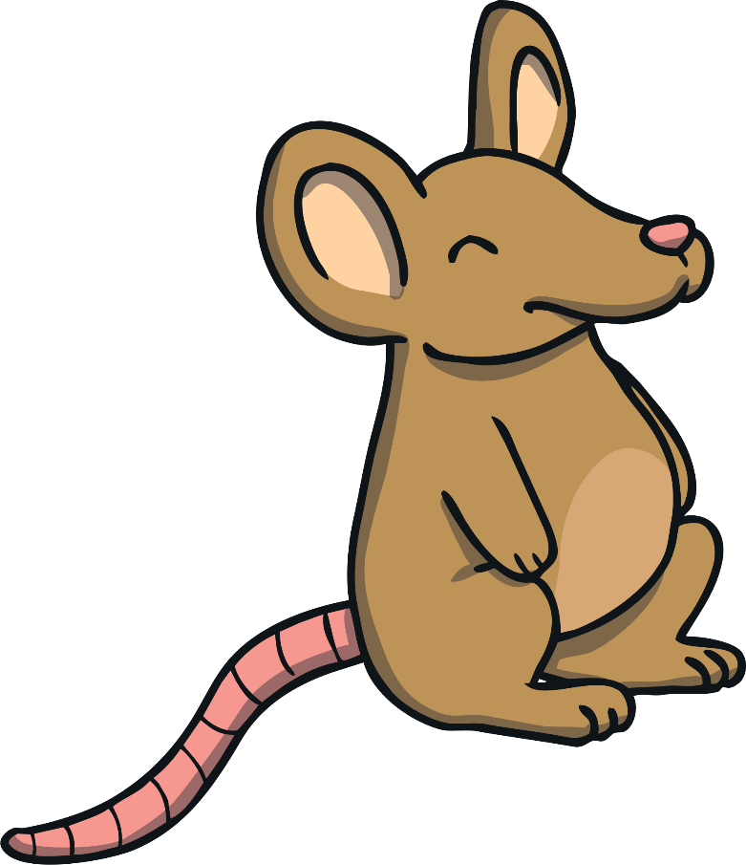
Hello children!
My name is Maths Mouse. I have been practising saying all the numbers to 10. Would you like to help me? See if you can join in and say the numbers as I walk along the path.

Slide 3
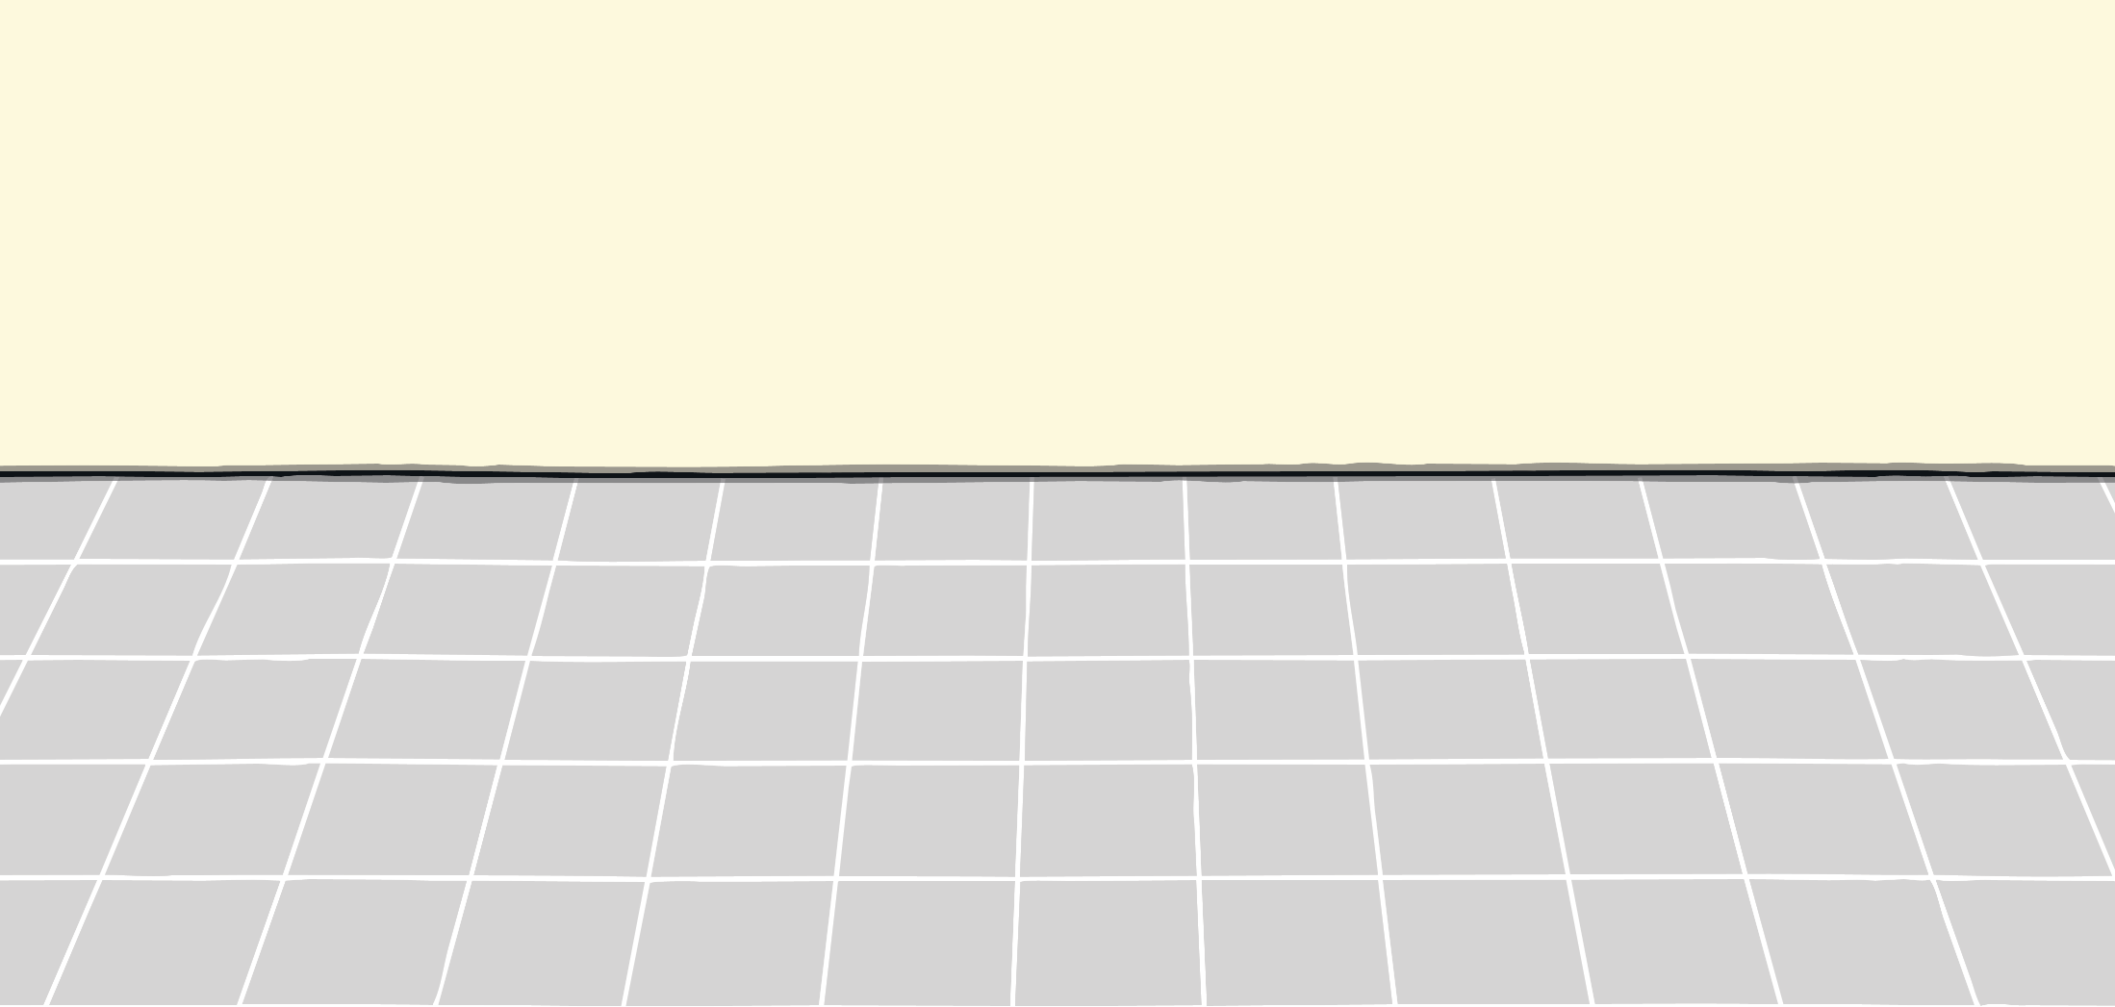
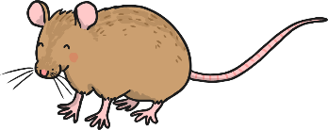
0
1
2
3
4
5
6
7
8
9
10

Slide 4
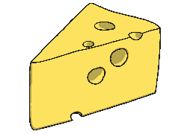
0
1
2
3
4
5
6
7
8
9
10

Slide 5
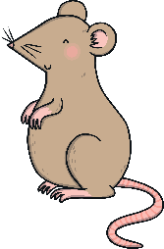
0
1
2
3
4
5
6
7
8
9
10

Slide 6
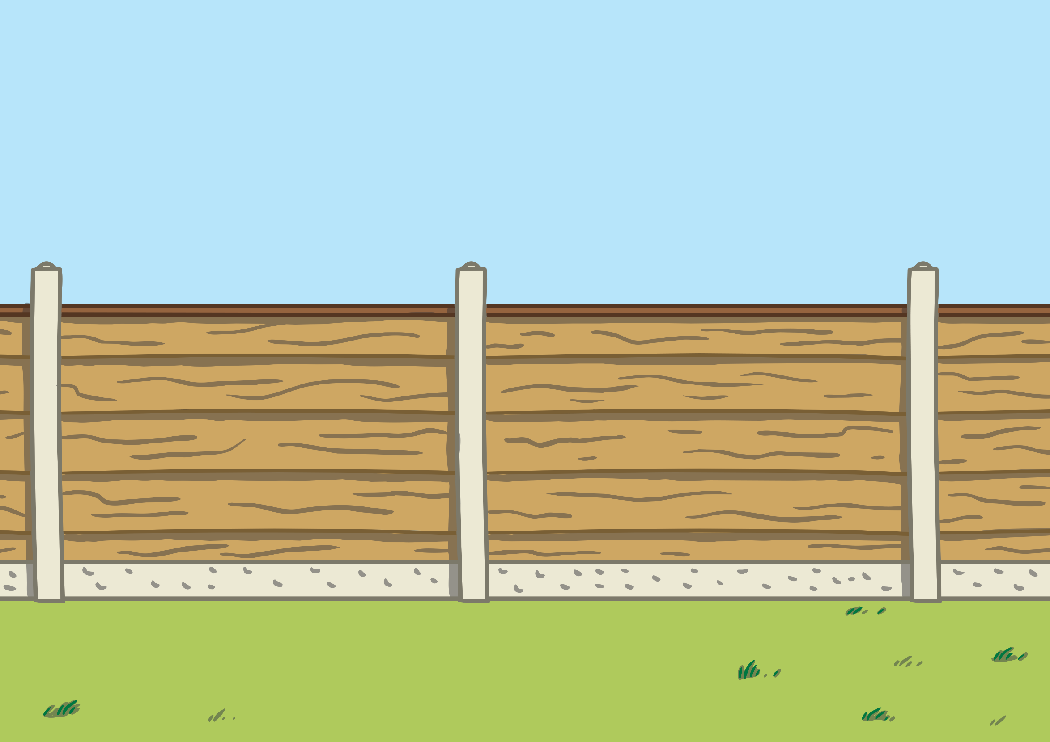
2
3
4
5
6
7
8
9
10

Slide 7
6
7
8
9
10

Slide 8
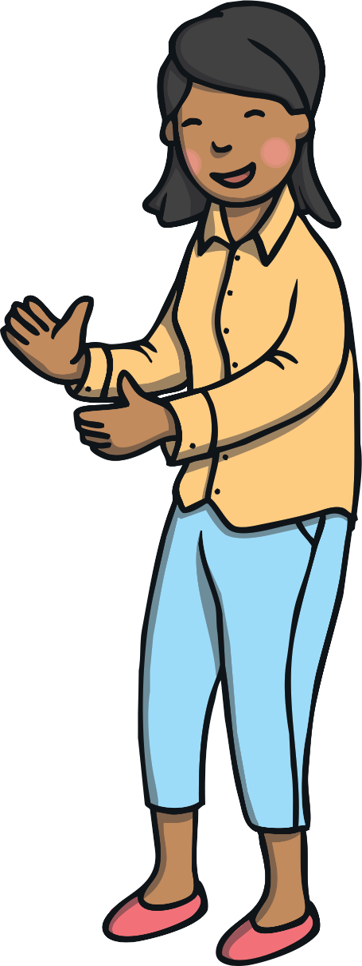
Thank you for helping me!
Give yourselves a mini-mouse clap for all your brilliant counting.

