Slide 2
Just click on the pencil and it will show you how to form the number.
Press the menu button at any time during the slide show to return to the letter choice screen.

Slide 3
Click on the number you would like to practise.
0
1
2
3
4
5
6
7
8
9

Slide 4
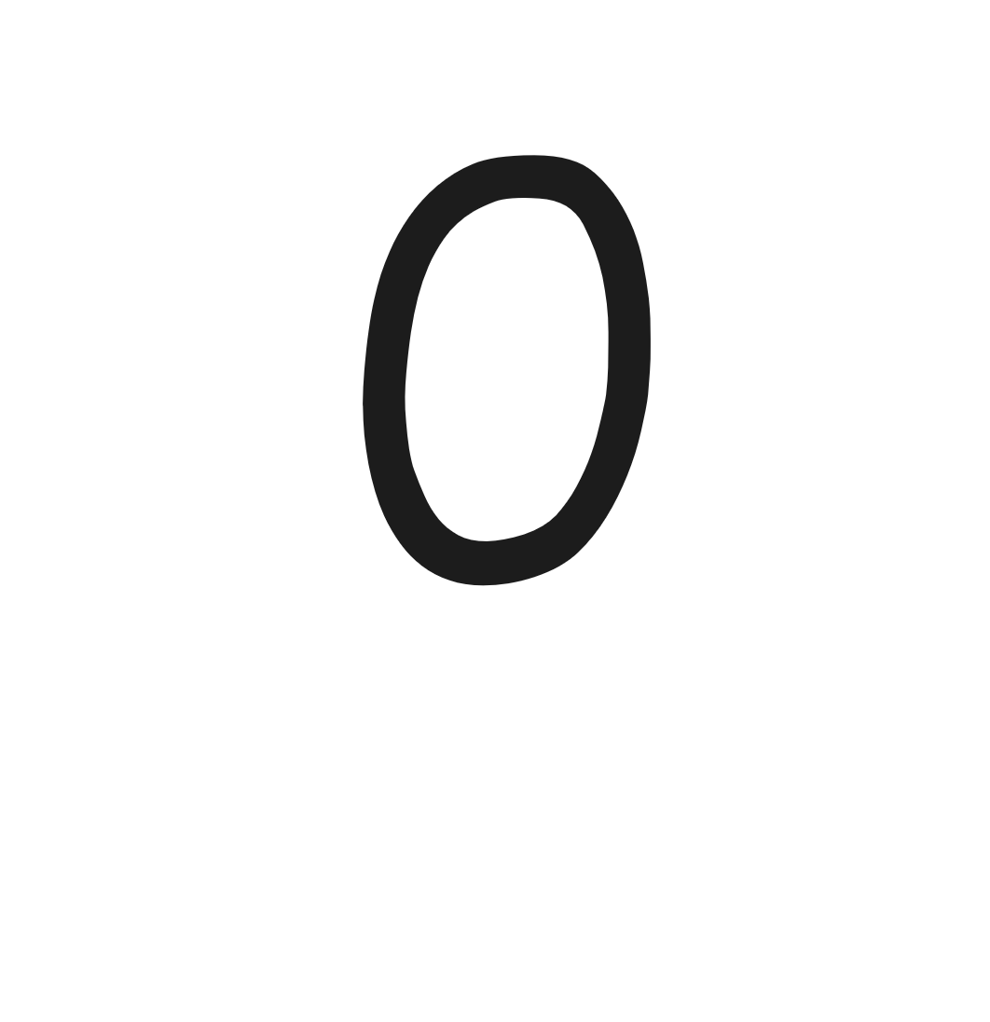
Watch the pencil.
Click on the pencil to see it write.
Menu

Slide 5
Watch the pencil.
Click on the pencil to see it write.
Menu

Slide 6
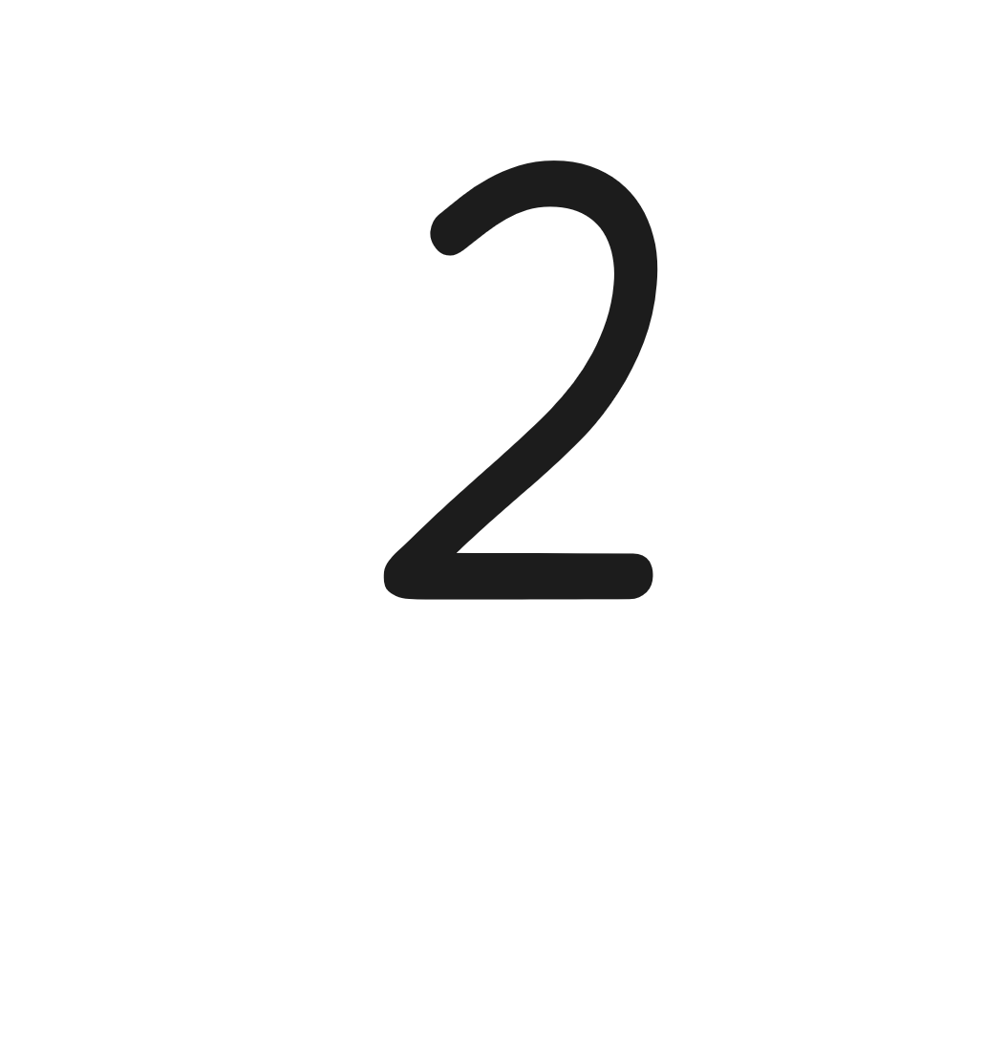
Watch the pencil.
Click on the pencil to see it write.
Menu

Slide 7
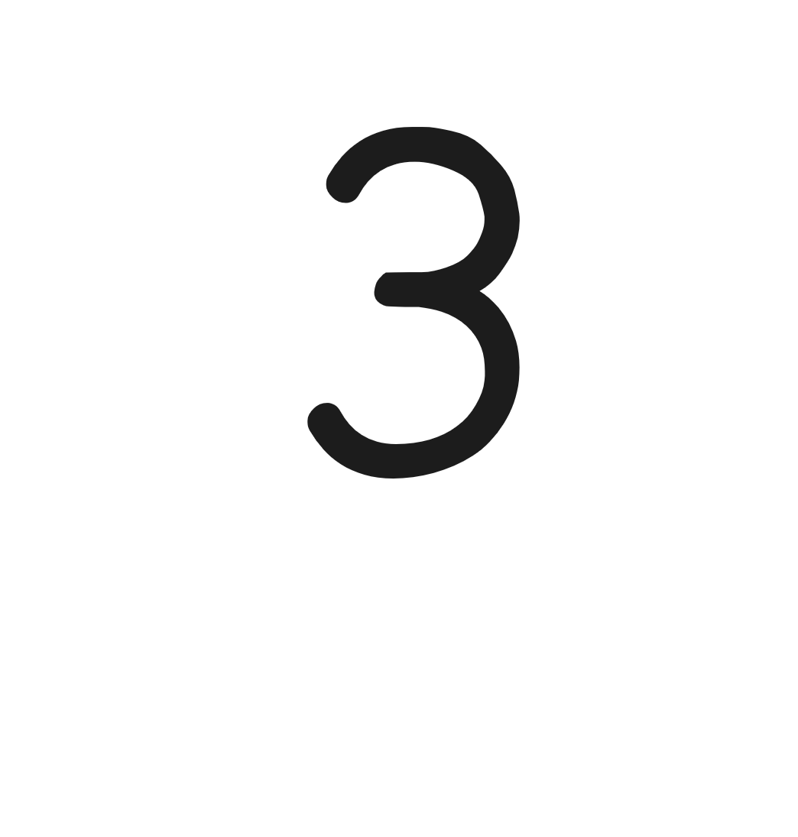
Watch the pencil.
Click on the pencil to see it write.
Menu

Slide 8
Watch the pencil.
Click on the pencil to see it write.
Menu

Slide 9
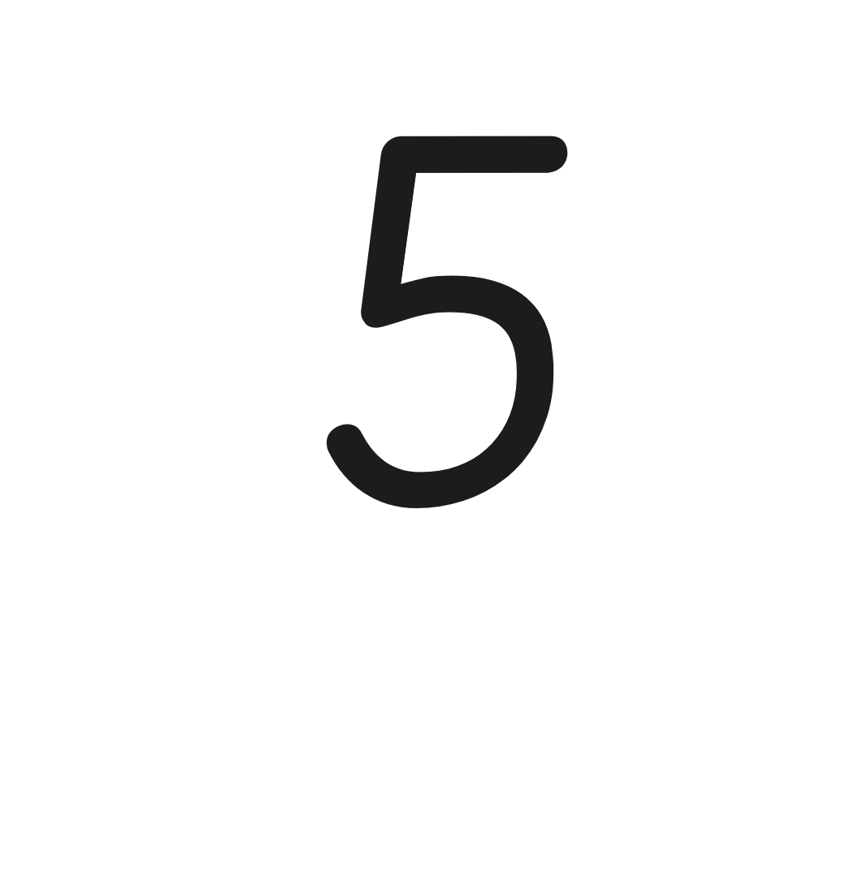
Watch the pencil.
Click on the pencil to see it write.
Menu

Slide 10
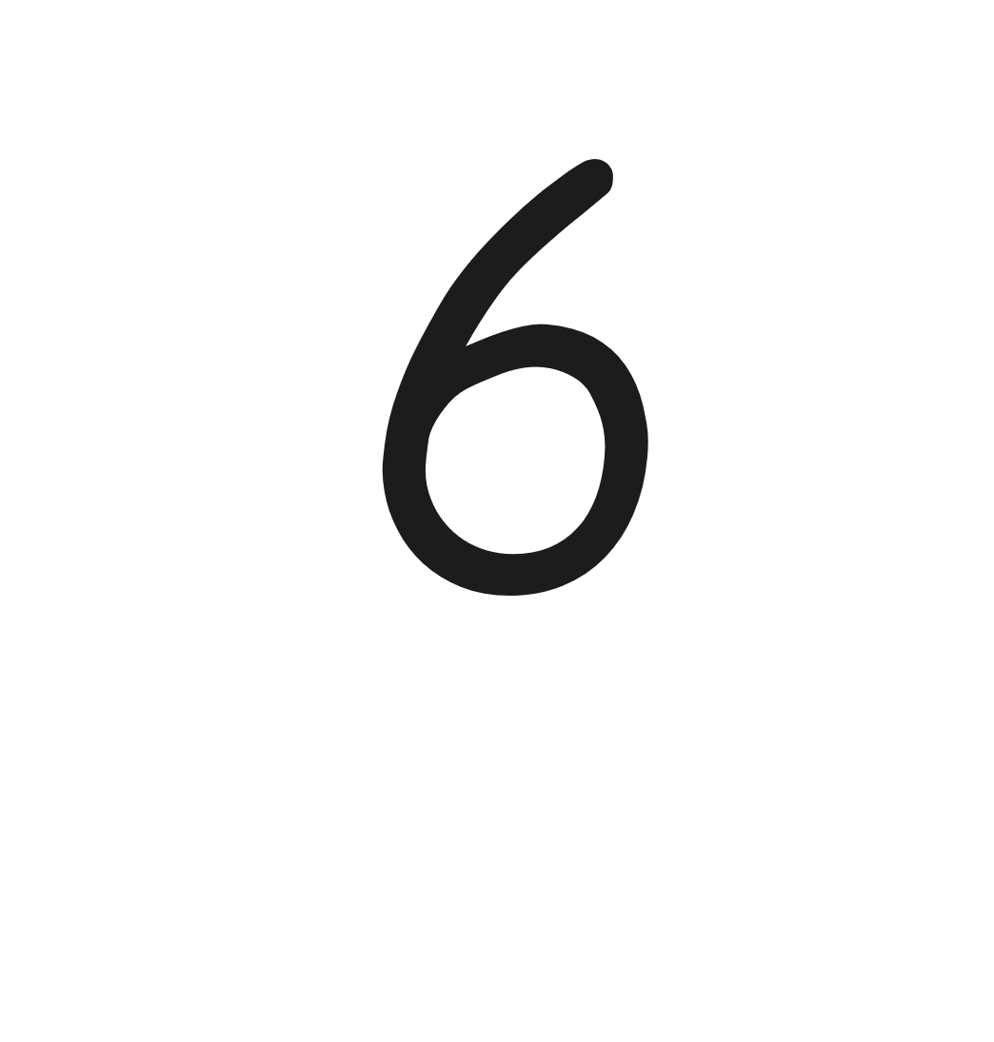
Watch the pencil.
Click on the pencil to see it write.
Menu

Slide 11
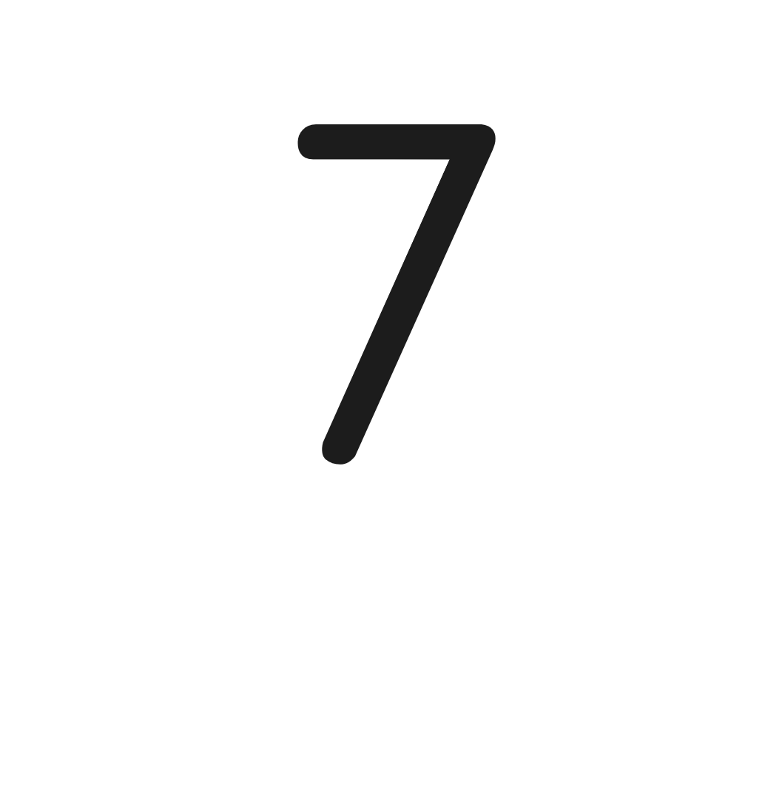
Watch the pencil.
Click on the pencil to see it write.
Menu

Slide 12
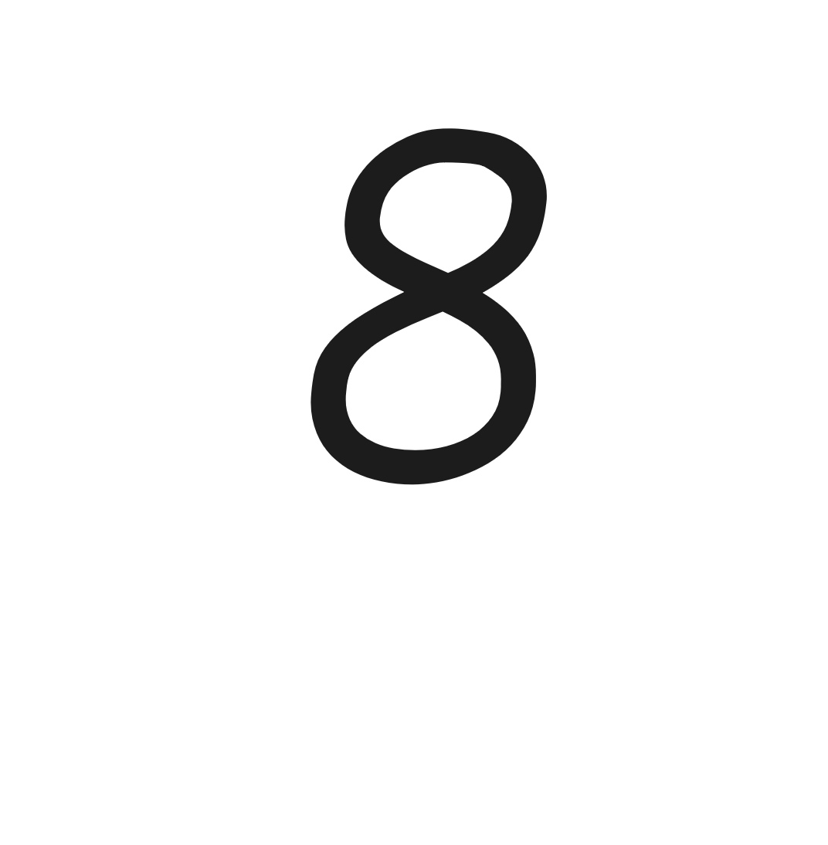
Watch the pencil.
Click on the pencil to see it write.
Menu

Slide 13
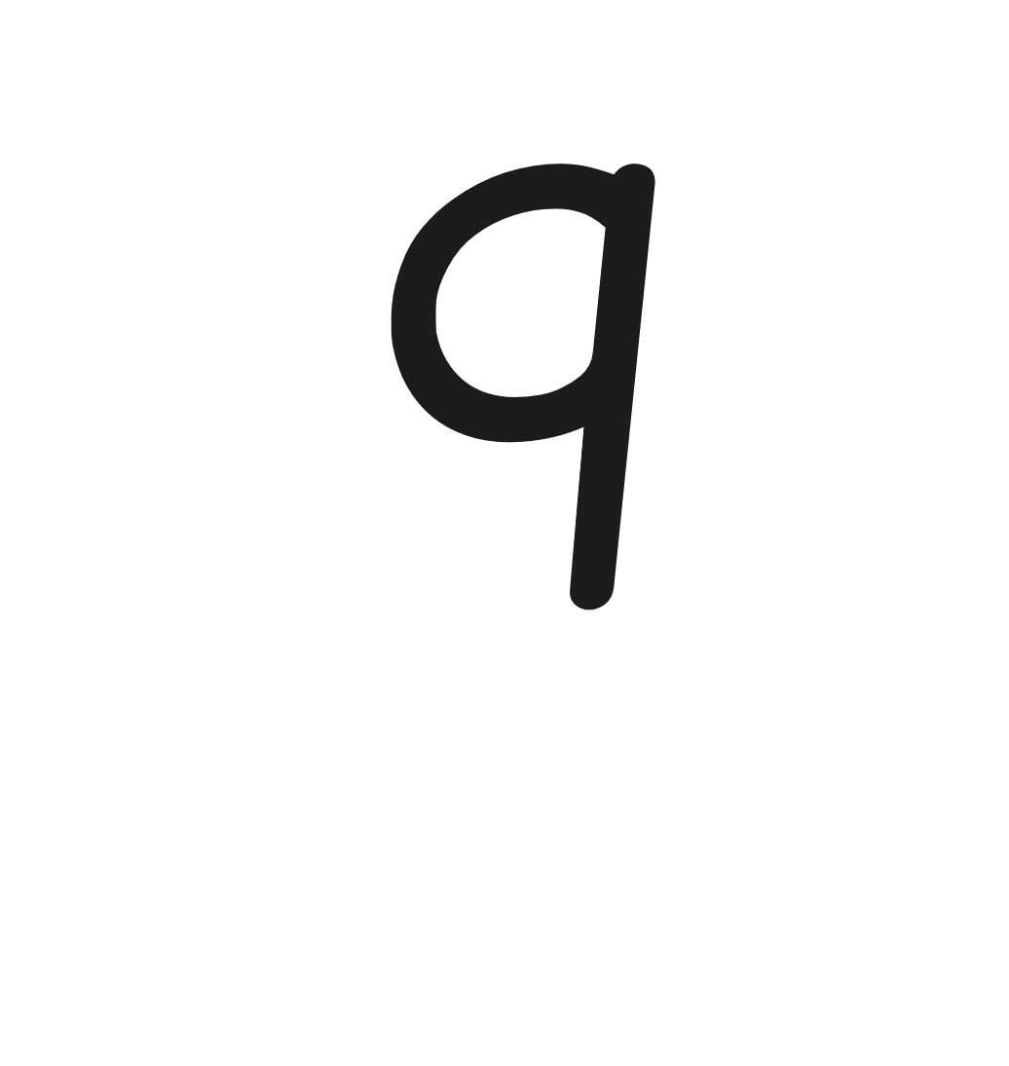
Watch the pencil.
Click on the pencil to see it write.
Menu

