Slide 2
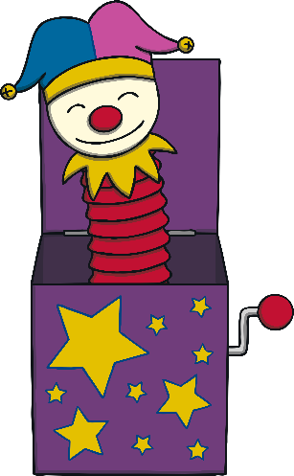
Jack-in-the-Box Reciting Numbers Challenge
Use this PowerPoint to encourage children to practise reciting numbers to 10.
As the children recite the numbers to 10, click on the star button to reveal the jack popping up out of the box!
When the jack pops up, children should stop counting. What number did they say as he popped up out of the box?
Repeat the activity, clicking the star to make the jack pop up on different numbers.

Slide 3
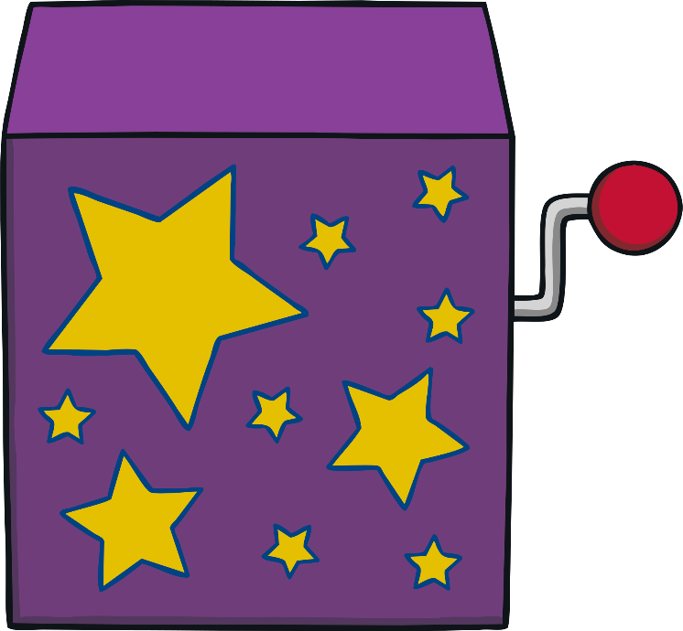
Pop Up Jack!
Click me!

Slide 4
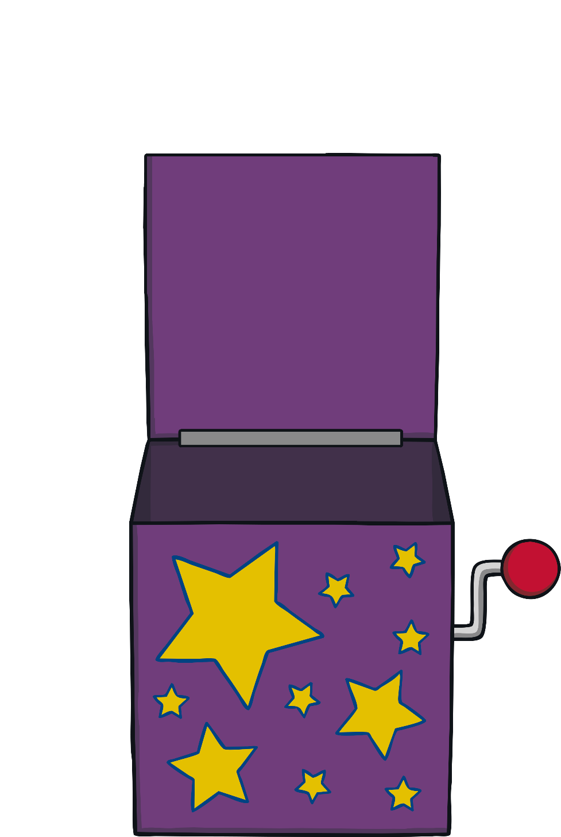
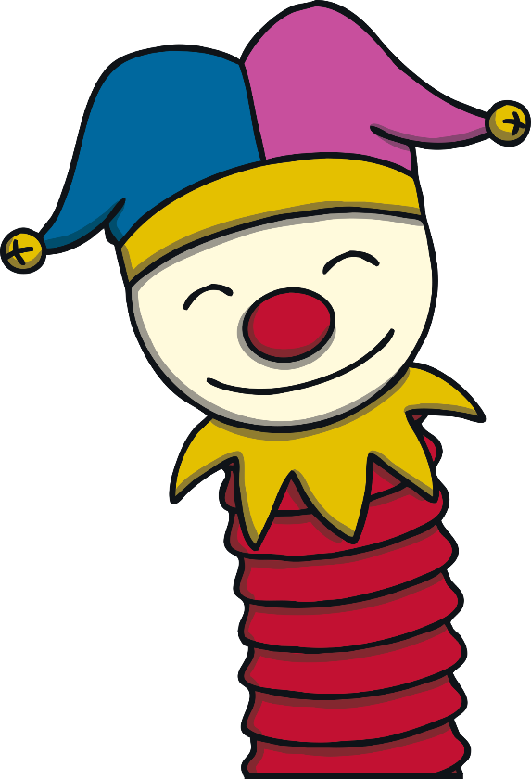
Go back

