Slide 1
Disclaimer/s
We hope you find the information on our website and resources useful.
Animations
This resource has been designed with animations to make it as fun and engaging as possible. To view the content in the correct formatting, please view the PowerPoint in ‘slide show mode’. This takes you from desktop to presentation mode. If you view the slides out of ‘slide show mode’, you may find that some of the text and images overlap each other and/or are difficult to read.
To enter slide show mode, go to the slide show menu tab and select either from beginning or from current slide.
You may wish to delete this slide before beginning the presentation.

Slide 3
1
one

Slide 4
2
two

Slide 5
3
three

Slide 6
4
four

Slide 7
5
five

Slide 8
6
six

Slide 9
7
seven

Slide 10
8
eight

Slide 11
9
nine

Slide 12
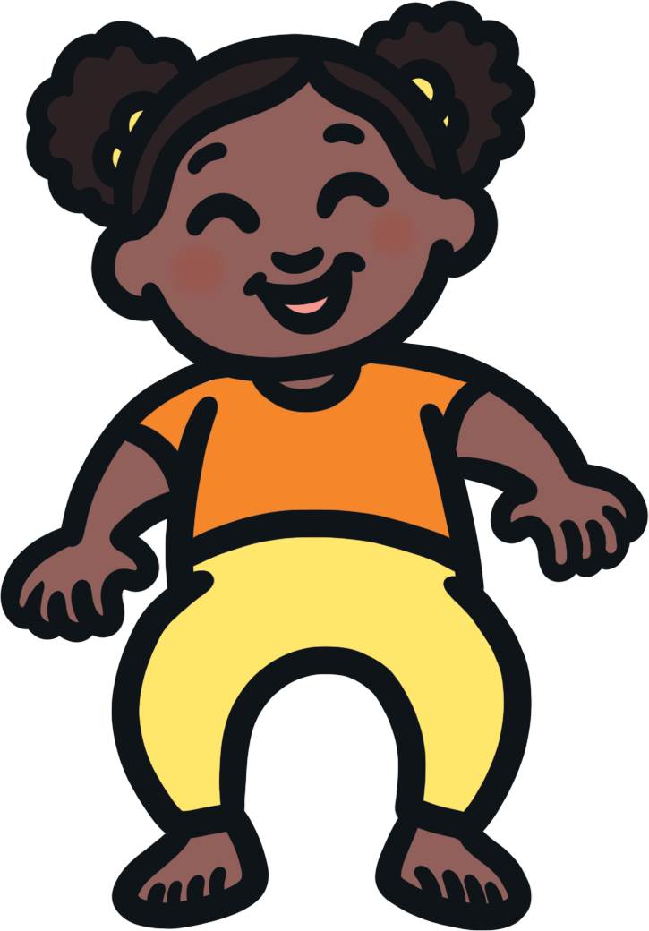
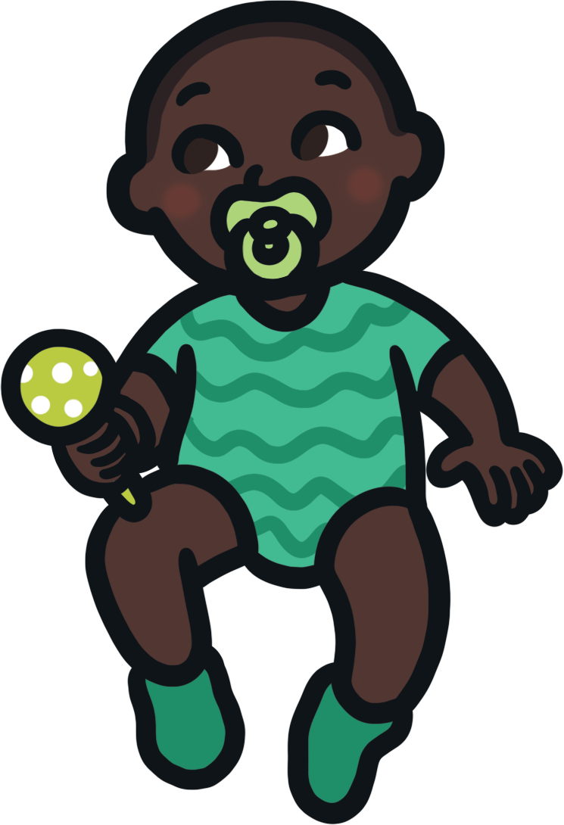
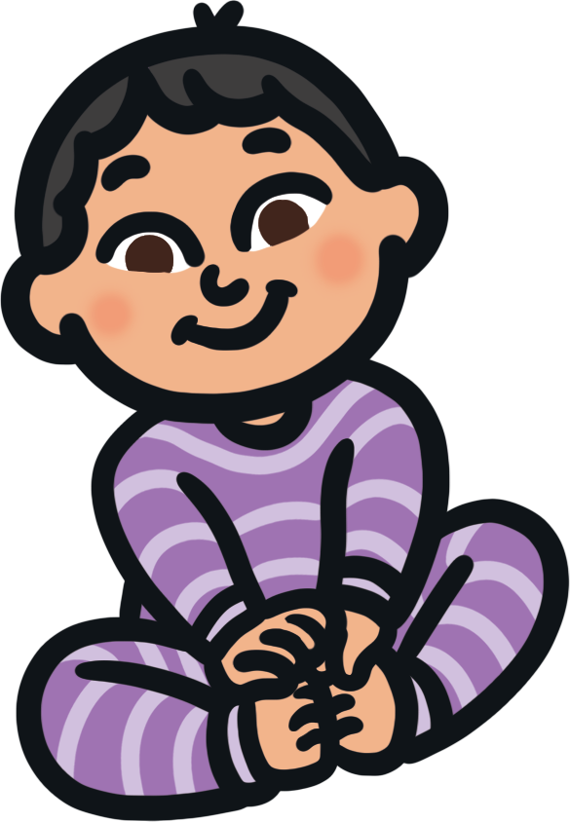
10
ten

Slide 13
Let’s count to 10!
1
2
3
4
5
one
two
three
four
five
6
7
8
9
10
six
seven
eight
nine
ten

Slide 14
Can you find the matching number?
1
2
3

Slide 15
Can you find the matching number?
4
5
6

Slide 16
Can you find the matching number?
8
9
10

Slide 17
Can you find the matching number?
1
one
2
3

Slide 18
Can you find the matching number?
3
four
4
5

Slide 19
Can you find the matching number?
7
seven
8
9

Slide 20
Can you find the matching number?
9
eight
nine
ten

Slide 21
Can you find the matching number?
2
two
three
four

Slide 22
Can you find the matching number?
10
eight
nine
ten

Slide 23
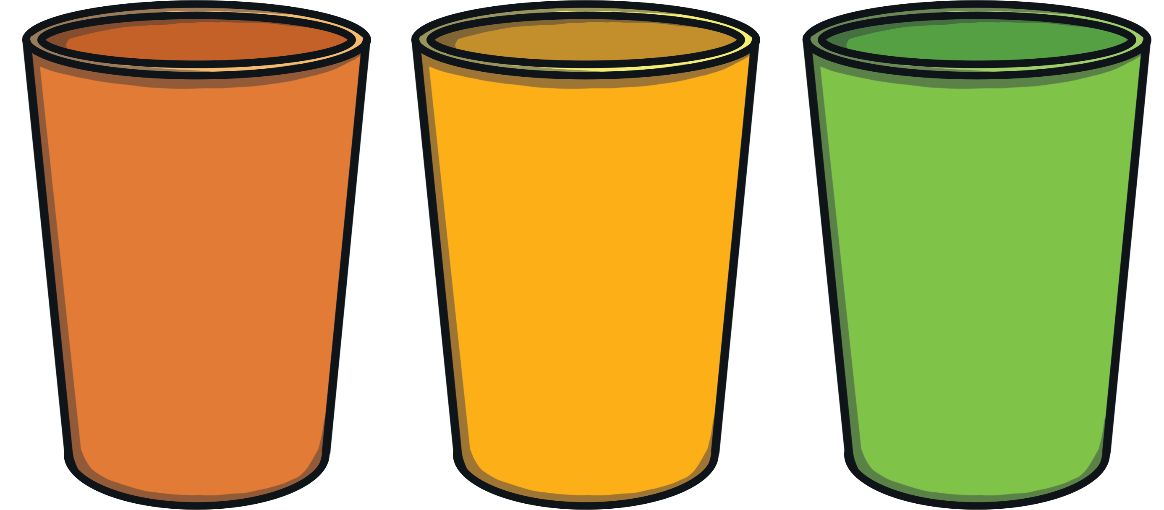
Can you find the matching number?

Slide 24
Can you find the matching number?

Slide 25
Can you find the matching number?

Slide 26
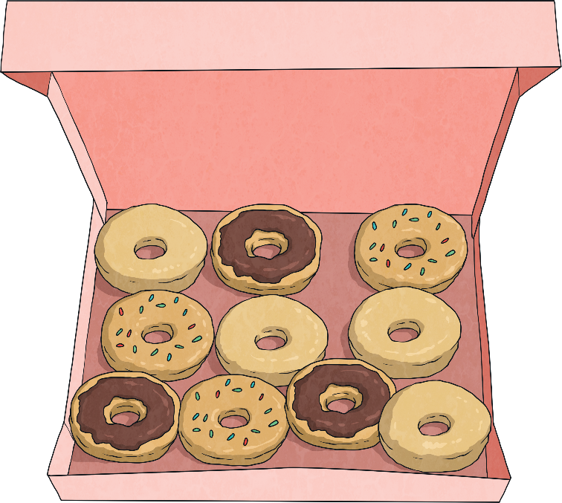
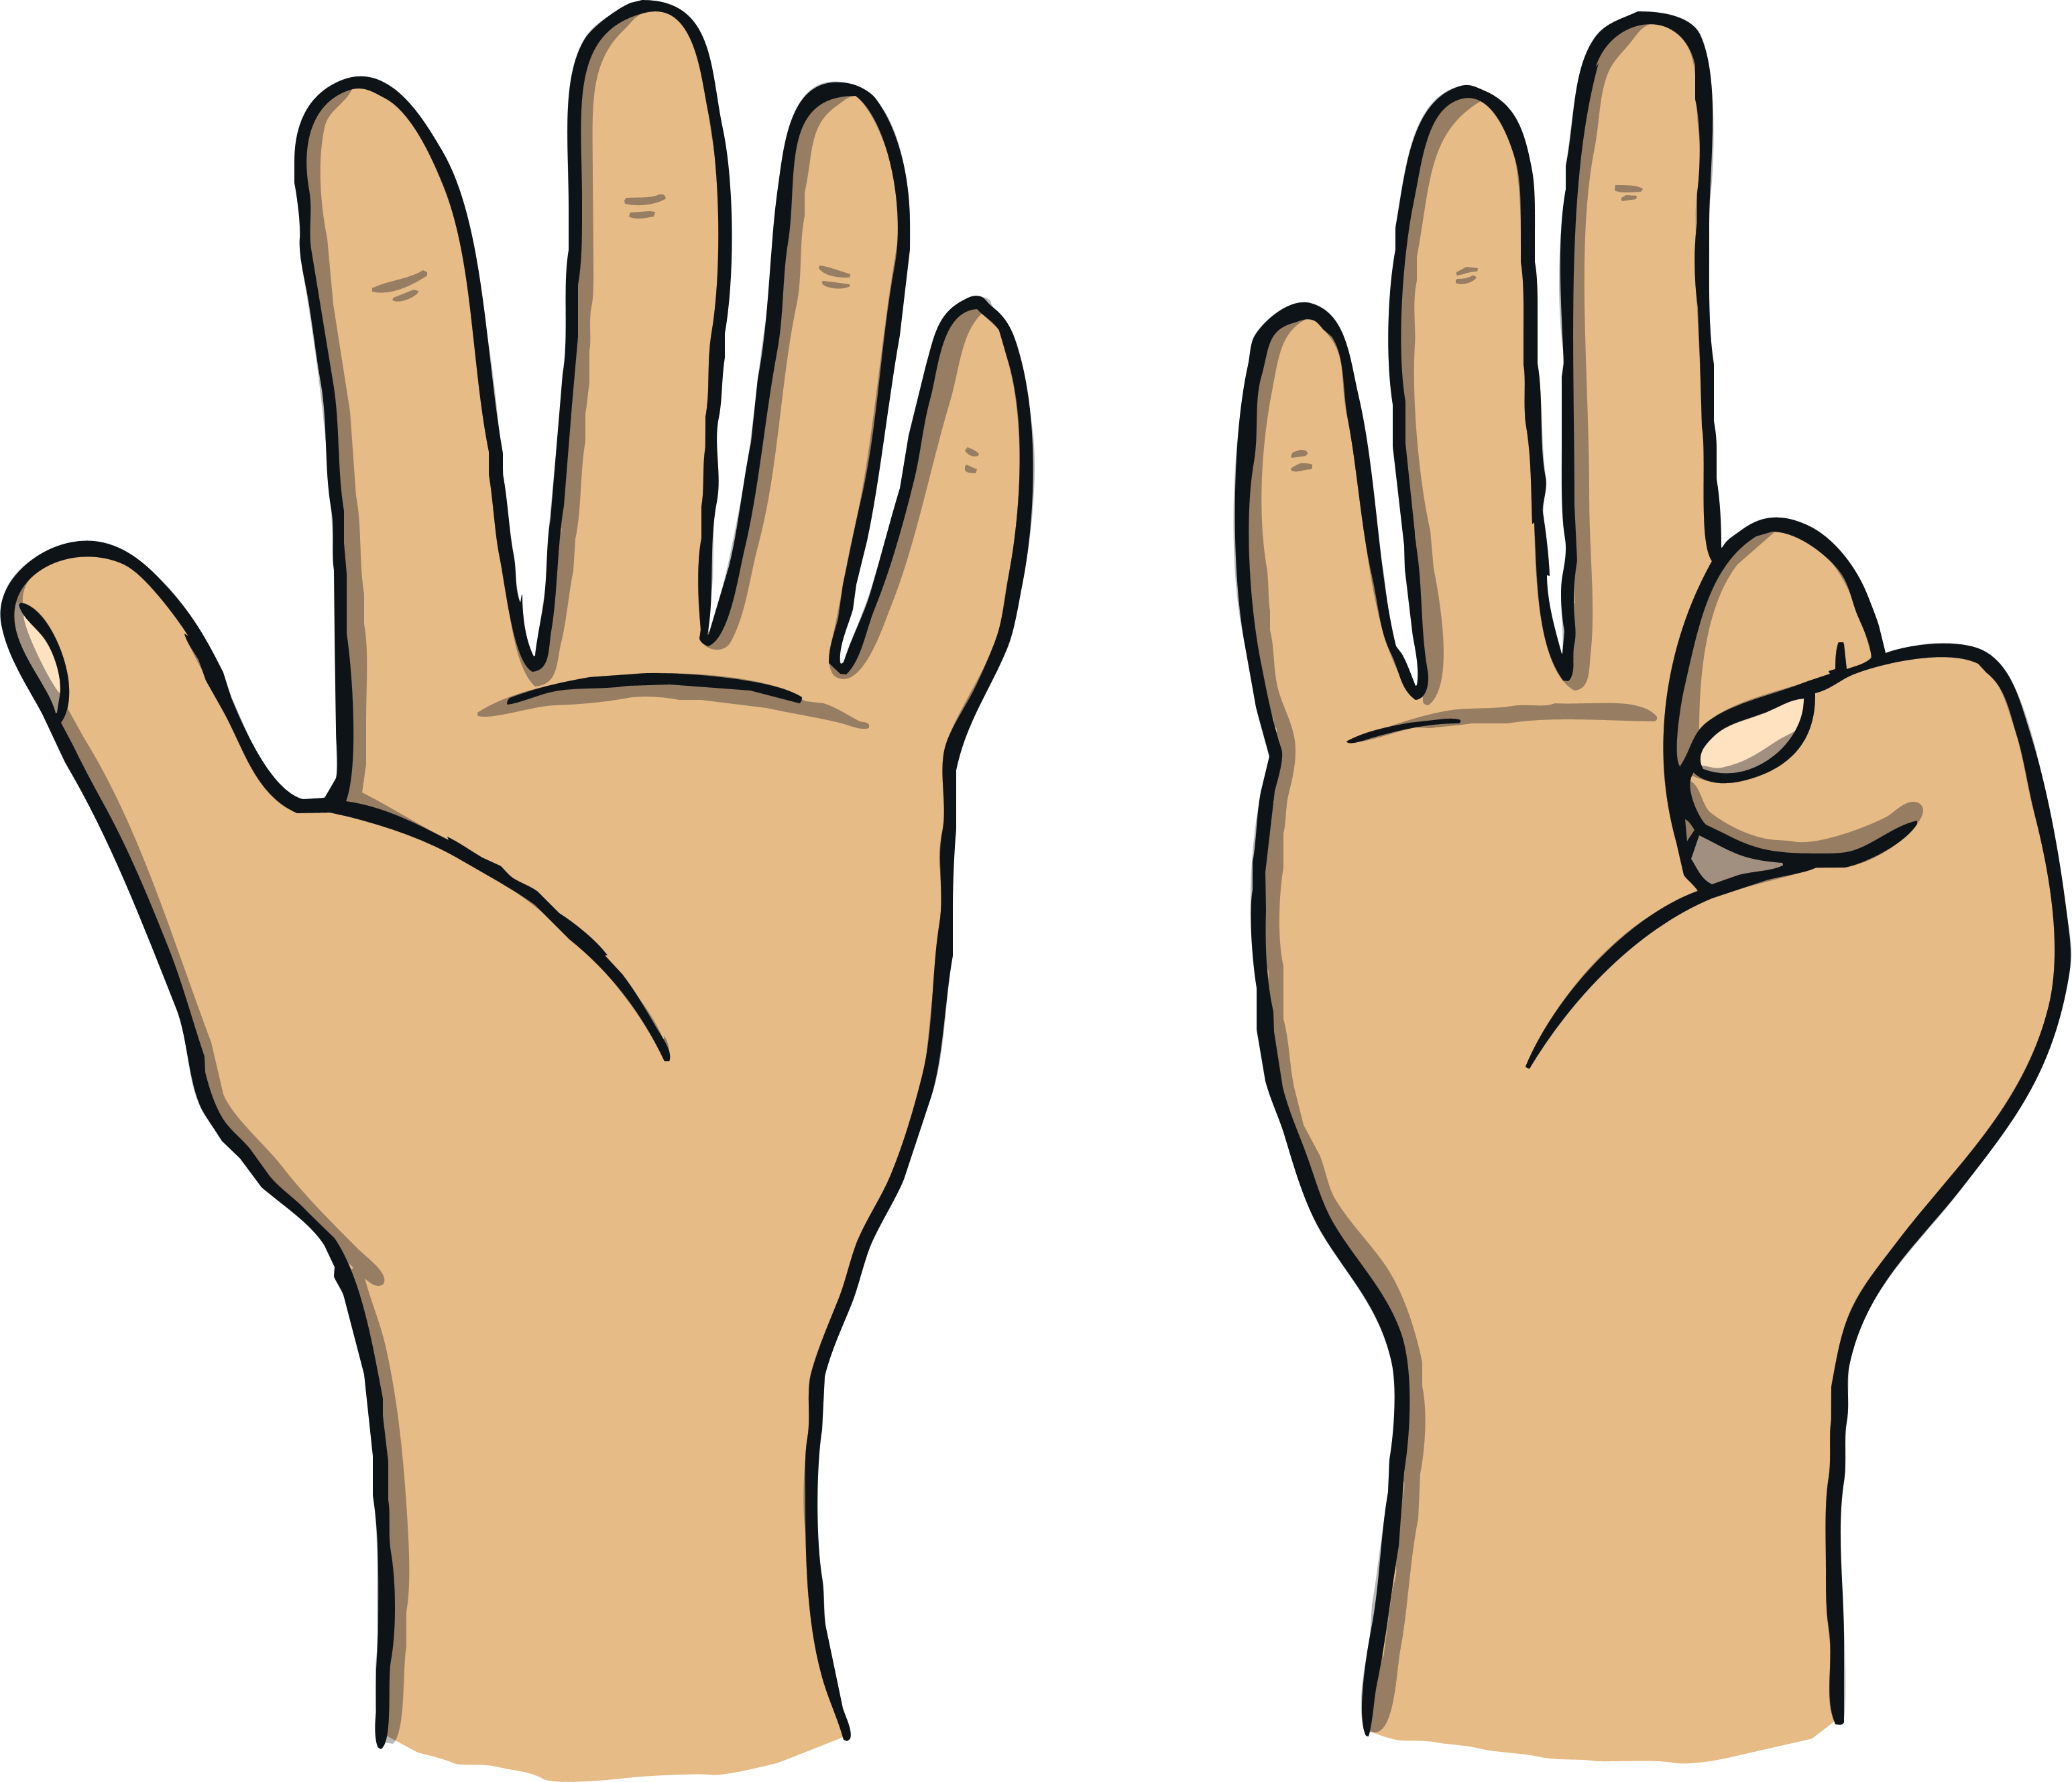
Well done!
What else can you find to count today?

