Slide 2
I Spy…
Teacher Guidance
This PowerPoint has been developed to enable children to practise their counting skills.
Each slide contains a different scene for the children to play I Spy with.
Example: I Spy with my little eye, 12 objects that are the same.
This can be developed as some of the objects are in different arrays, so the children can talk about more efficient counting strategies.

Slide 8
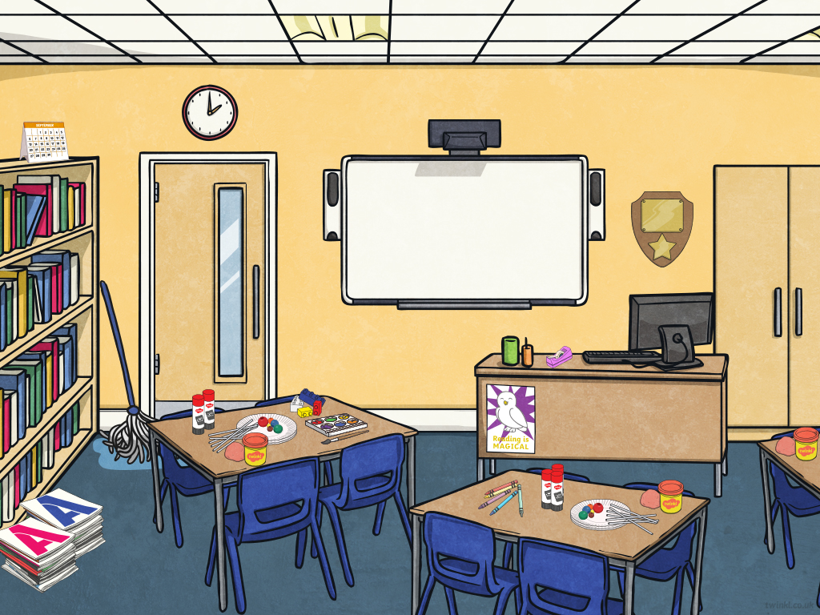

Slide 9
