Slide 2
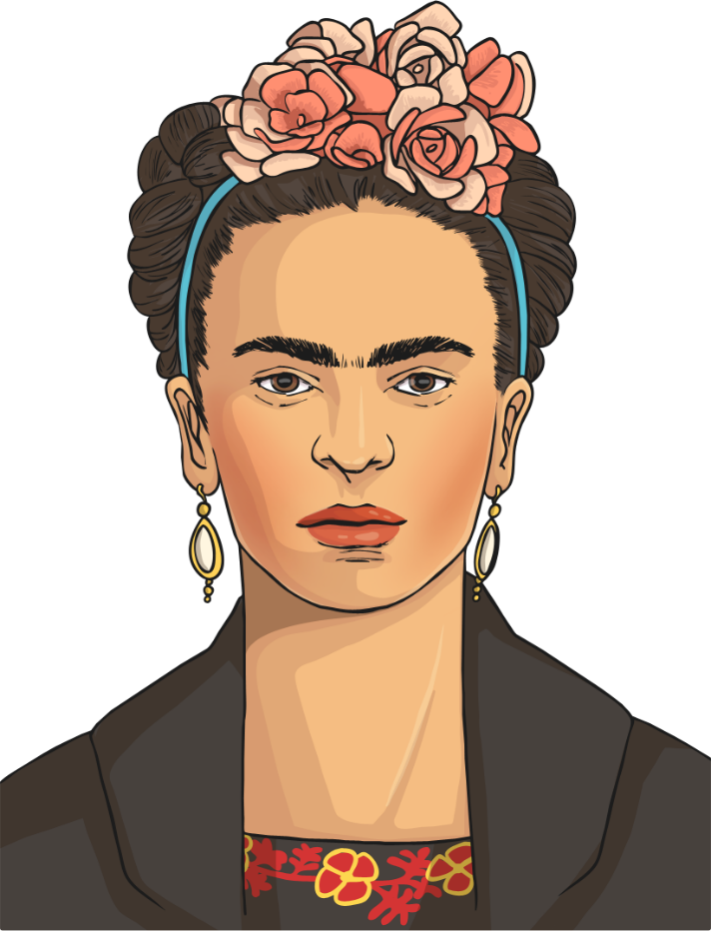
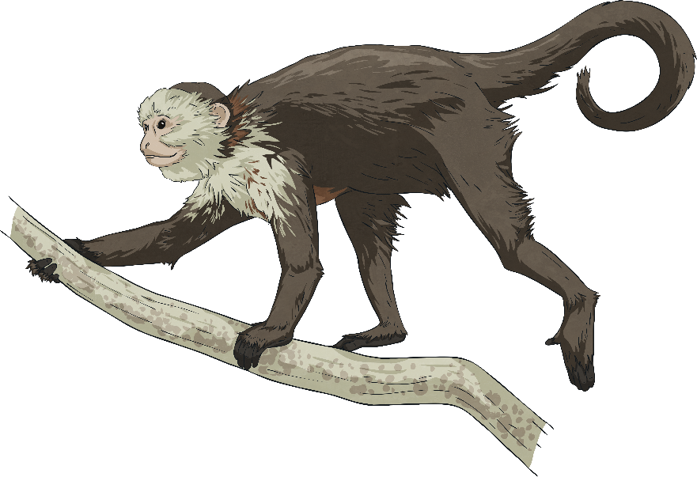
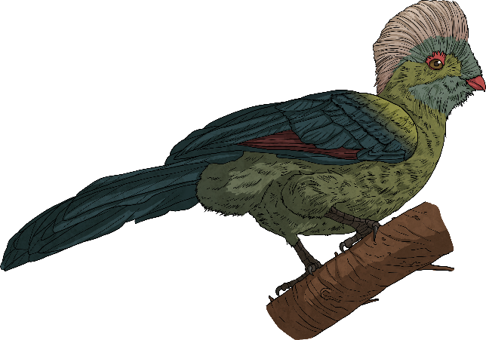
Frida Kahlo
July 6th 1907 – July 13th 1954
Frida Kahlo is considered to be one of the most important artists of modern times. She was famous for painting self-portraits (pictures of herself) but she was particularly famous for painting women as strong people.

Slide 3
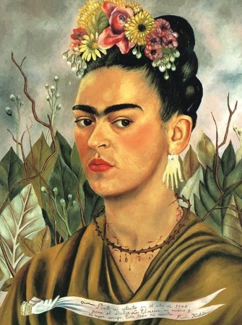
Early Years
Frida was born in a village just outside of Mexico City, Mexico, in 1907. When she was a child, Frida loved to draw. She preferred to spend hours on her own, being creative, rather than playing with her siblings.
When Frida was six, she contracted a disease called polio. This left her with a damaged leg which meant that she had to wear a special support to help her walk.
During this recovery time, she spent a lot of time with her father who taught her about photography.

Slide 4
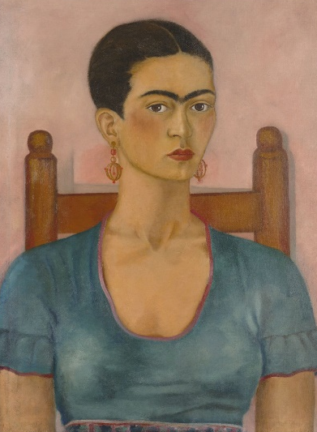
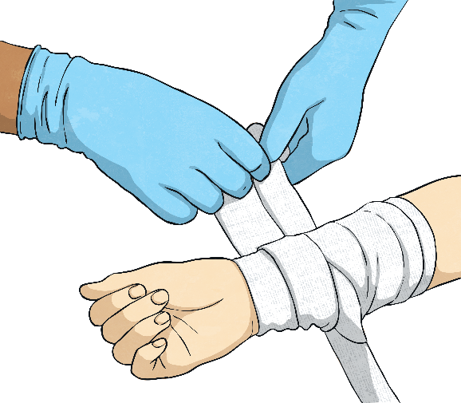
An Accident
When Frida was 18, she was involved in a traffic accident. This left her with many injuries including broken bones in her spine, collarbone, ribs, pelvis, leg, foot and shoulder.
She had many operations and spent three months in a full-body cast to help her to recover.

Slide 5
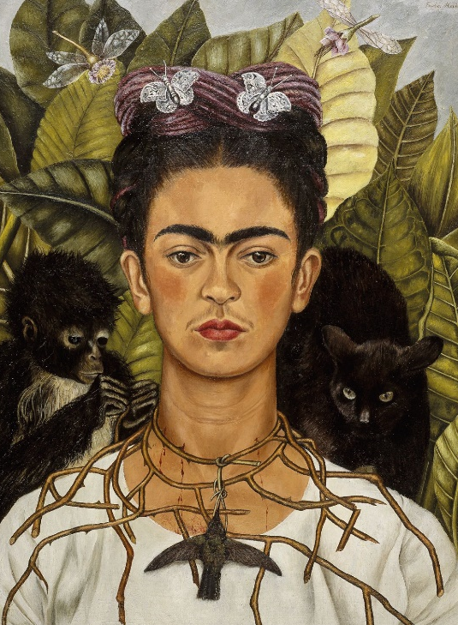
Her Recovery
During her time in bed when recovering from polio and her accident, Frida would draw to pass the time.
She couldn’t see very much from her bed, so she had a mirror placed on the ceiling so that she could see herself. Frida drew and painted a lot of self-portraits.

Slide 6
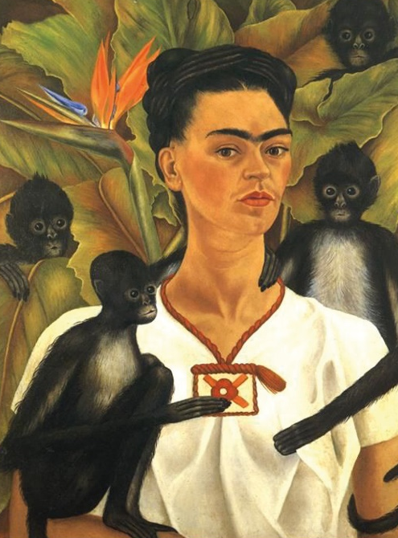
Self-Portraits
She used lots of bright colours in her self-portraits which reminded her of the vibrant colours of the hot country where she lived. Frida was very proud of her Mexican heritage.
She also included lots of tropical flowers and animals, such as monkeys and birds.

Slide 7
Appearance
Frida was well known for wearing bright colours, flowers in her hair and jewellery.

Slide 8
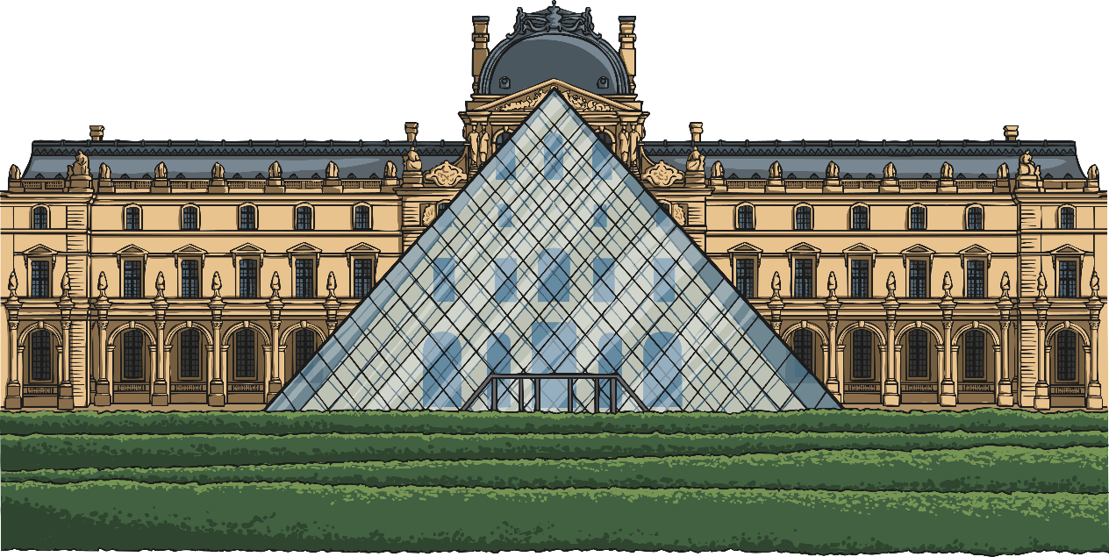
Popularity
The Louvre, in Paris, is a very famous art museum. When they purchased one of Frida’s paintings, she became the first Mexican artist to have art acquired by a world-renowned museum. Despite this, Frida didn’t really become famous until after her death.
Today, there is a museum dedicated to her at the house where she was born and grew up.

Slide 9
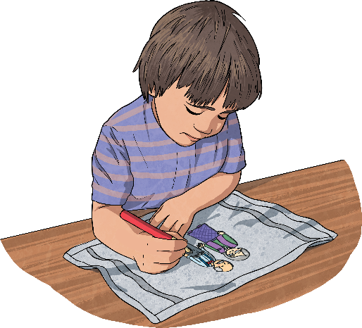
Quotes
She said that she painted self-portraits because
“…I am the person I know best.”
“I am not sick. I am broken. But I am happy as long as I can paint.”
Do you have a hobby that cheers you up?

