Slide 1
WORD WORK ACTIVITIES INFOGRAPHICS
Here is where this template begins

Slide 2
ABOUT WORD WORK ACTIVITIES INFOGRAPHICS
This template contains an assortment of complementary infographic resources for the Word Work Activities presentation.
These infographics are adapted to the style of the aforementioned presentation, so you can insert them easily and have them completely integrated at once. You just need to do the following:
Select the element that you want to copy
Right-click and choose “Copy”
Go to the slide where you want the element to appear
Right-click and choose “Paste”

Slide 3
WORD WORK ACTIVITIES INFOGRAPHICS
Write the words from the pink list in alphabetical order
1 | LOVE
2 | ALBUM
3 | HAPPY
4 | CIRCLE
1
2
3
4

Slide 4
WORD WORK ACTIVITIES INFOGRAPHICS
Create a sentence with these concepts
MY FRIEND
GOES INTO THE KITCHEN TO
IN THE SEA
THE BIG BEAR
SWIMS
EAT THE HONEY
MOM
MAKES ME HAPPY
TO THE WOODS
A LITTLE BIRD
FLIES AWAY
AND LOVES ME

Slide 5
WORD WORK ACTIVITIES INFOGRAPHICS
Choose the sentence that is written correctly
Mercury is the closest planet to the Sun and the smallest one in the Solar System—it’s only a bit larger than the Moon
Mercury is the closer planet to the Sun and the smallest one in the Solar System—its only one more large than the moon

Slide 6
WORD WORK ACTIVITIES INFOGRAPHICS
Let’s write words with the suffix —tion
Reaction
- - - - -
- - - - -
- - - - -
- - - - -
- - - - -
- - - - -
- - - - -
- - - - -
- - - - -
- - - - -
- - - - -

Slide 7
WORD WORK ACTIVITIES INFOGRAPHICS
Which one of these words need to be capitalized in a sentence?
car
forest
ocean
dog
music
jack
mary
water
spain
mountain
everest
flower
Now create a sentence with at least two of the words
I drove my car until I arrived to the forest

Slide 8
WORD WORK ACTIVITIES INFOGRAPHICS
Write a word of every kind
NOUN
1.
ADJECTIVE
2.
VERB
3.
ADVERB
4.

Slide 9
WORD WORK ACTIVITIES INFOGRAPHICS
Choose the correct answers and write a sentence with all of them
Hi! I’m Chicky and I’m…
BLUE
A RODENT
A SQUIRREL
A MAMMAL
YELLOW
ANGRY
A CHICKEN
NICE
SMALL
GREEN
OVIPAROUS
A DOG

Slide 10
WORD WORK ACTIVITIES INFOGRAPHICS
Pick and color!
NOUN
ADJECTIVE
ADVERB
HOUSE | HOT | TREE | CLEAR
GREEN | INSIDE | BIG | FISH
OFTEN | SOON | BANANA | NOW

Slide 11
WORD WORK ACTIVITIES INFOGRAPHICS
Group the following words by its semantic field
Red
Sunday
Kid
Saturday
Teen
Blue
Elder
Yellow
Monday
Violet
Friday
Pink
COLORS
DAYS
AGE
Here you can add your answers
Here you can add your answers
Here you can add your answers

Slide 12
WORD WORK ACTIVITIES INFOGRAPHICS
Match the nouns on the left with the nouns on the right
SUMMER
CASE
PENCIL
MAP
MIND
MACHINE
WASHING
HOLIDAYS
ORANGE
JUICE

Slide 13
WORD WORK ACTIVITIES INFOGRAPHICS
Circle the correct prefix for every word
BELIEVABLE
UN-
IR-
IM-
DIS-
RATIONAL
UN-
IR-
IM-
DIS-
PERMANENT
UN-
IR-
IM-
DIS-
LOYAL
UN-
IR-
IM-
DIS-

Slide 14
WORD WORK ACTIVITIES INFOGRAPHICS
Fill in the gaps with the verbs bring or take
Can you _________ the book to Tim, please?
Don't forget to _________ something to eat
_________ this shirt to the closet, please
You don’t need to _________ it seriously

Slide 15
WORD WORK ACTIVITIES INFOGRAPHICS
Fill in the blanks with the correct positional word
UNDER
ON
IN
BY
He’s _____ the box
He’s _____ the box
He’s _____ the box
He’s _____ the box

Slide 16
WORD WORK ACTIVITIES INFOGRAPHICS
Fit the words into the spelling boxes below
Tree
Ship
Owl
Lemon
Stone
Sea
Path
Up
S
H
I
P

Slide 17
WORD WORK ACTIVITIES INFOGRAPHICS
Write words for each of the following semantic fields
SPORTS
SEASONS
Basketball
Winter
HOUSEHOLD ITEMS
PLANTS
Fridge
Aloe vera

Slide 18
WORD WORK ACTIVITIES INFOGRAPHICS
Write and spell the word
APPLE
WATERMELON
Now try to write it with your eyes closed

Slide 19
WORD WORK ACTIVITIES INFOGRAPHICS
Find the vowels and highlight them
A | B | C | D | E | F | G
H | I | J | K | L | M | N
O | P | Q | R | S | T | U
V | W | X | Y | Z

Slide 20
WORD WORK ACTIVITIES INFOGRAPHICS
Mark the number of syllables of each word
 | Over | Dog | Flower | Wall | Metaphor | Sand
1
2
3
4

Slide 21
WORD WORK ACTIVITIES INFOGRAPHICS
Write a synonym and an antonym of each word
SYNONYM
ANTONYM
UP
Above
Down
SKIP
LIKE
REST

Slide 22
WORD WORK ACTIVITIES INFOGRAPHICS
Complete the pyramid spelling words
F
C
T
F
R
I
E
N
D
C
E
R
E
A
L
T
U
R
T
L
E

Slide 23
WORD WORK ACTIVITIES INFOGRAPHICS
Write a word that rhymes with each spelling word
SLIDE
RIDE
BOWL
BIRD
SPEED

Slide 24
WORD WORK ACTIVITIES INFOGRAPHICS
Write a short story about Timmy and Jimmy using the words from the list
JIMMY
Garden
Swim
Almond
Worm
Trip
Fly
Leaf
Smile
Mercury is the closest planet to the Sun and the smallest one in the Solar System—it’s only a bit larger than the Moon
TIMMY

Slide 25
WORD WORK ACTIVITIES INFOGRAPHICS
Each letter has a value. Add up the value of the word
LETTER | abcde | fghij | klmno | pqrstu | vwxyz
VALUE | 2 | 4 | 6 | 8 | 10
WORD
VALUE
Swimming
8+10+4+6+6+4+6+4=48
Island
Civilisation

Slide 26
WORD WORK ACTIVITIES INFOGRAPHICS
What words from the list below belong to technology semantic field?
Hello! I’m a PC…
COMPUTER
KILOGRAM
PIXEL
BYTE
GIGABYTE
INCH
ORANGE
NUT
USB
PROGRAM
BIT
HIP

Slide 27
WORD WORK ACTIVITIES INFOGRAPHICS
Mark the word you think is different and write down your reason for choosing it
DOG
CAT
REASON
Carrots are not animals
CARROT
BEAR
REGGAE
ROCK
REASON
SOFA
HIP HOP
CAR
MOTORCYCLE
REASON
TRAIN
DISH

Slide 28
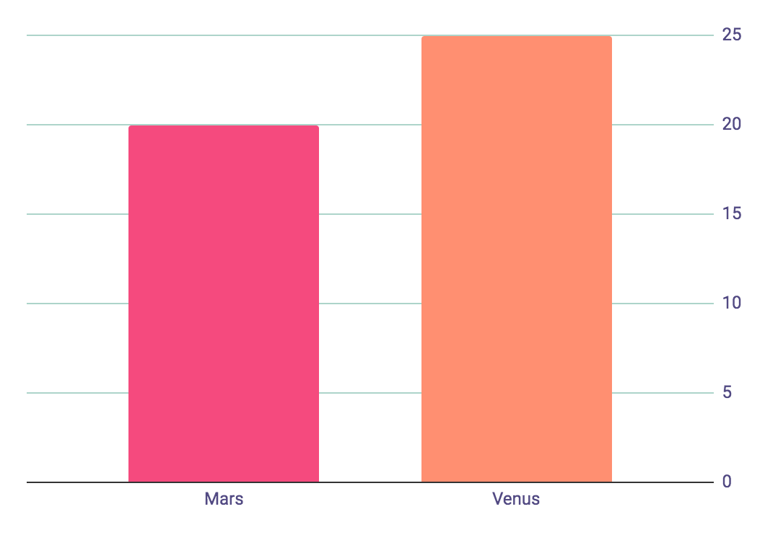
WORD WORK ACTIVITIES INFOGRAPHICS
Congratulations! You did great!
100%
JUPITER
Jupiter the biggest planet of them all
80%
MARS
Despite being red, it is a cold place
To modify this graph, click on it, follow the link, change the data and paste the new graph here, replacing this one

Slide 29
WORD WORK ACTIVITIES INFOGRAPHICS
 | MON | TUES | WED | THURS | FRI | SAT | SUN
8:00 9:00 | Synonyms
10:00 11:00 |  |  |  |  |  | Fields of meaning
12:00 13:00 |  | Semantic fields |  | Reading
14:00 15:00 | Spelling |  | Vowels |  |  |  | Suffixes
16:00 17:00 |  | Writing |  | Storytelling | Consonants | Adverbs

Slide 30
WORD WORK ACTIVITIES INFOGRAPHICS
MONDAY
TUESDAY
WEDNESDAY
THURSDAY
Saturn is composed mostly of hydrogen and also helium
Despite being red, Mars is actually a very cold place
Jupiter is the biggest planet in the entire Solar System
Mars is a cold desert world half the size of Earth
MONTH
FRIDAY
SATURDAY
SUNDAY
1
2
Mercury is the smallest planet in the entire System
Venus is a planet that has a really nice and beautiful name
Earth is the planet that harbors life and is where we live on
3
4
5
6
7
8
9
10
11
12
13
14
15
16
17
18
19
20
21
22
23
24
25
26
27
28
29
30
31

Slide 31
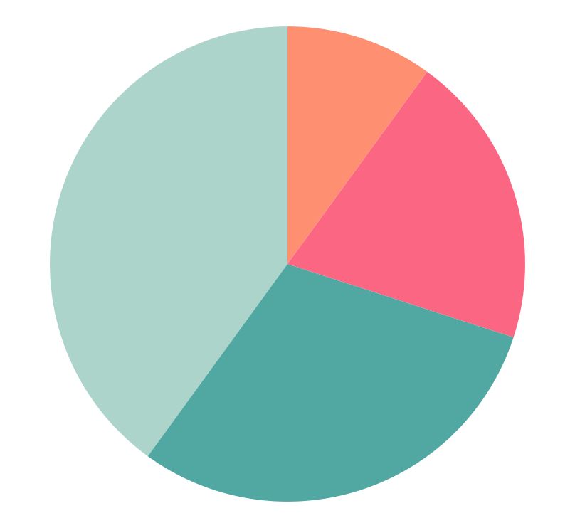
WORD WORK ACTIVITIES INFOGRAPHICS
40%
10%
MERCURY
JUPITER
Mercury is the smallest planet
Jupiter the biggest planet of them all
30%
20%
VENUS
MARS
Venus has a beautiful name
Despite being red, it is a cold place
To modify this graph, click on it, follow the link, change the data and paste the new graph here, replacing this one

Slide 32
Instructions for use (premium users)
In order to use this template, you must be a Premium user on Slidesgo.
You are allowed to:
Modify this template.
Use it for both personal and commercial purposes.
Hide or delete the “Thanks” slide and the mention to Slidesgo in the credits.
Share this template in an editable format with people who are not part of your team.
You are not allowed to:
Sublicense, sell or rent this Slidesgo Template (or a modified version of this Slidesgo Template).
Distribute this Slidesgo Template (or a modified version of this Slidesgo Template) or include it in a database or in any other product or service that offers downloadable images, icons or presentations that may be subject to distribution or resale.
Use any of the elements that are part of this Slidesgo Template in an isolated and separated way from this Template.
Register any of the elements that are part of this template as a trademark or logo, or register it as a work in an intellectual property registry or similar.
For more information about editing slides, please read our FAQs or visit Slidesgo School:
https://slidesgo.com/faqs and https://slidesgo.com/slidesgo-school

Slide 33
Premium infographics...
Text 1
Text 2
Text 3
Add the Title here
2016
2017
2018
2019
2020
Text 4
Text 5
Text 6
“Mercury is closest planet to the Sun and the smallest”
“Despite being red, Mars is a cold place full of iron oxide”
“Venus has a beautiful name and is the second planet”
“Neptune is the farthest-known planet from the Sun”
“Saturn is a gas giant and has several rings”

Slide 34
Premium infographics...
75%
“Mercury is closest planet to the Sun and the smallest”
75%
“Mercury is closest planet to the Sun and the smallest”
TITLE 1
“Mercury is closest planet to the Sun and the smallest”
“Mercury is closest planet to the Sun and the smallest”

Slide 35
Premium Icons

Slide 36
Premium Icons

Slide 37
Premium Icons

Slide 38
Premium Icons

Slide 39
Premium Icons

Slide 40
Infographics
You can add and edit some infographics to your presentation to present your data in a visual way.
Choose your favourite infographic and insert it in your presentation using Ctrl C + Ctrl V or Cmd C + Cmd V in Mac.
Select one of the parts and ungroup it by right-clicking and choosing “Ungroup”.
Change the color by clicking on the paint bucket.
Then resize the element by clicking and dragging one of the square-shaped points of its bounding box (the cursor should look like a double-headed arrow). Remember to hold Shift while dragging to keep the proportions.
Group the elements again by selecting them, right-clicking and choosing “Group”.
Repeat the steps above with the other parts and when you’re done editing, copy the end result and paste it into your presentation.
Remember to choose the “Keep source formatting” option so that it keeps the design. For more info, please visit Slidesgo School.

