Slide 1
Earth & Ocean Zones Infographics
Here is where this template begins

Slide 2
Earth & Ocean Zones Infographics
Geosphere
Hydrosphere
Atmosphere
Mars is actually a very cold place
Venus is the second planet from the Sun
Mercury is the closest planet to the Sun

Slide 3
Earth & Ocean Zones Infographics
Mercury is the closest planet to the Sun
Crust
Venus is the second planet from the Sun
Upper mantle
Mars is actually a very cold place
Mantle
Jupiter is the biggest planet of them all
Outer core
Neptune is the farthest planet from the Sun
Inner core

Slide 4
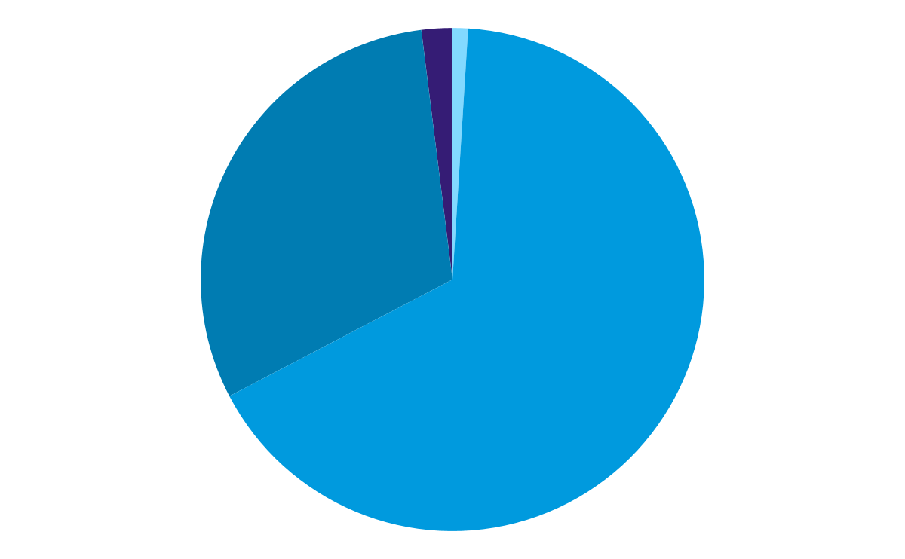
Earth & Ocean Zones Infographics
1.7%
0.473%
Inner core
Crust
Neptune is the farthest planet from the Sun
Mercury is the closest planet to the Sun
30.8%
67.3%
Outer core
Mantle
Jupiter is the biggest planet of them all
Mars is actually a very cold place
Follow the link in the graph to modify its data and then paste the new one here. For more info, click here

Slide 5
Earth & Ocean Zones Infographics
Surface components
30%
98%
70%
Forest
Minerals
Water
Mars is actually a very cold place
Venus is the second planet from the Sun
Mercury is the closest planet to the Sun

Slide 6
Earth & Ocean Zones Infographics
Continental relief
Venus is the second planet from the Sun
Coastal relief
Jupiter is the biggest planet of them all

Slide 7
Earth & Ocean Zones Infographics
 | Continental relief |  | Coastal relief
Mountain | Mercury is the closest planet to the Sun | Peninsula | Jupiter is the biggest planet of them all
Valley | Venus is the second planet from the Sun | Isthmus | Ceres is located in the main asteroid belt
Plains | Mars is actually a very cold place | Cape | Mercury is the closest planet to the Sun
Plateau | Jupiter is the biggest planet of them all | Gulf | Neptune is the farthest planet from the Sun
Basin | Neptune is far away from Earth | Island | Venus is second planet from the Sun
 |  | Beach | Mars is actually a very cold place
 |  | Cliff | Pluto is now considered a dwarf planet

Slide 8
Earth & Ocean Zones Infographics
510 millions km²
6 Continents
361 millions km²
5 Oceans
Venus is the second planet from the Sun
America
Asia
Africa
Europe
Oceania
The Antarctic
Jupiter is the biggest planet of them all
Atlantic
Pacific
Indian
Southern
Artic

Slide 9
Earth & Ocean Zones Infographics
Europe
Asia
Venus is the second planet from the Sun
Mercury is a very small planet
Africa
Oceania
Jupiter is the biggest planet of them all
Saturn is a gas giant with several rings
America
The Atlantic
Mars is actually a very cold place
Neptune is far away from Earth

Slide 10
Earth & Ocean Zones Infographics
Mercury is the closest planet to the Sun
Pacific O.
Venus is the second planet from the Sun
Atlantic O.
Mars is actually a very cold place
Antarctic O.
Jupiter is the biggest planet of them all
Arctic O.
Neptune is the farthest planet from the Sun
Indic O.

Slide 11
Earth & Ocean Zones Infographics
Atmosphere components
Nitrogen
78%
0.9%
Argon
Neptune is the farthest planet from the Sun
Venus is the second planet from the Sun
Oxigen
21%
0.03%
Carbon dioxide
Mercury is the closest planet to the Sun
Mars is actually a very cold place

Slide 12
Earth & Ocean Zones Infographics
1200ºC
Exosphere
800 to 3000 km
-86.5 to 1200ºC
Thermosphere
80-90 to 800 km
-2.5 to -86.5ºC
Mesosphere
40-50 to 80-90 km
-56.5 to -2.5ºC
Stratosphere
11 to 50 km
15 to -56.5ºC
Troposphere
0 to 12-18 km

Slide 13
Earth & Ocean Zones Infographics
Climate zones
Arctic Circle
90ºN
-7ºC
Polar
Tropic Of Cancer 23.5ºN
Temperate
+24ºC
Equator
0º
Torrid
+26ºC
Torrid
Tropic Of Capricorn
23.5ºS
Temperate
+22ºC
Antarctic Circle
90ºS
Polar
-33ºC

Slide 14
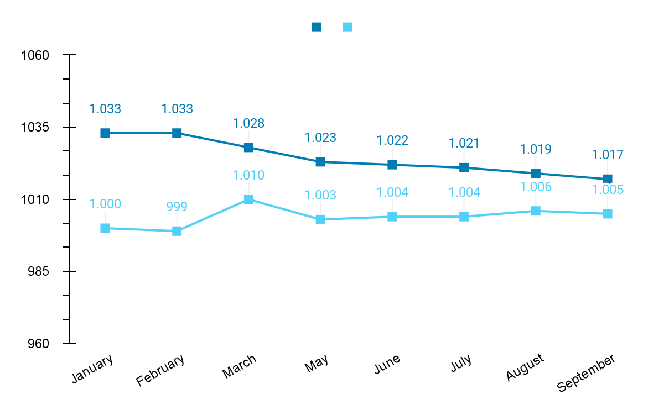
Earth & Ocean Zones Infographics
Atmospheric pressure
Mercury is the closest planet to the Sun
Maximum (hPa)
Minimum (hPa)
Follow the link in the graph to modify its data and then paste the new one here. For more info, click here

Slide 15
Earth & Ocean Zones Infographics
Climate zones
Warm weather
Temperate climates
Cold climates
Equatorial climate
Mediterranean climate
Polar climate
Tropical climate
Chinese weather
Alpine climate
Arid subtropical climate
Oceanic climate
Desert and semi-desert
Continental weather

Slide 16
Earth & Ocean Zones Infographics
Mars is actually a very cold place
Jupiter is the biggest planet of them all
Solstice June 22
Equinox September 23
Equinox March 21
Sun
Solstice December 22
Venus is the second planet from the Sun
Neptune is the farthest planet from the Sun
Saturn is a gas giant with several rings

Slide 17
Earth & Ocean Zones Infographics
Winter
Spring
Summer
Fall
Neptune is the farthest planet from the Sun
Venus is the second planet from the Sun
Mars is red and actually a very cold place
Jupiter is the biggest planet of them all

Slide 18
Earth & Ocean Zones Infographics
Mercury is the closest planet to the Sun
Summer
40%
Mars is actually a very cold place
Spring
30%
Neptune is the farthest planet from the Sun
Autumn
20%
It’s the biggest planet of them all
Winter
10%

Slide 19
Earth & Ocean Zones Infographics
98%
Minerals
Venus is the second planet from the Sun
70%
Water
Mercury is the closest planet to the Sun
30%
Forest
Mars is actually a very cold place

Slide 20
Earth & Ocean Zones Infographics
Type of forests
Boreal forest
Subtropical forest
Venus is the second planet from the Sun
Mars is actually a very cold place
Temperate forest
Tropical forest
Mercury is the closest planet to the Sun
Jupiter is the biggest planet of them all

Slide 21
Earth & Ocean Zones Infographics
Types of deserts
Hot and dry deserts
Coastal deserts
Venus is the second planet from the Sun
Jupiter is the biggest planet of them all
Semiarid deserts
Cold deserts
Mercury is the closest planet to the Sun
Mars is actually a very cold place

Slide 22
Earth & Ocean Zones Infographics
Mountains and plateau
Fold mountains
Volcanic mountains
Plateau
Mercury is the closest planet to the Sun
Mars is actually a very cold place
Jupiter is the biggest planet of them all
Block mountains
Dome mountains
Venus is the second planet from the Sun
Neptune is the farthest planet from the Sun

Slide 23
Earth & Ocean Zones Infographics
Causes of seismic movements
Volcanic activity
Movements of the plates
Mercury is the closest planet to the Sun and the smallest one in the Solar System—it’s only a bit larger than the Moon
Venus has a beautiful name and is the second planet from the Sun. It’s hot and has a poisonous atmosphere

Slide 24
Earth & Ocean Zones Infographics
 |  | Ocean depth
Epipelagic zone | up to 200m | Mercury is the closest planet to the Sun
Mesopelagic zone | up to 1000m | Venus is the second planet from the Sun
Bathypelagic zone | up to 4000m | Mars is actually a very cold place
Abyssopelagic zone | up to 6000m | Jupiter is the biggest planet of them all
Hadal zone | up to 11000m | Neptune is the farthest planet from the Sun

Slide 25
Earth & Ocean Zones Infographics
Epipelagic zone
0 m
Abyssopelagic zone
Turtle, dolphins, fish, jellyfish
Black swallower
200 m
Mesopelagic zone
1000 m
Hadal zone
Squid, crab, catshark, krill
Sea cucumber
4000 m
Bathypelagic zone
6000 m
Viperfish, octopus, sea star
11000 m

Slide 26
Earth & Ocean Zones Infographics
Ocean currents
Cold current
Warm current
Venus is the second planet from the Sun
Neptune is far away from Earth
Physical causes of ocean currents
Earth movements
The planetary winds
The emergence of cold water
Jupiter is the biggest planet of them all
Mars is red and actually a very cold place
Saturn is composed mostly of hydrogen and helium

Slide 27
Earth & Ocean Zones Infographics
Ocean current
Coastal drift current
Venus is the second planet from the Sun
Jupiter is the biggest planet of them all
Tidal current
Density current
Mercury is the closest planet to the Sun
Neptune is the farthest planet from the Sun
Wave current
Mars is actually a very cold place

Slide 28
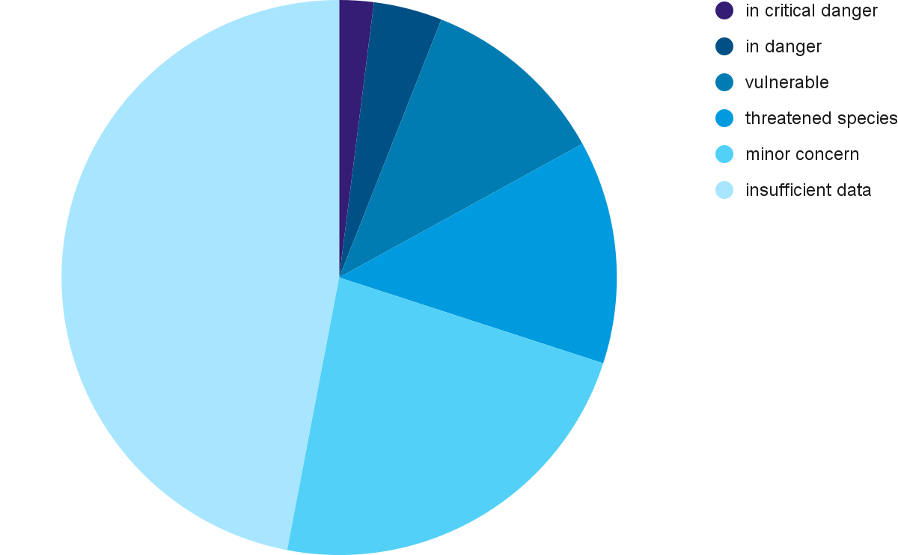
Earth & Ocean Zones Infographics
2%
In critical danger
4%
In danger
11%
Vulnerable
Species
13%
Threatened species
23%
Minor concern
47%
Insufficient data
Follow the link in the graph to modify its data and then paste the new one here. For more info, click here

Slide 29
Earth & Ocean Zones Infographics
Marine animal adaptation
Breathing
Salt concentration
Temperature
Mercury is the closest planet to the Sun
Despite being red, Mars is a very cold place
Venus is the second planet from the Sun

Slide 30
Earth & Ocean Zones Infographics
Mercury is the closest planet to the Sun
Venus is the second planet from the Sun
Fish
Birds
Vertebrates
Despite being red, Mars is a very cold place
Jupiter is the biggest planet of them all
Marine reptiles
Mammals

Slide 31
Earth & Ocean Zones Infographics
Invertebrates
Arthropods
Mercury is the closest planet to the Sun
Crustaceans
Venus is the second planet from the Sun
Mollusks
Mars is actually a very cold place
95%
Echinoderms
Jupiter is the biggest planet of them all
Porifera
Neptune is the farthest planet from the Sun

Slide 32
Instructions for use (premium users)
As a Premium user, you can use this template without attributing Slidesgo or keeping the "Thanks" slide.
You are allowed to:
Modify this template.
Use it for both personal and commercial purposes.
Hide or delete the “Thanks” slide and the mention to Slidesgo in the credits.
Share this template in an editable format with people who are not part of your team.
You are not allowed to:
Sublicense, sell or rent this Slidesgo Template (or a modified version of this Slidesgo Template).
Distribute this Slidesgo Template (or a modified version of this Slidesgo Template) or include it in a database or in any other product or service that offers downloadable images, icons or presentations that may be subject to distribution or resale.
Use any of the elements that are part of this Slidesgo Template in an isolated and separated way from this Template.
Register any of the elements that are part of this template as a trademark or logo, or register it as a work in an intellectual property registry or similar.
For more information about editing slides, please read our FAQs or visit Slidesgo School:
https://slidesgo.com/faqs and https://slidesgo.com/slidesgo-school

Slide 33
Infographics
You can add and edit some infographics to your presentation to present your data in a visual way.
Choose your favourite infographic and insert it in your presentation using Ctrl C + Ctrl V or Cmd C + Cmd V in Mac.
Select one of the parts and ungroup it by right-clicking and choosing “Ungroup”.
Change the color by clicking on the paint bucket.
Then resize the element by clicking and dragging one of the square-shaped points of its bounding box (the cursor should look like a double-headed arrow). Remember to hold Shift while dragging to keep the proportions.
Group the elements again by selecting them, right-clicking and choosing “Group”.
Repeat the steps above with the other parts and when you’re done editing, copy the end result and paste it into your presentation.
Remember to choose the “Keep source formatting” option so that it keeps the design. For more info, please visit Slidesgo School.

