Slide 1
Daylight Infographics
Here is where this template begins

Slide 2
Daylight Infographics
Night
Day
Mercury is the closest planet to the Sun and the smallest one in the Solar System
It has a nice name and is the second planet. It’s terribly hot, more than Mercury
Mercury
Venus
25%
75%
Mercury is the closest planet to the Sun and the smallest one
Venus has a beautiful name and is the second planet
75%
50%

Slide 3
Daylight Infographics
12 p.m.
Day
Saturn is the ringed one. It’s mostly made of hydrogen and helium
08 a.m.
04 p.m.
Venus has a nice name
06 a.m.
06 p.m.
Night
Mars is a very cold place full of iron oxide dust. It was named after a god
04 a.m.
08 p.m.
Neptune is the farthest
12 a.m.

Slide 4
Daylight Infographics
Morning
Afternoon
Night
Venus has a beautiful name and is the second planet from the Sun in the Solar System
Despite being red, planet Mars is a cold place full of iron oxide dust. It was named after a god
It‘s the ringed one. It’s made of hydrogen and helium. It has several rings. It’s a gas giant
08 a.m.
07 p.m.
11 p.m.

Slide 5
Daylight Infographics
Night
Day
Mars is actually a very cold place full of iron oxide dust
Mercury is the closest planet to the Sun and the smallest one
0º
5º
10º
15º
35º
30º
25º
20º
Per hour
Per hour
01 a.m - 03 a.m
12 p.m - 02 p.m
5º
35º
03 a.m - 06 a.m
02 p.m - 06 p.m
15º
25º

Slide 6
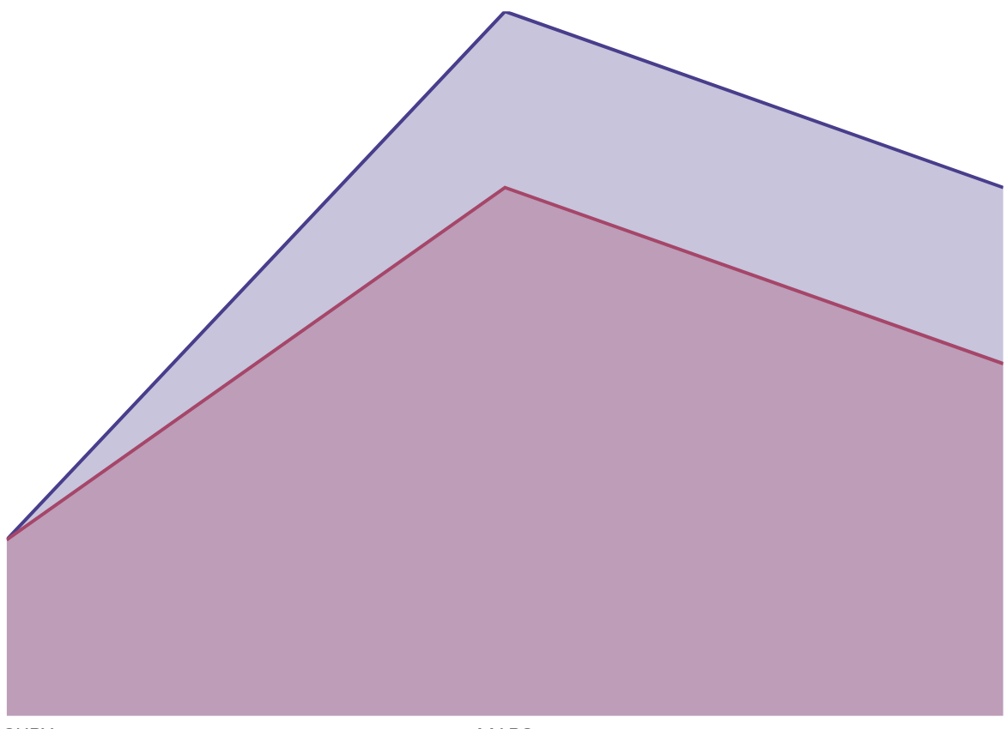
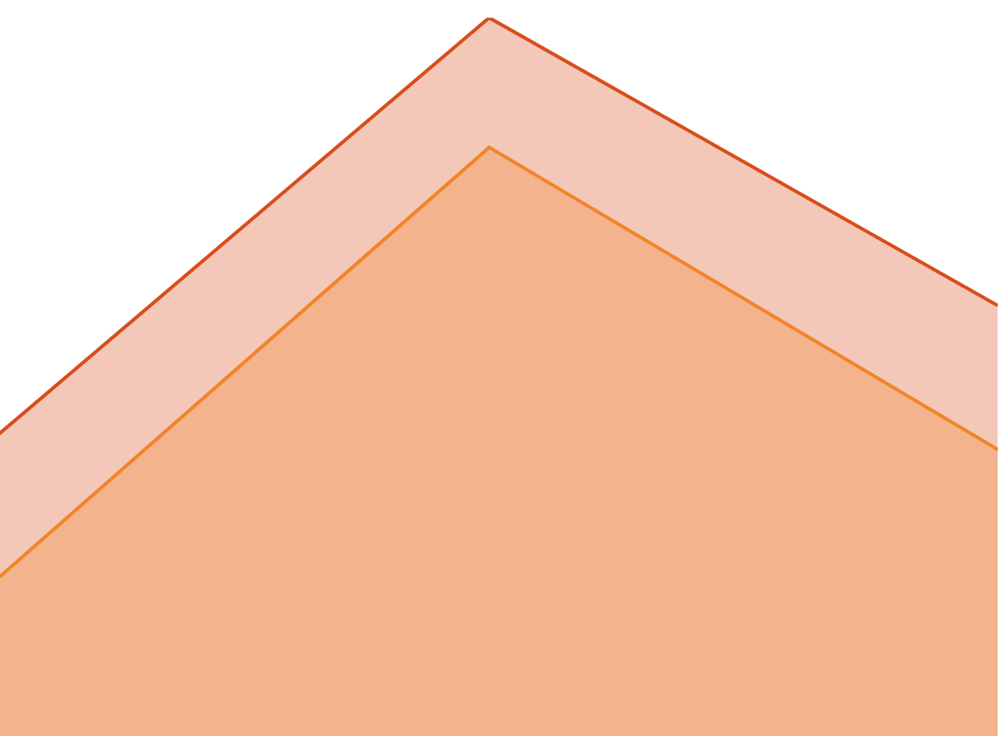
Daylight Infographics
80
Day
40
Mercury is the closest planet to the Sun and the smallest one in the Solar System
30
20
10
50
Venus
Saturn
40
30
Night
20
Venus has a beautiful name and is the second planet from the Sun. It’s terribly hot
10
To modify this graph, click on it, follow the link, change the data and paste the new graph here
Mars
Venus

Slide 7
Daylight Infographics
01 a.m. - 05 a.m.
06 a.m. - 12 a.m.
Mercury is the closest planet to the Sun and the smallest one in the Solar System—it’s only a bit larger than the Moon
The planet’s name has nothing to do with the liquid metal, since it was named after the Roman messenger god
01 p.m. - 05 p.m.
06 p.m. - 12 p.m.
Venus has a beautiful name and is the second planet from the Sun. It’s terribly hot—even hotter than Mercury
Jupiter is the biggest object in the Solar System and also an orange gas giant. It’s the fifth planet from the Sun

Slide 8
Daylight Infographics
Night
Day
45º
45º
40º
It’s the closest planet to the Sun and the smallest one in the Solar System
Venus has a beautiful name and is the second planet from the Sun
40º
35º
35º
30º
30º
25º
25º
20º
50%
25%
20º
15º
15º
10º
10º
Saturn
Venus
5º
5º
0º
0º
75%
97%
Jupiter
1º
10º
15º
20º
25º
30º
Mercury
To modify these graphs, click on them, follow the link, change the data and paste the new graphs here

Slide 9
Daylight Infographics
Night
Day
Mercury is the closest planet to the Sun and the smallest one in the Solar System—it’s only a bit larger than the Moon
Venus has a beautiful name and is the second planet from the Sun. It’s terribly hot—even hotter than Mercury
97%
75%

Slide 10
Daylight Infographics
Day
Night
Mercury is the closest planet to the Sun and the smallest one
Mars is a cold place. It’s full of iron oxide dust
Saturn is composed mostly made of hydrogen and helium
Mercury is the smallest one in the Solar System
16 h
08 h
Venus has a beautiful name and is the second planet
Jupiter is the biggest planet in the Solar System

Slide 11
Daylight Infographics
15º
5º
08
Day
10
Night
Mercury is the closest planet to the Sun and the smallest one in the Solar System—it’s only a bit larger than the Moon
Venus has a beautiful name and is the second planet from the Sun. It’s terribly hot—even hotter than Mercury
a.m.
p.m.

Slide 12
Daylight Infographics
Morning
Afternoon
Night
Jupiter is the biggest planet
Venus has a beautiful name
Mars is actually a cold place
01 p.m.
04 p.m.
06 p.m.
08 p.m.
10 p.m.
12 a.m.
02 a.m.
04 a.m.
05 a.m.
06 a.m.
Day
Night
Mercury is the closest planet to the Sun and the smallest one
Neptune is the farthest planet from the Sun

Slide 13
Daylight Infographics
25%
75%
Day
Night
Venus has a nice name and is the second planet. It’s terribly hot—even hotter than Mercury
Mercury is the closest planet to the Sun and the smallest one in the entire Solar System

Slide 14
Daylight Infographics
5,000
Venus has a nice name and is the second planet
10
It’s the closest planet to the Sun and the smallest
25%
65%

Slide 15
Daylight Infographics
Night
Day
Mercury is the closest planet to the Sun and the smallest one in the Solar System
Venus has a beautiful name and is the second planet from the Sun. It’s terribly hot
Mercury
Saturn
50%
90%
Venus
Neptune
10%
70%

Slide 16
Daylight Infographics
Day
Night
Venus has a beautiful name and is the second planet from the Sun. It’s terribly hot
Mercury is the closest planet to the Sun and the smallest one in the entire Solar System
30%
60%
50%
80%
80%
90%
Neptune
Saturn
Venus
Mercury
Jupiter
Mars

Slide 17
Daylight Infographics
Mercury
Jupiter
Mercury is the smallest planet and the closest to the Sun
It’s the biggest object in the Solar System and also a gas giant
Venus
Neptune
It has a very nice name, but also high temperatures
It’s the farthest planet from the Sun and the fourth-largest

Slide 18
Daylight Infographics
Day
Venus has a nice name and is the second planet. It’s terribly hot—even hotter than Mercury
95%
80%
90%
78%
10%
50%
10%
40%
80%
50%
90%
70%
Night
It’s the closest planet to the Sun and the smallest one in the Solar System

Slide 19
Daylight Infographics
Night
Day
Venus has a beautiful name and is the second planet from the Sun
Neptune is the farthest planet from the Sun and the fourth-largest
zzz
25%
85%

Slide 20
Daylight Infographics
Day
60%
Venus has a beautiful name and is the second planet from the Sun. It’s terribly hot
80%
90%
20%
50%
Night
70%
Mercury is the closest planet to the Sun and the smallest one in the Solar System
10%
40%

Slide 21
Daylight Infographics
Day
Night
Neptune is the farthest planet from the Sun and the fourth-largest by diameter
Mercury is the closest planet to the Sun and the smallest one in the Solar System
Saturn
Mars
90%
60%
Venus
Neptune
50%
70%
Jupiter
Mercury
30%
80%

Slide 22
Daylight Infographics
Mercury
Venus
It’s the smallest one in the Solar System
Venus has a nice name and is the second planet
Saturn
Jupiter
Yes, this is the ringed one. It’s a gas giant
It’s the biggest planet in the Solar System

Slide 23
Daylight Infographics
Venus
Mercury
Venus has a nice name and is the second planet. It’s terribly hot
It’s the closest planet and the smallest one in the Solar System
01p.m.
04p.m.
06p.m.
08p.m.
10p.m.
Venus
Mercury
Venus has a nice name and is the second planet. It’s terribly hot
It’s the closest planet and the smallest one in the Solar System
06a.m.
05a.m.
04a.m.
03a.m.
01a.m.

Slide 24
Daylight Infographics
Night
Day
Mercury is the closest planet to the Sun and the smallest one in the Solar System—it’s a bit larger than the Moon
Venus has a beautiful name and is the second planet from the Sun. It’s terribly hot—even hotter than Mercury
15%
85%

Slide 25
Daylight Infographics
Day
Night
60%
50%
It’s the closest planet and the smallest one in the Solar System
Venus has a beautiful name and is the second planet
40%
90%

Slide 26
Daylight Infographics
Neptune
Mercury
It’s the biggest object in the Solar System and also a gas giant
It’s the farthest planet from the Sun and the fourth-largest
Mars
Saturn
Mercury is the small and the closest planet to the Sun
It’s the ringed one. It’s mostly made of hydrogen and helium

Slide 27
Daylight Infographics
Venus
Mercury
It has a beautiful name and is the second planet from the Sun
Mercury is the closest planet to the Sun and the smallest one
Mars
Jupiter
10 p.m.
10%
90%
70%
60%
05 p.m.
30%
60%
11 p.m.
40%
70%
Neptune
10 a.m.
30%
60%
Neptune is far away from Earth
50%
05 a.m.
90%
10%
Saturn
Yes, this is the ringed one
85%
Women
Men

Slide 28
Daylight Infographics
01
02
03
04
Venus
Mercury
Jupiter
Saturn
Venus has a beautiful name and is the second planet from the Sun
Mercury is the closest planet to the Sun and the smallest one
Jupiter is the biggest object in the Solar System and a gas giant
Saturn is the ringed one. It’s composed of hydrogen and helium

Slide 29
Daylight Infographics
Mars
Jupiter
Despite being red, Mars is actually a cold place full of iron oxide dust
Jupiter is the biggest object in the Solar System and also a gas giant
Saturn
Venus
Mercury
Saturn is the ringed one. It’s made mostly of hydrogen and helium
Venus has a nice name and is the second planet from the Sun
Mercury is small and the closest to the Sun. It was named after a Roman god

Slide 30
Daylight Infographics
Jupiter
Neptune
Jupiter is the biggest object in the Solar System
Neptune is the farthest planet from the Sun
Mercury
Saturn
Mercury is the closest planet to the Sun
Saturn is the ringed one and has several rings
Venus
Mars
Venus has a beautiful name and is the second
Mars is a very cold place full of iron oxide dust

Slide 31
Daylight Infographics
Day
Night
25%
Jupiter is the biggest planet
90%
Saturn is the ringed one
Mars
Mars
Activities Day
Activities Night
Venus has a beautiful name
Neptune is the farthest planet
Mars is a very cold place
Mercury is the smallest one
Rest
30%
Rest
90%

Slide 32
Instructions for use (premium users)
In order to use this template, you must be a Premium user on Slidesgo.
You are allowed to:
Modify this template.
Use it for both personal and commercial purposes.
Hide or delete the “Thanks” slide and the mention to Slidesgo in the credits.
Share this template in an editable format with people who are not part of your team.
You are not allowed to:
Sublicense, sell or rent this Slidesgo Template (or a modified version of this Slidesgo Template).
Distribute this Slidesgo Template (or a modified version of this Slidesgo Template) or include it in a database or in any other product or service that offers downloadable images, icons or presentations that may be subject to distribution or resale.
Use any of the elements that are part of this Slidesgo Template in an isolated and separated way from this Template.
Register any of the elements that are part of this template as a trademark or logo, or register it as a work in an intellectual property registry or similar.
For more information about editing slides, please read our FAQs or visit Slidesgo School:
https://slidesgo.com/faqs and https://slidesgo.com/slidesgo-school

Slide 33
Premium infographics...
Text 1
Text 2
Text 3
Add the Title here
2016
2017
2018
2019
2020
Text 4
Text 5
Text 6
“Mercury is closest planet to the Sun and the smallest”
“Despite being red, Mars is a cold place full of iron oxide”
“Venus has a beautiful name and is the second planet”
“Neptune is the farthest-known planet from the Sun”
“Saturn is a gas giant and has several rings”

Slide 34
Premium infographics...
75%
“Mercury is closest planet to the Sun and the smallest”
75%
“Mercury is closest planet to the Sun and the smallest”
TITLE 1
“Mercury is closest planet to the Sun and the smallest”
“Mercury is closest planet to the Sun and the smallest”

Slide 35
Premium Icons

Slide 36
Premium Icons

Slide 37
Premium Icons

Slide 38
Premium Icons

Slide 39
Premium Icons

Slide 40
Infographics
You can add and edit some infographics to your presentation to present your data in a visual way.
Choose your favourite infographic and insert it in your presentation using Ctrl C + Ctrl V or Cmd C + Cmd V in Mac.
Select one of the parts and ungroup it by right-clicking and choosing “Ungroup”.
Change the color by clicking on the paint bucket.
Then resize the element by clicking and dragging one of the square-shaped points of its bounding box (the cursor should look like a double-headed arrow). Remember to hold Shift while dragging to keep the proportions.
Group the elements again by selecting them, right-clicking and choosing “Group”.
Repeat the steps above with the other parts and when you’re done editing, copy the end result and paste it into your presentation.
Remember to choose the “Keep source formatting” option so that it keeps the design. For more info, please visit Slidesgo School.

