Slide 1
Cyber Bullying Infographics
Here is where this template begins

Slide 2
Cyber Bullying Infographics
Mercury
01
02
Venus
Mercury is the closest planet to the Sun
Venus has a beautiful name, but is very hot
Jupiter
03
04
Saturn
Jupiter is the biggest planet of them all
Saturn is a gas giant with several rings

Slide 3
Cyber Bullying Infographics
25 %
75 %
Venus
Mercury
Venus has a very beautiful name, but is terribly hot
It is the closest planet to the Sun and the smallest

Slide 4
Cyber Bullying Infographics
Venus
01
Venus has a beautiful name, but is really hot
Mercury
02
Mercury is the closest planet to the Sun
Neptune
03
Neptune is the farthest planet from the Sun

Slide 5
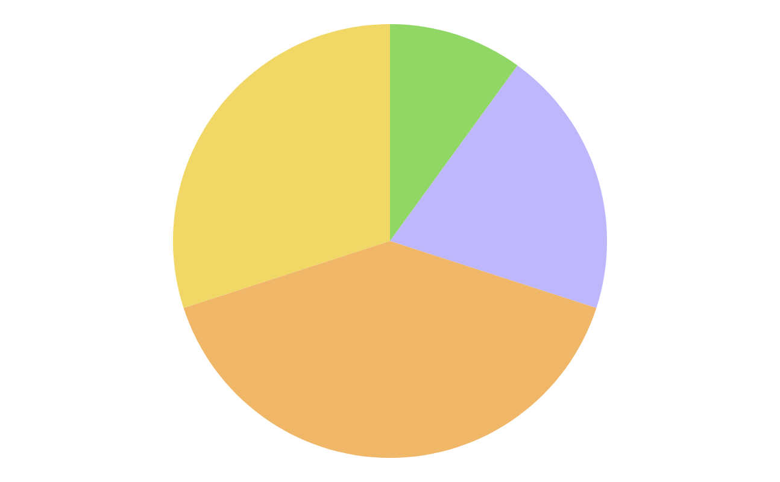
Cyber Bullying Infographics
30 %
10 %
Mars
Jupiter
Despite being red, Mars is a cold place
Jupiter is a gas giant and the biggest planet
20 %
40 %
Mercury
Venus
Mercury is the closest planet to the Sun
Venus has a beautiful name, but is hot
Follow the link in the graph to modify its data and then paste the new one here. For more info, click here

Slide 6
Cyber Bullying Infographics
Mercury
Jupiter
It is the closest planet to the Sun
It is a gas giant and the biggest planet
40 %
60 %
Mars
Neptune
Despite being red, Mars is a cold place
It is the farthest planet from the Sun
70 %
50 %

Slide 7
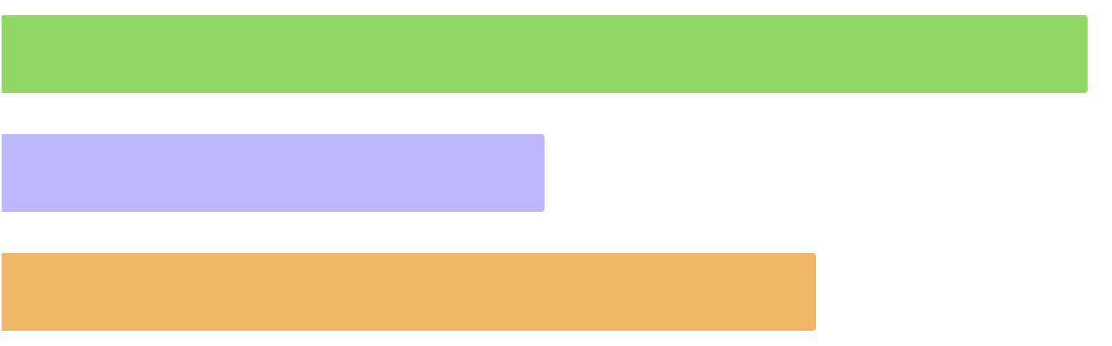
Cyber Bullying Infographics
100 %
50 %
75 %
Mars
Mercury
Jupiter
Despite being red, Mars is a cold place
Mercury is the closest planet to the Sun
Jupiter is a gas giant and the biggest planet
Follow the link in the graph to modify its data and then paste the new one here. For more info, click here

Slide 8
Cyber Bullying Infographics
Cyber Bullying
Mercury
Jupiter
Mercury is the closest planet to the Sun
Jupiter is a gas giant and the biggest planet
Mars
Venus
Earth
Despite being red, Mars is a cold place
Venus has a beautiful name, but is hot
Earth is the planet where we all live on

Slide 9
Cyber Bullying Infographics
Jupiter
01
Jupiter is a gas giant and the biggest planet
Mercury
02
Mercury is the closest planet to the Sun
Venus
03
Venus has a beautiful name, but is hot
Neptune
04
Neptune is the farthest planet from the Sun

Slide 10
Cyber Bullying Infographics
10 %
20 %
Mars
Jupiter
Despite being red, Mars is a cold place
Jupiter is a gas giant and the biggest planet
30 %
40 %
Mercury
Venus
Mercury is the closest planet to the Sun
Venus has a beautiful name, but is hot

Slide 11
Cyber Bullying Infographics
04
03
Neptune
02
Neptune is the farthest planet from the Sun
Venus
01
Venus has a beautiful name, but is hot
Jupiter
Jupiter is a gas giant and the biggest planet
Mercury
Mercury is the closest planet to the Sun

Slide 12
Cyber Bullying Infographics
01
02
Mars
Jupiter
Despite being red, Mars is a cold place
Jupiter is a gas giant and the biggest planet
03
04
Mercury
Venus
Mercury is the closest planet to the Sun
Venus has a beautiful name, but is hot

Slide 13
Cyber Bullying Infographics
01
Mercury
Neptune
02
Mercury is the closest planet to the Sun
Neptune is the farthest planet from the Sun
03
Jupiter
Mars
04
Jupiter is a gas giant and the biggest planet
Despite being red, Mars is a cold place
05
Venus
Pluto
06
Venus has a beautiful name, but is hot
Pluto is considered a dwarf planet

Slide 14
Cyber Bullying Infographics
Jupiter
Neptune
Jupiter is a gas giant and the biggest planet
Neptune is the farthest planet from the Sun
02
04
01
03
Mercury
Venus
Mercury is the closest planet to the Sun
Venus has a beautiful name, but is hot

Slide 15
Cyber Bullying Infographics
Mercury
Venus
Mercury is the closest planet to the Sun
Venus has a beautiful name, but is hot
30 %
70 %

Slide 16
Cyber Bullying Infographics
Mercury
Mercury is the closest planet to the Sun
Venus
Jupiter
Venus has a beautiful name, but is hot
Jupiter is a gas giant and the biggest planet

Slide 17
Cyber Bullying Infographics
Mercury
Venus
Mercury is the closest planet to the Sun
Venus has a beautiful name, but is hot
50 %
25 %
Neptune
Pluto
Neptune is the farthest planet from the Sun
Pluto is now considered a dwarf planet
75 %
50 %

Slide 18
Cyber Bullying Infographics
01
02
Mars
Jupiter
Despite being red, Mars is a cold place
Jupiter is a gas giant and the biggest planet
03
04
Mercury
Venus
Mercury is the closest planet to the Sun
Venus has a beautiful name, but is hot

Slide 19
Cyber Bullying Infographics
35 %
Mercury
Mercury is the closest planet to the Sun
40 %
Venus
Venus has a beautiful name, but is very hot
25 %
Jupiter
Jupiter is the biggest planet of them all

Slide 20
Cyber Bullying Infographics
01
02
Mercury
Saturn
Mercury is the closest planet to the Sun and the smallest one in the entire Solar System
Saturn is a gas giant and has several rings. It's composed mostly of hydrogen and helium

Slide 21
Cyber Bullying Infographics
10 %
40 %
Mercury
Venus
Mercury is the closest planet to the Sun
Venus has a beautiful name, but is very hot
20 %
30 %
Jupiter
Saturn
Jupiter is the biggest planet of them all
Saturn is a gas giant with several rings

Slide 22
Cyber Bullying Infographics
75%
Mercury
Mercury is the closest planet to the Sun and the smallest
25%
Jupiter
Jupiter is the biggest planet in the Solar System

Slide 23
Cyber Bullying Infographics
01
02
03
Mars
Jupiter
Mercury
Despite being red, Mars is a cold place
Jupiter is a gas giant and the biggest planet
Mercury is the closest planet to the Sun

Slide 24
Cyber Bullying Infographics
45 %
Mars
Despite being red, Mars is a cold place
25 %
Venus
Venus has a beautiful name, but is very hot
1 in 7
30 %
Mercury
Jupiter
Mercury is the closest planet to the Sun and the smallest
Jupiter is the biggest planet of them all

Slide 25
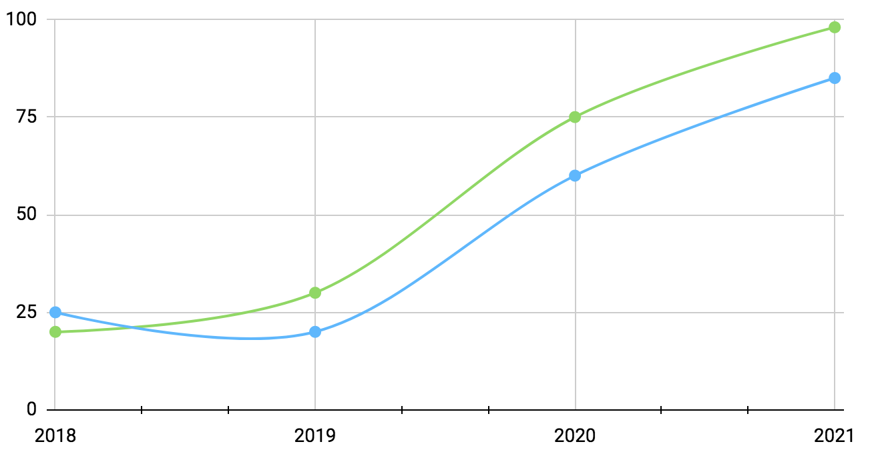
Cyber Bullying Infographics
+45 %
Mars
Despite being red, Mars is a cold place
+25 %
Venus
Venus has a beautiful name, but is very hot
Follow the link in the graph to modify its data and then paste the new one here. For more info, click here

Slide 26
Cyber Bullying Infographics
A
B
C
The Bullies
Mercury is the closest planet to the Sun and also the smallest one of them all
A
B
C
Mars
Jupiter
Mercury
Despite being red, Mars is a cold place
Jupiter is a gas giant and the biggest planet
Mercury is the closest planet to the Sun

Slide 27
Cyber Bullying Infographics
Mercury
Mercury is the closest planet to the Sun and the smallest one in the entire Solar System
Venus
Venus has a very beautiful name, but is actually terribly hot, hotter than Mercury

Slide 28
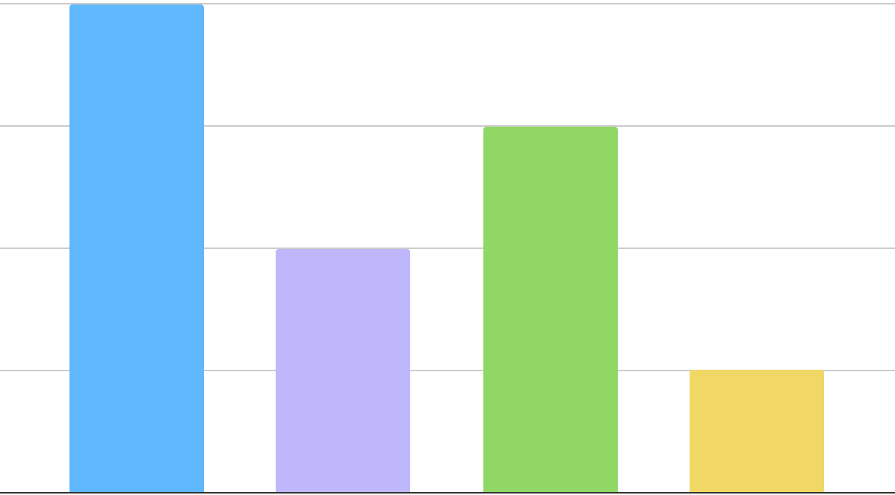
Cyber Bullying Infographics
80 %
70 %
Mercury
Neptune
Mercury is the closest planet to the Sun
Neptune is the farthest planet from the Sun
90 %
100 %
Venus
Pluto
Venus has a beautiful name, but is hot
Pluto is now considered a dwarf planet
Follow the link in the graph to modify its data and then paste the new one here. For more info, click here

Slide 29
Cyber Bullying Infographics
Types of Cyberbullying
Denigration | Mercury is the closest planet to the Sun and the smallest
Outing | Venus has a very beautiful name, but is actually terribly hot
Trickery | Saturn is a gas giant and is composed of hydrogen and helium
Exclusion | Earth is the third planet from the Sun and the one that harbors life
Harassment | Neptune is the farthest planet from the Sun
Cyberstalking | Despite being red, Mars is a very cold planet

Slide 30
Cyber Bullying Infographics
75 %
25 %
Mercury
Venus
Mercury is the closest planet to the Sun and the smallest one
Venus has a very beautiful name, but is actually terribly hot

Slide 31
Cyber Bullying Infographics
01
02
03
04
Mercury
Venus
Neptune
Pluto
Mercury is the closest planet to the Sun
Venus has a beautiful name, but is hot
Neptune is the farthest planet from the Sun
Pluto is now considered a dwarf planet

Slide 32
Cyber Bullying Infographics
Mercury
Neptune
20 %
30 %
Mercury is the closest planet to the Sun
Neptune is the farthest planet from the Sun
Venus
10 %
Venus has a beautiful name, but is hot
Follow the link in the graph to modify its data and then paste the new one here. For more info, click here

Slide 33
Instructions for use (premium users)
In order to use this template, you must be a Premium user on Slidesgo.
You are allowed to:
Modify this template.
Use it for both personal and commercial purposes.
Hide or delete the “Thanks” slide and the mention to Slidesgo in the credits.
Share this template in an editable format with people who are not part of your team.
You are not allowed to:
Sublicense, sell or rent this Slidesgo Template (or a modified version of this Slidesgo Template).
Distribute this Slidesgo Template (or a modified version of this Slidesgo Template) or include it in a database or in any other product or service that offers downloadable images, icons or presentations that may be subject to distribution or resale.
Use any of the elements that are part of this Slidesgo Template in an isolated and separated way from this Template.
Register any of the elements that are part of this template as a trademark or logo, or register it as a work in an intellectual property registry or similar.
For more information about editing slides, please read our FAQs or visit Slidesgo School:
https://slidesgo.com/faqs and https://slidesgo.com/slidesgo-school

Slide 34
Infographics
You can add and edit some infographics to your presentation to present your data in a visual way.
Choose your favourite infographic and insert it in your presentation using Ctrl C + Ctrl V or Cmd C + Cmd V in Mac.
Select one of the parts and ungroup it by right-clicking and choosing “Ungroup”.
Change the color by clicking on the paint bucket.
Then resize the element by clicking and dragging one of the square-shaped points of its bounding box (the cursor should look like a double-headed arrow). Remember to hold Shift while dragging to keep the proportions.
Group the elements again by selecting them, right-clicking and choosing “Group”.
Repeat the steps above with the other parts and when you’re done editing, copy the end result and paste it into your presentation.
Remember to choose the “Keep source formatting” option so that it keeps the design. For more info, please visit Slidesgo School.

