Slide 1
Cartoon Style Objects Infographics
Here is where this template begins

Slide 2
Cartoon Style Objects Infographics
Mars
Despite being red, Mars is actually a cold place
1
Jupiter
Jupiter is a giant and the fifth planet from the Sun
2
Saturn
Saturn is a gas giant made of hydrogen and helium
3
Neptune
Neptune is the farthest planet from the Sun
4

Slide 3
Cartoon Style Objects Infographics
80%
60%
20%
Jupiter
50%
Neptune
30%
Mars
Jupiter is a gas giant and the biggest of them all
Neptune is the farthest planet from the Sun
Despite being red, Mars is actually a cold place
Saturn
Earth
It’s composed mostly of hydrogen and helium
Earth, where we live on, is the third from the Sun

Slide 4
Cartoon Style Objects Infographics
Mars
Earth
Despite being red, Mars is actually a cold place
Mercury
Earth, where we live on, is the third one from the Sun
Saturn
Venus
It’s composed mostly of hydrogen and helium
Venus is the second planet from the Sun

Slide 5
Cartoon Style Objects Infographics
Saturn
1
Saturn is a gas giant and has rings
Venus
2
Venus has a beautiful name and is the second planet
Earth
3
Earth is the third planet from the Sun and the one that harbors life
Mars
4
Despite being red, Mars is a very cold place with a big quantity of iron oxide dust

Slide 6
Cartoon Style Objects Infographics
Mercury
Venus
It’s the closest planet to the Sun and the smallest
Venus is the second planet from the Sun
Saturn
Mars
It’s composed mostly of hydrogen and helium
Despite being red, Mars is actually a cold place
Jupiter
Earth
It’s the biggest planet in the Solar System
Earth is the planet where we all live on

Slide 7
Cartoon Style Objects Infographics
1
2
Mercury
Jupiter
Mercury is the closest planet to the Sun
Jupiter is a gas giant and the biggest planet
3
4
Venus
Mars
Venus is the second planet from the Sun
Despite being red, Mars is actually cold

Slide 8
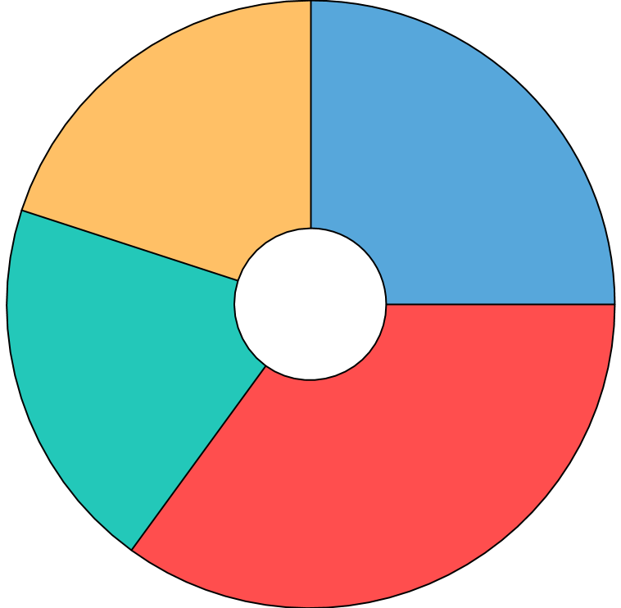
Cartoon Style Objects Infographics
Mercury
20%
25%
Venus
It is the closest planet to the Sun and the smallest one in the Solar System
Venus has a beautiful name and very high temperatures
Saturn
20%
35%
Mars
Saturn is composed mostly of hydrogen and also of helium
Despite being red, Mars is also a very cold place full of iron oxide dust
To modify this graph, follow the link, change the data and paste the new graph here

Slide 9
Cartoon Style Objects Infographics
2021
2022
2023
2024
Mercury
Venus
Mars
Saturn
It’s the closest planet to the Sun and the smallest
Venus is the second planet from the Sun
Despite being red, Mars is actually a cold place
It’s composed mostly of hydrogen and helium

Slide 10
Cartoon Style Objects Infographics
Venus
Mars
Venus has a beautiful name, but also very high temperatures
Despite being red, Mars is a very cold place full of iron oxide dust
Jupiter
Mercury
Jupiter is a gas giant and the biggest planet of them all
Mercury is the closest planet to the Sun and also the smallest one
Earth

Slide 11
Cartoon Style Objects Infographics
01
Venus
Venus is the second planet from the Sun and is very hot
Jupiter
02
Jupiter is the biggest planet in the whole Solar System
03
Saturn
Saturn is composed mostly of hydrogen and also helium
Mercury
04
Mercury is the closest planet to the Sun and the smallest

Slide 12
Cartoon Style Objects Infographics
01
02
03
04
Jupiter is the biggest planet in the whole Solar System
Despite being red, Mars is actually a very very cold place
Venus also has a very beautiful name and is the second planet
Neptune is the farthest planet from the Sun
Jupiter
Mars
Venus
Neptune

Slide 13
Cartoon Style Objects Infographics
Mercury
It’s the closest planet to the Sun and the smallest
Saturn
Mars
It’s composed mostly of hydrogen and helium
Despite being red, Mars is actually a cold place
Jupiter
Earth
It’s the biggest planet in the Solar System
Earth is the planet where we all live on

Slide 14
Cartoon Style Objects Infographics
NEPTUNE |  | MARS |  | EARTH
Mercury |  | Mercury is the closest planet to the Sun and the smallest one in the Solar System
Jupiter |  | Jupiter is the biggest planet in the Solar System and the fifth one from the Sun
Saturn |  | Saturn is composed mostly of hydrogen and also of helium. It’s the only ringed one
Venus |  | Venus has a beautiful name and very high temperatures. It is also hotter than other planets

Slide 15
Cartoon Style Objects Infographics
Jupiter
Mars
Saturn
Jupiter is the biggest of them all
2
Despite being red, Mars is cold
4
It’s a gas giant and has several rings
6
Neptune
Mercury
Earth
1
Neptune is the farthest planet
3
Mercury is the closest to the Sun
5
Earth is the third planet from the Sun

Slide 16
Cartoon Style Objects Infographics
Venus
Venus has a beautiful name and very high temperatures
Saturn
Saturn is composed mostly of hydrogen and also of helium
Earth
Earth is the third planet from the Sun and the one that harbors life

Slide 17
Cartoon Style Objects Infographics
Neptune
Neptune is the fourth-largest planet in the Solar System
Jupiter is the fifth planet from the Sun and the biggest of them all
Jupiter
Earth
Earth is the third planet from the Sun. It’s where we all live on
Venus has a beautiful name and is the second planet from the Sun
Venus

Slide 18
Cartoon Style Objects Infographics
Jupiter:
It’s the fifth planet from the Sun
25%
Mars:
It’s the fourth planet from the Sun
25%
Saturn:
Saturn is the only ringed planet
25%
Venus:
It’s the second planet from the Sun
25%

Slide 19
Cartoon Style Objects Infographics
Venus
Mercury
Mars
Neptune
It’s terribly hot, even hotter than Mercury
Mercury is the smallest planet in the Solar System
Despite being red, Mars is a very cold place
Neptune is the farthest planet from the Sun
01
02
03
04

Slide 20
Cartoon Style Objects Infographics
01
Venus
Venus has a beautiful name, but also very high temperatures
Jupiter
02
Jupiter is the fifth planet from the Sun and the largest of them all
03
Saturn
Saturn is the sixth planet from the Sun and the second-largest

Slide 21
Cartoon Style Objects Infographics
1
Mercury is the closest planet to the Sun and the smallest in the Solar System
Mercury
2
Despite being red, Mars is actually a very cold planet full of iron oxide dust
Mars
3
Jupiter is the biggest planet of the Solar System and also a gas giant
Jupiter
4
Venus has a beautiful name, but also a very poisonous atmosphere
Venus

Slide 22
Cartoon Style Objects Infographics
Mercury
90%
Mercury is the closest planet to the Sun and the smallest one in the entire Solar System
Venus
95%
Venus has a beautiful name and is the second planet from the Sun
Jupiter
75%
Jupiter is the second-brightest natural object in the night sky after the Moon

Slide 23
Cartoon Style Objects Infographics
Venus
Saturn
Venus is the second planet from the Sun
It’s composed of hydrogen and also of helium
1
2
3
4
5
Mercury
Mars
Jupiter
It is the closest planet to the Sun and the smallest
Despite being red, Mars is actually a very cold place
Jupiter is the biggest planet in the Solar System

Slide 24
Cartoon Style Objects Infographics
95%
Mercury
It is the closest planet to the Sun and the smallest one
55%
Venus
Venus has a beautiful name and very high temperatures
65%
Saturn
Saturn is composed mostly of hydrogen and helium
85%
Jupiter
To modify this graph, follow the link, change the data and paste the new graph here
It is the fifth planet from the Sun and the biggest of them all

Slide 25
Cartoon Style Objects Infographics
Saturn
It’s composed mostly of hydrogen and helium
Jupiter
Mars
It’s the biggest planet in the Solar System
Despite being red, Mars is actually a cold place

Slide 26
Cartoon Style Objects Infographics
Mercury
Venus
It’s the closest planet to the Sun and the smallest
Venus is the second planet from the Sun
Jupiter
Mars
It’s the biggest planet in the Solar System
Despite being red, Mars is actually a cold place
Saturn
Earth
It’s composed mostly of hydrogen and helium
Earth is the planet where we all live on

Slide 27
Cartoon Style Objects Infographics
Mercury
Mercury is the smallest planet of them all
01
02
Neptune is the farthest planet from the Sun
Neptune
Jupiter
Jupiter is a gas giant and the biggest planet
03
04
Saturn is composed of hydrogen and helium
Saturn

Slide 28
Cartoon Style Objects Infographics
Mercury
Earth
Saturn
Neptune
Mars
Venus
Earth
Jupiter
Moon
Mercury
Uranus
Saturn

Slide 29
Cartoon Style Objects Infographics
Mercury
1
It is the closest planet to the Sun and the smallest
Venus
2
02
Venus has a beautiful name and high temperatures
Saturn
03
3
Saturn is composed of hydrogen and helium
Jupiter
04
4
It’s the the biggest planet in the Solar System

Slide 30
Cartoon Style Objects Infographics
Mercury | Saturn is composed mostly of hydrogen and helium | Earth, where we live on, is the third planet from the Sun |  | Despite being red, Mars is a cold place
Saturn |  |  | Venus has a beautiful name and very high temperatures
Jupiter |  |  |  | It is the closest planet to the Sun and the smallest one
Earth

Slide 31
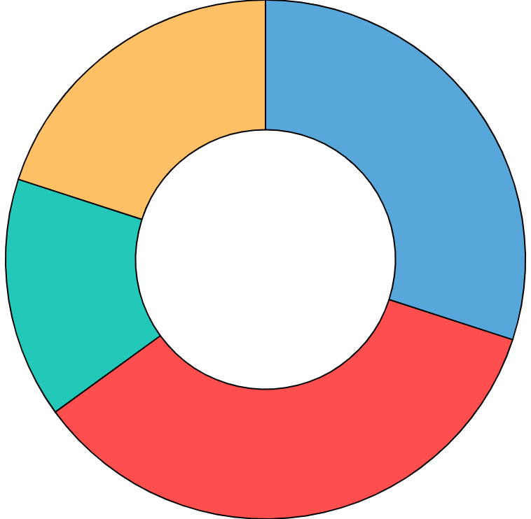
Cartoon Style Objects Infographics
20%
Neptune is the farthest planet from the Sun
Neptune
30%
Despite being red, Mars is actually a cold place
Mars
Venus
15%
Venus is terribly hot, even hotter than Mercury
Mercury
35%
Mercury is the closest planet to the Sun
To modify this graph, follow the link, change the data and paste the new graph here

Slide 32
Instructions for use (premium users)
In order to use this template, you must be a Premium user on Slidesgo.
You are allowed to:
Modify this template.
Use it for both personal and commercial purposes.
Hide or delete the “Thanks” slide and the mention to Slidesgo in the credits.
Share this template in an editable format with people who are not part of your team.
You are not allowed to:
Sublicense, sell or rent this Slidesgo Template (or a modified version of this Slidesgo Template).
Distribute this Slidesgo Template (or a modified version of this Slidesgo Template) or include it in a database or in any other product or service that offers downloadable images, icons or presentations that may be subject to distribution or resale.
Use any of the elements that are part of this Slidesgo Template in an isolated and separated way from this Template.
Register any of the elements that are part of this template as a trademark or logo, or register it as a work in an intellectual property registry or similar.
For more information about editing slides, please read our FAQs or visit Slidesgo School:
https://slidesgo.com/faqs and https://slidesgo.com/slidesgo-school

Slide 33
Premium infographics...
Text 1
Text 2
Text 3
Add the Title here
2016
2017
2018
2019
2020
Text 4
Text 5
Text 6
“Mercury is closest planet to the Sun and the smallest”
“Despite being red, Mars is a cold place full of iron oxide”
“Venus has a beautiful name and is the second planet”
“Neptune is the farthest-known planet from the Sun”
“Saturn is a gas giant and has several rings”

Slide 34
Premium infographics...
75%
“Mercury is closest planet to the Sun and the smallest”
75%
“Mercury is closest planet to the Sun and the smallest”
TITLE 1
“Mercury is closest planet to the Sun and the smallest”
“Mercury is closest planet to the Sun and the smallest”

Slide 35
Premium Icons

Slide 36
Premium Icons

Slide 37
Premium Icons

Slide 38
Premium Icons

Slide 39
Premium Icons

Slide 40
Infographics
You can add and edit some infographics to your presentation to show your data in a visual way.
Choose your favourite infographic and insert it in your presentation using Ctrl C + Ctrl V or Cmd C + Cmd V in Mac.
Select one of the parts and ungroup it by right-clicking and choosing “Ungroup”.
Change the color by clicking on the paint bucket.
Then resize the element by clicking and dragging one of the square-shaped points of its bounding box (the cursor should look like a double-headed arrow). Remember to hold Shift while dragging to keep the proportions.
Group the elements again by selecting them, right-clicking and choosing “Group”.
Repeat the steps above with the other parts and when you’re done editing, copy the end result and paste it into your presentation.
Remember to choose the “Keep source formatting” option so that it keeps the design. For more info, please visit Slidesgo School.

